Slide 1
TEXAS SET UPDATE
Retail Market Subcommittee
June 12, 2025

Slide 2
UPDATE
Flight 0625 Updates
Day 1 transactions began on 06/09/25 and Flight 0625 is scheduled to conclude on 06/20/25
Began the TMTP review process to review and recommend edits to the Texas Market Test Plan document
Reviewed section 1-3 and 8 for edits/ updates
Added swimlane for MVI on deenergized premise per RMTTF’s request

Slide 3
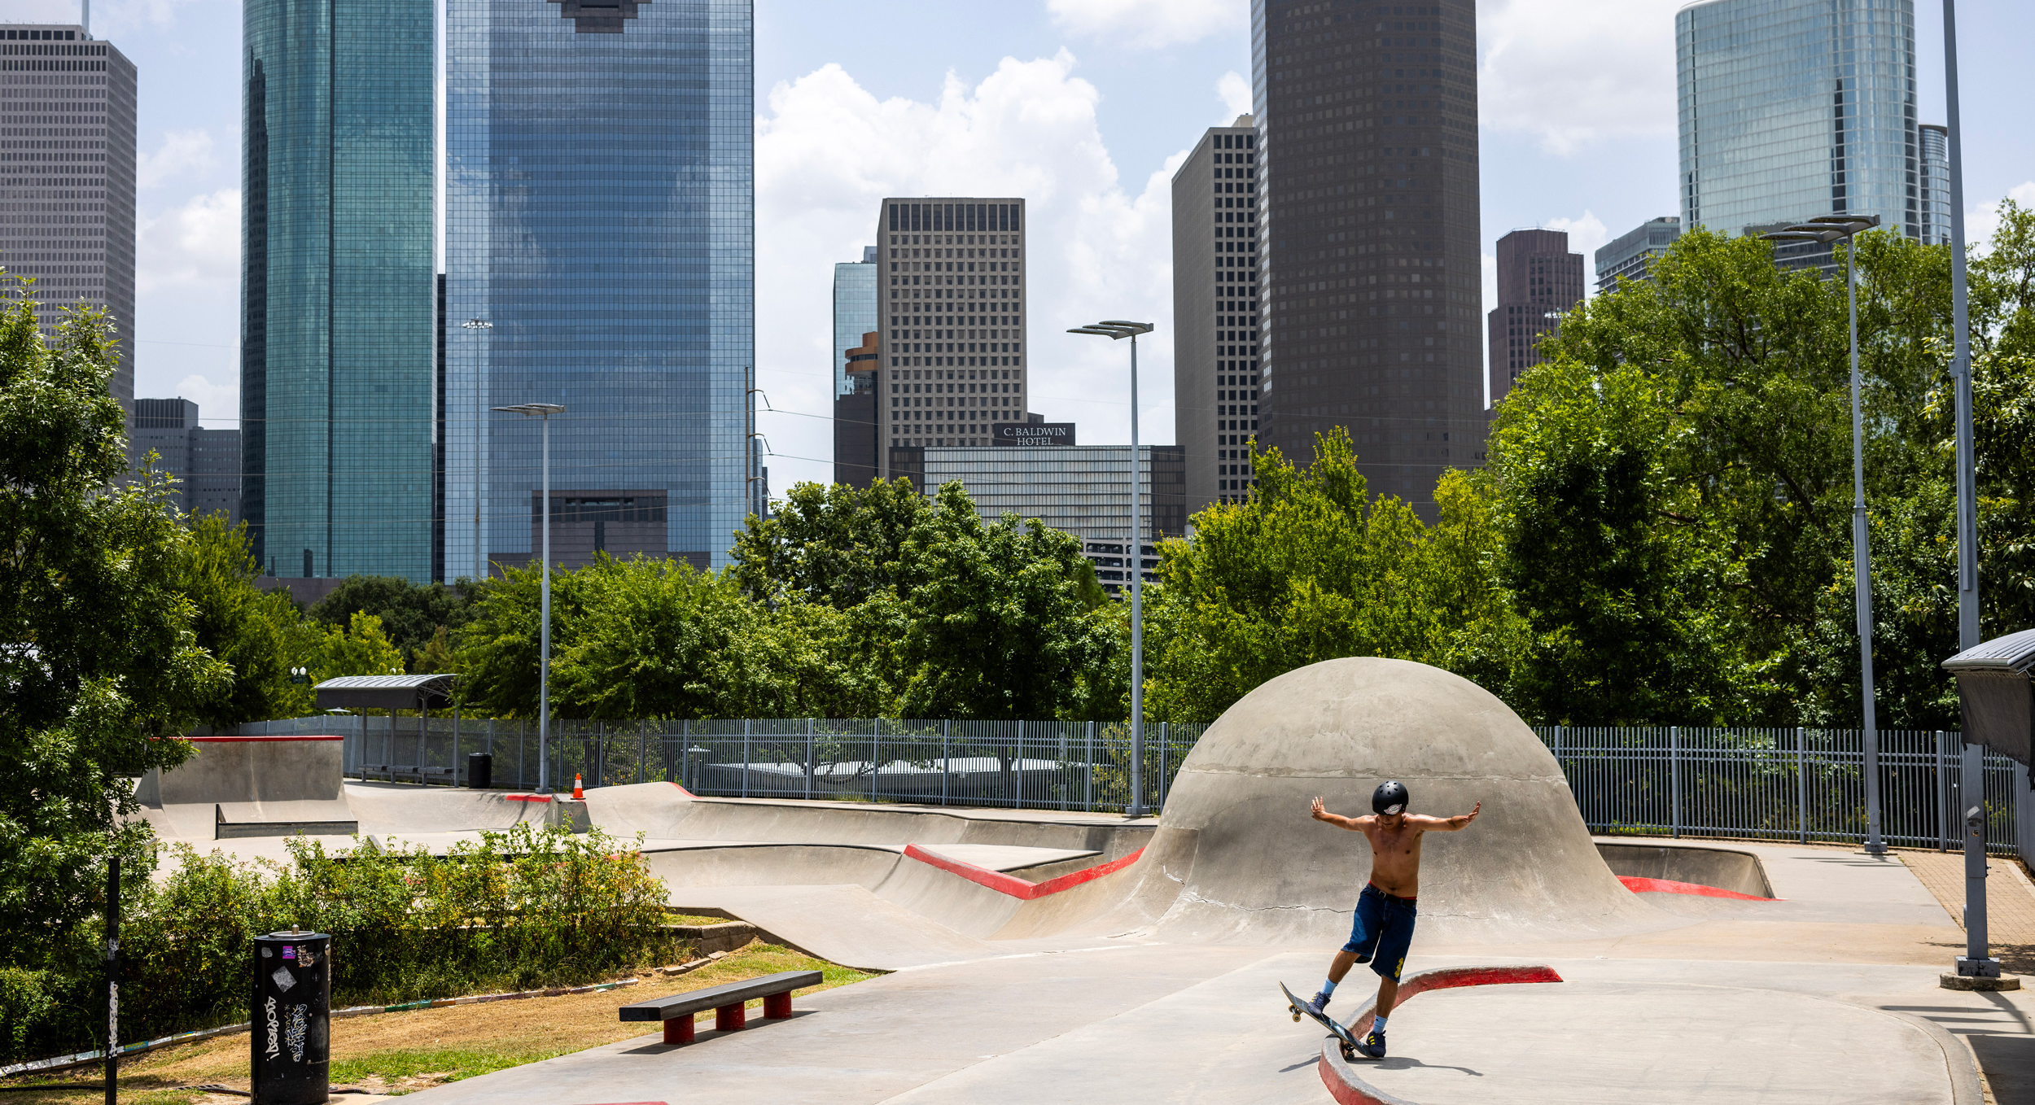
NEXT MEETING
June 17th
In Person at ERCOT MetCenter/Webex

