Slide 1
Project Update
June 11, 2025
Troy Anderson
ERCOT Portfolio Management

Slide 2
Project Update Agenda
Recent / Upcoming Project Highlights
2025 Release Targets
Major Projects
Priority/Rank Recommendations for Revision Requests with Impacts
NPRR1214 – Reliability Deployment Price Adder Fix to Provide Locational Price Signals, Reduce Uplift and Risk
NPRR1277 – Revisions to EAL Formula
NPRR1281 – Improvements to Alternate FFSS Resource Designation
Technology Working Group (TWG)
Next meeting is 6/26/2025
Aging Projects Related to Revision Requests
Location of Revision Request Project Information: http://www.ercot.com/services/projects

Slide 3
2025 Release Targets – Approved NPRRs / SCRs / xGRRs
R1
R3
R5
January 1/30 | February 2/27 | March 3/27 | April 4/24 | May 5/29 | June 6/26
NPRR945 NPRR1219 | NPRR1254 RTC+B Market Trials Sandbox Deployed | NPRR1145 | RTC+B Market Trials begin on 5/5/2025 | NPRR1253
R2
R4
R6
ü
ü
ü
RTC QSE Submission Testing
3/1
ü
RTC QSE Telemetry Check-out
1/1
3/7
ü
ü
RTC+B
12/5
July 7/31 | August 8/28 | September 9/25 | October 10/23 |  | December 12/18
 |  |  |  |  | RTC+B Stabilization begins
R7
R8
R9
R10
E
R11
NPRR1007-1013
Open-loop RTC SCED
Closed-loop SCED/LFC
NPRR963(a)
NPRR965
NPRR1000
NPRR1014
NPRR1054
NPRR1058
NPRR1172
NPRR1204
NPRR1216
NPRR1236
NPRR1245
NPRR1246
NOGRR211
NOGRR268
OBDRR020
OBDRR052
PGRR118
QSE Telemetry Tests
Day-Ahead Market
Go-live dates can differ from Protocol effective dates – Please refer to market notices for more details
APPENDIX
Red Text: New additions and target release changes
Strike-Through Text: Previous target release
(a), (b), etc.: Multiple phase release
Project Status Codes
NS = Not Started
I = Initiation
P = Planning
E = Execution
H = On Hold
NPRR963(a) – Portion of NPRR
NPRR1253(a) – ICCP
NPRR1253(b) – Public API
RTC+B Market Trials
RTC+B Stabilization
Release targets are subject to change

Slide 4
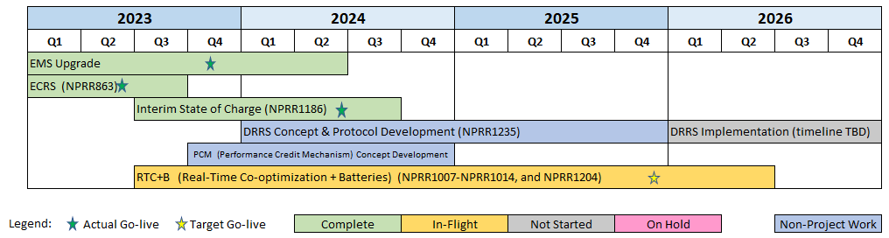
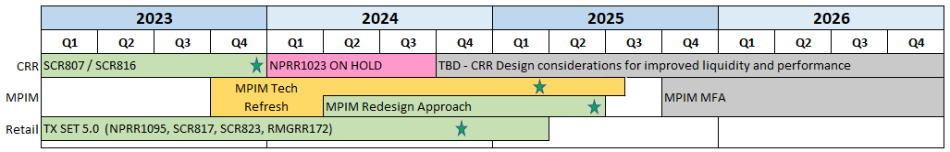
Major Projects
Other Project Highlights

Slide 5
Priority / Rank Recommendations for Revision Requests with Impacts
Recommendations for…
Revision Request | Description | Priority | Rank | Comments
NPRR1214 | Reliability Deployment Price Adder Fix to Provide Locational Price Signals, Reduce Uplift and Risk | TBD | TBD | $800k-$1.2M, 12-18 months Impacted Systems: MMS, Settlements, Reporting ERCOT requests a continued table at PRS due to RTC+B resource constraints and design concerns
NPRR1277 | Revisions to EAL Formula | 2025 | 4570 | $90k-$140k, 4-6 months Impacted Systems: CMM, Reporting No RTC+B resource impacts; if approved, potential implementation before summer 2026
NPRR1281 | Improvements to Alternate FFSS Resource Designation | 2026 | 4780 | $75k-$100k, 6-8 months Impacted Systems: S&B, Reporting Candidate for priority discussion compared to other Settlements items in the project queue
PPL Rank Information
Next 2025 Rank in Business Strategy = 4570 Next 2028 Rank in Business Strategy = 5110
Next 2026 Rank in Business Strategy = 4780 Next 2029 Rank in Business Strategy = 5300
Next 2027 Rank in Business Strategy = 4900 Next Rank in Regulatory = 400

Slide 6
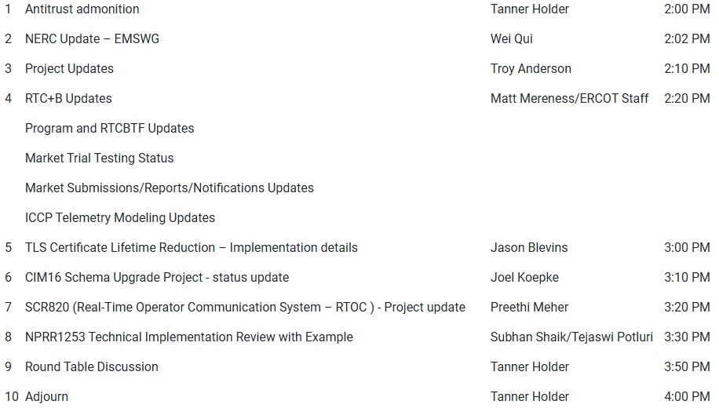
Technology Working Group (TWG)
Agenda for TWG meeting held on 5/29/2025:
Next TWG scheduled for 6/26/2025

Slide 7
Aging Revision Request Project Review
After the RTC+B project goes live, it will be valuable to have a reprioritized list of pending Revision Request projects
The “Aging Projects Relating to Revision Requests” list used in 2024 has been updated for recent activity
Multi-month review at PRS
May: Review the contents of the posted aging list
June: PRS members are asked to be prepared for a priority discussion
July/August:
Coordination with TAC on an Initiative Workshop
Follow-up discussion after ERCOT assesses resources on highest priority items
Legislative priorities will be an important consideration

Slide 8
Aging Revision Request Project Review Approach
Categorize RRs into “Tiers”
Tier 1 Critical Must-have items (PUCT/Board directives, etc.)
Tier 2 High Priority Highest priority after Tier 1
Tier 3 Medium Priority Fit in without impacting Tier 1 and 2 projects
Tier 4 Candidate for Removal May move to another tier after evaluation
Important Point
Some aging RRs are expected to require language changes to bring them up to current market or system constructs
Language updates would be made with a new RR
ERCOT suggests this analysis be limited to aging items that are prioritized high enough to be queued for implementation

Slide 9
Aging Revision Request Review at PRS – Stats
Category | June 2025
1 – Critical
2 – High Priority
3 – Medium Priority
4 – Candidate for Removal
TBD | 66
Total | 66
Posted Excel file details
Retained notes from prior year prioritization discussions
Updated for latest status
Column added to capture “Tier”
During the PRS meeting we will attempt to categorize as many aging RR projects as possible
This will be the first of several iterations
Note: Currently there are 24 Revision Requests in-flight for delivery, including RTC+B

