Slide 1
DWG Report to ROS
Fahad Qureshi – DWG Chair
June 5th, 2025

Slide 2
DWG Update
DWG Webex meeting held on 5/15/2025
PGRR120 (SSO Prevention for Generator Interconnection)
  ERCOT presented their revised planning guide language changes based on feedback received from TSPs
  ERCOT would like to hold firm to the “SGIA executed on or after September 1, 2025” date however is open to changing it within reason
  AEP suggested date be moved to January 2026, however Lonestar would like it moved out further (Lonestar will discuss offline with ERCOT)
  Would be discussed at upcoming PLWG meeting

Slide 3
DWG Update, continued
PGRR122 (Reliability Performance Criteria for Loss of Load)
  ERCOT presented results from the Load Loss Threshold Analysis
  Outlined various aspects of the study including case selection and study methodology
  Based on the results of the study, ERCOT will propose a 2,600 MW load threshold in PGRR 122
  TSPs questioned the threshold which did not consider some future proposed projects remarking that the threshold has a potential to keep on changing
  ERCOT will keep the Market updated on progress and additional steps

Slide 4
DWG Update, continued
Large Load Model Survey Form
  ERCOT presented a final version of the Large Load Model Survey
  Some minor language edits were made during the meeting
  Procedure Manual [UPDATE 1] edits related to Large Load Model Survey document (Section 3.4.4 Load Model Data [p. 46]) (requesting ROS vote today)
  Following ROS vote ERCOT will publish the Large Load Model Survey document to the DWG website
Additional action item agreed to at May DWG meeting
  Procedure Manual [UPDATE 2] edits related to PSSE 36 transition (Sections 3.1.1 [p. 7]) (requesting ROS vote today)

Slide 5
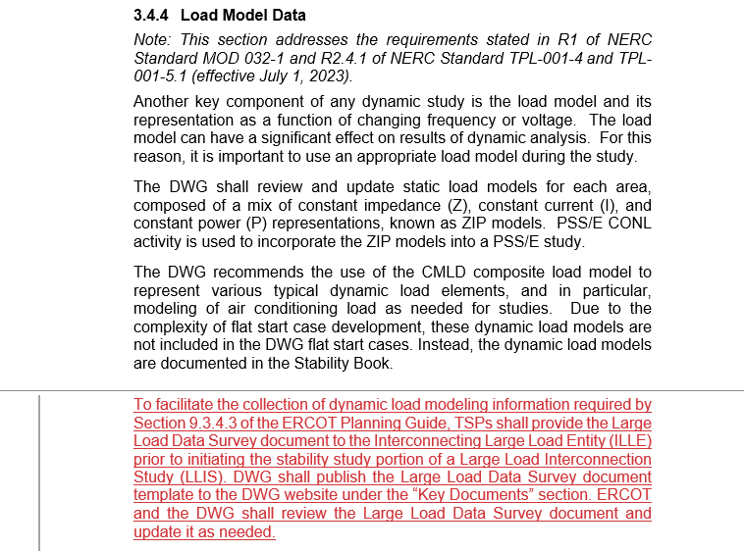
Procedure Manual Update 1
Procedure Manual [UPDATE 1] edits related to Large Load Model Survey document (Section 3.4.4 Load Model Data [p. 46]) (requesting ROS vote today)

Slide 6
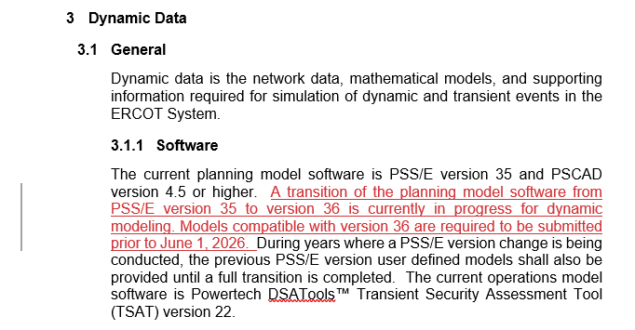
Procedure Manual Update 2
Procedure Manual [UPDATE 2] edits related to PSSE 36 transition (Sections 3.1.1 [p. 7]) (requesting ROS vote today)

Slide 7
Questions or Feedback?

