Slide 1
SSWG Report to ROS
June 5, 2025
Chair: Zach Walker (Zachary.Walker2@oncor.com)
Vice Chair: Chris Ramirez (cramirez@wettllc.com)

Slide 2
SSWG Updates
Updates
SCR 831
Joint Meeting Scheduled
Monday, June 9 @ 9:30 AM
SSWG \ NDSWG \ SPWG
Meeting Details
Proposed SSWG Procedure Manual (PM) Revisions
Seeking ROS Approval
Minor edits
Summary:
Section 2.2 Acronyms
Addition of SOL – System Operating Limit
Section 4.1.7 Bus Voltage Limits
Language change from System Operating Limit Methodology for Planning to ERCOT SOL Methodology
Appendix C – Synchronous Ties:
Updated Bus Number
Appendix A - Description of Zones in the SSWG Cases:
Updated Zone Table per TSP Request
SSWG Report to ROS External

Slide 3
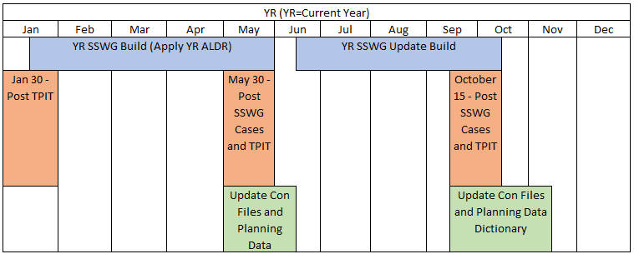
SSWG Updates
Key Dates & Updates
25SSWG Case Build #1
Currently Ongoing
Significant difficulty producing solving cases
Several TSPs included Officer Letter Load (OLL) in SSWG Cases
Not enough generation to support additional load levels
Posting could be delayed up to two weeks
Target Posting: 5/23/25 6/6/25
SSWG Report to ROS External

Slide 4
SSWG Updates
Updates
25SSWG Case Build #1
Total In-Service Load
SSWG Report to ROS External

Slide 5
SSWG Updates
Updates
25SSWG Case Build #1
Total Load (Online & Offline)
SSWG Report to ROS External

Slide 6
SSWG Updates
SSWG Procedure Manual (PM)
4.3.3.1 Extraordinary Dispatch Conditions
On occasion, the total load plus the spinning reserve indicated above can exceed the amount of available generation due to load forecasts. SSWG Cases typically model load at individual coincident TSP peaks instead of at the ERCOT coincident system peak. When such a condition is encountered in future cases, ERCOT may increase generation resources by taking the indicated action, or adding generation, in the following order:
Ignore spinning reserve.
Increase NOIE generation with prior NOIE consent.
DC ties dispatched to increase transfers into ERCOT to the full capacity of the DC ties.
Dispatch SODG natural gas and diesel units up to their full capacity.
Dispatch units that have changed their status to indefinite mothball within the last 18 months and that have not announced their return to service. The dispatch methodology for this procedure is detailed below.
Scale transmission level wind generation dispatch up to 50% of capability.
Add units with interconnection agreements, but do not meet all of the requirements for inclusion defined in the Planning Guide.
SSWG Report to ROS External

Slide 7
SSWG Updates
25SSWG Extraordinary Dispatch
Added Generation not approved per ERCOT Planning Guide (PG) 6.9
SSWG Report to ROS External

Slide 8
SSWG Updates
Moving Forward
25SSWG Case Build #1
SSWG will publish 3x Case Sets
Officer Letter Load (OLL)
Case Set #3 to be official case set
Case Set | OLL Status | Case State
1 | All OLL in service | Most cases do not solve Voltage collapse in several areas around OLL’s
2 | Some OLL out of service | Solves in base case Some OLLs removed to avert voltage collapse Doesn't solve when running contingencies
3 | All OLL out of service | - Official Case Set
SSWG Report to ROS External

