Slide 1
RTC+B Task Force
& Market Trials Update
Matt Mereness
TWG
May 29, 2025

Slide 2
Outline
Update on RTCBTF Issues
Market Trials Update (began 5/5/25)

Slide 3
RTCBTF Issues List
NPRR1268, 1269, 1270 approved at PUCT (thank you!)
State of Charge and AS Duration (NPRR1282/NOGRR277 target June Board)
Market Trials
Market Trials

Slide 4
Summary and Timeline of NPRRs
NPRRs approved at PUCT May 15 Open Meeting
NPRR1268 for ASDC Modifications (IMM sponsor)
NPRR1269 for 3 Parameter/Policy Changes (ERCOT sponsor)
NPRR1270 for AS Qualification details (ERCOT sponsor)
AS Duration / State of Charge (NPRR1282 / NOGRR277)
Began discussion March 25 and targeting June Board
NPRR1282 PRS approved / NOGRR277 ROS email approval
Final Clarifying NPRR – Began discussion June 18 May 21 (Sept Board)
Will be filed and can be tabled at PRS while more discussion at RTCBTF
10 areas of clarification with minimal to no system changes such as:
Settlement changes (corrections)
Retain current NFRC telemetry point (do not retire)
Offer/Bid structure clean-up (inconsistent protocols)
Remaining Stakeholder path to Board Meetings before Go-Live:
PRS May 14 > TAC May 28 > Board June 24
PRS Aug 13 > TAC Aug 28 > Board Sep 23

Slide 5
Other RTCBTF Updates
Readiness engagement update:
Developed new folders on RTCBTF home page (done)
Market Trials folder: Handbooks and supporting materials
Technical Support folder: Key TWG technical materials
RTCB@ercot.com mailbox for support of stakeholder implementation questions
Established FAQ document and posted on RTCBTF home page
Target to add more training videos in next 30 days (in process)
Operations / Load Resources / RTC Worksheet Solver Walkthrough
Day-Ahead Market / Battery
Following guidance from RTCBTF to engage DSWG separately (done 4/17/25)
Outreach to Operator Training Seminar and Spring GCPA (complete)
ERCOT posted sample Settlement Statements/Extracts at May 21 RTCBTF
Next TWG meeting is May 29
ERCOT will continue to support detailed technical conversations such as adding telemetry points to network model, digital certificates, accessing ERCOT systems in March/April timeframe
Formal Market Trials began May 5, 2025 (more on next slide)
Closed-Loop LFC Handbook review (critical for market feedback)
Starting internal work on Transition/Cutover Plan (moving earlier in review)
Shams proposal of removing system lambda capping logic deferred until an NPRR is potentially filed (out of scope for RTCBTF)

Slide 6
Weekly
RTC+B Market Trials Update
ERCOT Staff
May 27, 2025

Slide 7
Outline
Antitrust Admonition
Reminder of Key Document Postings
Expectations of QSEs for the Week
Provide Update of Cumulative QSE Scorecards
Communicate any known Issues within On-going Trial
Support any Technical and/or Business Questions

Slide 8
Sequence and Dates for Market Trials to Go-Live
Market trials are a progression of activities to mitigate the risk for Go-Live on new systems and processes for both the Market Participants & ERCOT.
30-day Market Notice
11/5/25
March/April
2025
Start
5/5/25
Start
7/7/25
Start
9/2/25
Go-Live
12/5/25*
May 2025
June 2025
July 2025
Aug 2025
Sep 2025
Oct 2025
Nov 2025
Dec 2025
QSE Scorecards & Exit Criteria for each Trial Phase
#1 RTC QSE Submission Testing
(Submit COP, RT AS Offers,
DAM Virtual AS, Outages for ESRs)
#3 Open-loop RTC SCED
(QSE offers, SCED non-binding award/dispatch)
#5 Ongoing Open-Loop
& Periodic Closed-loop SCED/LFC
(QSE RTC offers and telemetry to support closed-loop frequency control test 2-3 tests of 2-4 hour durations)
Transition to Go-Live
Upon completion of testing, confirmation of ERCOT and market readiness for Go-Live.
QSE/Vendor Submission Sandbox and Telemetry Points added Prod EMS model.
#2 RTC QSE Telemetry Checkout (QSEs add/verify new telemetry points for UDSP, New ramp rates, ESR telemetry)
#4 QSE Telemetry Tests
(Individual QSE to follow UDSP and support new ramp rate and ESR telemetry)
#6 Day-Ahead Market
(Non-binding DAM using QSE offers for at least 2 tests)
* Go-Live date reflects 12/5/2025 as first Operating Day
where 12/4/2025 is planned software migration.

Slide 9
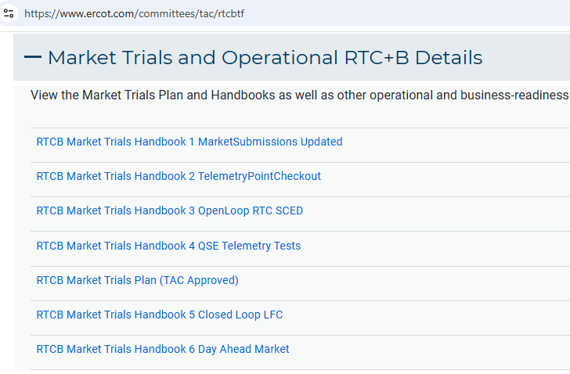
Market Trials
TAC Approved the Market Trials Plan in October 2024
Discussions with RTC+B Task Force have shaped the Handbooks
Handbook #1- QSE Submission Testing
Handbook #2- QSE Telemetry Tests
Handbook #3- Open Loop SCED
Handbook #4- QSE Telemetry Tests
Handbook #5- Close-Loop LFC Tests (draft)
Handbook #6- Day-Ahead Market Tests (draft)
All are posted on the
RTCBTF Homepage
under Market Trials banner

Slide 10
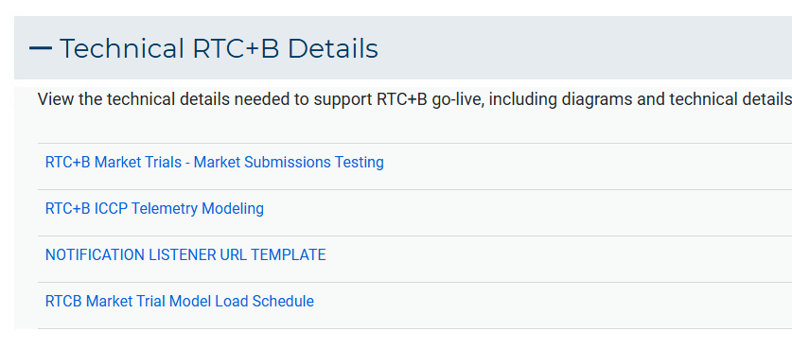
Market Trials
Detailed discussions with TWG have provided technical content details
Digital Certificate details
Connectivity/URL details to User Interfaces and APIs
Reminder of how to submit new ICCP requests
RTC and Production Telemetry connectivity
Network Model Load Schedule
All are posted on the
RTCBTF Homepage
under Technical Details banner

Slide 11
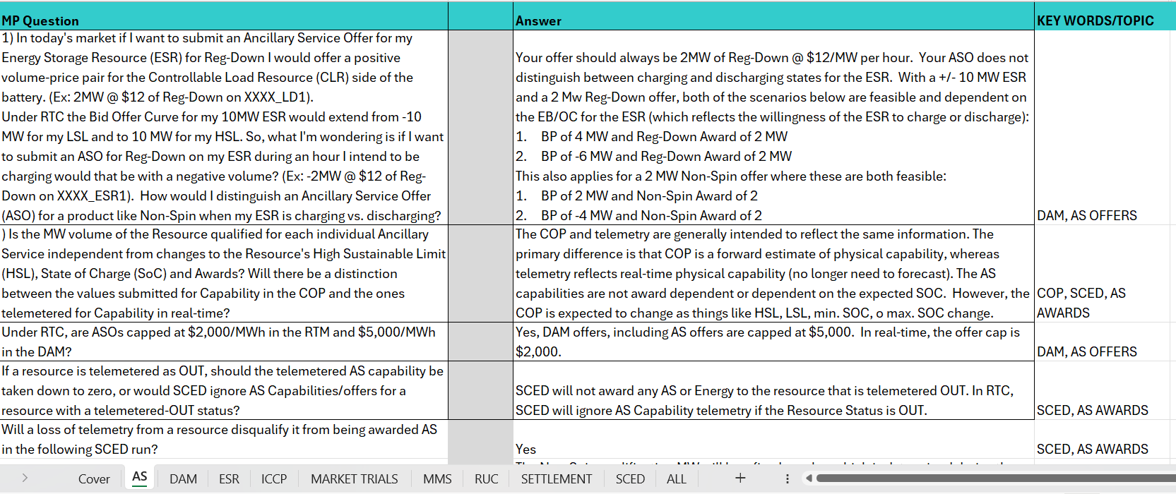
RTC+B FAQ has been updated to 5/22
Posted on RTCBTF Home Page under Key Documents
Common questions/responses in Excel Workbook (target weekly updates)
Search workbook for Key Words
Worksheets for categories

Slide 12
Resources for May-June Market Trials
Everything needed for current market trials is on RTCBTF home page

Slide 13
Summary of Market Trial activities for this week and following weeks
QSE connectivity and market submissions
Submit to Market Management System and Outage Scheduler
Goal to submit at least one successful transaction for each requested transaction type per QSE once during the 8-week period
QSE telemetry set-up and check-out
Submit all ICCP requests to ERCOT to add telemetry points
Lead time to get modeled after requests submitted: ~ 3 weeks
Check-out will be for a sampling of resources within the QSE portfolio to ensure data flowing between ERCOT/QSE
Scoring continues

Slide 14
Scorecards for this Market Trials
Handbook Book 1: ERCOT will publish 3 scores, one for each type of Resource: Generation, Load Resources, ESR
Green: all submissions types completed at least once during the trial
Yellow: some submissions types completed at least once during the trial
Red: no submissions received
Handbook 2: ERCOT will publish 2 scorecards:
Complete all telemetry additions
Green: all new telemetry added (100%)
Yellow: some telemetry added
Red: no new telemetry added
Check-out complete
Green: Check-out successfully completed (for sample of Resources)
Yellow: Check-out scheduled, but not yet complete
Red: No check-out activity

Slide 15
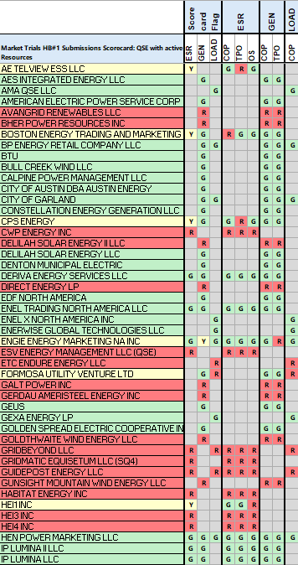
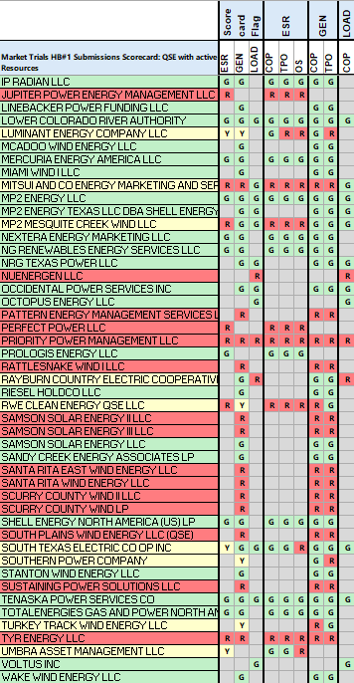
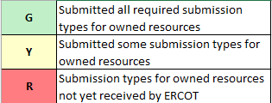
Detailed Scorecard for Handbook 1 Market submissions:
5/27 Scores for QSEs with Resources – successful submissions for resource types specified in Handbook 1
Scoring:

Slide 16
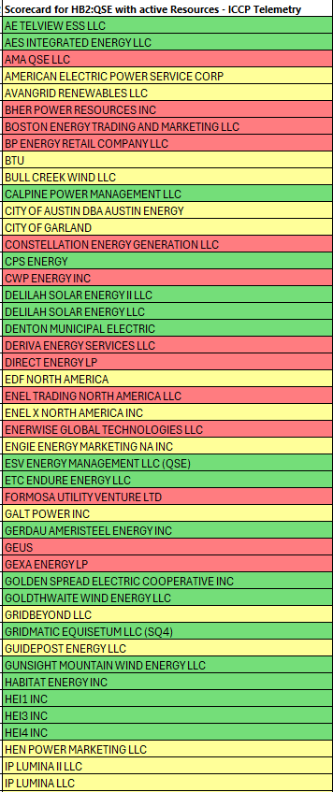
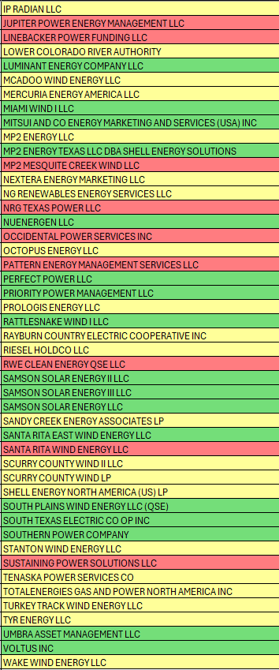
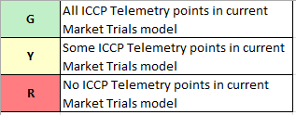
Scorecard 2A for Handbook 2- 100% of ICCP Telemetry points added by QSE
5/27 Scores for QSE with Resources - ICCP Telemetry points added in current model.
Scoring:

Slide 17
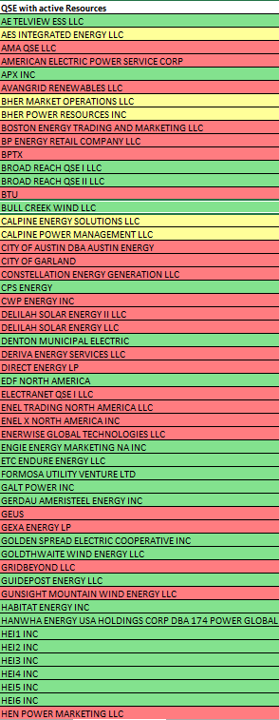
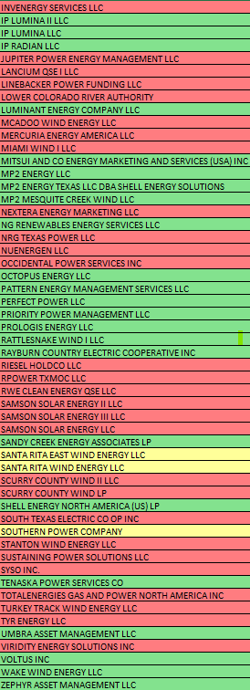
Scorecard 2B for Handbook 2- Telemetry checkout meetings completed with ERCOT staff for sample of live data transfer capability
5/27 Scores for QSEs with Resources – Scheduling Check-out and Check-out complete
Scoring:

Slide 18
Current ERCOT Issues Impacting Trial sequence
Defects to be resolved in next release (May 28):
Some user access issues reported (data set-up issue in environment)
QSE can request assistance for ERCOT to resolve RTCB@ercot.com
Load Resources submitting ECRS in COP
Submit COP with 0 MW for ECRS
AS Only Offer Submission response is missing
No workaround needed
ESR Energy Bid/Offer Curve rejected if last quantity below 1MW
Submit EB/OC with last quantity value at or above 1MW
May 28 - Short outage around 4PM CDT to fix the above issues
Ongoing issue:
COP MaxSOC value with 2 decimal places rejected
Submit COP MaxSOC with only 1 decimal place until fix implemented

Slide 19
Wrap-Up and Questions
Remainder of meeting time to take questions each week-
First round of questions specifically about this Market Trial period
Second round of questions for more general RTC+B as time allows
Can always email the RTC+B Program mailbox: RTCB@ercot.com
FAQ is also a resource for questions that other have asked.
Thanks for your support!

