Slide 1
Lesson Learned
Loss of Monitoring and Control due to a Communication Failure between Control Centers
Wei Qiu
ERCOT TWG Conference Call
May 29, 2025

Slide 2
Remote Operation

Slide 3
Case 1
Planned maintenance on UPS at control B
Unintended consequence
A momentary loss of power
Stand-by backup firewall not recover properly
ARP routine Issue
Data was prevented from routing correctly through the firewall
Correction Actions
Operators transitioned from control center A to control B
Informed RC

Slide 4
Case 2
Problem
VPN tunnel collapsed (with unknown reasons)
Both sites became “Primary” by design due to loss of communications between control centers
After connecting both sites, a split-brain scenario was formed
The system struggled to determine which COM was primary, which delayed the restoration process
The databases out of sync
Corrective Actions
A patch from EMS vendor

Slide 5
Case 3
Problem
Periodically operating from the alternate control center
An issue with Ethernet Virtual Private Line (EVPL) connection
Two-direction communication downgraded to one-direction
Corrective Actions
the web-based read-only version of the EMS and communicated instructions

Slide 6
Lessons Learned
Utilizing EMS servers located in the same area as the operation personnel, especially during nights, weekends, and holidays
Keeping/deploying a small number of operators work from the backup center during planned maintenance activities
Configuring workstations within the data center where the EMS server are hosted – avoid a need for VPN tunnels
Additional VPN tunnels across different geographical areas
And more

Slide 7
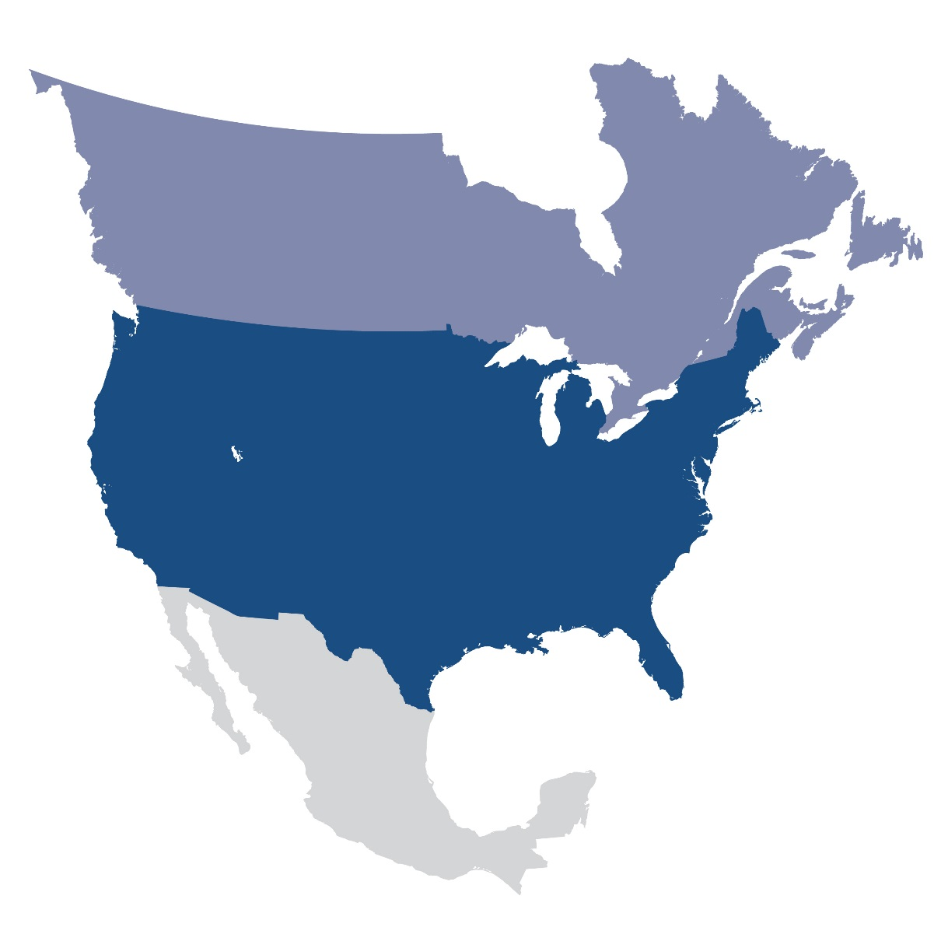
Questions and Answers
Contact Information:
wei.qiu@nerc.net

