Slide 1
NPRR1253 – Technical Implementation
ERCOT Staff
05/29/2025

Slide 2
NPRR-1253 - Summary
An increasing number of energy Customers are responding to potential 4-Coincident Peak (4-CP) intervals by curtailing their load. This reduction in load by these consumers increases reliability by reducing stress on the ERCOT Transmission Grid at the time when needed most.
Customers relying on the Demand as reported on ERCOT’s website may miss these important 4-CP intervals because the Demand reported by ERCOT includes Wholesale Storage Load (WSL) while the Protocols defining the 4-CP intervals specifically exclude WSL. Per the Protocols, WSL incorporates multiple sources of load, but the largest and rapidly growing source of WSL is associated with ESR charging Load.
Currently system level ESR charging MW (5-minute Average value) is shown on ercot.com website ESR Dashboard and data available to market participants download manually.
This NPRR requests ERCOT to send system level ESR charging MW through ICCP and make available through ercot website to download programmatically through API.

Slide 3
Implementation Approach and Timelines
ICCP and Public API system changes will be implemented on or before 06/01/2025 to provide the capability to Market Participants to access ESR charging MW programmatically with 4 seconds granular data.
ICCP Telemetry Changes
New ICCP Telemetry point TCMW (Total ESR Charging MW) will be added to ERCOT ICCP system and make it available to all Market Participants (TSPs and QSEs)
It is a 4 seconds value. This transfer frequency aligns with 4 seconds system demand being sent currently through ICCP and avoids time difference to calculate 4CP values.
ICCP Handbook was updated with this new ICCP telemetry point object name and other required details.
Went Live – March 27th
Public API Changes
4 second system level ESR charging MW and System Demand MW values will be made available through both file and direct data request via the existing Public API interface. Both will be served in JSON format. Files will contain complete 4 seconds samples for 5-minute intervals.
Public API system changes are going through Testing.
Go Live – May 29, 2025
JSON file format and sample data presented in 04/24 TWG meeting and same details are available in this slide deck as well (slides 4-8).
Today we present the details of the expected datasets form this Public API and recommendations.

Slide 4
Data Specification for Public API
Field Name | Data Type | Description
AGCExecTime | Date / Time | Time of AGC application completion In Central Prevailing Time. AGC application calculates system demand and ESR Charging MW.
DSTFlag | Boolean | Flag indicating repeat hour in Fall daylight savings time change
AGCExecTimeUTC | Date / Time | Time of AGC application completion In Coordinated Universal Time (+0)
systemDemand | Numeric (8,8) | System Demand
ESRChargingMW | Numeric (8,12) | Energy Storage Resource charging in MW
Note: Field names and/or data types are subject to change prior to final release.

Slide 5
JSON Payload – Metadata Specification
Example: Typical metadata payload for an interval specific query parameter list:
../api/public-data/nprr1253/4_sec_esr_charging_mw \
?AGCExecTimeUTCFrom=2025-02-10T17:05:02 \
&AGCExecTimeUTCTo=2025-02-10T17:05:14 \
&sort=AGCExecTimeUTC \
&dir=asc
"_meta": {
"totalRecords": 4,
"pageSize": 4,
"totalPages": 1,
"currentPage": 1,
"query": {
"parameterCount": 2,
"parameters": {
"AGCExecTimeUTCFrom": "2025-02-10T17:05:02",
"AGCExecTimeUTCTo": "2025-02-10T17:05:14"
},
"sortedBy": "AGCExecTimeUTC: ASC"
}
},
Note: URL’s and API operations are subject to change prior to final release.

Slide 6
JSON Payload – Field Specification
"fields": [
{
"name": "AGCExecTime",
"label": "AGC Exec Time",
"cardinality": 1,
"dataType": "DATETIME",
"searchable": true,
"sortable": true,
"hasRange": true
},
{
"name": "DSTFlag",
"label": "DST Flag",
"cardinality": 2,
"dataType": "BOOLEAN",
"searchable": true,
"sortable": true,
"hasRange": false
},
{
"name": "AGCExecTimeUTC",
"label": "AGC Exec Time (UTC)",
"cardinality": 3,
"dataType": "DATETIME",
"searchable": true,
"sortable": true,
"hasRange": true
},
{
"name": "systemDemand",
"label": "System Demand",
"cardinality": 4,
"dataType": "DOUBLE",
"searchable": true,
"sortable": true,
"hasRange": true
},
{
"name": "ESRChargingMW",
"label": "ESR Charging MW",
"cardinality": 5,
"dataType": "DOUBLE",
"searchable": true,
"sortable": true,
"hasRange": true
}
],

Slide 7
JSON Payload – Data
"data": [
[
"2025-02-11T11:05:02",
false,
"2025-02-10T17:05:02",
53577.19921875,
561.719421386719
],
[
"2025-02-11T11:05:06",
false,
"2025-02-10T17:05:06",
53584.15234375,
557.368765108933
],
[
"2025-02-11T11:05:10",
false,
"2025-02-10T17:05:10",
53588.44356761,
556.877104837540
],
[
"2025-02-11T11:05:14",
false,
"2025-02-10T17:05:14",
53586.33650982,
558.118463850838
],
...
AGCExecTime
DSTFlag
AGCExecTimeUTC
systemDemand
ESRChargingMW

Slide 8
JSON Payload – Links
"_links": {
"self": {
"href": "https://api.ercot.com/api/public-data/nprr1253/4_sec_esr_charging_mw"
},
"parent": {
"href": "https://api.ercot.com/api/public-data/nprr1253"
}
}
]
All Public API JSON payloads include Hypertext Application Language (HAL) link references. HAL is an implementation of HATEOAS (Hypertext As The Engine Of Application State).
For additional information, see https://en.wikipedia.org/wiki/HATEOAS

Slide 9
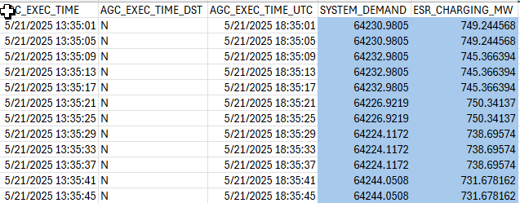
ICCP/Public API Vs MIS WSL Data sets
Public API
ICCP
MIS - WSL Report
System Demand &
ESR Charging Load
Both 4 sec instantaneous MW
15 min Average Energy (MWH)
15 min Averages (MW)
15 min Average Energy (MWH)

Slide 10
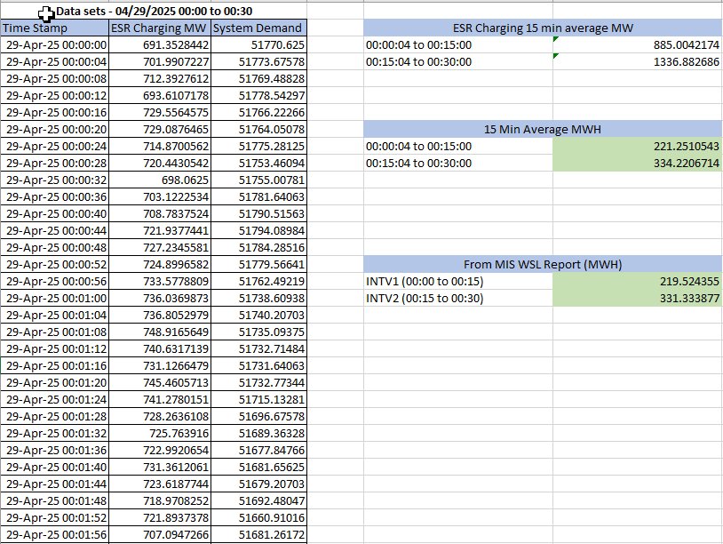
ICCP/Public API Vs MIS WSL Data sets
Example:

Slide 11
Key Points
4 seconds samples of ERCOT System Demand and ESR charging MW data will be available through Public API every 5 minutes with 20 seconds offset (Example: HH:00:20, HH:05:20, HH:10:20 etc.).
Recommendation from ERCOT is to use ICCP or Public API to pull correct ESR Charging MW data due to following reasons:
Alleviate the asynchronous dataset issues – because the source and timestamps of ERCOT system demand and ESR charging load will be the same with NPRR-1253 Public API.
Reduced manual downloads of same data from ERCOT website dashboards.
Accurate calculations enable energy customers to respond to potential 4-Coincident Peak (4-CP) intervals to reduce stress on the ERCOT Transmission Grid and to ensure Reliability.
Public API Go Live is on May 29, 2025, afternoon. Full day datasets will be available from May 30,2025.

Slide 12
Questions
Questions / Comments / Feedback

