Slide 1
ERCOT Technology Working Group (TWG)
May 29, 2025

Slide 2
ERCOT TWG
WELCOME

Slide 3
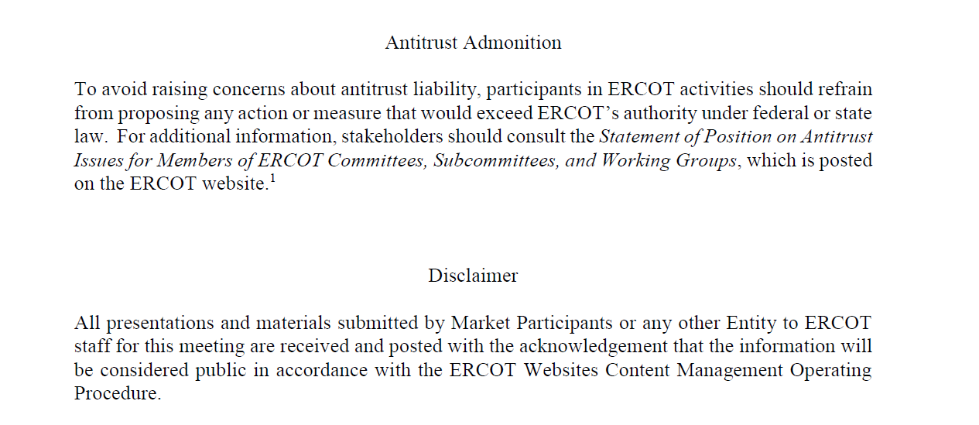
ERCOT TWG

Slide 4
ERCOT TWG Agenda
Item # | Item Description | Presenter | Start Time
1 | Antitrust admonition | Tanner Holder | 2:00 PM
2 | NERC Update – EMSWG | Wei Qui | 2:02 PM
3 | Project Updates | Troy Anderson | 2:10 PM
4 | RTC+B Updates Program and RTCBTF Updates Market Trial Testing Status Market Submissions/Reports/Notifications Updates ICCP Telemetry Modeling Updates | Matt Mereness/ERCOT Staff | 2:20 PM
5 | TLS Certificate Lifetime Reduction – Implementation details | Jason Blevins | 3:00 PM
6 | CIM16 Schema Upgrade Project - status update | Joel Koepke | 3:10 PM
7 | SCR820 (Real-Time Operator Communication System – RTOC ) - Project update | Preethi Meher | 3:20 PM
8 | NPRR1253 Technical Implementation Review with Example | Subhan Shaik/Tejaswi Potluri | 3:30 PM
9 | Round Table Discussion | Tanner Holder | 3:50 PM
10 | Adjourn | Tanner Holder | 4:00 PM

Slide 5
NERC Update
NERC EMSWG Update – Wei Qui

Slide 6
Project Updates
Project Updates – Troy Anderson

Slide 7
RTC+B Updates
RTC+B Updates – Matt Mereness/ERCOT Staff

Slide 8
TLS Certificate Lifetime Reduction
TLS Certificate Lifetime Reduction – Implementation Details – Jason Blevins

Slide 9
CIM Schema Upgrade Project
CIM16 Schema Upgrade project – status update – Joel Koepke

Slide 10
SCR820 – Real-Time Operator Communication System (RTOC)
SCR820 (Real Time Operator Communication System) – Project Update – Preethi Meher

Slide 11
NPRR1253
NPRR1253 Technical Implementation Review with Example – Subhan Shaik/Tejaswi Potluri

Slide 12
ERCOT TWG – Round Table Discussion
ERCOT TWG – Round Table Discussion
  Future Topics of Interest
  Topics and presentations from TWG members

Slide 13
ERCOT TWG
Thank You
You can reach Sreenivas at
Sreenivas.Badri@ercot.com and Tanner at tholder@tnsk.com

