Slide 1
Monthly Review of Reliability Unit Commitment Market Impacts – April 2025
Wholesale Market Working Group
ERCOT Market Analysis

Slide 2
RUC Resource-Hours
April 2025 | Total | Capacity |  | Congestion
 |  | Opt-Out | Non-Opt-Out | Opt-Out | Non-Opt-Out
Instructed Resource-Hours
Total Count | 312.6 | 6.0 | 33.6 | 0.0 | 273.0
Effective Resource-Hours*
Total Count | 300.2 | 5.9 | 33.6 | 0.0 | 260.7
Average Megawatts (MW) for Effective Resource-Hours
Average LSL | 78.3 | 223.1 | 107.5 | 0.0 | 71.4
Average LDL | 84.5 | 343.6 | 107.5 | 0.0 | 75.9
Average BP | 87.6 | 378.4 | 107.5 | 0.0 | 78.6
Average HSL | 277.8 | 629.0 | 327.6 | 0.0 | 263.7
* The difference between “Instructed” and “Effective” values is a result of Resources starting up, shutting down, receiving partial hour instructions, or otherwise not being dispatchable by SCED.

Slide 3
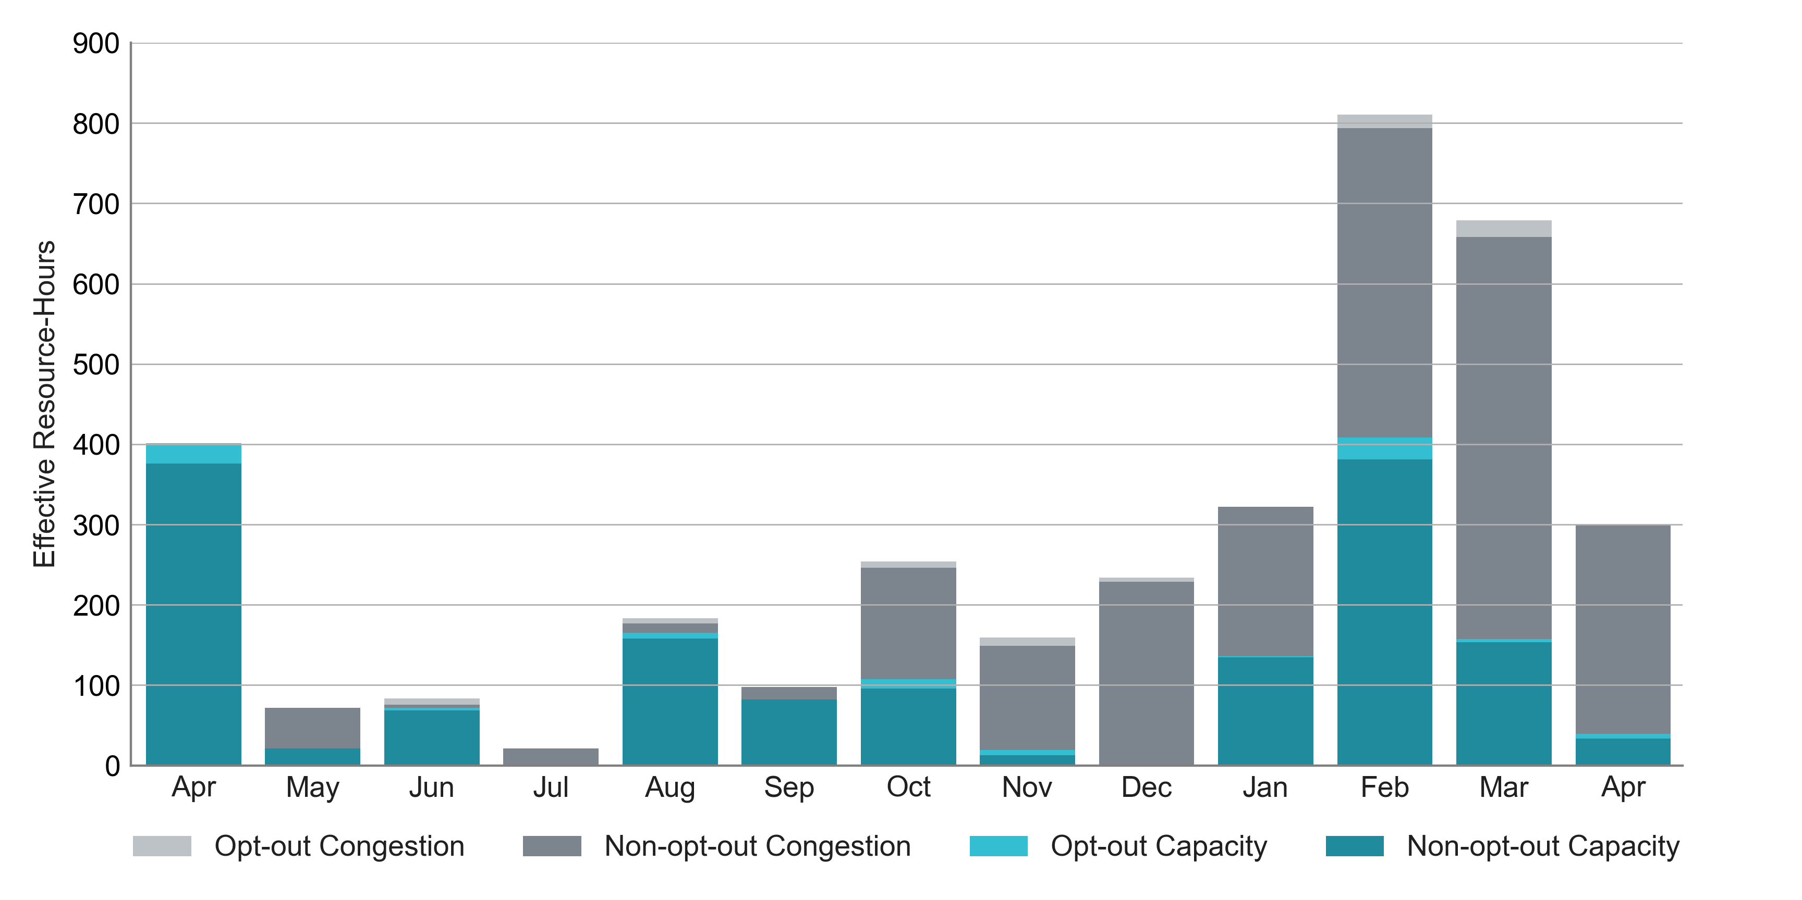
RUC Instruction Reasons: Last 13 Months Most RUC effective hours in April 2025 were nominally attributed to congestion.

Slide 4
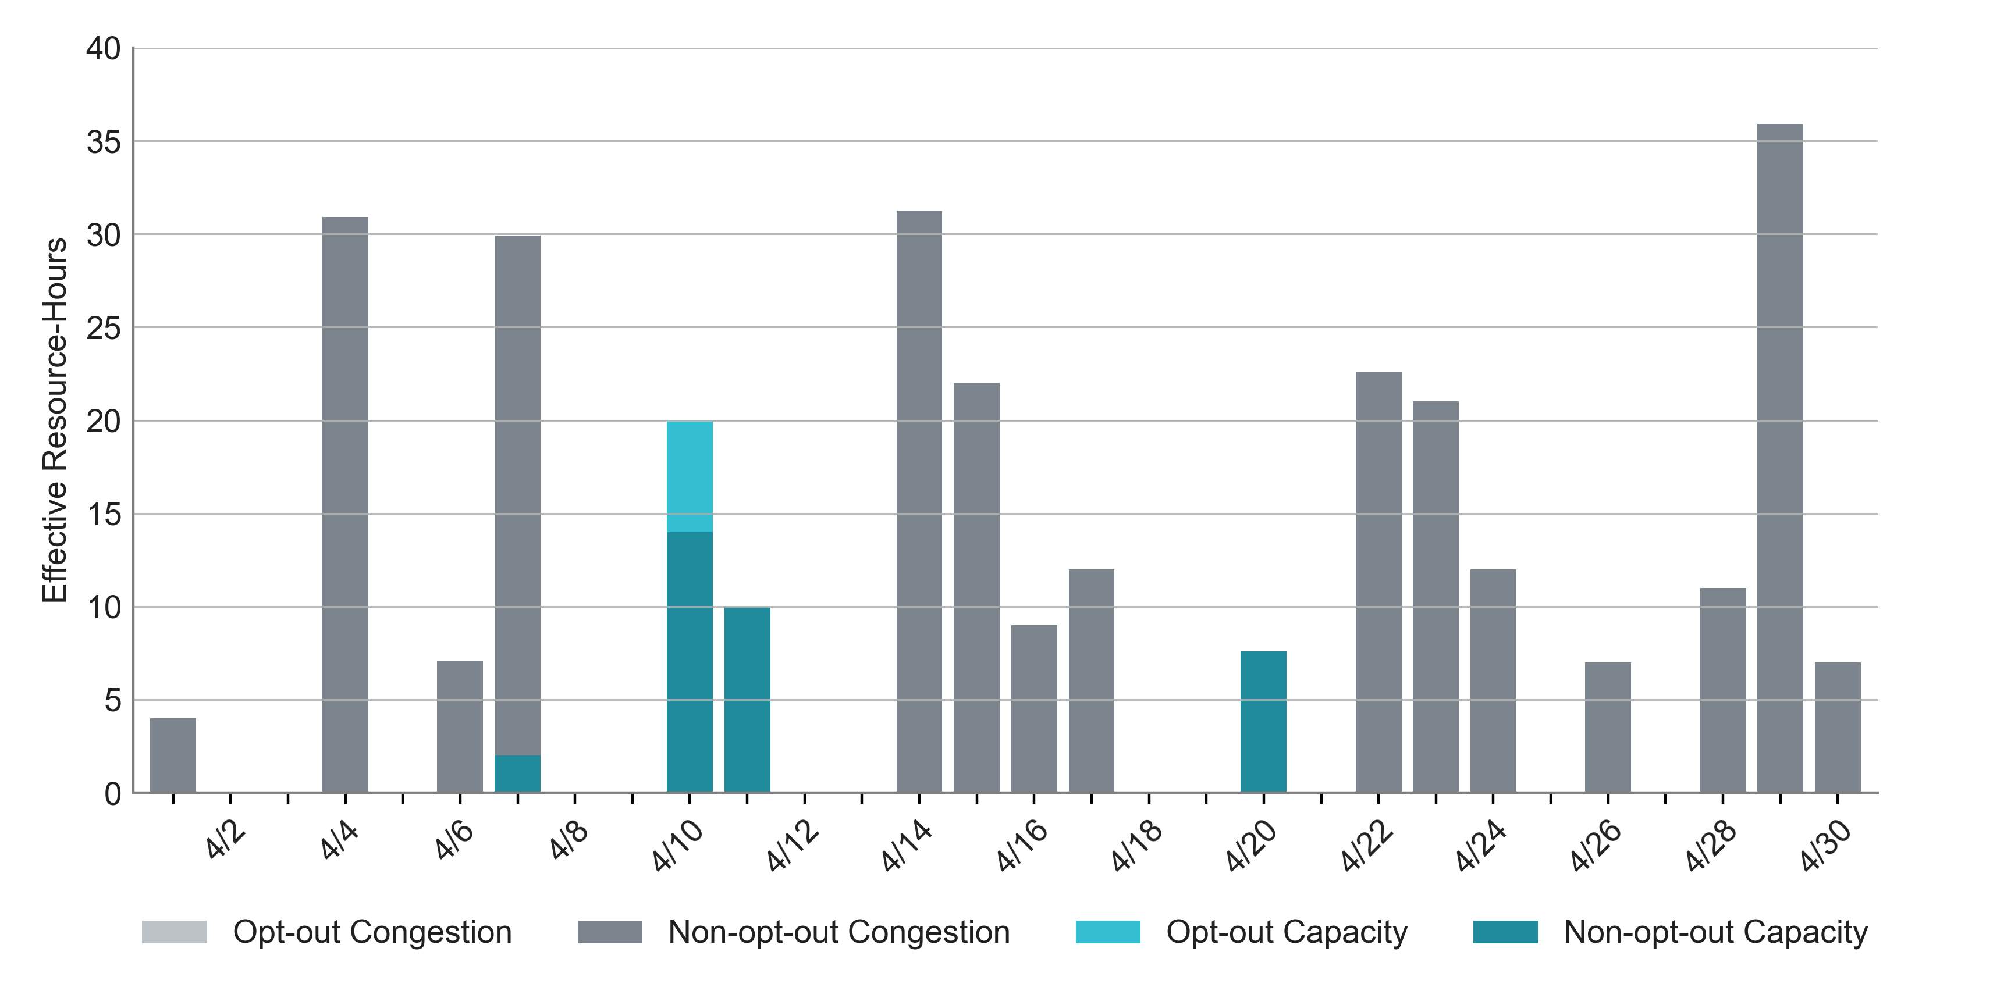
RUC Instruction Reasons in April 2025
300.2 RUC effective Resource-hours.
260.7 hours (87%) for congestion.

Slide 5
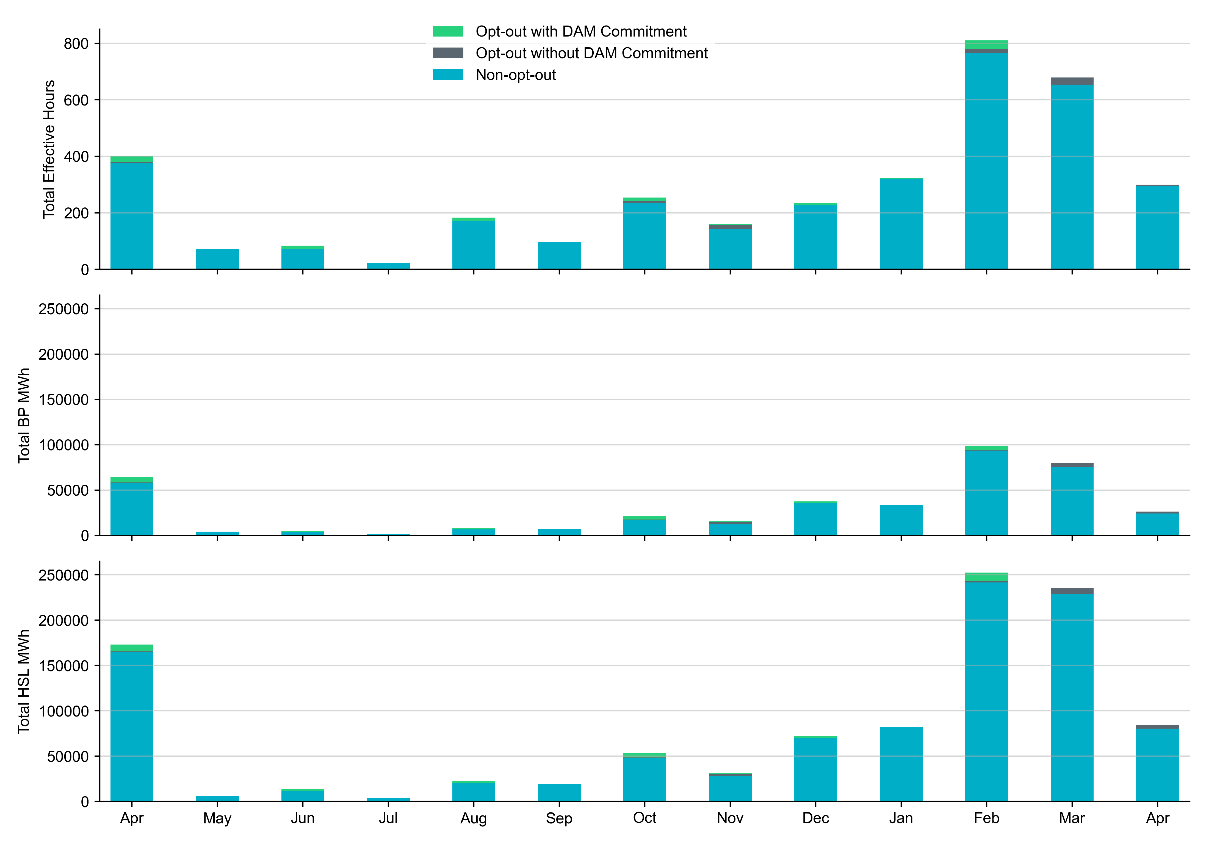
Non-opt-out and Opt-out Totals: Last 13 Months April 2025 had a total of 294.3 non-opt-out effective Resource-hours (98%) and 5.9 opt-out effective Resource-hours (2%).

Slide 6
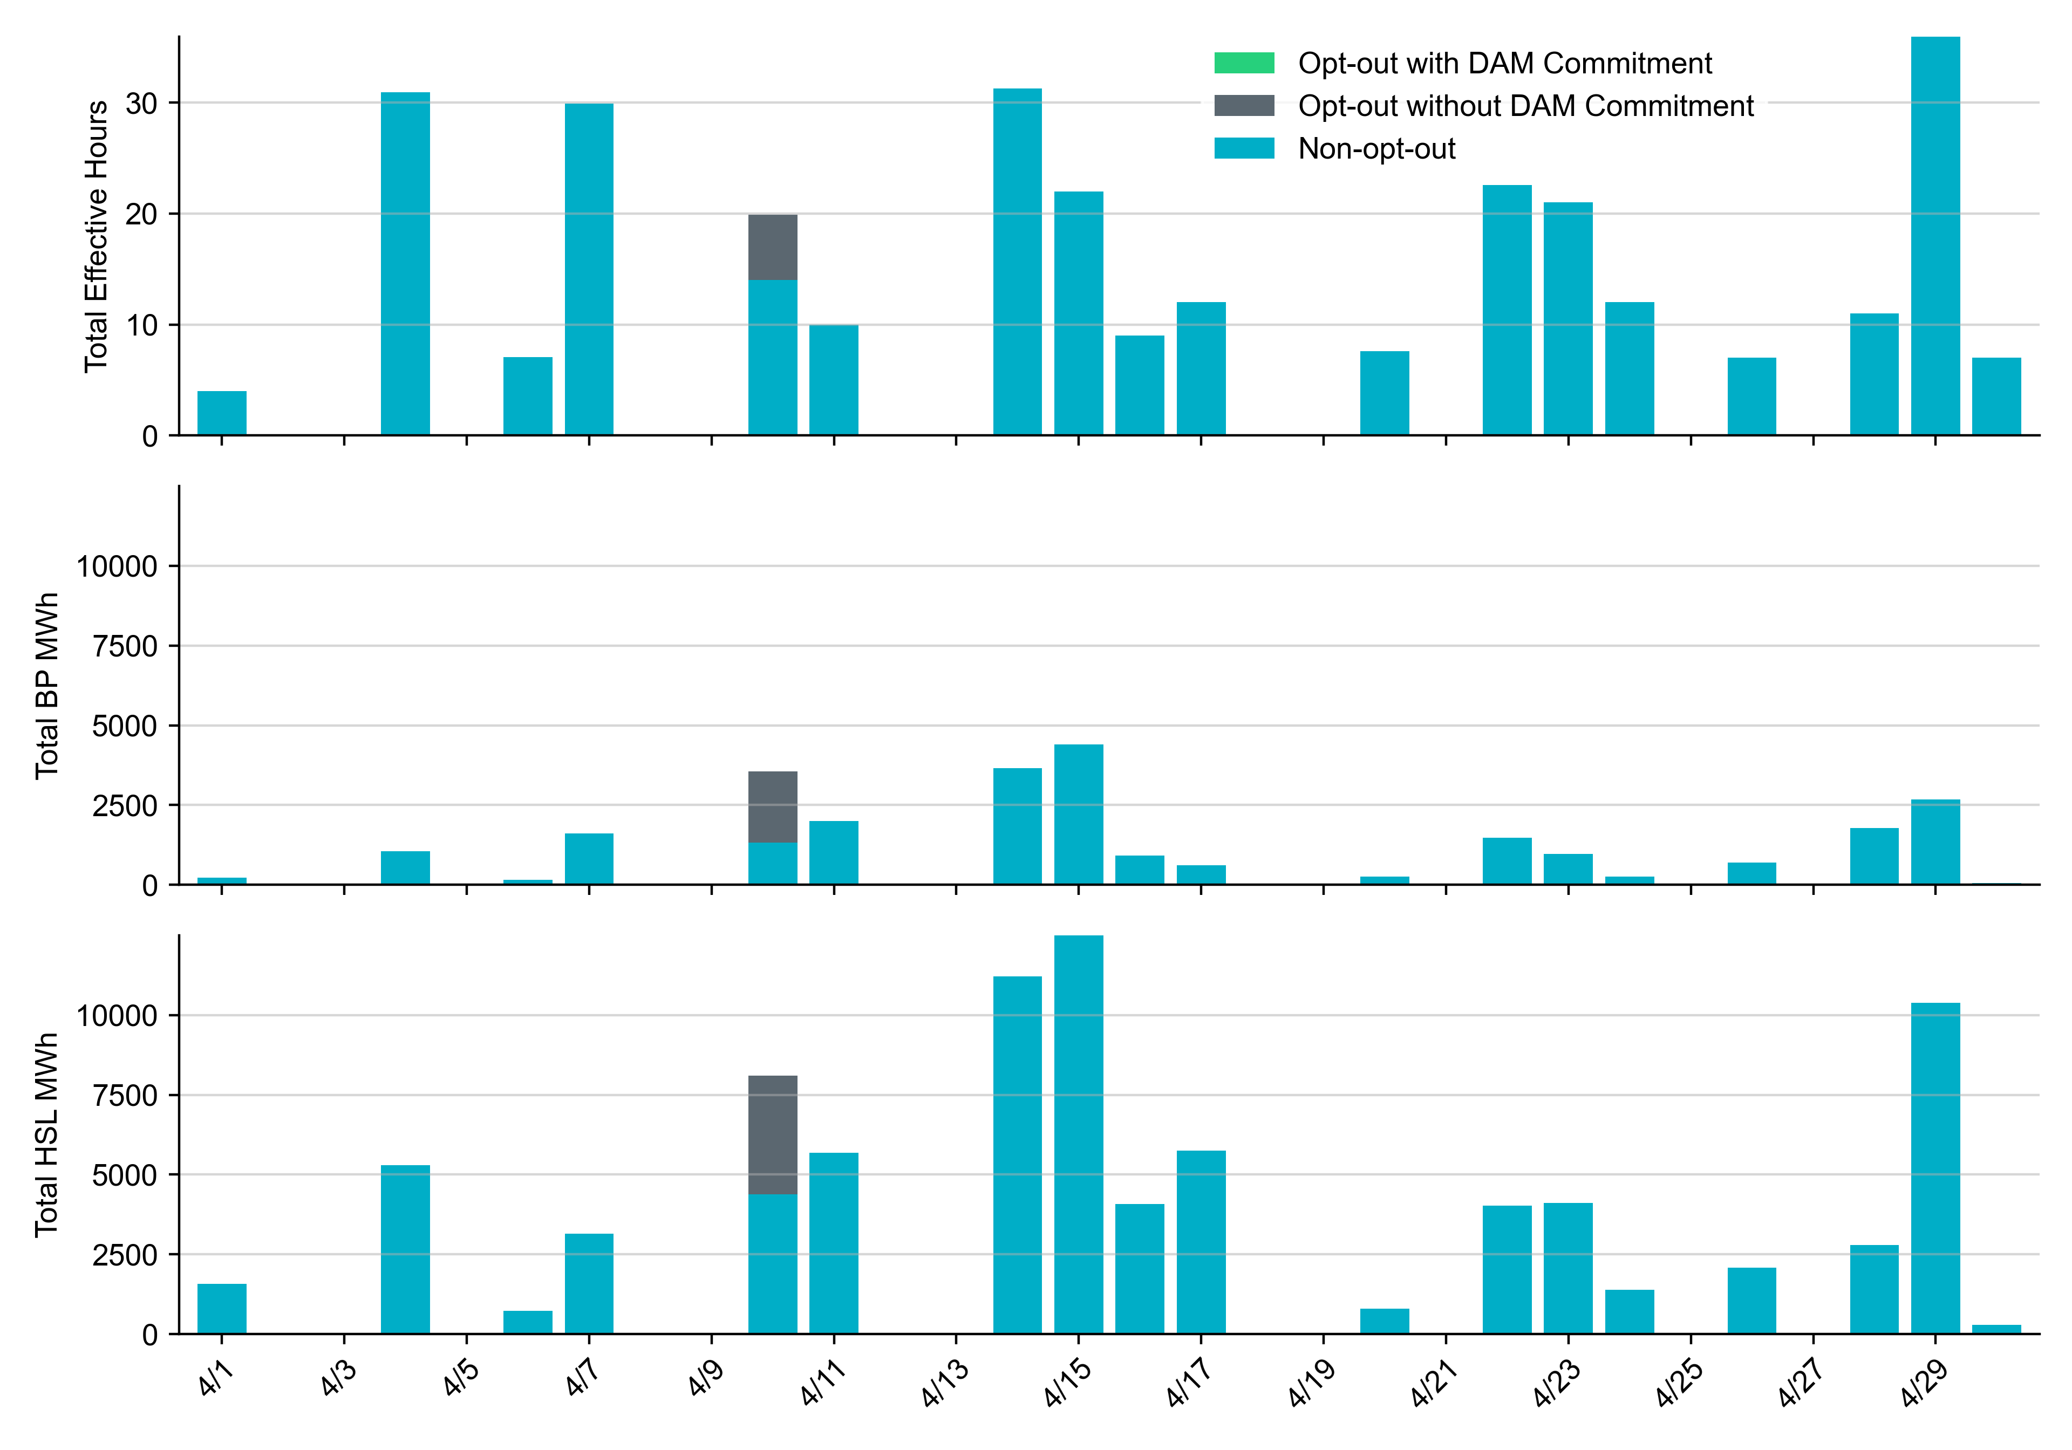
Non-opt-out and Opt-out Totals: April 2025

Slide 7
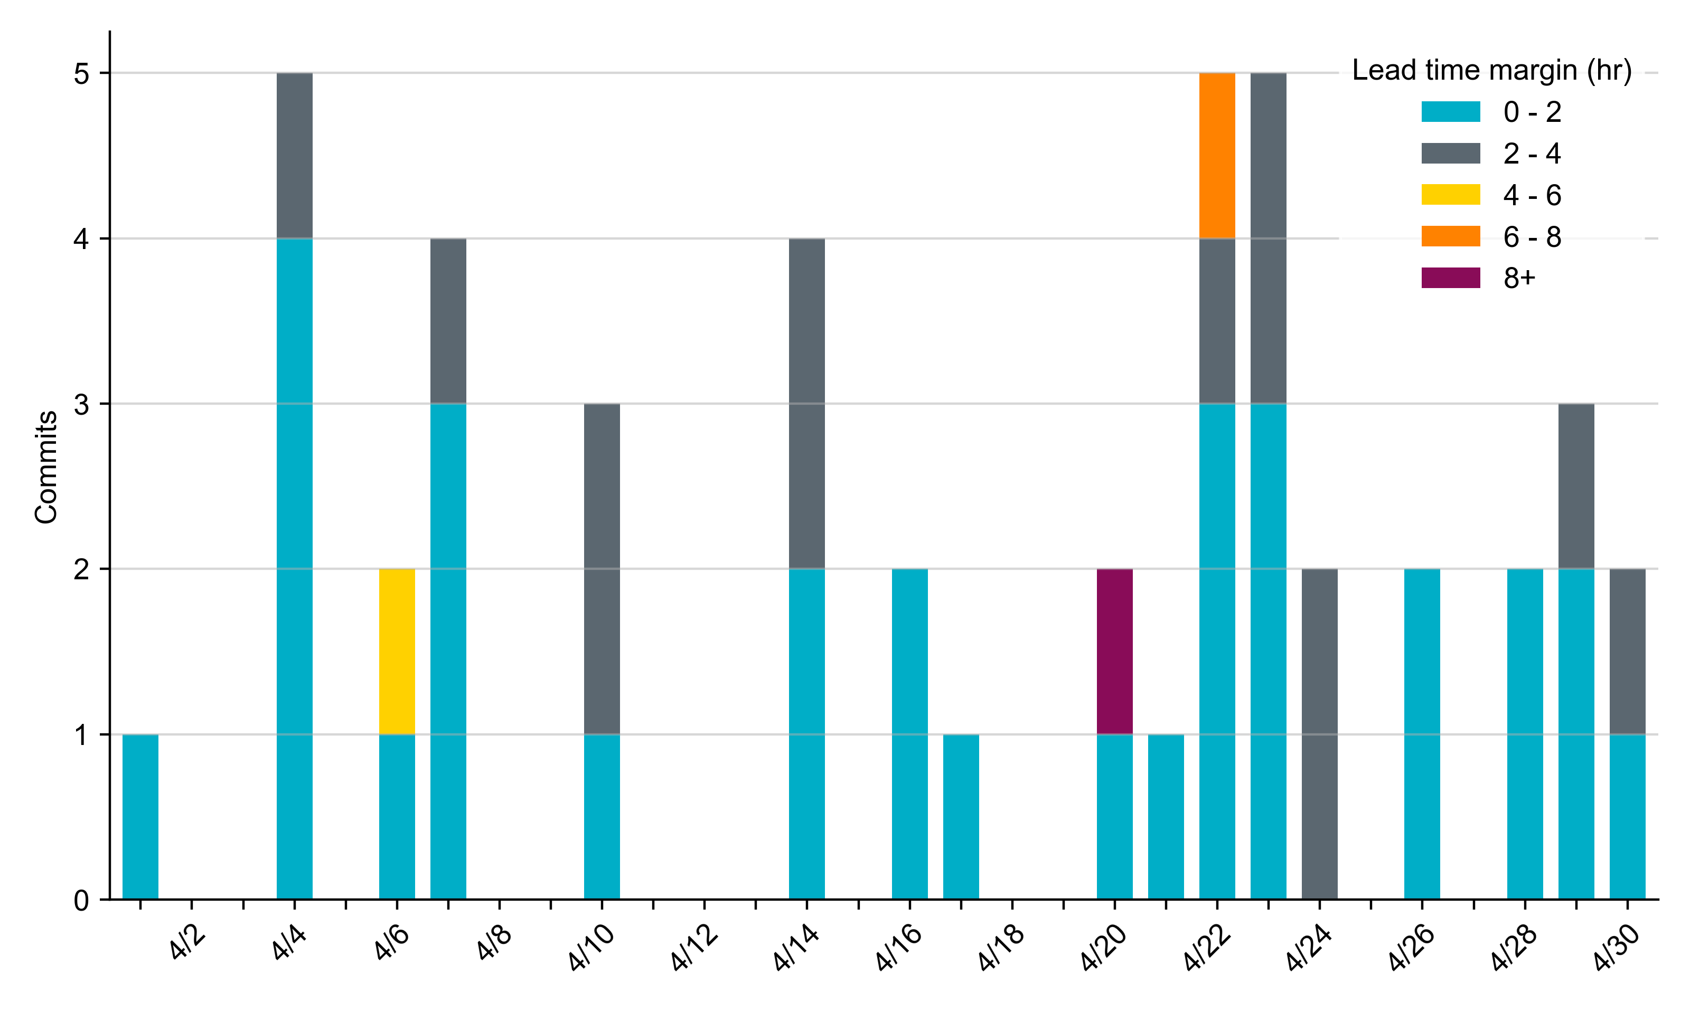
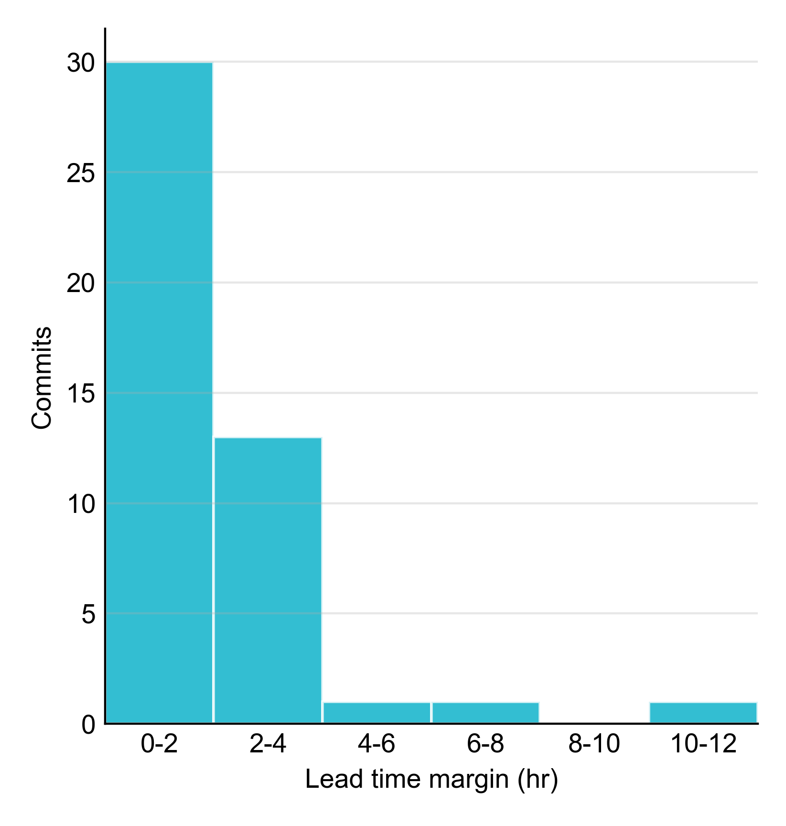
RUC Lead Time Margin: April 2025
Most RUC commitment windows (65%) had a lead time margin of 2 hours or less.
Lead time refers to the length of time between a RUC instruction and the start of the commitment window.
Lead time margin is the difference between lead time and the Resource’s startup time.
In cases where a Resource is committed for multiple back-to-back time blocks, lead time margin is calculated from the first instruction.

Slide 8
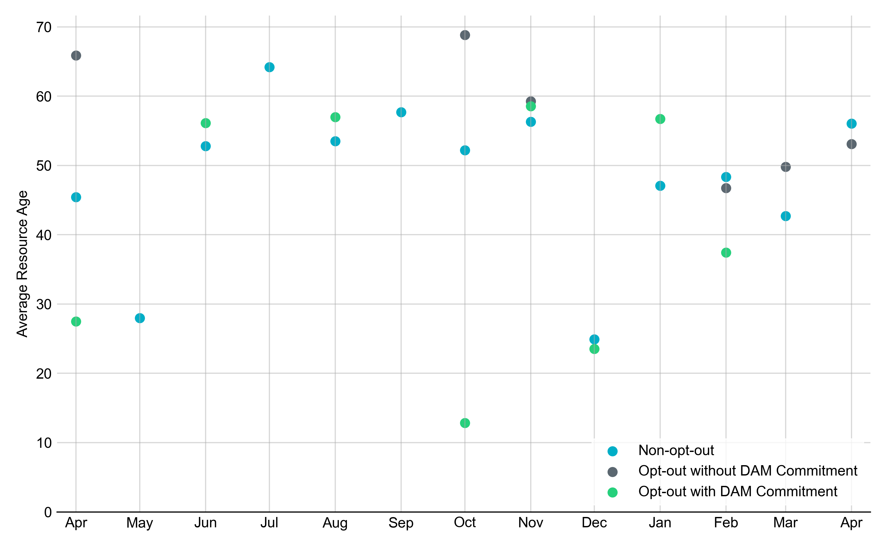
Average Resource Age: Last 13 Months In April 2025, the average age of RUC-committed Resources was 56.1 years for Non-opt-out Resource-hours.
Note: For Resource configurations with multiple physical generators, the age of the oldest generator is used.

Slide 9
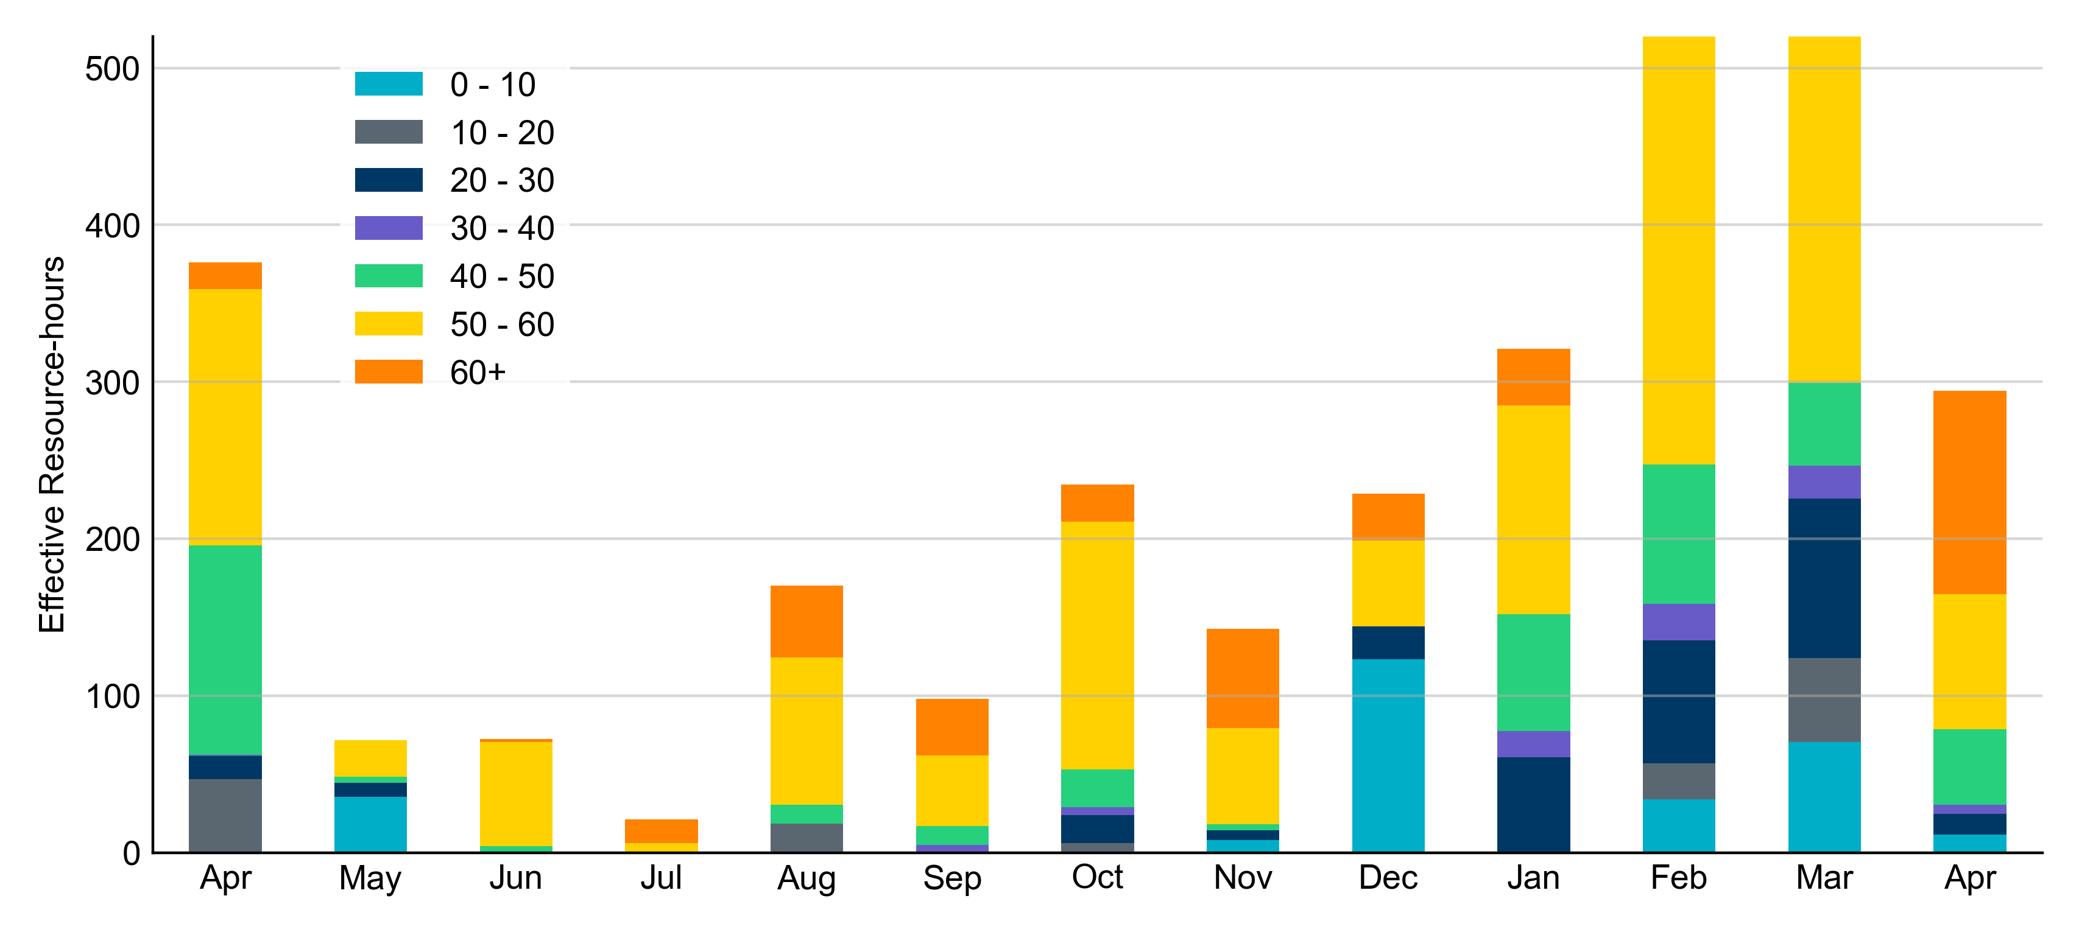
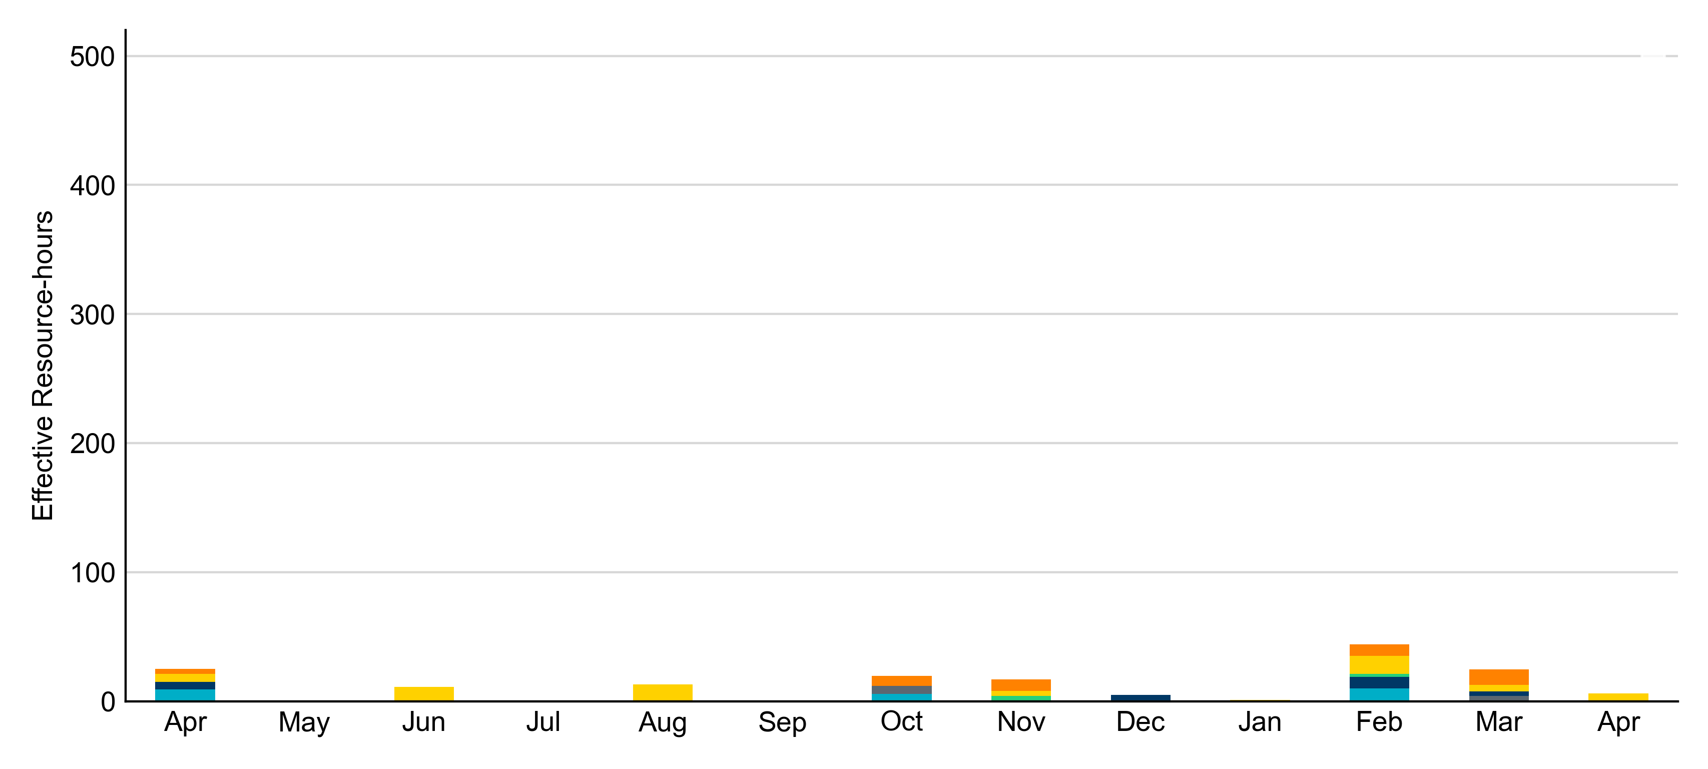
Age Category: Last 13 Months In April 2025, most RUC Effective Resource-hours (74%) were provided by resources that were more than 50 years old.
Non-opt-out
Opt-out

Slide 10
RUC-Instructed Resource Dispatch above LDL
April 2025
There were 17.4 effective Resource-hours in which Resources that did not successfully opt out were dispatched above their LDL.
For 8.8 of these Resource-hours, the LMP for the RUC-instructed Resource was above the RUC offer floor.
For 8.6 of these Resource-hours, the LMP for the RUC-instructed Resource was below the RUC offer floor.
For all of these 8.6 Resource-hours, the RUC-instructed Resource was mitigated.
There were no Exceptional Fuel Cost submissions for any RUC-committed Resources.

Slide 11
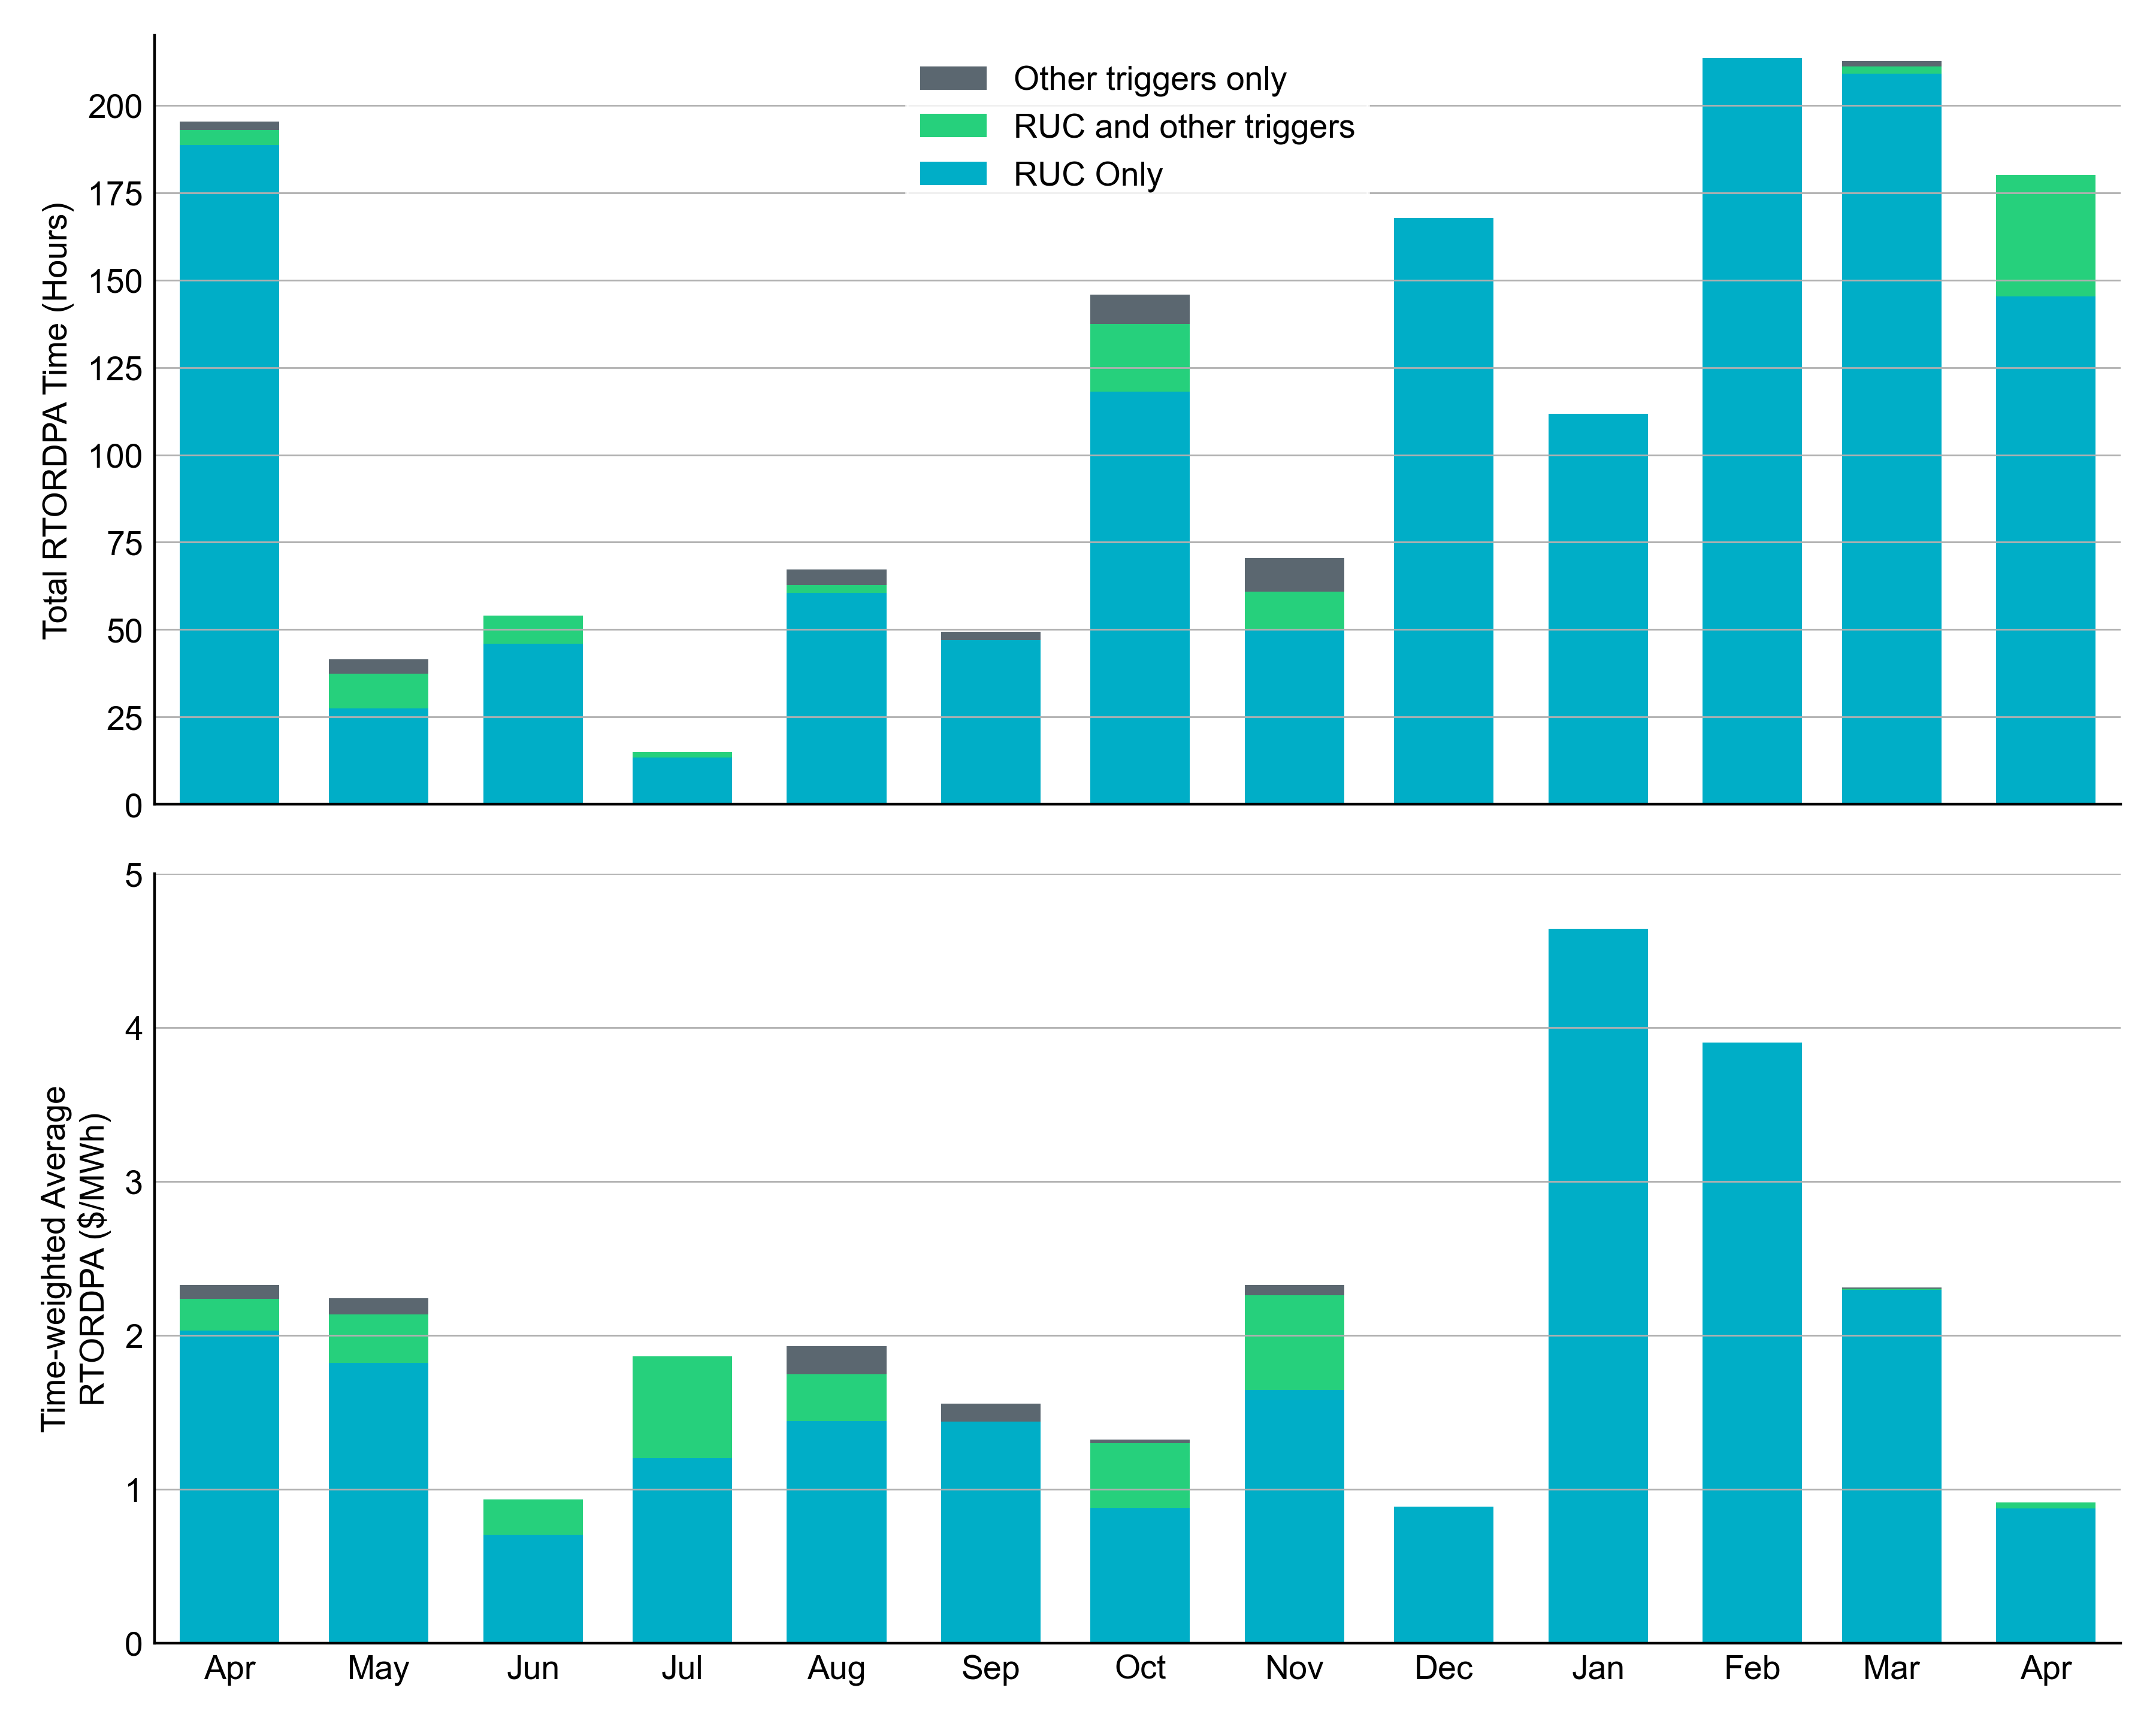
Reliability Deployment Price Adder: Last 13 Months April 2025 had a total of 180.34 RTORDPA hours with a time-weighted average value of $0.92/MWh.
These graphs show RTORDPA instances by reliability action: 'RUC Only' for instances triggered solely by Reliability Unit Commitment, 'RUC and other triggers' for instances with RUC and additional triggers, and 'Other triggers only' for instances with non-RUC triggers. The daily average RTORDPA is calculated using the total duration across all categories. See ERCOT protocol section 6.5.7.3.1 for details.

Slide 12
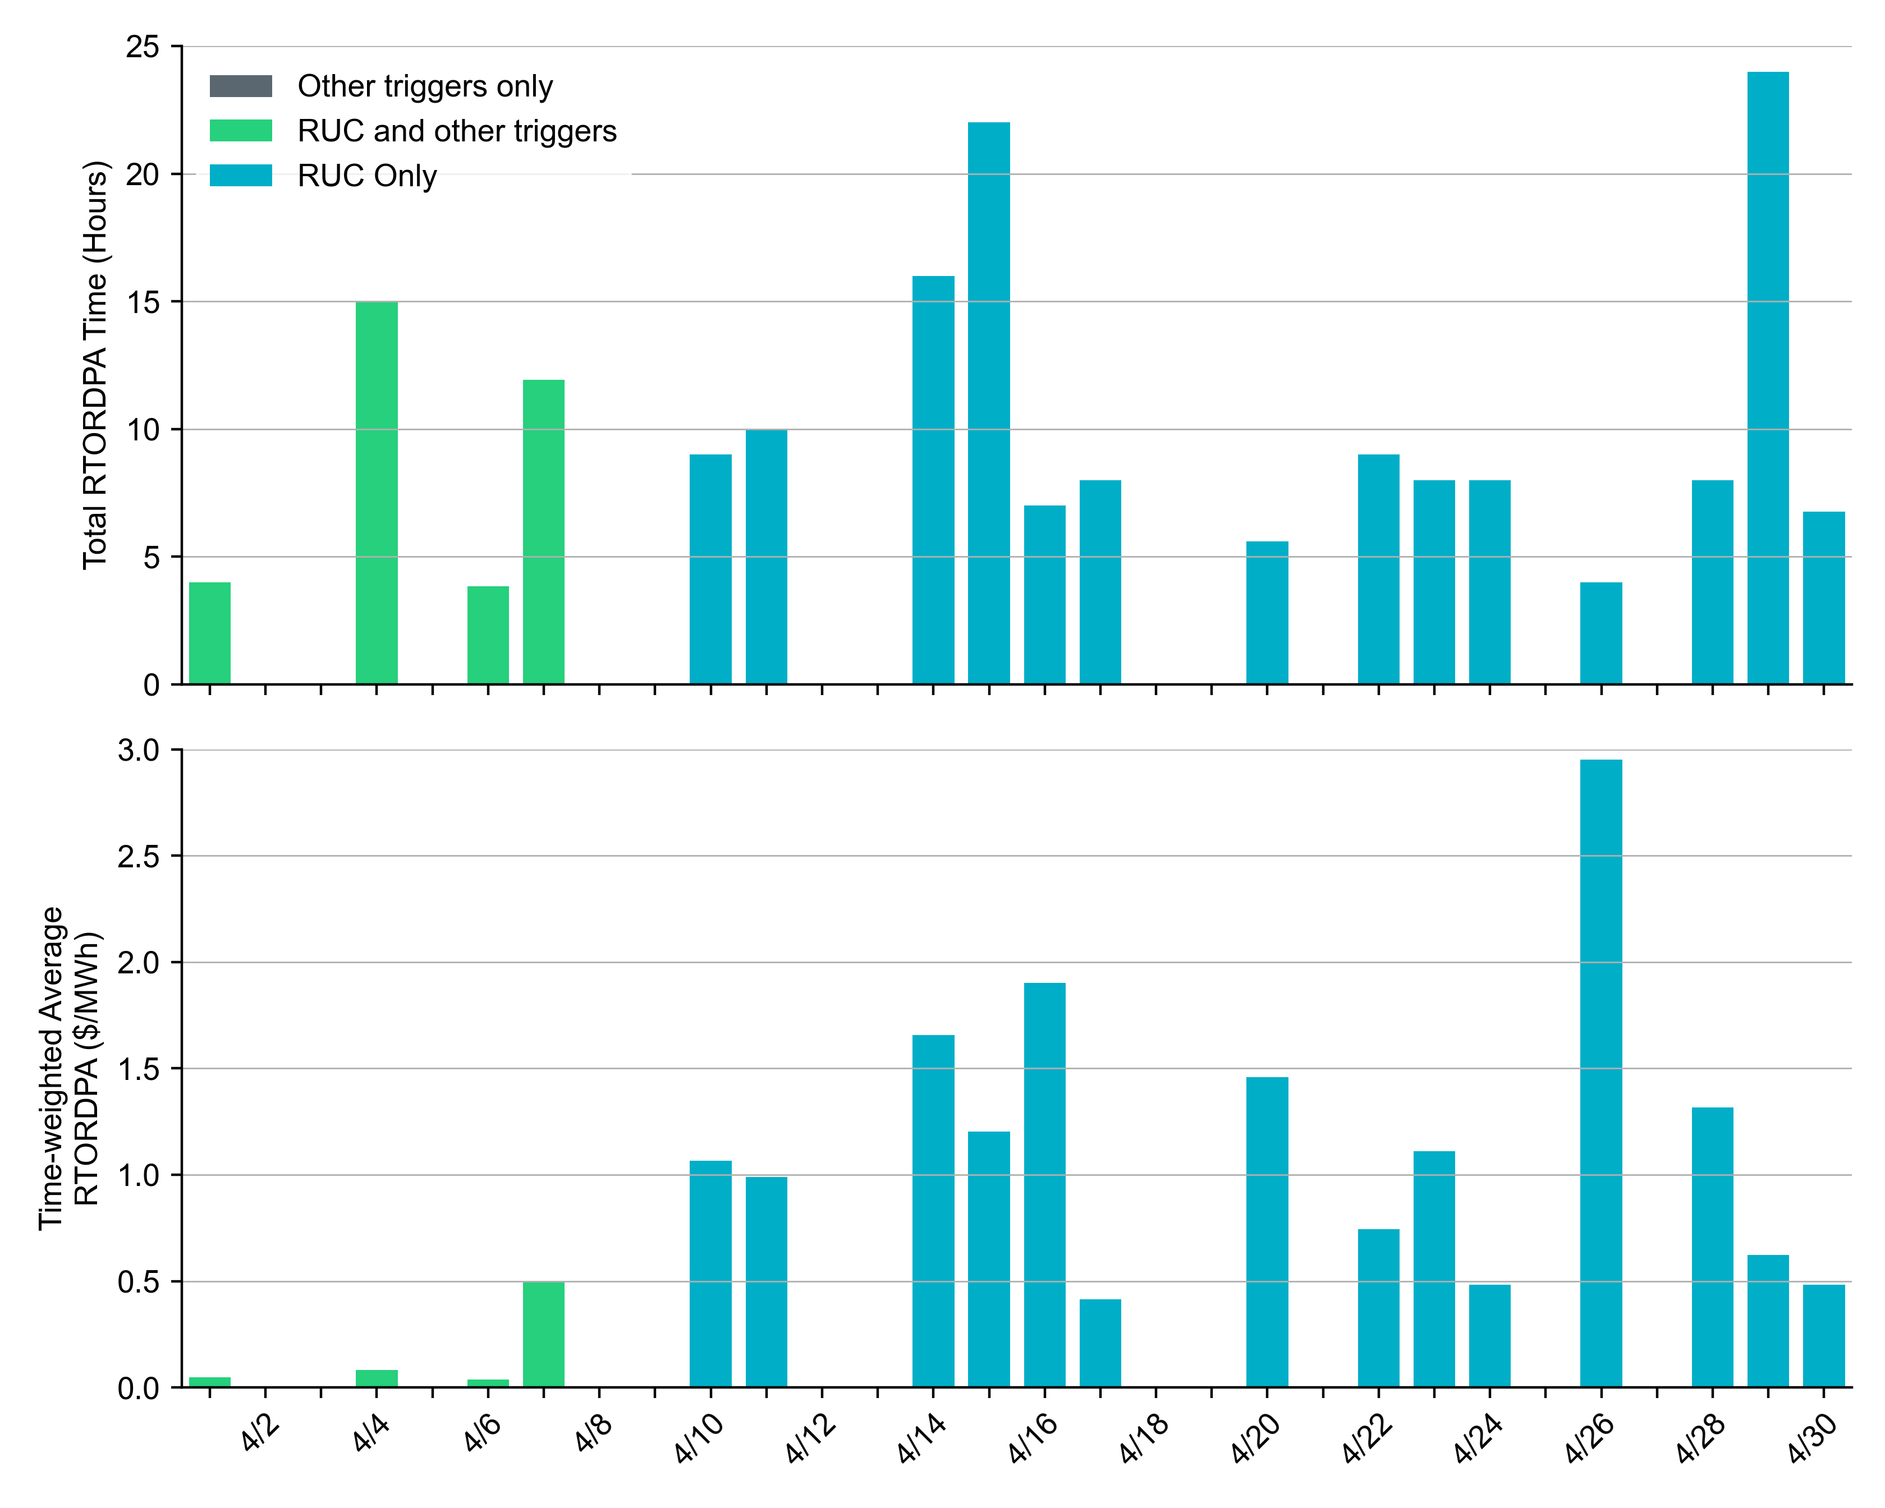
Reliability Deployment Price Adder: April 2025 OD 04/26 had the highest daily time-weighted average RTORDPA of $2.95/MWh.
These graphs show RTORDPA instances by reliability action: 'RUC Only' for instances triggered solely by Reliability Unit Commitment, 'RUC and other triggers' for instances with RUC and additional triggers, and 'Other triggers only' for instances with non-RUC triggers. The daily average RTORDPA is calculated using the total duration across all categories. See ERCOT protocol section 6.5.7.3.1 for more details.

Slide 13
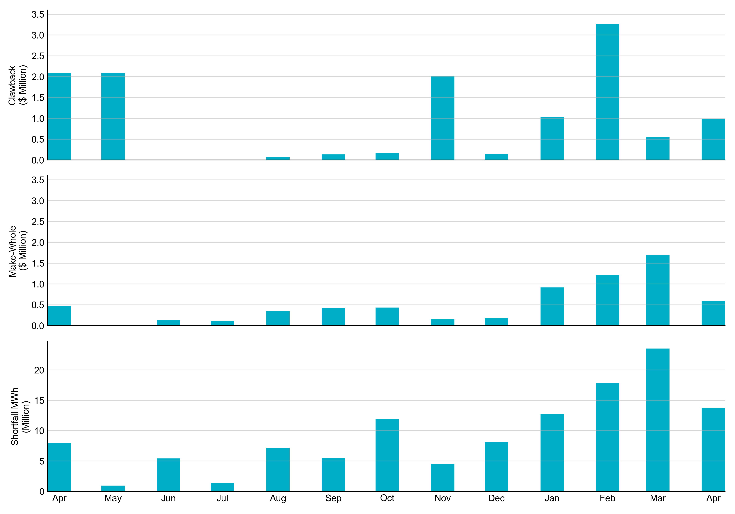
RUC Clawback, Make-Whole, and Shortfall For April 2025, the total Clawback Charge was $993,341. The total Make-Whole Payment was $594,864.
Of the $594,864 in Make-Whole Payments made in April 2025, $5.53 was uplifted to load due to rounding.
The remaining amount was collected through Capacity-Short Charges.
Data as of February 18th, 2025

Slide 14
RUC Clawback by Settlement Type
Month | Initial Settlement ($) | Final Settlement Change ($) | True-up Settlement Change ($) | Net as of May 14, 2025 ($)
Apr ‘24 | 2,092,224 | 0 | -11,818 | 2,080,406
May ‘24 | 2,084,416 | 0 | 0 | 2,084,416
Jun ’24 | 58 | 0 | 0 | 58
Jul ‘24 | 47,627 | 0 | -47,627 | 0
Aug ‘24 | 73,690 | 0 | 0 | 73,690
Sep ‘24 | 140,239 | 0 | -7,864 | 132,375
Oct ‘24 | 179,331 | 0 | 0 | 179,331
Nov ‘24 | 2,022,874 | 0 | 0 | 2,022,874
Dec ‘24 | 147,389 | -3 | - | -
Jan ‘25 | 1,037,717 | 0 | - | -
Feb ‘25 | 3,272,312 | 2,726,670 | - | -
Mar ‘25 | 545,642 | 0 | - | -
Apr ‘25 | 993,341 | - | - | -
Negative dollars represent a payment from ERCOT to a market participant
“-” indicates settlement has yet to be completed.
Net figures may differ slightly due to rounding.

Slide 15
RUC Make-Whole by Settlement Type
Month | Initial Settlement ($) | Final Settlement Change ($) | True-up Settlement Change ($) | Net as of May 14, 2025 ($)
Apr ‘24 | -443,178 | 0 | -35,271 | -478,449
May ‘24 | -2,957 | 0 | 0 | -2,957
Jun ’24 | -76,670 | 0 | -57,341 | -134,011
Jul ‘24 | -4,297 | 0 | -109,781 | -114,078
Aug ‘24 | -305,171 | 0 | -46,445 | -351,616
Sep ‘24 | -239,681 | 0 | -192,317 | -431,998
Oct ‘24 | -364,395 | 0 | -26,567 | -390,962
Nov ‘24 | -164,191 | 0 | 328,382 | 164,191
Dec ‘24 | -179,587 | 0 | - | -
Jan ‘25 | -834,867 | -26,923 | - | -
Feb ‘25 | -1,198,579 | 503,128 | - | -
Mar ‘25 | -1,701,707 | 0 | - | -
Apr ‘25 | -594,864 | - | - | -
Negative dollars represent a payment from ERCOT to a market participant
“-” indicates settlement has yet to be completed.
Net figures may differ slightly due to rounding.

