Slide 1
Weekly
RTC+B Market Trials Update
ERCOT Staff
May 19, 2025
(updated May 20, 2025)

Slide 2
Outline
Antitrust Admonition
Reminder of Key Document Postings
Expectations of QSEs for the Week
Provide Update of Cumulative QSE Scorecards
Communicate any known Issues within On-going Trial
Support any Technical and/or Business Questions

Slide 3
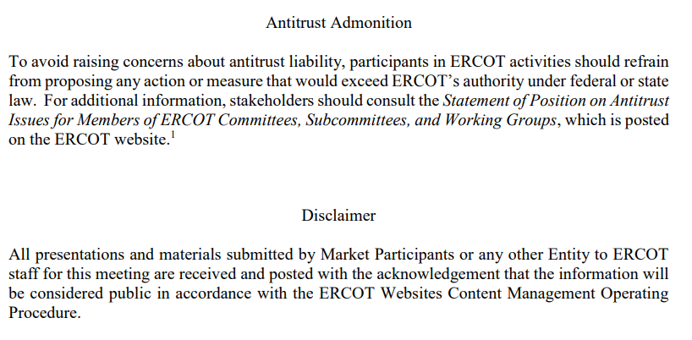
WebEx Meeting reminders (same as other ERCOT forums):
Please keep line muted
If you have a question, please use the chat feature to either:
  Type in your question, or
  Type in “Question” and wait to be recognized to state question

Slide 4
Sequence and Dates for Market Trials to Go-Live
Market trials are a progression of activities to mitigate the risk for Go-Live on new systems and processes for both the Market Participants & ERCOT.
30-day Market Notice
11/5/25
March/April
2025
Start
5/5/25
Start
7/7/25
Start
9/2/25
Go-Live
12/5/25*
May 2025
June 2025
July 2025
Aug 2025
Sep 2025
Oct 2025
Nov 2025
Dec 2025
QSE Scorecards & Exit Criteria for each Trial Phase
#1 RTC QSE Submission Testing
(Submit COP, RT AS Offers,
DAM Virtual AS, Outages for ESRs)
#3 Open-loop RTC SCED
(QSE offers, SCED non-binding award/dispatch)
#5 Ongoing Open-Loop
& Periodic Closed-loop SCED/LFC
(QSE RTC offers and telemetry to support closed-loop frequency control test 2-3 tests of 2-4 hour durations)
Transition to Go-Live
Upon completion of testing, confirmation of ERCOT and market readiness for Go-Live.
QSE/Vendor Submission Sandbox and Telemetry Points added Prod EMS model.
#2 RTC QSE Telemetry Checkout (QSEs add/verify new telemetry points for UDSP, New ramp rates, ESR telemetry)
#4 QSE Telemetry Tests
(Individual QSE to follow UDSP and support new ramp rate and ESR telemetry)
#6 Day-Ahead Market
(Non-binding DAM using QSE offers for at least 2 tests)
* Go-Live date reflects 12/5/2025 as first Operating Day
where 12/4/2025 is planned software migration.

Slide 5
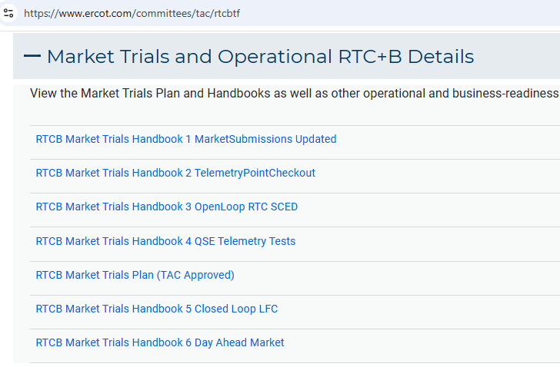
Market Trials
TAC Approved the Market Trials Plan in October 2024
Discussions with RTC+B Task Force have shaped the Handbooks
Handbook #1- QSE Submission Testing
Handbook #2- QSE Telemetry Tests
Handbook #3- Open Loop SCED
Handbook #4- QSE Telemetry Tests
Handbook #5- Close-Loop LFC Tests (draft)
Handbook #6- Day-Ahead Market Tests (draft)
All are posted on the
RTCBTF Homepage
under Market Trials banner

Slide 6
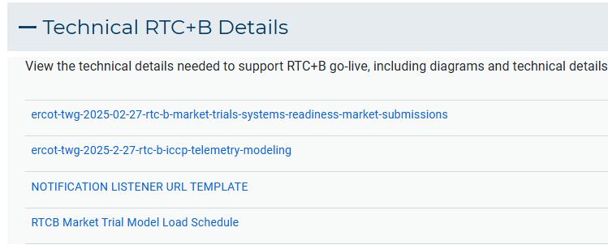
Market Trials
Detailed discussions with TWG have provided technical content details
Digital Certificate details
Connectivity/URL details to User Interfaces and APIs
Reminder of how to submit new ICCP requests
RTC and Production Telemetry connectivity
Network Model Load Schedule
All are posted on the
RTCBTF Homepage
under Technical Details banner

Slide 7
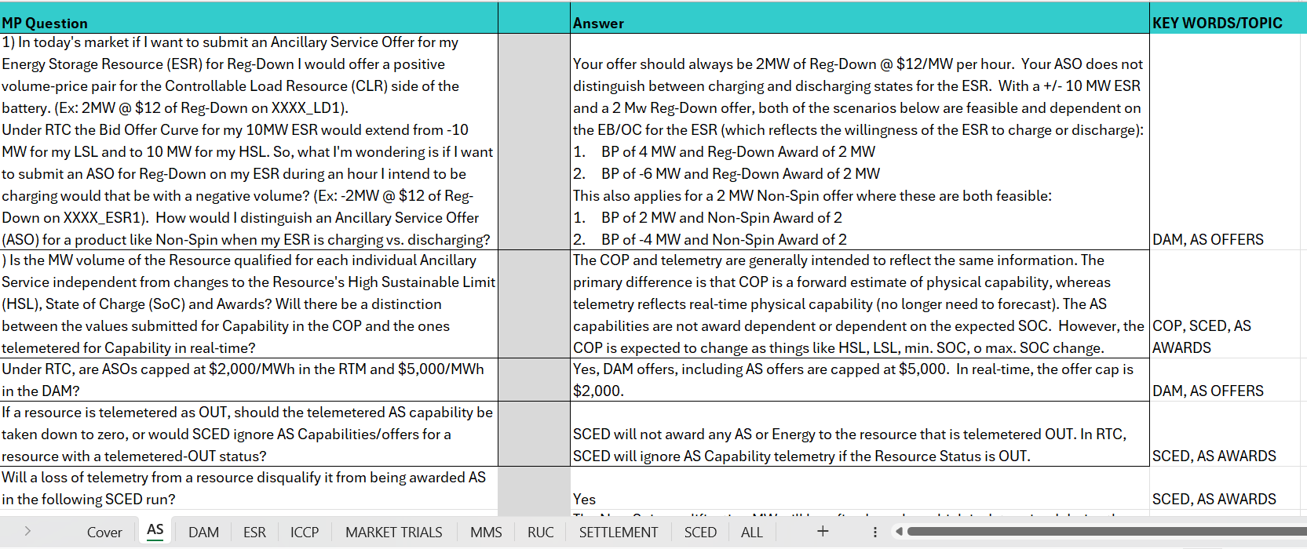
Initial RTC+B FAQ has been posted
Posted on RTCBTF Home Page under KeyDocs
Common questions/responses in Excel Workbook (target weekly updates)
Search workbook for Key Words
Worksheets for categories

Slide 8
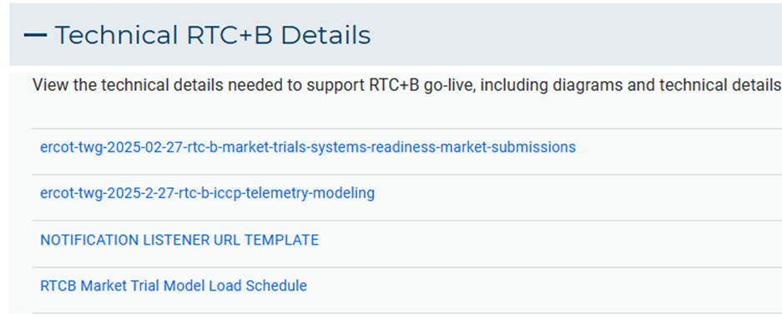
Resources for May-June Market Trials
Everything needed for current market trials is on RTCBTF home page

Slide 9
Summary of Market Trial activities for this week and following weeks
QSE connectivity and market submissions
  Submit to Market Management System and Outage Scheduler
  Goal to submit at least one successful transaction for each requested transaction type per QSE once during the 8-week period
QSE telemetry set-up and check-out
  Submit all ICCP requests to ERCOT to add telemetry points
  Check-out will be for a sampling of resources within the QSE portfolio to ensure data flowing between ERCOT/QSE
Scoring begins this week

Slide 10
Scorecards for this Market Trials
Handbook Book 1: ERCOT will publish 3 scorecards, one for each type of Resource: Generation, Load Resources, ESR
    Green: all submissions types completed at least once during the trial
    Yellow: some submissions types completed at least once during the trial
    Red: no submissions received
Handbook 2: ERCOT will publish 2 scorecards:
  Complete all telemetry additions
    Green: all new telemetry added (100%)
    Yellow: some telemetry added
    Red: no new telemetry added
  Check-out complete
    Green: Check-out successfully completed (for sample of Resources)
    Yellow: Check-out scheduled, but not yet complete
    Red: No check-out activity

Slide 11
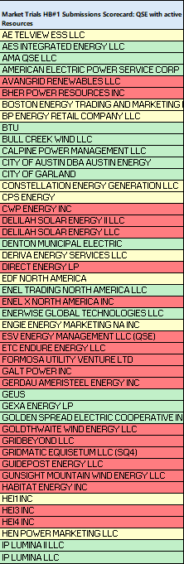
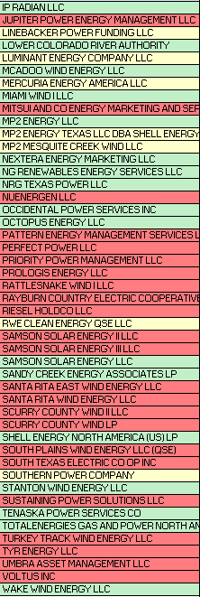
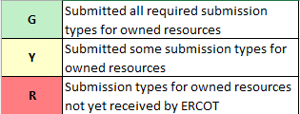
Scorecard for
Hand Book 1
Market submissions:
5/19 Scores for QSEs with Resources – successful submissions for resource types specified in Hand Book 1
Scoring:

Slide 12
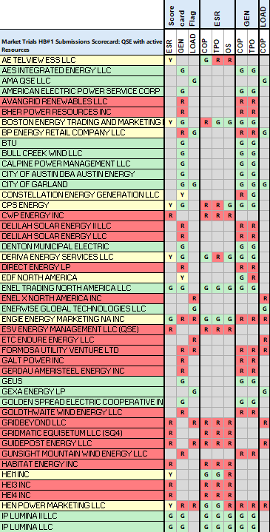
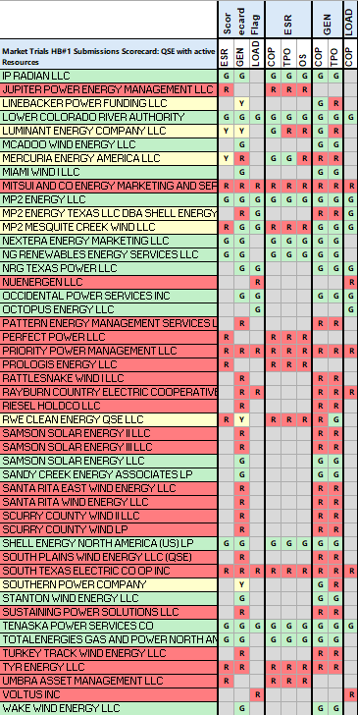
Detailed Scorecard for
Hand Book 1
Market submissions:
5/19 Scores for QSEs with Resources – successful submissions for resource types specified in Hand Book 1
Scoring:

Slide 13
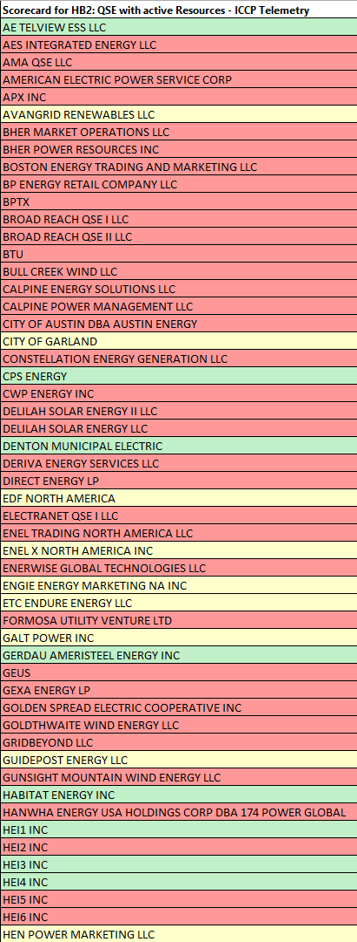
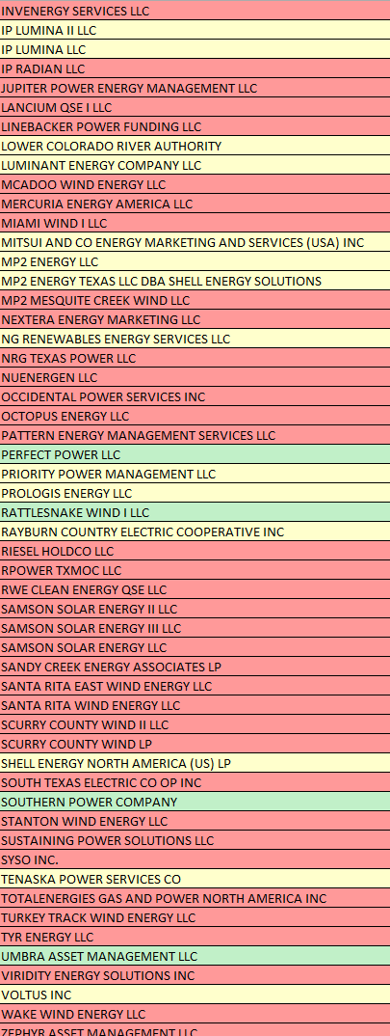
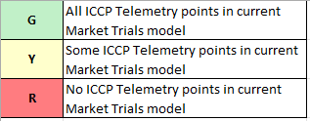
Scorecard for
Hand Book 2
ICCP Telemetry points added to current model:
5/19 Scores for QSE with Resources - ICCP Telemetry points added in current model. Expect scores to improve as we load future models.
Scoring:

Slide 14
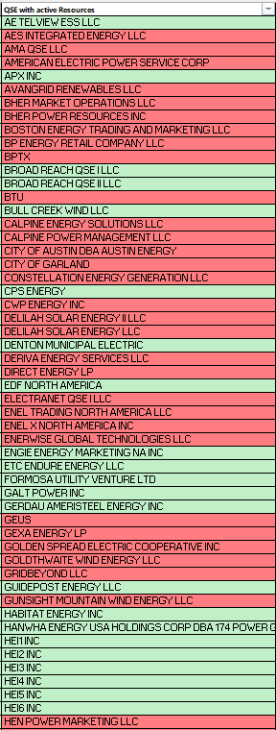
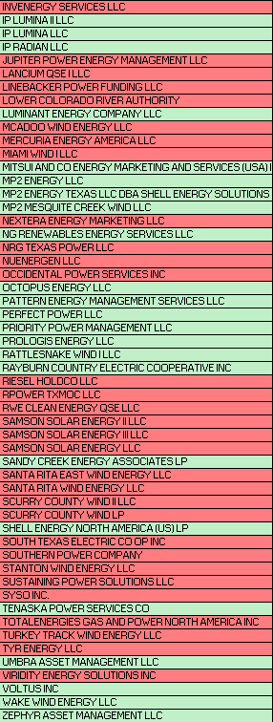

Scorecard for
Hand Book 2
Telemetry checkout:
5/19 Scores for QSEs with Resources – Scheduling Check-out and Check-out complete

Slide 15
Current ERCOT Issues Impacting Trial sequence
Environment:
  Some user access issues reported (data set-up issue in environment). QSE can request assistance for ERCOT to resolve RTCB@ercot.com
Defects:
  Load Resources submitting ECRS in COP
  AS Only Offer Submission response is missing
  COP MaxSOC value with 2 decimal places rejected
  ESR Energy Bid/Offer Curve rejected if last quantity below 1MW
  Next release planned May 28

Slide 16
Wrap-Up and Questions
Remainder of meeting time to take questions each week-
First round of questions specifically about this Market Trial period
Second round of questions for more general RTC+B as time allows
Can always email the RTC+B Program mailbox: RTCB@ercot.com
FAQ is also a resource for questions that other have asked.
Thanks for your support!

