Slide 1
NDSWG Meeting
May 2025

Slide 2
Topics
ONCOR Comments on NPRR 1265 - Unregistered Distributed Generator
SCR 831 – Short Circuit Model Integration
ERCOT Notification Logs
NOMCR Timeline and Inclusion on Outage Coordination Studies
NOMCR Business Change on Additional Action Required Status
CIM 16 Timeline Update
Manual Contingency Review
Data Submission Reminders
Other Topics

Slide 3
Notification Logs in MAGE
Matthew Perez
05/20/2025

Slide 4
Outline
Background
What is a Notification Log?
What is Happening?
How to View?
How to Read?
How to Handle
What to do?
Notes:
Add new graphic to show public power entity.

Slide 5
Background – What is a Notification Log?
A notification log is a log that is generated on a CR (triggering CR) when the CR contains changes to the attributes of an instance that another CR (tagged CR), with a future effective date but was submitted earlier, also makes changes to. This can occur on submission as well as withdrawal.
Definitions for this presentation:
Triggering CR – CR that triggers and will contain the notification log
Tagged CR – CR that is called out in the notification log
Notification Log on Submission
Triggering CR
Submitted 2nd
Tagged CR
Submitted first
Today
Future
Effective Date
Notification Log on Withdrawal
Triggering CR
CR that is Withdrawn
Tagged CR
Today
Future
Effective Date
Notes:
Notification Logs should not be confused with Conflict logs. Notification Logs deal with attribute changes and do not block submission/withdrawal. Conflict logs deal with links and do block submission/withdrawal

Slide 6
What is Happening?
System is providing information that future changes could overwrite the changes you just submitted.
Or
System is providing information that the changes you are withdrawing might continue to persist even though you are withdrawing the changes.
Note: Change logs on tagged CR might be updated to reflect changes caused by the triggering CR.
Notification Log on Submission
Triggering CR
Submitted 2nd
Tagged CR
Submitted first
Today
Future
Effective Date
Notification Log on Withdrawal
Triggering CR
CR that is Withdrawn
Tagged CR
Today
Future
Effective Date

Slide 7
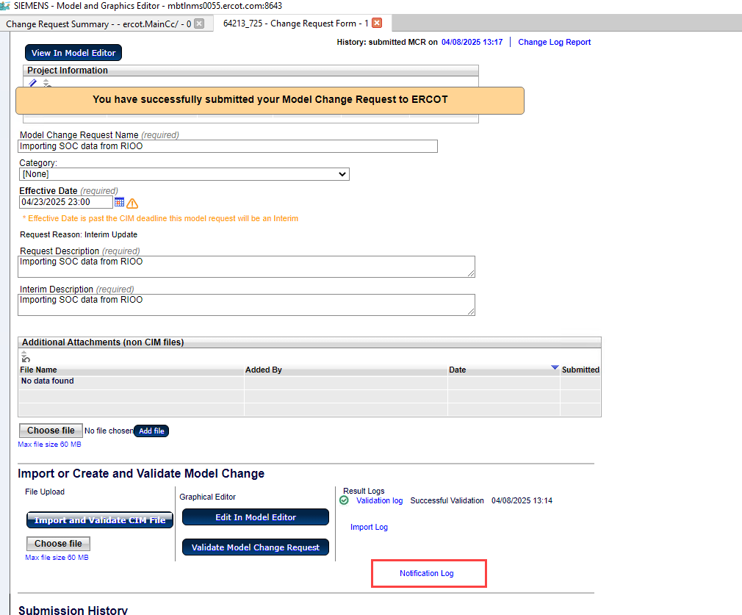
How to View?
Please note that if you exit the CR summary tab you will not see the conflict log when you open the CR again.
Notes:
Note to self it is 1 entry per instance. So only 1 CR per instance.

Slide 8
How to Read?
Tagged CR
Triggering CR
Instance Path
Instance Path
Affected changes in the Triggering CR
Affected changes in the Tagged CR

Slide 9
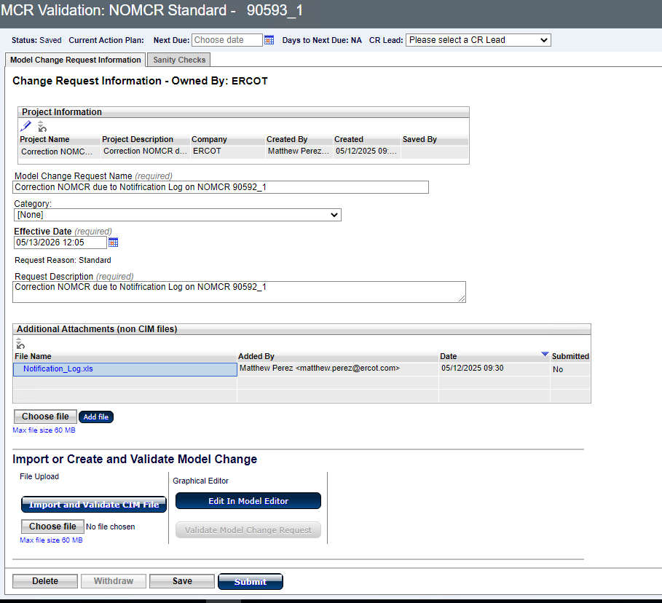
How to Handle on Your Own
You can correct yourself
Create a NOMCR after the Tagged CR to correct the overwrite. Or you can modify the existing NOMCR if within modeling deadlines.
NOMCR should have language in description along the lines of “Correction NOMCR due to Notification Log“
Attach Notification Log to NOMCR

Slide 10
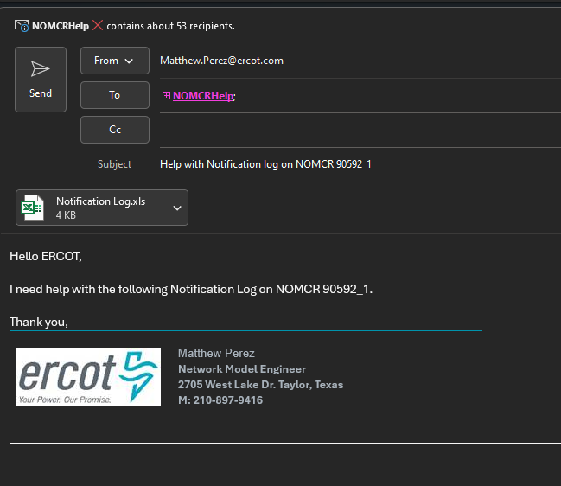
How to Handle if you are not sure what to do
Send an email to NOMCR Help
Include CR number, notification log as attachment, and short message of what you need help with.
Should be used for anything that ERCOT usually makes changes on.
Contingencies enable/disable

Slide 11
Withdrawn Notification Logs
No way for Submitter to know it occurred since CR closes upon withdrawal.
ERCOT currently has a process to catch notification logs but is a day behind of when they occur.
NOMCRHelp Lead will reach out to TSPs when seen as needed.
ERCOT is working with Siemens to make them more prominent, so the log is not missed.
Notes:
Report catches this. Withdrawn Notification Logs have tagged CRs carry the notification log.
Need to mention that if they modify an existing CR then when ERCOT reaches out, they will need to let us know it is taken care of.

Slide 12
Questions?

Slide 13
Topics
ONCOR Comments on NPRR 1265 - Unregistered Distributed Generator
SCR 831 – Short Circuit Model Integration
ERCOT Notification Logs
NOMCR Timeline and Inclusion on Outage Coordination Studies
NOMCR Business Change on Additional Action Required Status
CIM 16 Timeline Update
Manual Contingency Review
Data Submission Reminders
Other Topics

Slide 14
NOMCR Timeline
Timelines – Protocol Requirement for Standard Submissions
3.10.1 - Time Line for Network Operations Model Changes
TSPs and Resource Entities shall submit Network Operations Model updates at least three months prior to the physical equipment change. ERCOT shall update the Network Operations Model according to the following table:
Note: Actual schedule is posted on ERCOT website.
Deadline to Submit Information to ERCOT Prior to: | Model Complete and Available for Test | Updated Network Operations Model Testing Complete | Update Network Operations Model Production Environment | Target Physical Equipment included in Production Model
Jan 1 | Feb 15 | March 15 | April 1 | Month of April
Feb 1 | March 15 | April 15 | May 1 | Month of May
March 1 | April 15 | May 15 | June 1 | Month of June
April 1 | May 15 | June 15 | July 1 | Month of July
May 1 | June 15 | July 15 | August 1 | Month of August
June 1 | July 15 | August 15 | September 1 | Month of September
July 1 | August 15 | September 15 | October 1 | Month of October
August 1 | September 15 | October 15 | November 1 | Month of November
September 1 | October 15 | November 15 | December 1 | Month of December
October 1 | November 15 | December 15 | January 1 | Month of January (the next year)
November 1 | December 15 | January 15 | February 1 | Month of February (the next year)
December 1 | January 15 | February 15 | March 1 | Month of March (the next year)

Slide 15
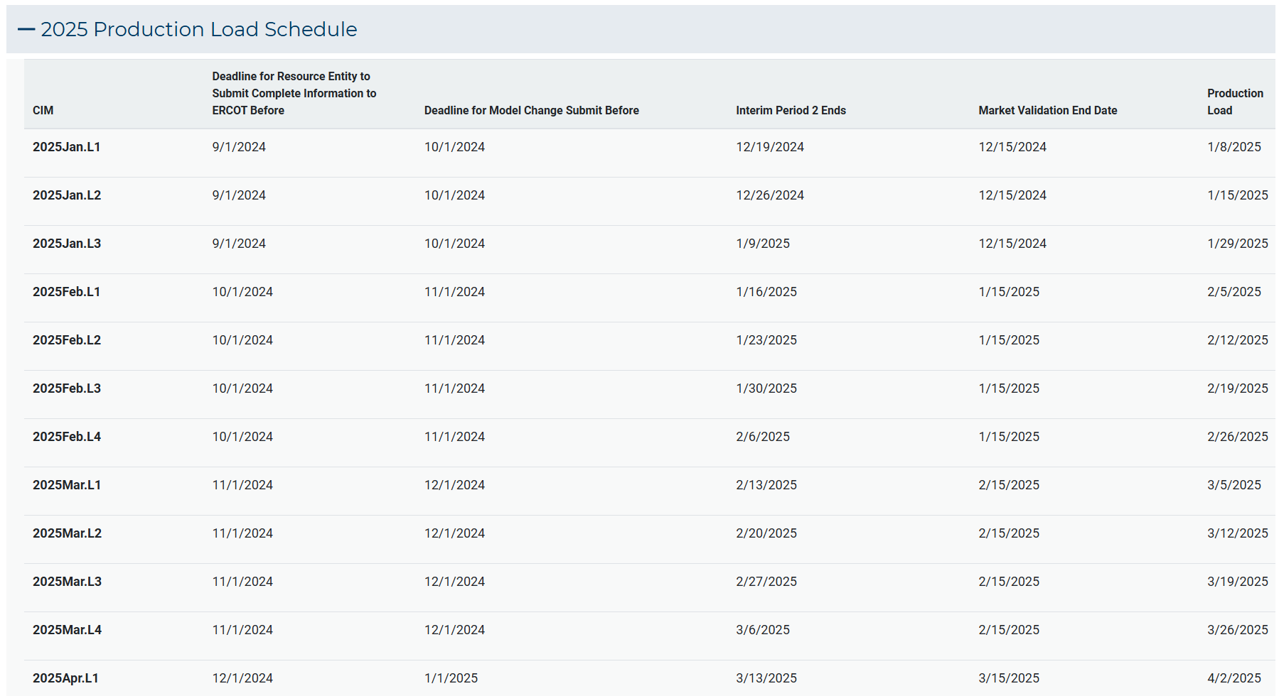
NOMCR Timeline
Notes:
NMG-Network Modeling Group MP-Market Participant’s
At the end of the validation period by the MPs the model is finalized. This is indicated by interim period 2.

Slide 16
NOMCR Timeline
Standard Model Change Submission
Initial Validation
(NMG)
Initial Validation
(MPs)
Final Validation
(Network Modeling & EMS Prod)
CIM 0 NOMCR Processing
Model for Week 1
Model for Week 1
CIM_0_ML1
Prod
Model for Week 2
Model for Week 2
CIM_0_ML2
Prod
Model for Week 3
Model for Week 3
CIM_0_ML3
Prod
Model for Week 4
Model for Week 4
CIM_0_ML4
Prod
-75
-45
-15
ML1
ML2
ML3
ML4
-90
-60
-30
Interim Period 2
0
Weekly DB loads for Cim 0
30
All Model Changes for CIM 0 due Prior to minus 90 days
CIM 0 Model Changes
Notes:
NMG-Network Modeling Group MP-Market Participant’s
At the end of the validation period by the MPs the model is finalized. This is indicated by interim period 2.

Slide 17
NOMCR Timeline for Outage Coordination Studies
Model Building Timeline
Interim Period 2 for CIM_0_ML1
CIM_60_ML1
CIM_0_ML1
CIM_90_ML1
Interim Update Model submission
~ 2 - 3 weeks before CIM_0_ML1 date
Notes:
Interim Period 2 is the last chance to make changes to the model. This period is usually 2~3 weeks before the model will go into production. The ML1 model is used to build the 60day and 90day models.

Slide 18
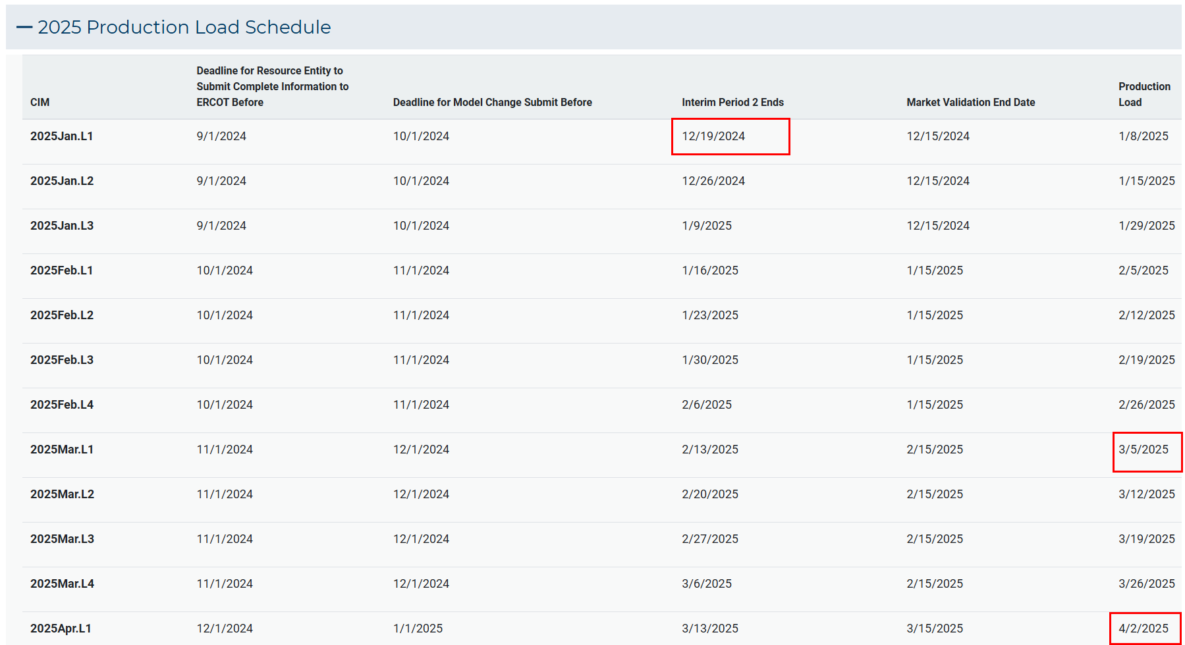
NOMCR Timeline for Outage Coordination Studies
Notes:
Interim Period 2 is the last chance to make changes to the model. This period is usually 2~3 weeks before the model will go into production. The ML1 model is used to build the 60day and 90day models.

Slide 19
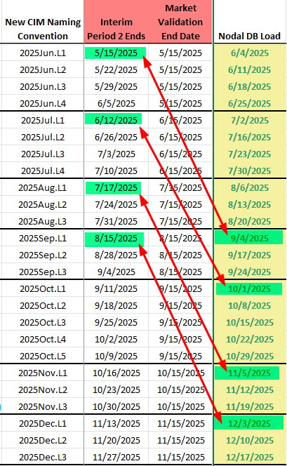
NOMCR Timeline for Outage Coordination Studies
90 Day Timeline
Notes:
Interim Period 2 is the last chance to make changes to the model. This period is usually 2~3 weeks before the model will go into production. The ML1 model is used to build the 60day and 90day models.

Slide 20
Topics
ONCOR Comments on NPRR 1265 - Unregistered Distributed Generator
SCR 831 – Short Circuit Model Integration
ERCOT Notification Logs
NOMCR Timeline and Inclusion on Outage Coordination Studies
NOMCR Business Change on Additional Action Required Status
CIM 16 Timeline Update
Manual Contingency Review
Data Submission Reminders
Other Topics

Slide 21
Additional Action Required (AAR)
New business rule to be implemented from June 1 2025 to relieve the last-minute submissions
TSP has 3 days to respond to an AAR status on a NOMCR or CAMR after which it may be subject to rejection
Further dialogue can happen based on the response received which will be subject to a 3-day response limit
Contingency group and modeling group should be in communication with each other to make this a smooth process
No changes accepted after Interim Period 2 deadline

Slide 22
Topics
ONCOR Comments on NPRR 1265 - Unregistered Distributed Generator
SCR 831 – Short Circuit Model Integration
ERCOT Notification Logs
NOMCR Timeline and Inclusion on Outage Coordination Studies
NOMCR Business Change on Additional Action Required Status
CIM 16 Timeline Update
Manual Contingency Review
Data Submission Reminders
Other Topics

Slide 23
CIM16 Project Overview
ERCOT’s CIM16 project enables the MAGE application to natively create CIM16-formatted models
How does this affect Market Participants?
All Market Participants
Posted models will transition from CIM10 to CIM16
No CIM10 models will be created after go-live
TSPs
Modeling methodologies within MAGE application will reflect CIM16 changes
Posted incremental files will transition to CIM16
Incremental files imported into MAGE must follow the CIM16 schema

Slide 24
CIM16 Key Events
Q3/Q4 2025
Market notice about impending workshop
Workshop to discuss project details and review CIM16 model posting schedule
Q4 2026
Update MAGE Test Environment (MOTE) to CIM16 schema
MAGE training for TSPs on CIM16 and SCR813
Q2 2027
Weekend database migration to CIM16
Go-Live

Slide 25
Topics
ONCOR Comments on NPRR 1265 - Unregistered Distributed Generator
SCR 831 – Short Circuit Model Integration
ERCOT Notification Logs
NOMCR Timeline and Inclusion on Outage Coordination Studies
NOMCR Business Change on Additional Action Required Status
CIM 16 Timeline Update
Manual Contingency Review – email to be sent on the first week of June
Data Submission Reminders
Other Topics

Slide 26
Topics
ONCOR Comments on NPRR 1265 - Unregistered Distributed Generator
SCR 831 – Short Circuit Model Integration
ERCOT Notification Logs
NOMCR Timeline and Inclusion on Outage Coordination Studies
NOMCR Business Change on Additional Action Required Status
CIM 16 Timeline Update
Manual Contingency Review
Data Submission Reminders
Other Topics

Slide 27
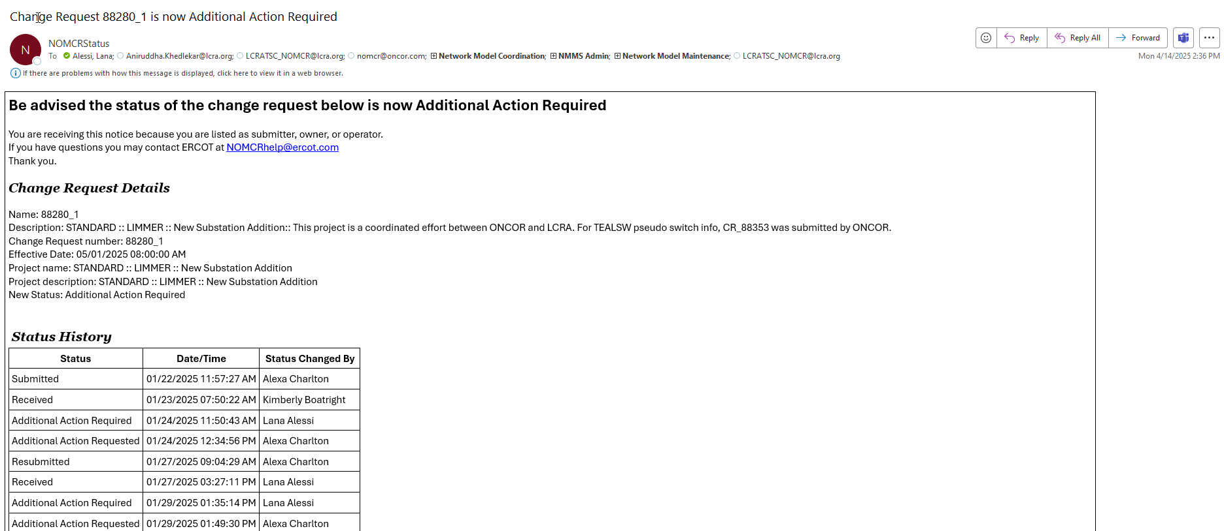
Additional Action Required Status Reminder
NOMCRStatus automatic email notification
NOMCR has a question to answer or needs to be resubmitted with update data

Slide 28
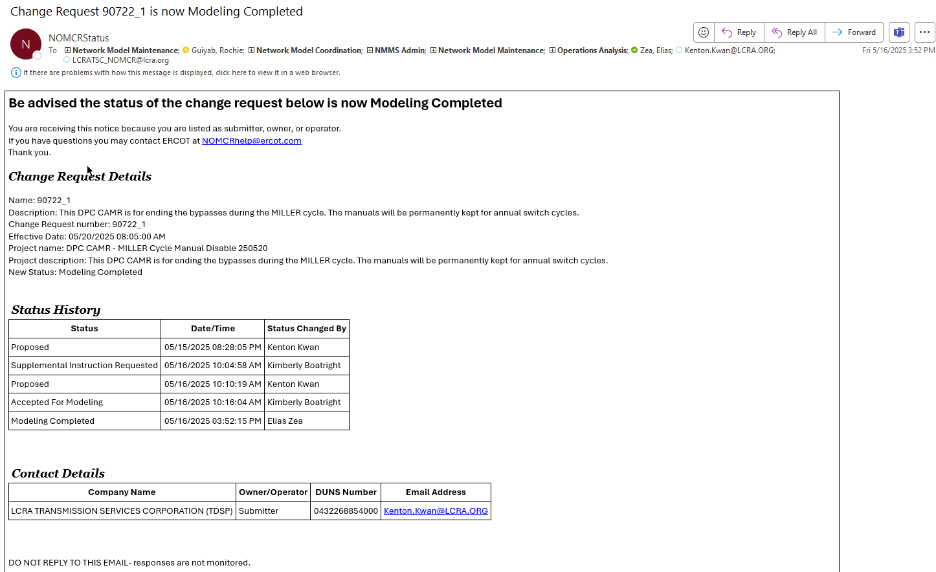
Contingency DPC CAMR Reminder
NOMCRStatus automatic email notification
CAMR is ready to be submitted

Slide 29
Topics
ONCOR Comments on NPRR 1265 - Unregistered Distributed Generator
SCR 831 – Short Circuit Model Integration
ERCOT Notification Logs
NOMCR Timeline and Inclusion on Outage Coordination Studies
NOMCR Business Change on Additional Action Required Status
CIM 16 Timeline Update
Manual Contingency Review
Data Submission Reminders
Other Topics

Slide 30
NPRR 1234 Load End Use Classification Categories (draft)
Draft : Load End-Use Classification Categories.
Cryptocurrency Mining
Data Centers (non-crypto)
Government and Medical
Hydrogen and Electrofuel Production
Oil and Chemical Refining
Oil and Gas Production, Processing, and Transmission
Steel and Aluminum Manufacturing
Transportation
Other Industrial

Slide 31
Non-DPC Change Request Submissions

Slide 32
Non-DPC Interim Change Requests

Slide 33
Other Topics
Open Discussion…

