Slide 1
CRR Updates
CMWG
May 19, 2025

Slide 2
Agenda
LTAS transactions and solution times
CRR auction limits table

Slide 3
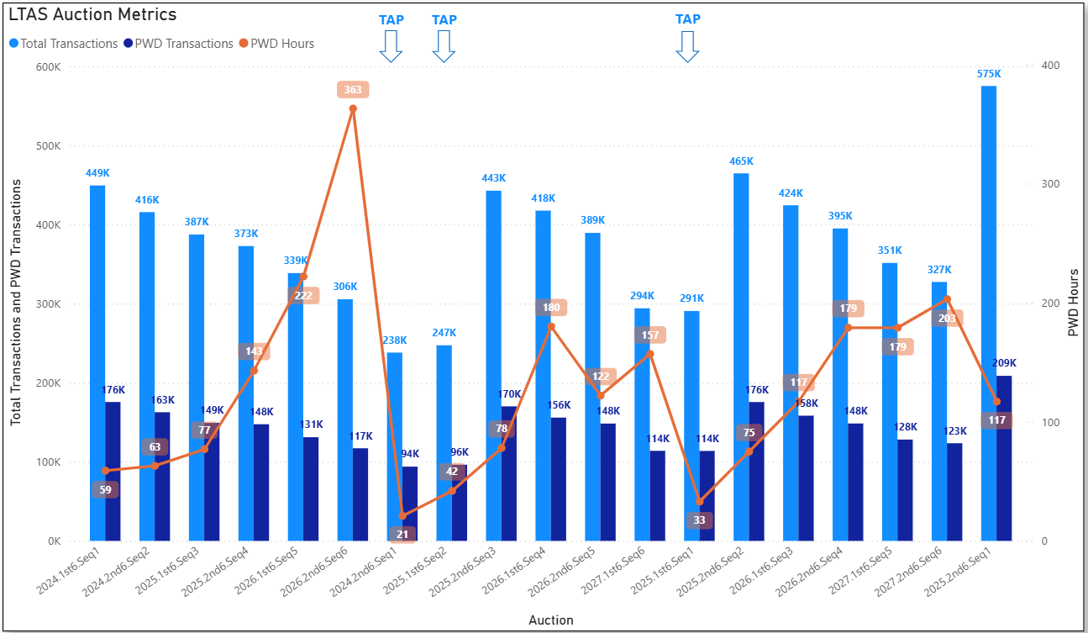
Historical LTAS transactions and solution times

Slide 4
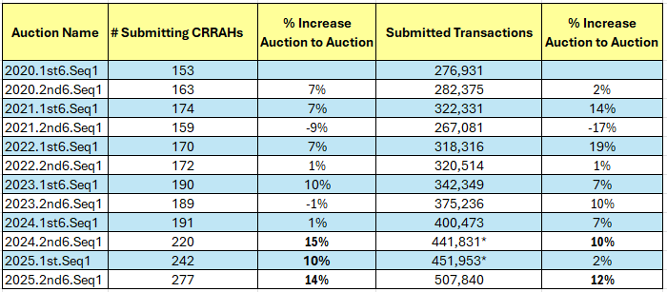
Increasing Submitting CRRAHs and Transactions
*Initial bid window transactions from Transaction Adjustment Periods

Slide 5
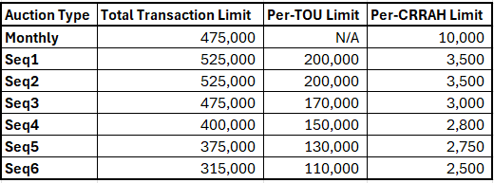
CRR auction limits
NPRR1261 Operational Flexibility for CRR auction limits was approved by the PUCT on March 13.
https://www.ercot.com/mktrules/issues/NPRR1261
The 2025.2nd6.AnnualAuction.Seq1 was the first LTAS to use the transaction limit table below.
In order to reduce the risk of Transaction Adjustment Periods occurring in the future, LTAS Per-CRRAH Limits will likely need to be reduced further due to continuing large increases in submitted transactions and submitting CRRAHs.

