Slide 1
Day-Ahead Market PTP and PTPLO Submission Activity, Update
May 19, 2025
Curry Holden
Day-Ahead Market Supervisor

Slide 2
Review
High volumes of PTP and PTPLO interval records submissions are linked to increased optimization engine execution times.
PTP submission volumes continue to grow, with no clear market-wide upper limit obvious.
Some form of submission fee for PTP submissions (excluding PTPLOs) has been proposed by ERCOT.
Resource nodes currently added as a part of NPRR1188: 25

Slide 3
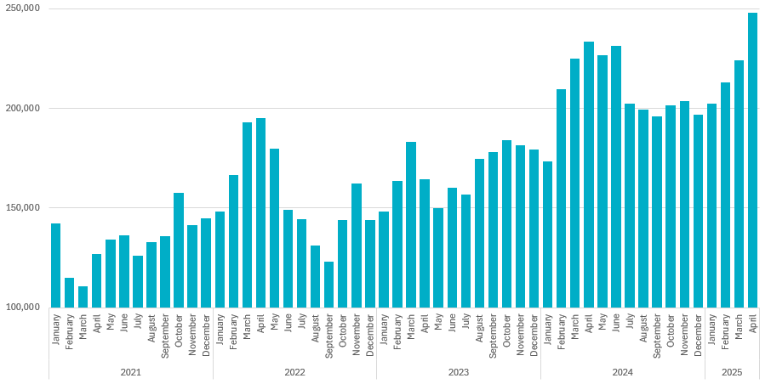
PTP Activity Since January 2021
Submission Activity has grown during the study period 2021-present
Average Daily PTP Submissions Per CP: 2021-2025

Slide 4
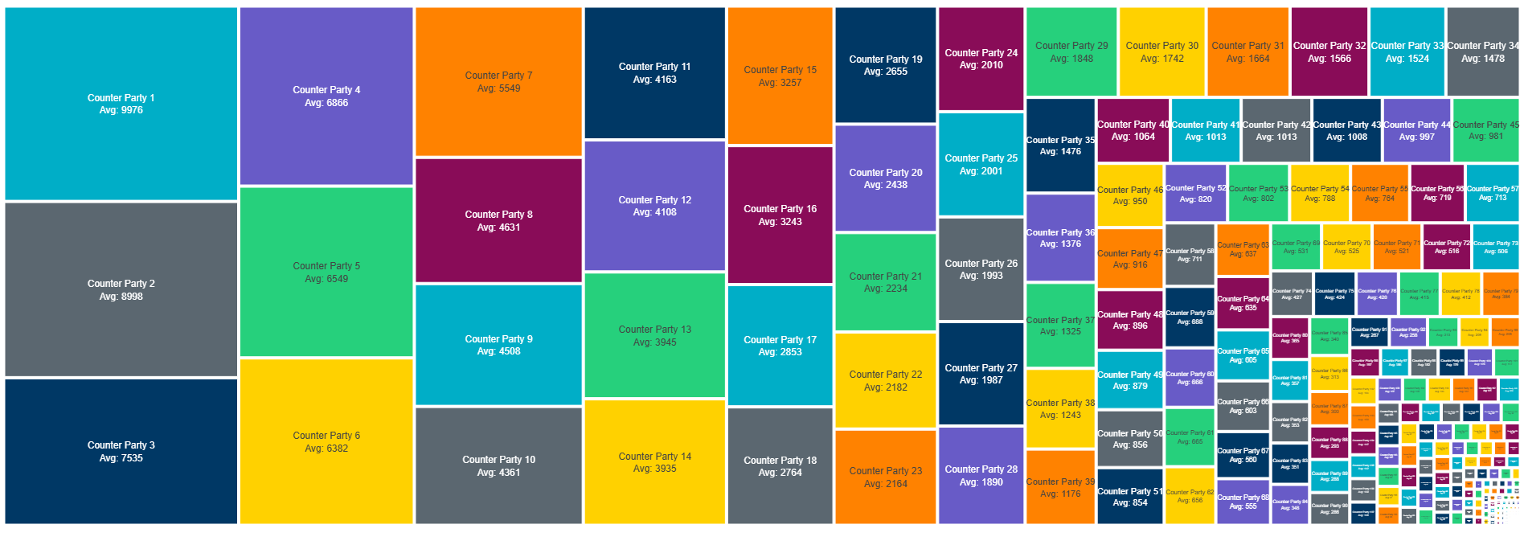
Submission Activity Per Counter Party
The majority of PTP submissions are received by a small minority of market participants (CPs).
Average Daily PTP Submissions Per CP: 2021-2025

Slide 5
Next Steps
ERCOT is continuing to study the influence of different input variables on execution time.
Any questions or concerns?

Slide 6
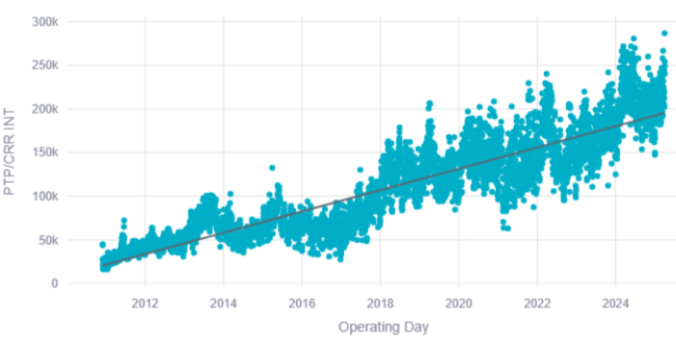
Appendix Slide 1; graph from 4/14/25 CMWG
OD vs PTP/CRR interval count 2010-2025

Slide 7
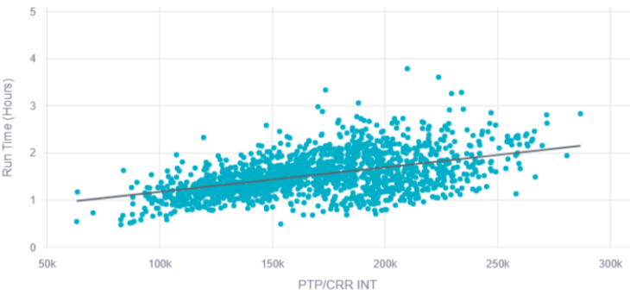
Appendix Slide 2; graph from 4/14/25 CMWG
Execution time vs PTP/CRR interval count 2021-2025

