Slide 1
Introduction to Probabilistic Framework for Computing ECRS & Non-Spin Requirement
ERCOT Staff
ERCOT Operations Analysis
Probabilistic Workshop # 1
May 19, 2025

Slide 2
Background and Introduction
Purpose of today’s workshop is to introduce the probabilistic framework ERCOT is considering to use to compute ERCOT Contingency Reserve Service (ECRS) and Non-Spinning Reserve Service (Non-Spin) requirements in 2026.
This probabilistic approach builds on the discussions that were conducted last year during PUC’s AS Study effort.
Agenda for Today
  Recap the PUC’s AS Study and their findings as they apply to AS Methodology
    Recap of some open questions specific to the probabilistic method that were called out in the study
  Introduce the probabilistic framework
    Inputs, data conditioning, Criteria to determine reserves, the optimization engine and reserve determination approach.
  Summary and What to expect at the next round of meetings.
ERCOT requests stakeholders to provide feedback on these topics. ERCOT will work to take these into account as we build the tool further.

Slide 3
PUC’s Ancillary Service Study: Summary
The Public Utility Commission of Texas (PUCT) initiated the Ancillary Services Study (Study) to meet the requirements of PURA § 35.004(g) (enacted in Senate Bill 3 (87 R.S.)).
The PUCT collaborated with ERCOT and the Independent Market Monitor (IMM) on this effort.
ERCOT was asked to review the existing Ancillary Service products, including an analysis of the purpose for each of the products and a more thorough review of the methodologies used to determine Ancillary Service quantities. ERCOT was also asked to evaluate if any additional Ancillary Service products are needed.
ERCOT produced a white paper that responds to those requests
PUCT used inputs from stakeholders, ERCOT, IMM and PUC Commissioners. PUC filed its findings and final report on January 14, 2025.
The PUCT has also included it in their biennial agency report to the Texas State Legislature in January 2025.
PUC’s Findings are summarized in slides # to #

Slide 4
PUC’s Findings Related To AS Methodology
Topic | Finding | Next Steps
PROVIDING ADEQUATE INCENTIVES FOR DISPATCHABLE GENERATION | The reliability standard rule (16 TAC § 25.508) has defined a process for assessing and ensuring resource adequacy. | The first holistic reliability standard assessment in 2026 will include an assessment of whether incentives are adequate to support a sustainable level of dispatchable generation, and ERCOT should incorporate the impact of new market features such as Texas Energy Fund, DRRS, and real-time co-optimization plus batteries (RTC+B) into this assessment.
APPROPRIATE CRITERION FOR AS PROCUREMENT QUANTITIES | ERCOT's current posture of maintaining AS quantities that minimize the chance of Entering the pre-emergency operational condition of an Operational Watch should be maintained in order to balance system improvements made since Winter Storm Uri until additional data is available to support further Commission evaluation of this operating posture. | ERCOT should develop the capability to provide current estimates of costs and probabilities of experiencing a Watch, Emergency Alert, and Load Shed for several potential alternative target reserve levels as soon as practicable and no later than to support the Commission setting an objective, data-based procurement criteria for the 2027 AS Methodology.
PROBABALISTIC MODELING TO DETERMINE AS QUANTITIES | ERCOT's current practice to determine AS quantities relies on a statistical analysis using historical operating conditions and outcomes. This methodology is no longer sufficient as myriad changes to the wholesale markets and operating conditions continue to impact reasonable forecasting needs. Changes such as incorporation of an unknown amount of TEF-supported capacity, how new large loads are integrated into grid operations, or the impact of new market designs present uncertainty for forecasting tools based exclusively on historical data. | ERCOT should develop a suitable probabilistic, forward-looking modeling capability, provide regular updates to TAC, and present options that can be incorporated no later than the 2027 AS Methodology.
DYNAMIC DETERMINATION OF AS QUANTITIES | Tradeoffs exist between the certainty provided to market participants by calculating AS quantities primarily on an annual basis (as is done currently) and the efficiency of calculating some portion of AS quantities closer to the operating day. | ERCOT should work with stakeholders to explore a dynamic AS methodology that best Balances these trade-offs.

Slide 5
AS Methodology Evolution Road Map
Market
Current Market
?
RTC+B
Tool/ Methodology Development
“Annual” Full Statistical Analysis Tool Dev
Current Approach
“Closer to Op Day” Dynamic AS Quantity Determination Tool Dev
Policy
Determination
Policy/Criteria Development
for “Annual”
Policy/Criteria
Development
for “Closer to Op Day”
AS Methodology
Approval
Approval
Approval
Approval
Quantification Approach Used
for Year
Statistical Annual AS
Statistical Annual AS
Full Statistical Annual AS
Updated Full Statistical Annual AS
“Closer to Op Day” AS Adjustment
2026
Q2
Q3
Q4
Q2
Q3
Q4
Q3
Q4
2025
Q2
Q3
Q4
2027
Shared with Market
You are Here

Slide 6
Recap: Full Statistical Analysis OPEN Questions
How should the available headroom/capacity that is not providing AS be accounted in this analysis? | For example, weather forecast errors typically cause corresponding errors in load, wind, and solar forecasts, but are generator trips correlated to forecast errors, also? Further, should historic headroom capacity be accounted for in this analysis? If so, is the historic headroom capacity of the online generation fleet correlated to other factors?
How should increases in variability and uncertainty due to wind, solar, and load growth, as well as future changes in generator commitment patterns be accounted for in the methodology? | Historically, as the Intermittent Renewable Resource (IRR) fleet’s installed capacity has increased, both variability and uncertainty in net load have increased, and relying on historic error alone may not sufficient.
What event/criteria should each AS be setup to cover? | Is the criteria simply a matter of avoiding loss of load? Or should there be criteria related to avoid entering into an Energy Emergency Alert (EEA) or a Watch due to insufficient reserves? How should avoiding the need for manual operator actions be included in the criteria?
How should temporal constraints and cumulative factors be accounted? | The possibility of multiple generator trips across multiple hours (as occurred on May 13, 2022, for example) presents a risk that needs to be covered by AS. (Cumulative forced outages) AS is needed until other generators can be started or until the conditions causing the need for the reserves from AS change. How should this be considered in the analysis? (Event duration/temporal constraints) Increasingly, AS is being provided by duration-limited resources (battery energy storage). There is some risk that battery energy storage resources providing AS deplete their storage capacity during a multi-hour forecast error event, even if they are meeting all applicable requirements. Should not being able to charge be accounted as a risk in this analysis? (lack of energy considerations)
How much can other types of AS reserves be counted on to address risks for a given AS product? | For example, should some or all of ECRS be counted towards meeting the reserve needs covered by Non-Spin?
Key Takeaway: ERCOT is generally supportive of doing a “full statistical” probabilistic analysis to determine AS quantities. Several key questions that have to be carefully considered to setup the appropriate model for this analysis. Responses to these questions directly impact the volume of reserves procured and operational actions needed to continue operations. As an example, setting reserves too low could result in lower self commitment and tools like Unit Commitment may be necessary to cover the overall expected operational risk on such days. For proper balance Stakeholder and potentially policymaker input on these is essential.

Slide 7
Probabilistic Framework

Slide 8
Flow Diagram

Slide 9
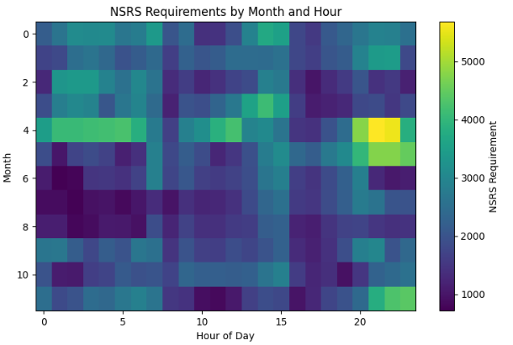
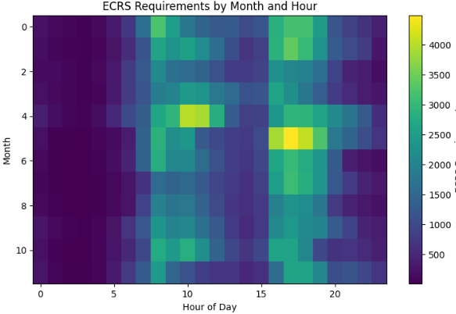
Optimization Workflow
Iterative process - Least Reserves for Target Reliability
If Current Reliability meets Target
Reserve Requirements
Analyze violations and Reliability Check
  Using the current reserve values, the process identifies the hours with the highest number of violations.
  If these reserve levels fail to meet the criteria, the process proceeds to the reserve adjustment phase.
If Current Reliability does not meet Target Reliability
  To initiate the optimization process, set initial reserve values which are allocated to cover the identified net risk
Initial Reserve
  If reliability falls short of the criteria, reserves are proportionally increased during the hours with the highest violation rates.
  If reliability exceeds the criteria, the required reserve values are proportionally reduced.
Get New Violations and do Another round of reliability Check with adjusted reserves
Reserve Adjustment

Slide 10
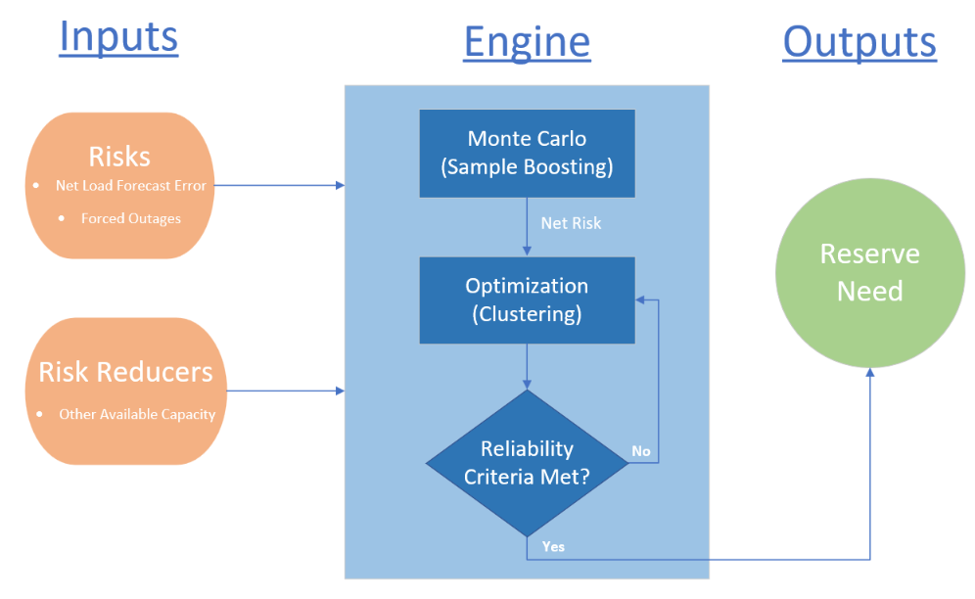
Engine Discussion

Slide 11
Monte Carlo
Sample Boosting

Slide 12
Sample Size for Analysis
Concern:
  Utilizing 3 years of data as an example. Each hour for a month over the period would only give us 90 data points for that hour. This sometimes can lead to sharp changes in AS quantities between hours.
Potential solutions
  Boost the data
  Utilize adjacent hours and or months

Slide 13
Monte Carlo Resampling
  Monte Carlo Resampling is a statistical technique for estimating distribution of a statistic (e.g. mean)
  It resamples from original data with replacement and statistic is calculated using the resample
  Distribution of the statistic is formed by the calculated statistics from the resamples
  forms distribution of avg

Slide 14
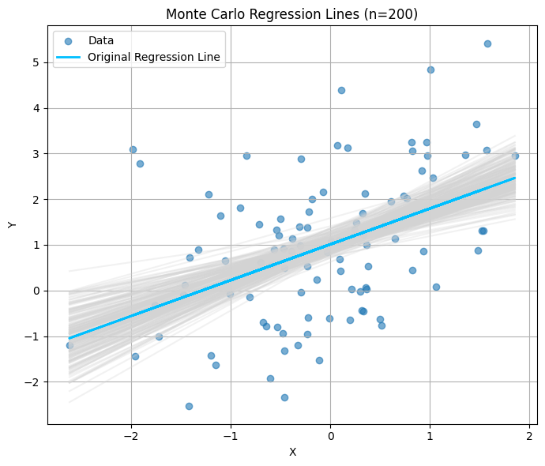
Monte Carlo Resampling (cont'd...)
another example
  A single dataset (scatter) with a best-fit regression line (in blue).
  Each gray line is a regression line created from a resampled data
  The spread of the gray lines illustrates how the best fit line can vary

Slide 15
Monte Carlo Resampling for Data Boosting
  The resamples (before calculating the stats) can be used to “boost” the parent sample
  However, it will not eliminate the choppiness and repetitive problem as same data points will show up in the boosted distribution
  To handle this, the original algorithm was slightly modified
    For the parent sample, z-scores were calculated using mean and standard deviation
    From each resample, mean and standard deviation (std) were calculated
    Using z-scores from the parent sample and mean and std from resample, new data points were synthesized
  The technique was tested for different kinds of distributions

Slide 16
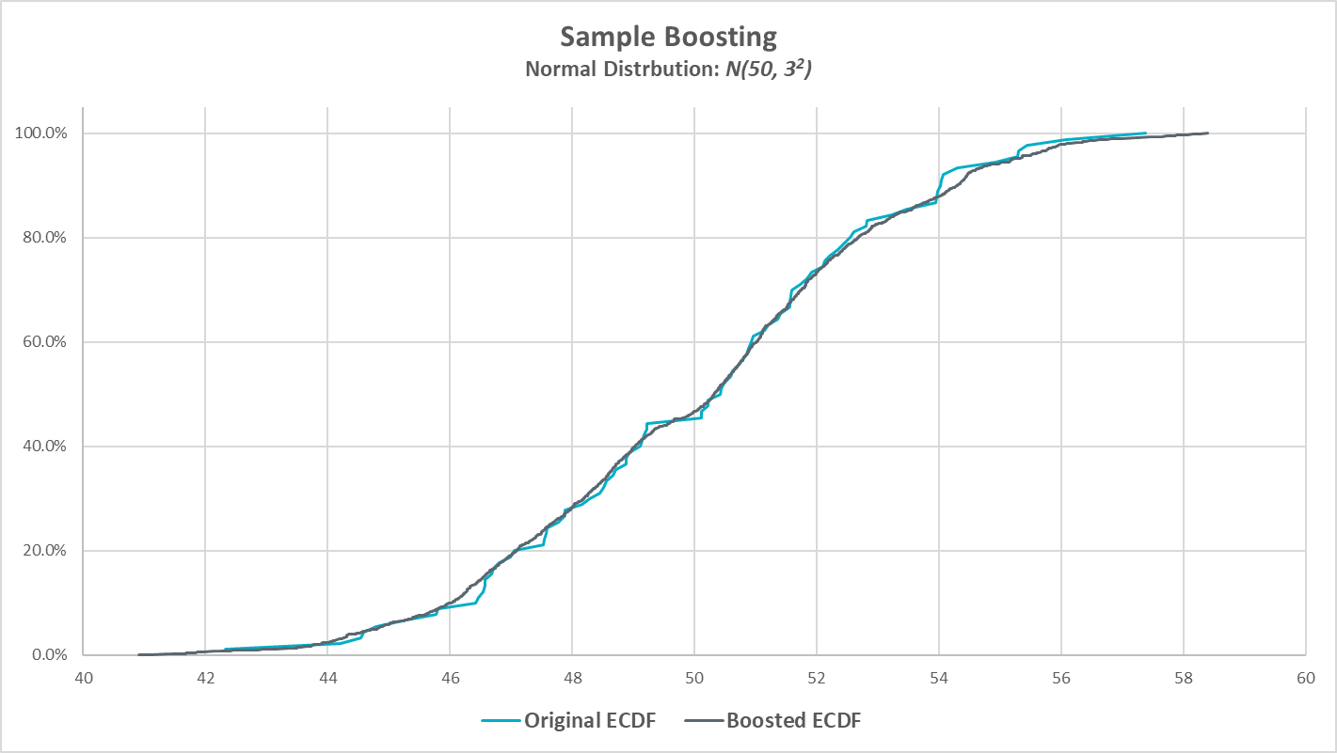
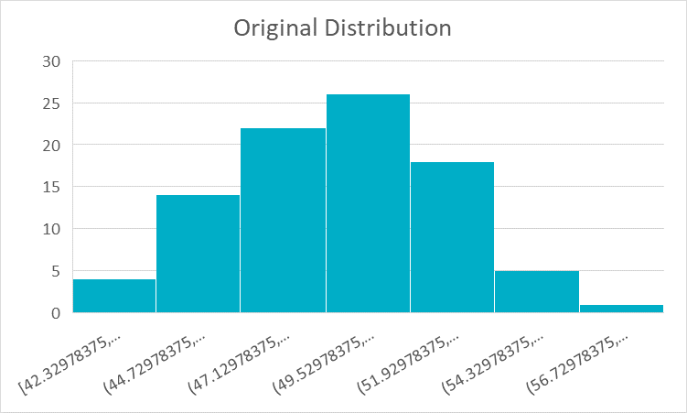
Data Boosting (cont’d…)

Slide 17
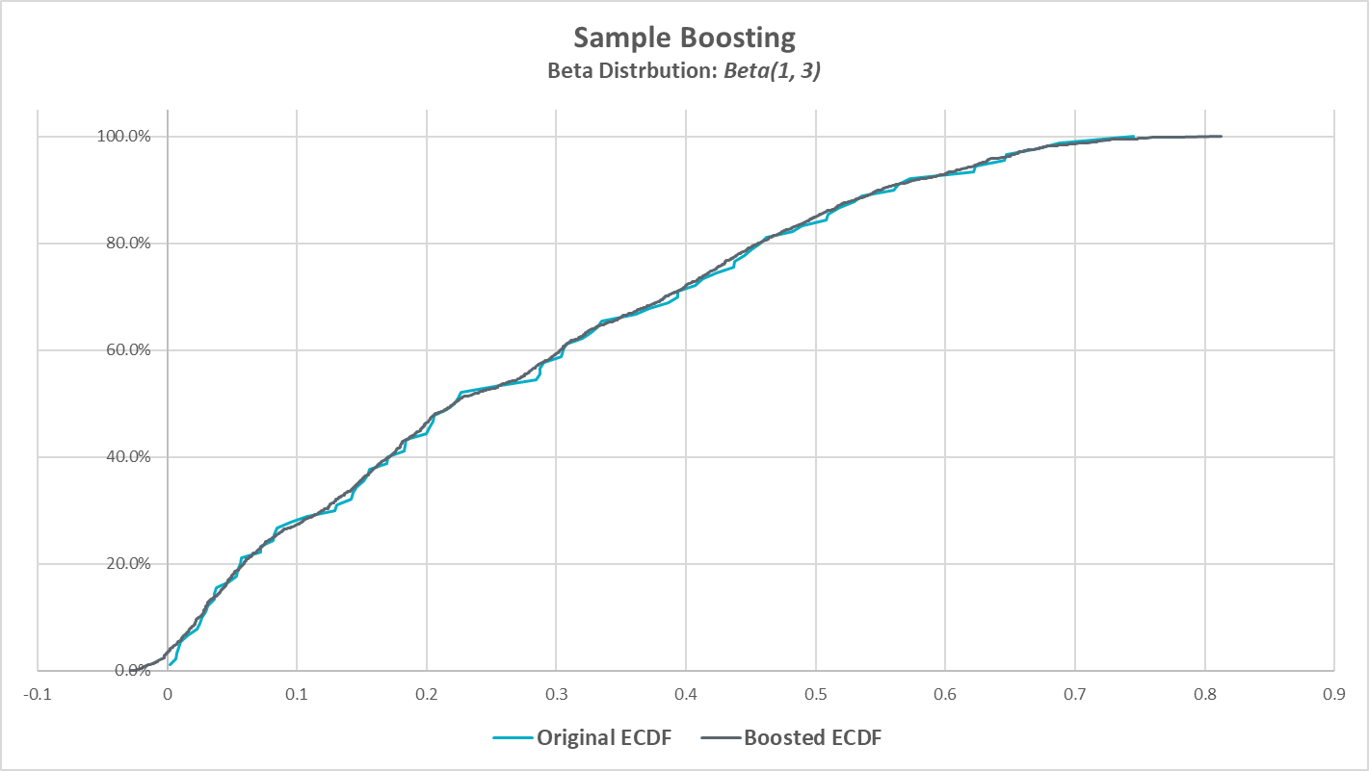
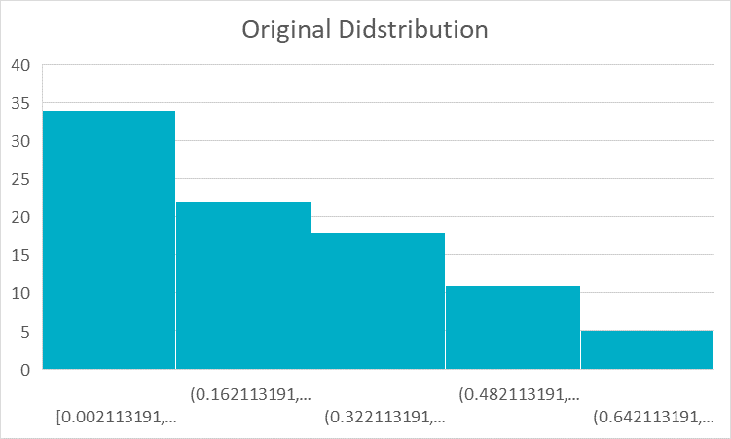
Data Boosting (cont’d…)

Slide 18
Optimization
Adjacent Hours and Clustering Methods

Slide 19
Adjacent Hours

Slide 20
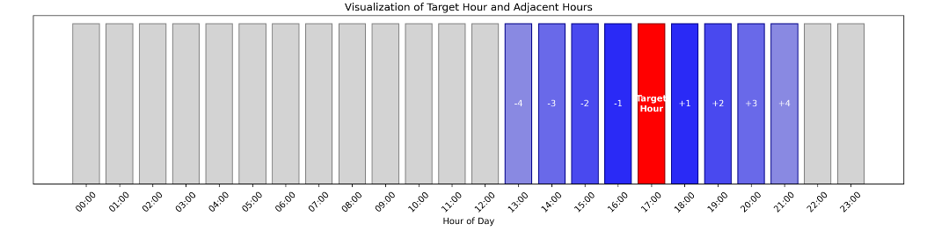
Using Adjacent hours in Optimization
  Analysis shows error correlation between adjacent hours for both 30-minute and 6-hour forecasts, diminishing with increased time distance from the target hour.
  Including adjacent hours in our analysis increases the sample size for Monte Carlo simulation, improving statistical reliability.
    In the Optimization, adjacent hours are weighted based on proximity to target hours - closer hours have greater influence, creating a distance-weighted sampling approach.
  This methodology produces smoother transitions between hourly requirements, avoiding abrupt changes that could create operational inefficiencies.

Slide 21
Clustering

Slide 22
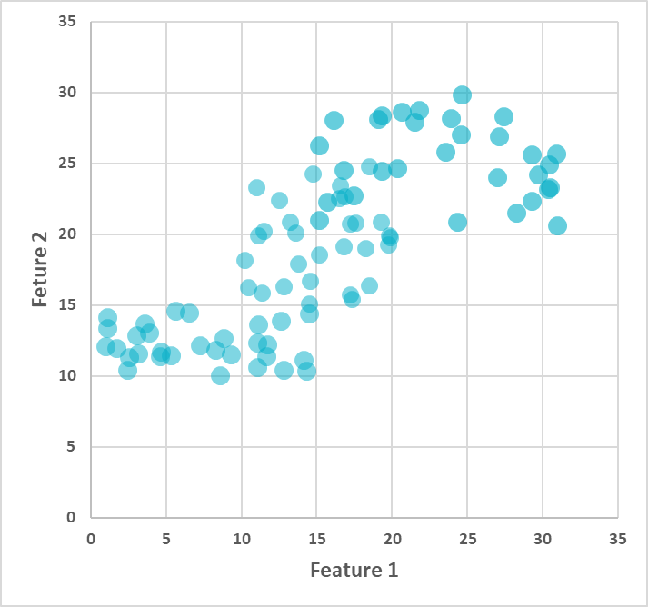
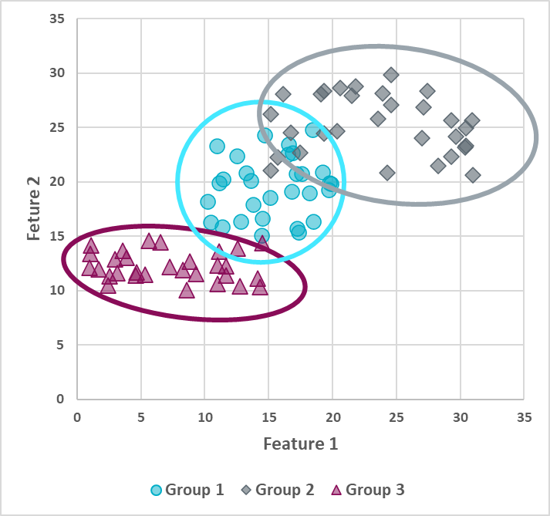
Clustering
Clustering is a method of grouping similar data points together based on their features - without using labels.
We have data, but no labels to begin with
Uses inherent characteristics/features to label that data and form different groups
Clustering can help identify different hours with similar characteristics to improve the sampling and additionally set AS quantities in those same hours.
288 reserve quantities vs k clustered quantities.

Slide 23
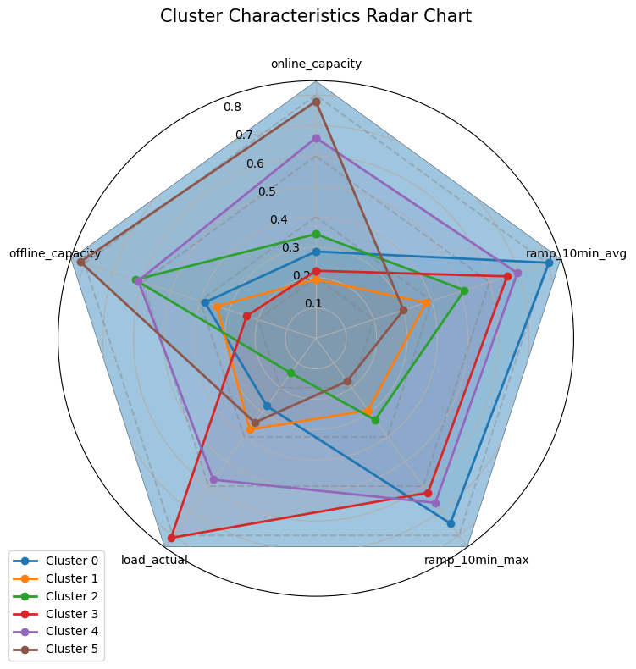
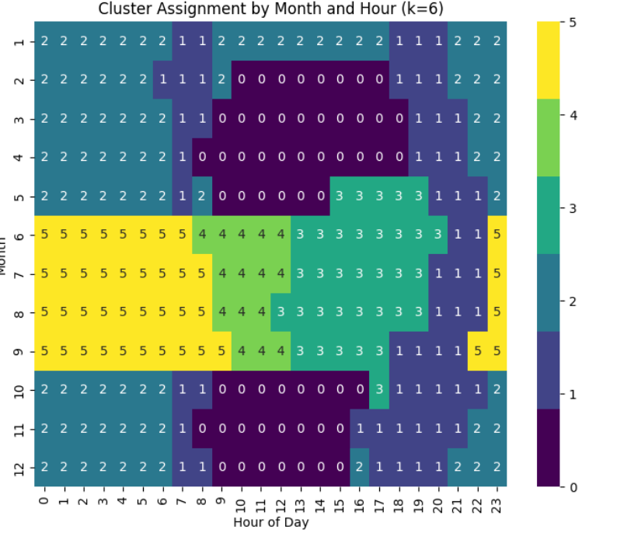
Cluster Characteristics and Features
Clusters can be built utilizing a varying amount of features (additional capacity, load, 10 minute ramping, etc)
In this example we can see weighted distribution of 5 features which then identifies 6 clusters.
Clustering groups non-adjacent hours with similar risk profiles
    Each cluster corresponds to a distinct reserve value

Slide 24
Inputs to Engine

Slide 25
Inputs
Risk
  Net Load Forecast Errors (NLFE)
    30 Minute Ahead for ECRS
    6 Hour Ahead for NSRS
    Capacity Growth for Wind, Solar, and Load
  Forced Outages
Risk Reducers
  Online Available Capacity
  Offline Available Capacity
  Other

Slide 26
Wind, Solar, and Load Capacity Growth

Slide 27
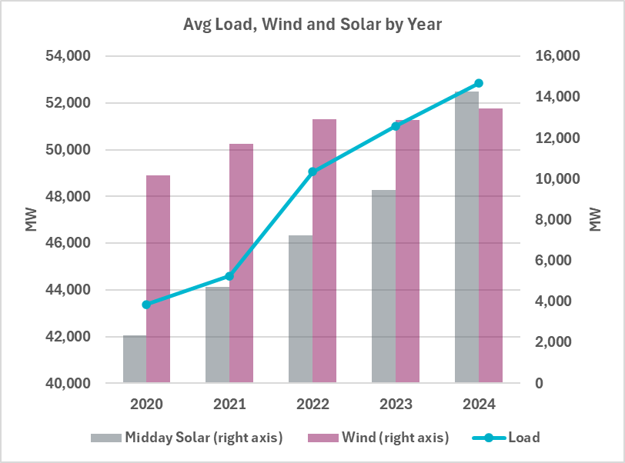
Impact of Load and Renewable Growth on Forecast Error Trends
Installed capacity for solar and wind is increasing over time.
Electric load is also growing consistently.
Intuition: As the base value (capacity or load) increases, so might the forecast error
Key Question:
Does the growth in load or renewables affect the magnitude of forecast errors?

Slide 28
Impact of Load and Renewable Growth on Forecast Error Trends (cont’d)
Monthly forecast errors over multiple years were analyzed.
Monthly forecast errors were summarized as standard deviation (SD), mean absolute error (MAE).
Monthly summaries were modeled as linear function of time (year).
From the model, we extracted
    R-squared – to assess model fit
    p-value of the year variable – to evaluate the strength of trend
The goal is to determine whether there is a meaningful trend in forecast error over time.

Slide 29
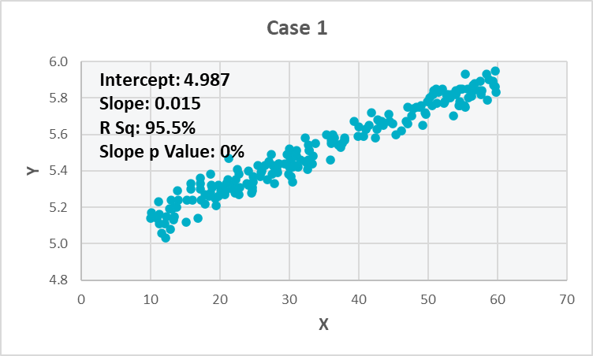
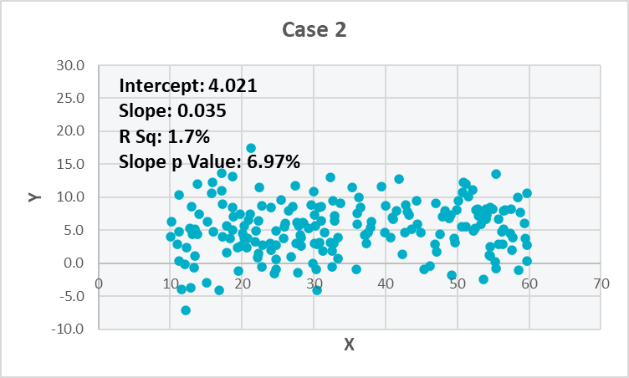
Trend Assessment Tools (R², p-value)
R² measures goodness of fit – higher is better
p-value of the slope tests if the predictor has a statistically significant effect on the outcome – lower means more statistical power
high R² + low p-value is desired – indicates strong, reliable model

Slide 30
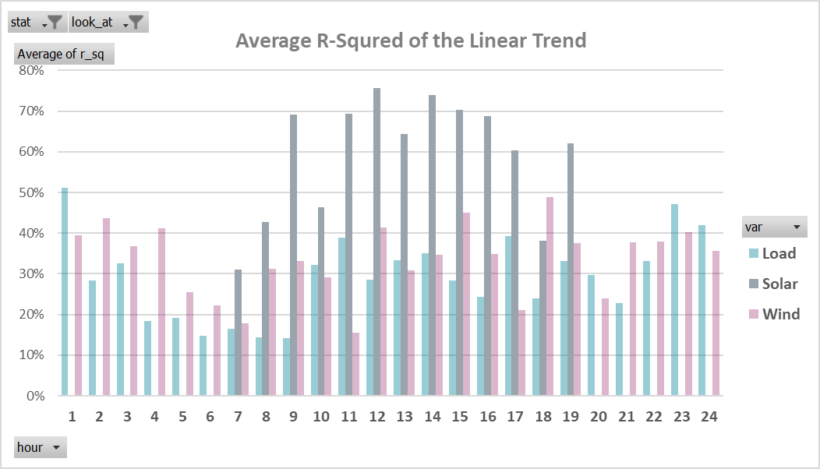
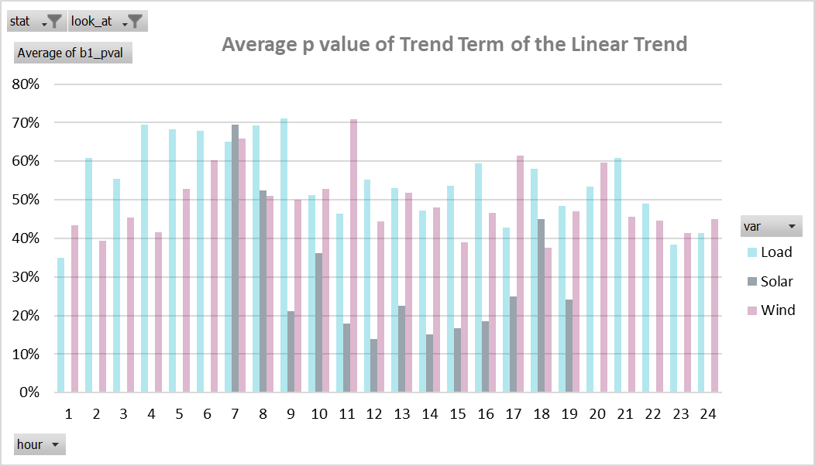
Impact of Load and Renewable Growth on Forecast Error Trends (cont’d)
Solar forecast errors show stronger trends, with high R² (~70%) and low p-values (<20%) during sunlight hours.
Load and wind errors show weak or inconsistent trends, with R² < 40% and p-values between 40 -70%
Adjustment was applied only to solar forecasts, based on statistical significance; no adjustment made for load or wind

Slide 31
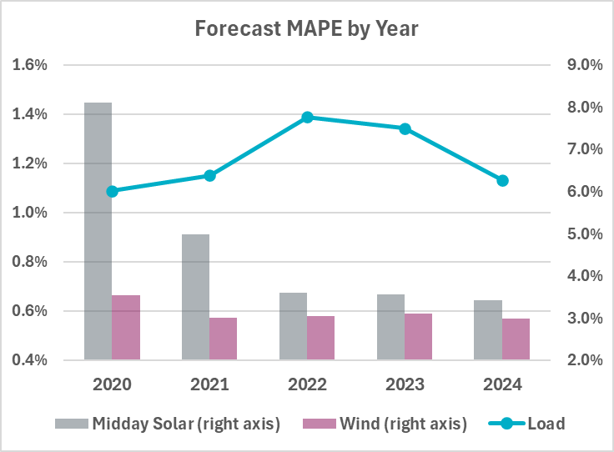
Forecast MAPE Trends
Forecast MAPE* has remained fairly stable over the years for load and wind.
Solar forecast performance prior to 2022 was inconsistent and less reliable, particularly when adjusting the error based on installed capacity.
*MAPE = Mean Absolute Percentage Error
MAPE=avg(|act-forecast|/(installed capacity))×100%

Slide 32
Forced Outages

Slide 33
Forced Outages
Forced generator outages as an input are needed to define the the uncertaintly that were unanticipated by the Operators and would not have been seen by RUC comitment proccess.
The previous AS Methodologies used to calculate Hourly HSL Sums by incrementally including forced generator outages by day starting from midnight. Although it did provide insights on the amount of forced outages we belived the analysis needed some refinements.
A new method has been defined to attempt and align Forced Outages by hour and only looking at outages that started within a window of observation for any particular hour. The outage window can then be aligned with the X-HA used in netload forecast error.

Slide 34
Information about the New Outage Process
Method removes all Solar and Wind outages and includes Unavoidable Extension (UE), Forced (FR), and Forced Extended (FE) Outages.
The process focuses on an hour of interest then it uses a 6-hour window prior to the hour to align with the net load forecast error.
This process additionally includes logic to ensure overlapping outages are also accounted for by looking at individual units and re-evaluating any outage that was present at the same time outage.
  If an outage was found to be overlapping with another, the outage with a higher loss of HSL will take priority and overwrite the original outage, but only for its timeframe.
Overlapping Outages
Results
80 HSL Lost
80
80
100
100 HSL Lost
*In this example outages are for the same unit

Slide 35
Outage HSL Sum Logic Examples
Hour of Interest
Hour - 6
Hour
Hour + 1
06:00
12:00
13:00
Scenario 1
Hour – 6 ≤ Start Time ≤ Hour
Hour + 1 ≤ End Time
Start Time
End Time
Scenario 2
Hour – 6 ≤ Start Time ≤ Hour Hour < End Time ≤ Hour + 1
13:30
Scenario 3
Hour ≤ Start Time < Hour + 1
10:00
12:45
6 Hour variable can be changed to desired time
12:15
13:35

Slide 36
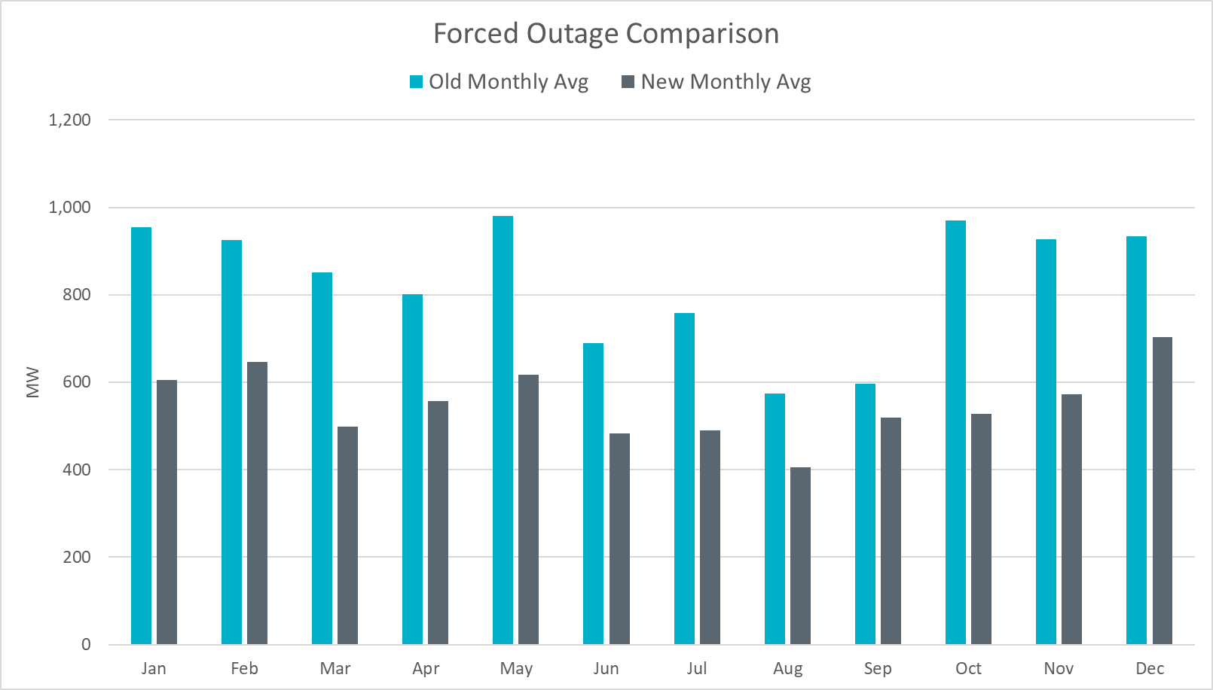
Outage Comparison of Methods
New process shows a decrease on average.
Notes:
4 years of data

Slide 37
Risk Reducers

Slide 38
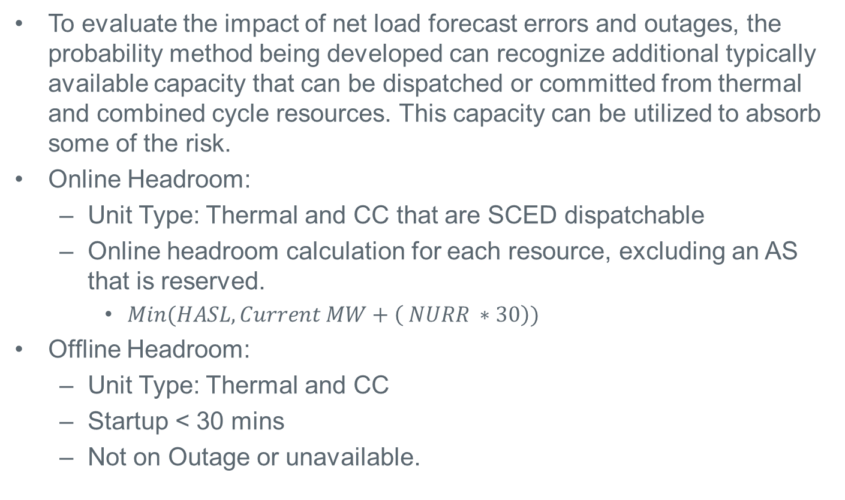
Capacity Included in the Probability Methodology
To evaluate the impact of net load forecast errors and outages, the probability method being developed can recognize additional typically available capacity that can be dispatched or committed from thermal and combined cycle resources. This capacity can be utilized to absorb some of the risk.
Online Headroom:
  Unit Type: Thermal and CC that are SCED dispatchable
  Online headroom calculation for each resource, excluding an AS that is reserved.
    $Min(HASL, Current MW+\left( NURR ∗30\right))$
Offline Headroom:
  Unit Type: Thermal and CC
  Startup < 30 mins
  Not on Outage or unavailable.

Slide 39
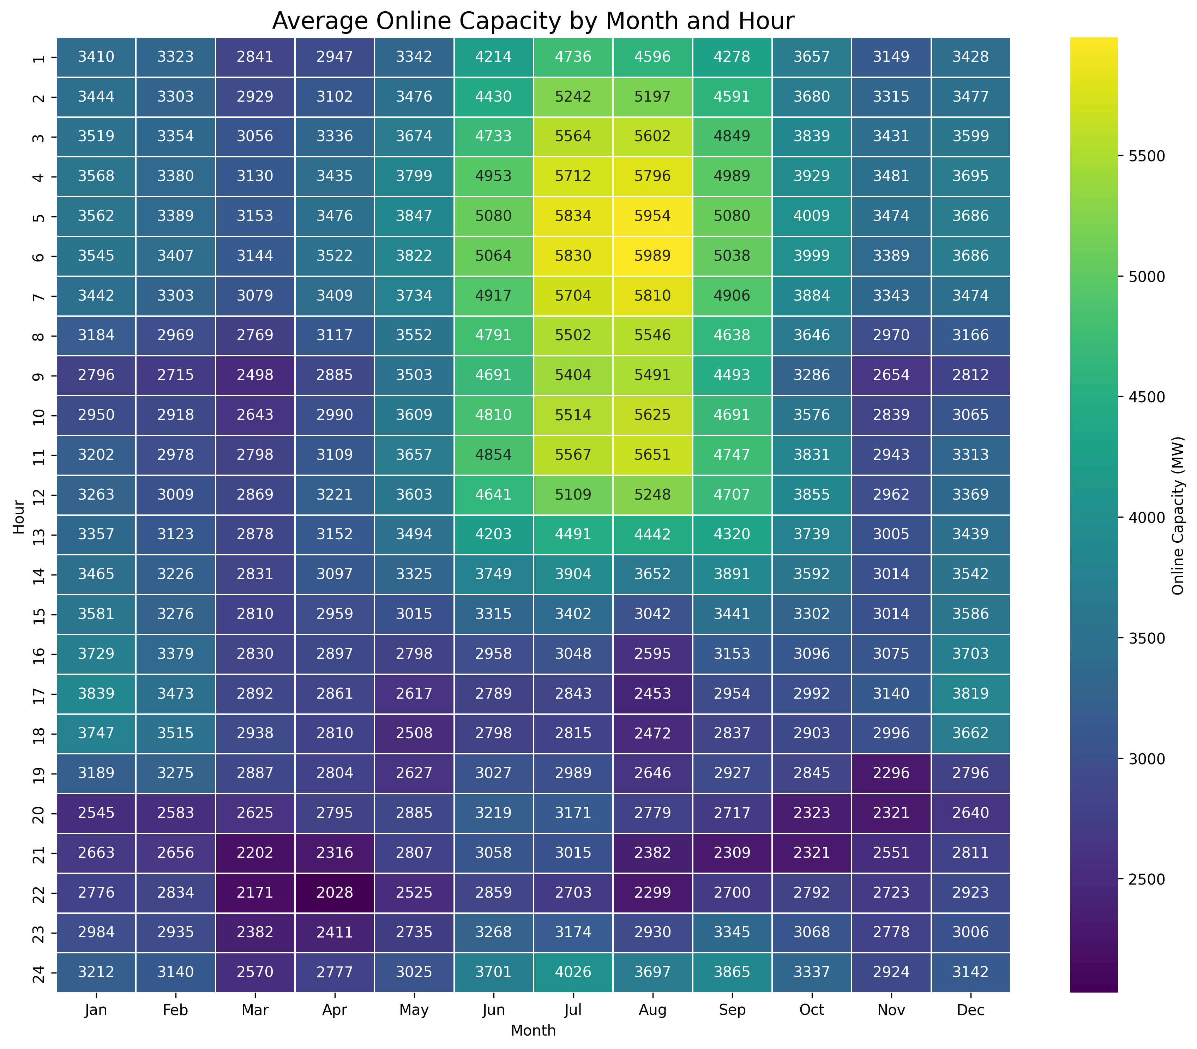
Average Hourly Online Capacity by Month: 2020–2024

Slide 40
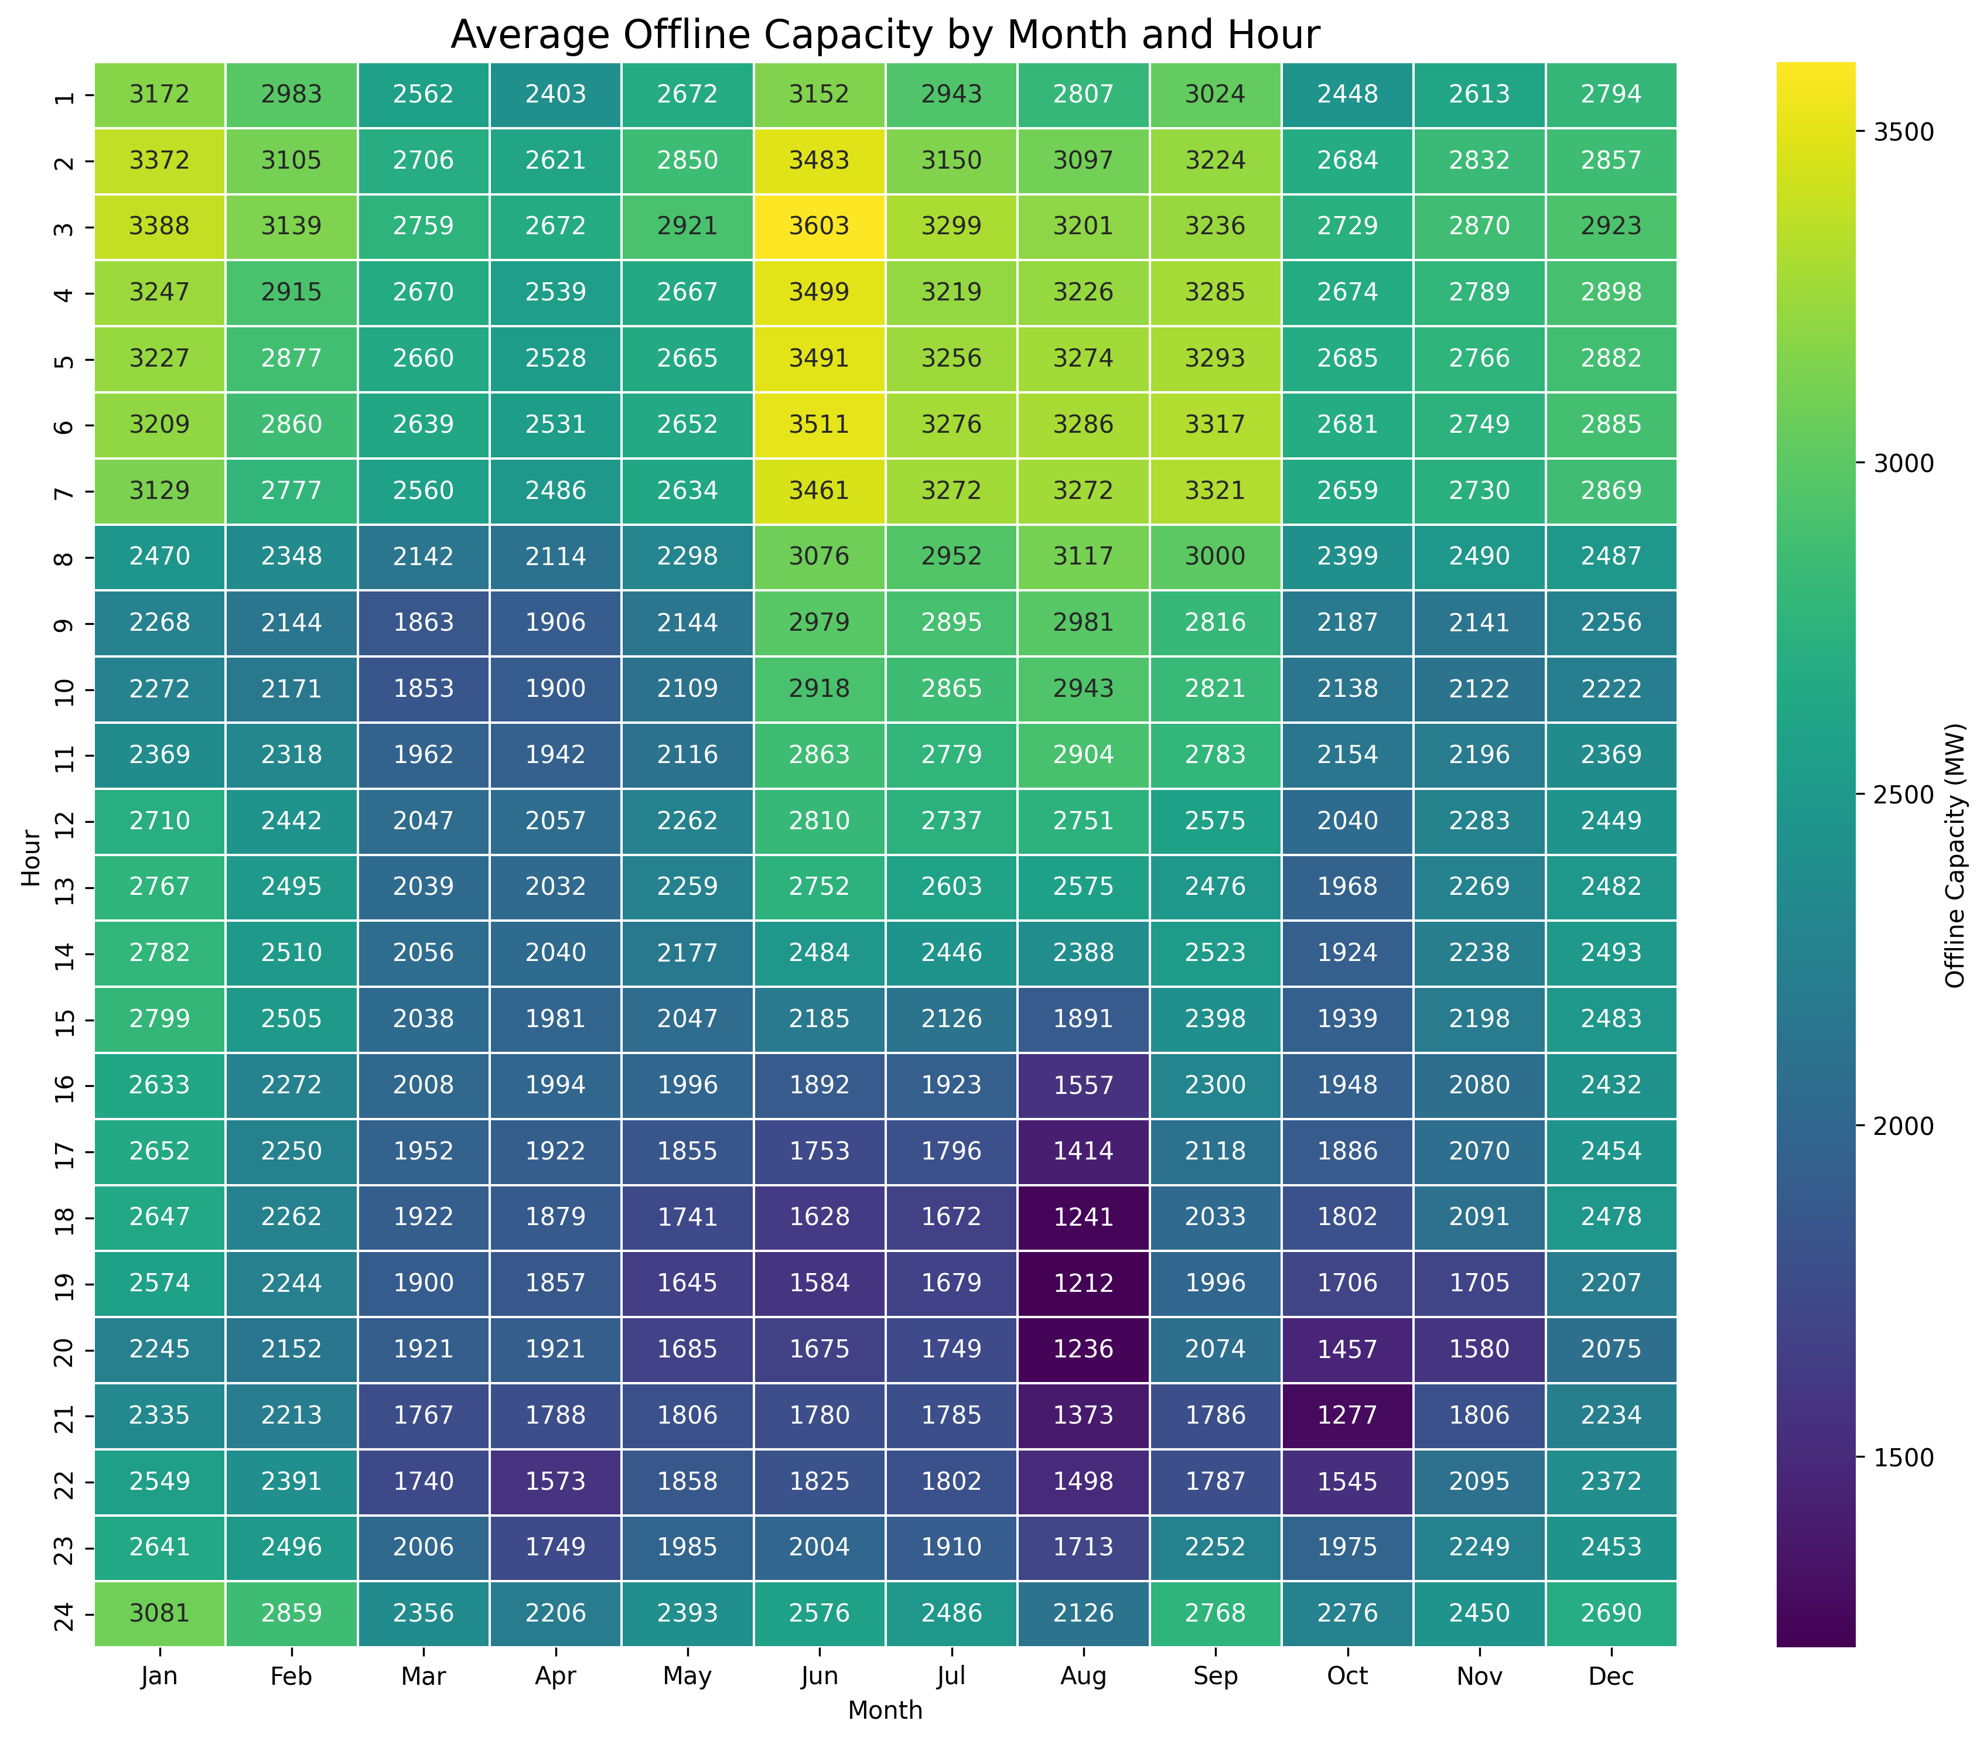
Average Hourly Offline Capacity by Month: 2020–2024

Slide 41
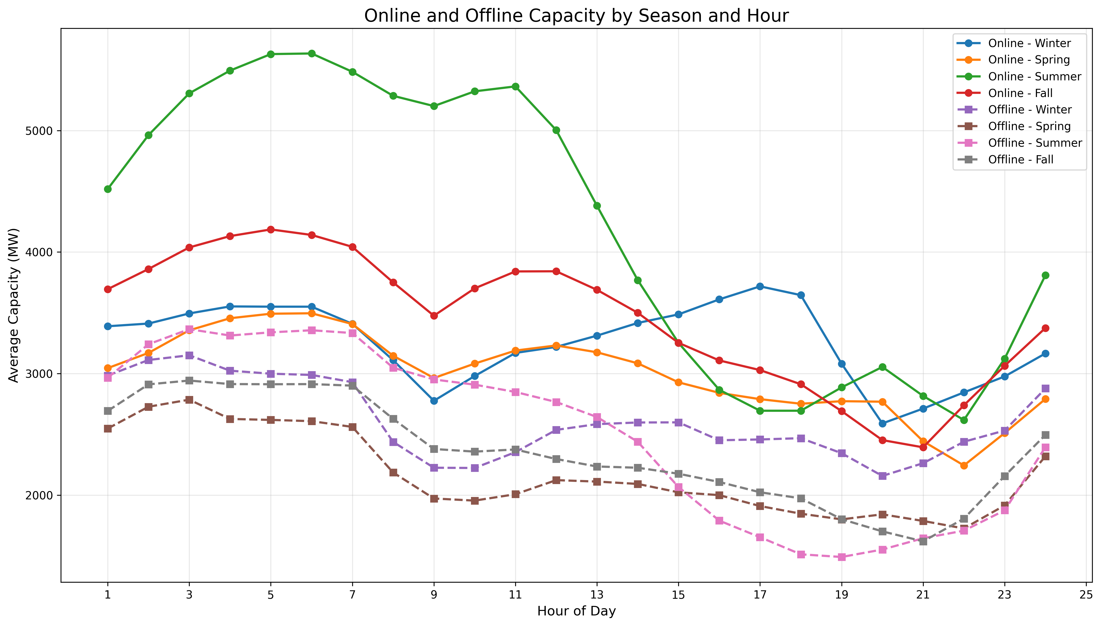
Capacity Trends by Season: Offline and Online

Slide 42
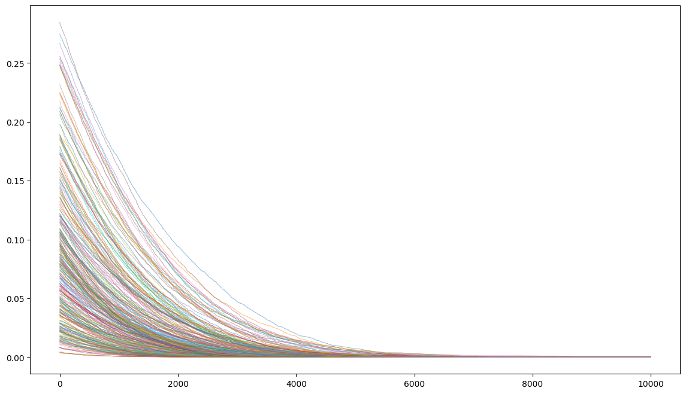
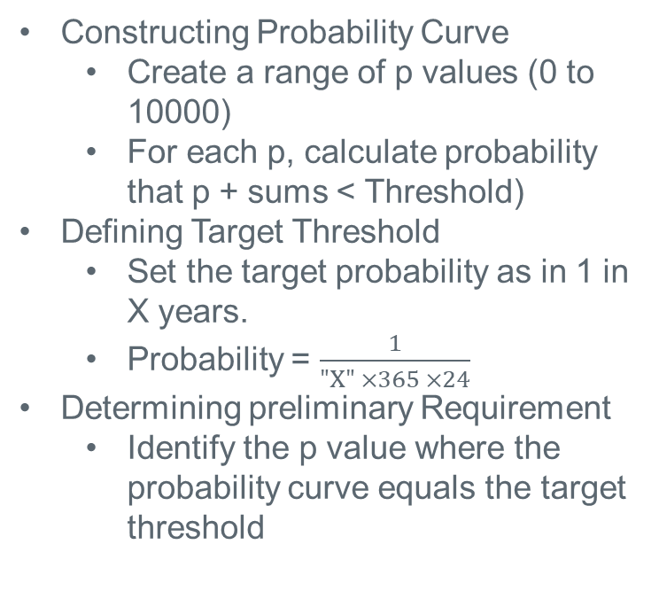
Creating Probability Curves for Each Month Hour Combination - Reliability Criteria
Constructing Probability Curve
  Create a range of p values (0 to 10000)
  For each p, calculate probability that p + sums < Threshold)
Defining Target Threshold
  Set the target probability as in 1 in X years.
  Probability = $\frac{1}{"X" ×365 ×24}$
Determining preliminary Requirement
  Identify the p value where the probability curve equals the target threshold
Y-axis: Probability of Threshold
X-axis: Reserve value
As the reserve value increases, the probability of entering Threshold decreases.

Slide 43
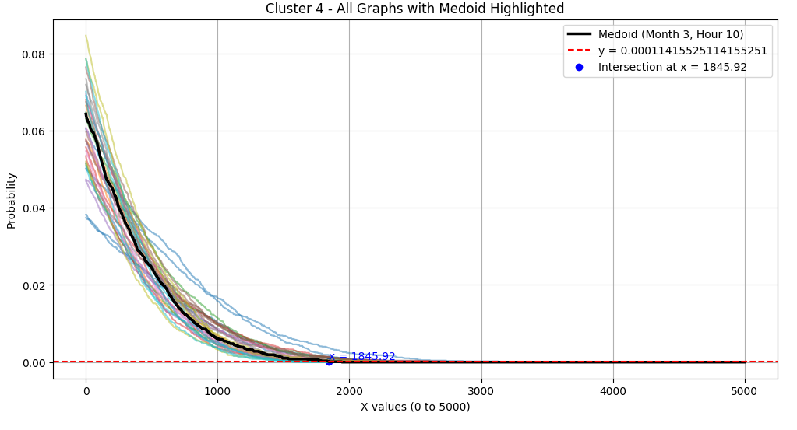
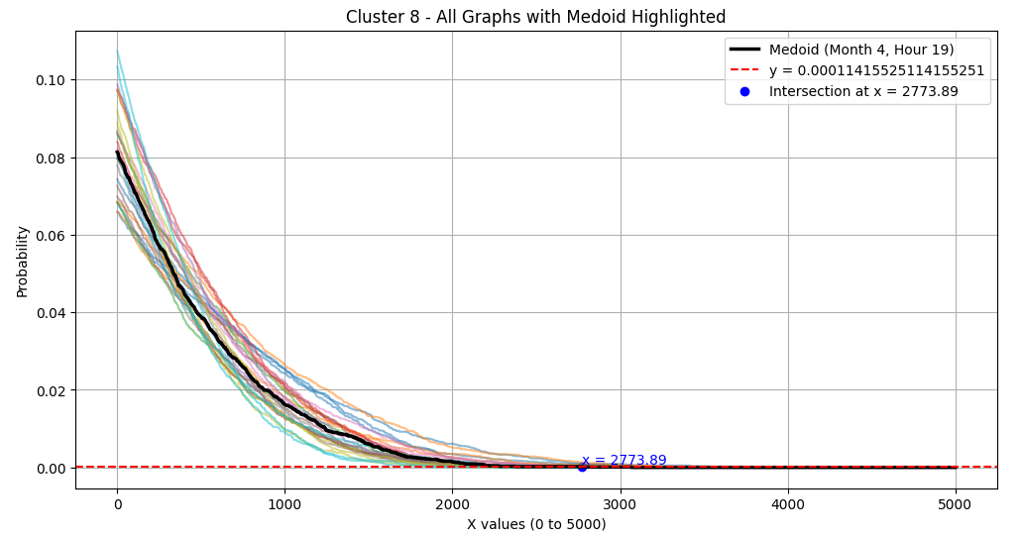
Clustering and Reserve Determination
Cluster Formation
  Divide the 288 probability curves ( one per month-hour combination) into 10 different clusters
Medoid Identification:
  For each cluster, compute Euclidean distances between the curves.
  Identify the best-fit curve.
Reserve Determination
  Determine the intersection point for the medoid, where the probability meets the target threshold.
  Assign that value are reserve required for all the month hour combinations within that cluster.

Slide 44
Reliability Criteria Check
What event/criteria should the engine use to determine the requirements?
Event: Loss of Load, avoid EEA or Watch?
Time horizon: 1/10 year, 1/1 year, other?
What other considerations should be included in this reliability criteria?

Slide 45
What else can be considered?

Slide 46
AS Study Timeline
Potential 2026 Methodology Review Timeline
April 23, 2025 – TAC Kickoff
May 19, 2025 – Workshop #1
June 02, 2025 – WMWG
June 13, 2025 – PDCWG
June 30th – Workshop #2
July 07, 2025 – WMWG (Proposed)
July 15, 2025 – OWG (Proposed)
July 22, 2025– PDCWG (Proposed)
August 06, 2025 – WMS
August 07, 2025 – ROS
August 28, 2025 – TAC
September 23, 2025 – BoD
Oct, Nov, Dec 2025 – PUC
ERCOT will be hosting two workshops related to the 2026 Ancillary Service Methodology.
The proposed timeline for this review is included in the image alongside. Per NPRR1222, which the ERCOT BoD approved, this timeline incorporates the PUC’s review/approval into the review process.
This year ERCOT will be sharing changes to the AS Methodology related to the use of a probabilistic method for quantifying AS as discussed in 2024. ERCOT plans to provide all relevant details on the proposed methodology during the workshops and working group discussions and provide just a summary of the proposed changes during the August/September discussions.
Interested Stakeholders are requested to attend the workshop and working group meetings to provide any feedback on the AS Methodology.

Slide 47

Questions
?

Slide 48
Appendix

Slide 49
PUC’s AS Study Findings
Topic | Finding | Next Steps
SUFFICIENCY OF CURRENT ANCILLARY SERVICES | The current set of AS, combined with the forthcoming Dispatchable Reliability Reserve Service (DRRS), provide ERCOT sufficient AS to comply with North American Electric Reliability Corporation (NERC) requirements and respond to inherent system variability and uncertainty. | ERCOT should continue to monitor the need for new AS. Staff should incorporate an update to this AS review into the 2026 reliability standard assessment.
PROVIDING ADEQUATE INCENTIVES FOR DISPATCHABLE GENERATION | The reliability standard rule (16 TAC § 25.508) has defined a process for assessing and ensuring resource adequacy. | The first holistic reliability standard assessment in 2026 will include an assessment of whether incentives are adequate to support a sustainable level of dispatchable generation, and ERCOT should incorporate the impact of new market features such as Texas Energy Fund, DRRS, and real-time co-optimization plus batteries (RTC+B) into this assessment.
APPROPRIATE CRITERION FOR AS PROCUREMENT QUANTITIES | ERCOT's current posture of maintaining AS quantities that minimize the chance of Entering the pre-emergency operational condition of an Operational Watch should be maintained in order to balance system improvements made since Winter Storm Uri until additional data is available to support further Commission evaluation of this operating posture. | ERCOT should develop the capability to provide current estimates of costs and probabilities of experiencing a Watch, Emergency Alert, and Load Shed for several potential alternative target reserve levels as soon as practicable and no later than to support the Commission setting an objective, data-based procurement criteria for the 2027 AS Methodology.
DYNAMIC DETERMINATION OF AS QUANTITIES | Tradeoffs exist between the certainty provided to market participants by calculating AS quantities primarily on an annual basis (as is done currently) and the efficiency of calculating some portion of AS quantities closer to the operating day. | ERCOT should work with stakeholders to explore a dynamic AS methodology that best Balances these trade-offs.

Slide 50
PUC’s AS Study Findings, Contd.
Topic | Finding | Next Steps
PROBABALISTIC MODELING TO DETERMINE AS QUANTITIES | ERCOT's current practice to determine AS quantities relies on a statistical analysis using historical operating conditions and outcomes. This methodology is no longer sufficient as myriad changes to the wholesale markets and operating conditions continue to impact reasonable forecasting needs. Changes such as incorporation of an unknown amount of TEF-supported capacity, how new large loads are integrated into grid operations, or the impact of new market designs present uncertainty for forecasting tools based exclusively on historical data. | ERCOT should develop a suitable probabilistic, forward-looking modeling capability, provide regular updates to TAC, and present options that can be incorporated no later than the 2027 AS Methodology.
DISPATCHABLE RELIABILITY RESERVE SERVICE (DRRS) | DRRS is one of the tools in the market design toolbox that may assist in meeting the ERCOT reliability standard and need not be specially designated as a tool for resource adequacy to be utilized for this purpose in the future. | ERCOT should design DRRS to ensure that it meets its primary role as an ancillary service to mitigate operational risks in real time and reduce the use of Reliability Unit Commitment. ERCOT should also design flexibility into the mechanism for procuring DRRS so that, if the Commission determines that the price for or quantity of DRRS should be modified in the future to provide targeted additional generator revenue, this could be done without requiring significant additional system changes and without creating artificial scarcity or other detrimental effects on the market. ERCOT and stakeholders may have additional ideas to achieve this outcome that merit continued examination.

Slide 51
PUC’s AS Study Findings, Contd.
Topic | Finding | Next Steps
OTHER CONSIDERATIONS #A FIRM FUEL SUPPLY SERVICE (FFSS) | No changes to FFSS are warranted as part of this study as risks mitigated with FFFS do not overlap with risks mitigated by procuring AS. | FFSS has its own project (Project No 56000) and any improvements to that service will continue there.
OTHER CONSIDERATIONS #B EMERGENCY RESPONSE SERVICE (ERS) | Opportunities to expand ERS or create related new demand response products should be pursued. | ERCOT should perform a holistic review of existing and potential voluntary and emergency-related DR programs, including ERS
OTHER CONSIDERATIONS #C INDIVIDUALLY PRICING AS SUB-TYPES | Creating separate clearing prices for different resource types that provide different subtypes of the same AS will likely benefit the ERCOT market, but it is not currently a top priority, given other market improvement efforts in-flight. | ERCOT and stakeholders should consider pricing AS subtypes separately after RTC+B has stabilized.
OTHER CONSIDERATIONS #D DURATION REQUIREMENTS FOR ERCOT CONTINGENCY RESERVE SERVICE AND NONSPIN RESERVE SERVICE. | Examining the length of response time required for these two AS will likely benefit the ERCOT market, but it is not currently a top priority, given other market improvement efforts in-flight. | ERCOT and stakeholders should revisit duration requirements for ECRS and Non-Spin after RTC+B has stabilized.

Slide 52
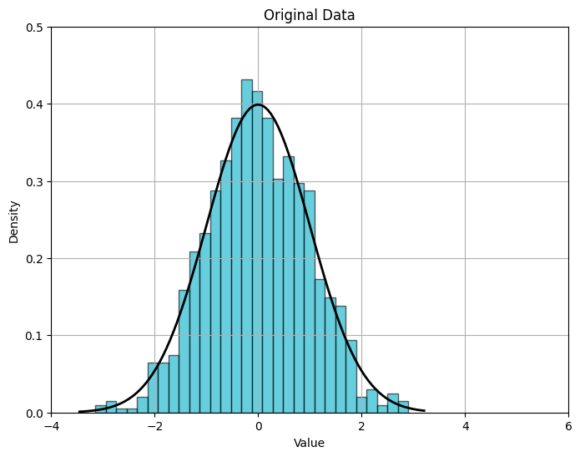
ERCOT Recommendation #1 – “Full Statistical” Analysis of risk
Change the methodology to calculate non-frequency-restoration portion of ECRS quantities and Non-Spin quantities to use a “full statistical” analysis of risks
  Current methodology uses a quasi-statistical approach based on combined risk percentiles that are stacked on top of each other. A “full statistical” approach will compute a single, combined risk for each AS type.
“Full Statistical” Monte Carlo Analysis of Reserve Need
Load Forecast Error
(Month:x, HE:y)
Forced Outages/ Derates
(Month:x, HE:y)
MC Draws
Distribution of Reserve Need (Month: x, HE: y)
Wind Forecast Error
(Month:x, HE:y)
Net-Load Forecast Error
(Month:x, HE:y)
MC Draws
MC Draws
Solar Forecast Error
(Month:x, HE:y)
Available Non-AS Headroom
(Month:x, HE:y)
*For illustration purposes only

Slide 53
ERCOT Recommendation #2 – Dynamic AS quantity determination
Examine the benefits of determining some portion of AS quantities closer to the Operating Day based on days-ahead forecast conditions rather than strictly through an annual calculation
  Net load variability is expected to increase substantially in the future and can also differ significantly on different days and hours.
  The difference between true minimum quantities or typical quantities of some AS products and the quantity needed to meet reliability risk objectives for worst-case or near worst-case conditions will be greater in the future.
  This type of approach, allows to set AS quantities based on a closer to Real Time assessment of operational risks.
  A possible framework could involve setting minimum, “expected,” and maximum AS quantities in an annual study and then setting the actual quantity for the Operating Day before the Day Ahead Market runs.
Key Takeaway: ERCOT should work with stakeholders to reexamine the tradeoffs between the certainty of calculating AS quantities on an annual basis and the efficiency of calculating at least some portion of AS quantities closer to the operating day.

Slide 54
Other Outage HSL Sum Logic
Hour
Hour of Interest
Hour + 1
12:00
13:00
End Time
Start Time
End Time
Start Time
80 HSL
80 HSL
100 HSL
Start Time
End Time
Start Time
End Time
80 HSL
80 HSL
Start Time
End Time
*Outages are for the Same Unit

Slide 55
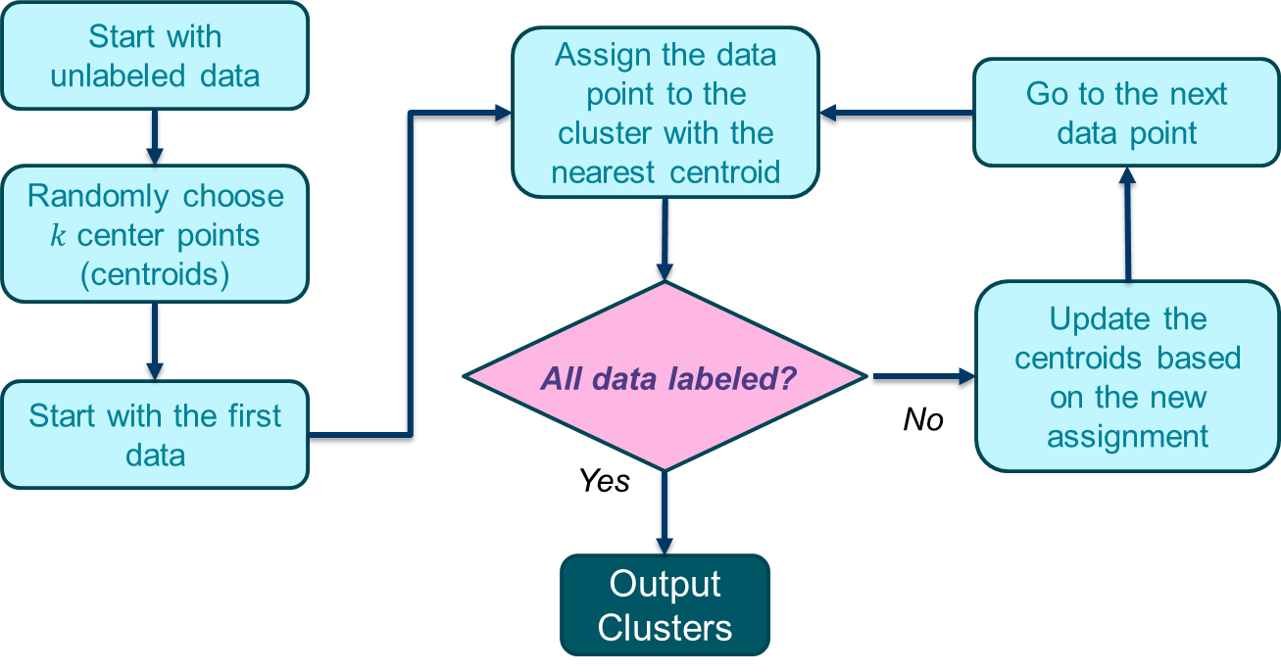
K-Means Clustering
The user specifies how many clusters (k) to create
The algorithm uses data features to compute cluster centroids
Euclidean distance is commonly used to measure how close a data point is to a centroid

