Slide 1
Preliminary Load Loss Assessment of Operational Large Loads in ERCOT
Yunzhi Cheng
Operations Support
LLWG Meeting
5/16/2025

Slide 2
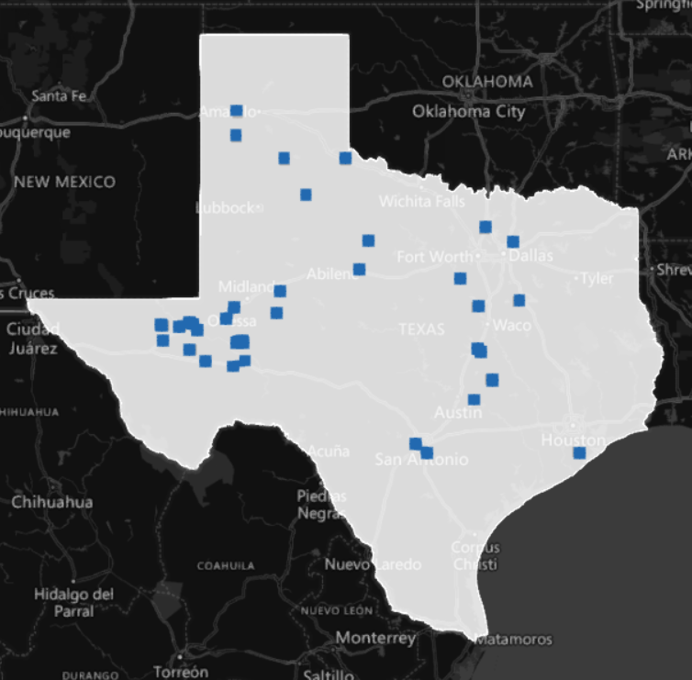
Operational Large Loads (LLs) in West Texas (WTX)
3,055MW ERCOT approved capacity for operational LLs in WTX load zone
Non-Coincident peak observed: ~2,200MW

Slide 3
Study Assumptions
Study Cases from DWG
Summer Peak (SP) with 5,500MVA in-service synchronous generators in WTX
High Renewable Minimum Load (HRML) with 900MVA in-service synchronous generators in WTX
CTG
4-cycle (~66ms) 3P fault at a 345kV station in WTX without line tripping
LL Voltage Tripping Settings for the Electronic Portion:
1#: 0.75pu instantaneous tripping, modeled as CMLD
2#: 0.7pu with 20ms delay (ITIC curve), modeled as UVLS since CMLD cannot model the time delay associated with tripping
No reconnection of LL in both tripping settings

Slide 4
Preliminary Results
Assuming a LL electric portion immediately trips if the voltage drops below 0.75pu, all the WTX LLs electronic portion will trip, leading to the total of loss of load of ~2,500MW
Assuming a LL electric portion can ride through 0.7pu for 20ms (ITIC curve), the total of loss of load is reduced to ~1,500MW
WTX LL Trip Assessment Results
Study Cases | Tripping Amount (MW)
 | Voltage Trip Setting #1 (0.75pu, instantaneous) | Voltage Trip Setting #2 (0.7pu, 20ms)
SP | ~1,500 | ~1,500
HRML | ~2,500 (All WTX LL electronic portion tripped) | ~1,500

Slide 5
Sensitivity Analysis
Add SynCon (synchronous condenser)
Add one SynCon at each LL POI bus with the size of ~1/3 of the LL MW, ~900MVA SynCons in total are added
SynCons seem to have some impact on LL tripping, depending on the system condition and LL VRT capability
WTX LL Trip Assessment Results (With SynCons)
Study Cases | Tripping Amount (MW)
 | Voltage Trip Setting #1 (0.75pu, instantaneous) | Voltage Trip Setting #2 (0.7pu, 20ms)
SP | ~1,500 | n/a
HRML | ~1,900 | ~1,300

Slide 6
Preliminary Observations and Future Work
~2.5GW (all electronic portion) of loss of load observed with a 3P fault at a 345kV station in WTX if each LL cannot ride through an instantaneous 0.75pu voltage dip
~1.5GW of loss of load observed with a 3P fault at a 345kV station in WTX if each LL can ride through 0.7pu voltage dip for 20ms (ITIC curve)
Synchronous condensers seem to have some impact on LL tripping, depending on the system condition and LL VRT capability
Future work
Investigate different fault locations
Work with the research community and industry to understand more about LL behavior and models

