Slide 1
Draft of Language Corrections Needed for RTC+B Go-Live: Mitigation for Resources Harmed by System Lambda Capping Process
David Maggio
Principal, Market Design & Analytics
May 21, 2025
Real-Time Co-optimization plus Batteries Task Force (RTCBTF)
ERCOT Public

Slide 2
Background
Following discussion at a previous RTCBTF, Dr. Shams Siddiqi reached out with questions and a concern that a Resource could be financially harmed as a result of the process of capping the Real-Time Market System Lambda.
From grey-boxed Protocol 6.5.7.3(15)(d):
“The System Lambda used to determine LMPs from SCED Step 2 shall be capped at the effective VOLL.”
This approach was an outcome of commission direction in 2019, with a memo filed by the chair and subsequent discussion at an open meeting with the full commission.
ERCOT staff agrees with Dr. Siddiqi’s concern and has identified that a Resource, particularly Resource dispatched by Security-Constrained Economic Dispatch (SCED) may be harmed financially under the following conditions:
The capping process is triggered;
For a Generation Resource or an Energy Storage Resource (ESR), the Resource’s Base Point is greater than its Low Dispatch Limit (LDL); and
The Locational Marginal Price (LMP), after capping is applied, is less than the price on the Resource’s Energy Offer Curve or Energy Bid/Offer Curve.
We’ll walk through a simple example of the issue.

Slide 3
Illustrative Example of the Criteria Being Met
Example for a Generation Resource:
For this example:
Let’s assume the Resource isn’t qualified to provide Ancillary Services.
The Generation Resource was marginal with an intersection of 70 MW and $50/MWh on it’s submitted Energy Offer Curve.
The LMP after capping is no longer in alignment with the Resource’s offer, now -$150/MWh.
Expected energy revenue based on the marginal offer = $3,500 * the interval length.
70*50*interval length
Actual energy revenue after capping = -$10,500 * the interval length
70*-150*interval length.
High Dispatch Limit (HDL) | 100 MW
LDL | 40 MW
Base Point | 70 MW
System Lambda before capping | $5,200/MWh
LMP before capping | $50/MWh
System Lambda after capping | $5,000/MWh
LMP after capping | -$150/MWh

Slide 4
Background cont.
To be clear, this issue is not new. It is a function of the System Lambda capping process, which has been in place since the development of the RTC Key Principles. However, thinking through this process was reinitiated following discussions on Nodal Protocol Revision Request (NPRR) 1268.
It should not be assumed that capping always leads to this type of harm.
In many cases and for the majority of Resources, either the capped LMP is still greater than the Resource’s offer or the Resource is already being backed down to LDL and the Resource is not setting the price.
Instances will be limited to times of deep scarcity and severe congestion.
We did not find any cases of this harm occurring when looking at our historical 2023/2024 RTC simulation work. However, we did begin to see occurrences if we took those historical cases and made significant increases to Generation-to-be-Dispatched (GTBD) to simulate higher scarcity conditions than what existed in those years.

Slide 5
ERCOT’s Proposed Solution
While occurrences are expected to be limited, the impacts to Qualified Scheduling Entities (QSE) could be severe. As such, it’s appropriate to have some mechanism that can be used in the near-term to provide relief.
Our proposal is to make use of existing emergency operations settlement logic, similar to what is used in the case of a Real-Time Market price correction or dispatch limit “manual override.”
The formulas used for determining any compensation would be based on what already exists in Protocol section 6.6.9.1, Payment for Emergency Operations Settlement.
Draft language is being proposed for Protocol sections 6.5.7.3 and 6.6.9 to describe this scenario and point to the use of existing Protocol 6.6.9.1 logic.

Slide 6
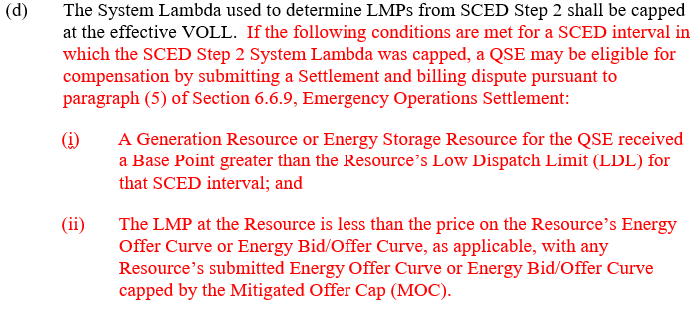
Draft Proposed Language

Slide 7
Draft Proposed Language cont.

Slide 8
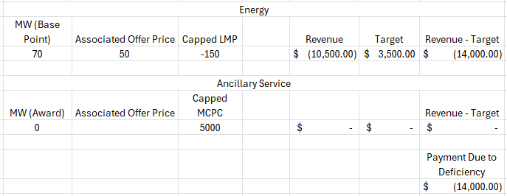
Quick Refresher on How 6.6.9.1(2) Settlement Works Under RTC
Under RTC, paragraph (2) of Section 6.6.9.1 logic is designed to take into account both energy and Ancillary Services for a Resource when considering harm to its QSE, where Ancillary Service revenues may offset otherwise deficient energy revenues.
Example 1 (no Ancillary Services, like on slide 3) :
Note: a negative value means a payment from ERCOT to the QSE

Slide 9
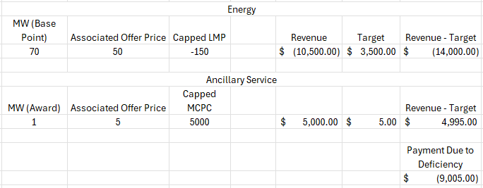
Quick Refresher on How 6.6.9.1(2) Settlement Works Under RTC cont.
Example 2 (Resource is awarded some small amount of Ancillary Services) :
Note: a negative value means a payment from ERCOT to the QSE

Slide 10
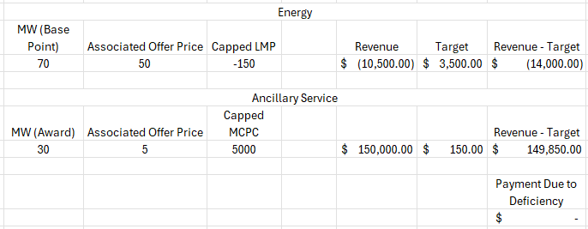
Quick Refresher on How 6.6.9.1(2) Settlement Works Under RTC cont.
Example 3 (Resource is awarded a larger amount of Ancillary Services) :
Note: a negative value means a payment from ERCOT to the QSE

Slide 11
Additional Notes
The language for this proposal is included in the draft NPRR shared with the RTCBTF today.
It should be noted that the proposed language changes do not include Controllable Load Resources (CLRs).
While these Resources may have some similar risks in theory, no emergency operations settlement currently exist for CLRs and new processes and systems will need to be created to capture CLRs in any type of compensation mechanism.
It’s also much more unlikely that a CLR could see these conditions, as they are settled at a Load Zone price.
We recognize that our proposal may only be a near-term solution as we look to RTC+B implementation in December. However, it may be reasonable in the longer-term to consider alternative mitigation measures that have further reaching software changes or policy considerations.

