Slide 1
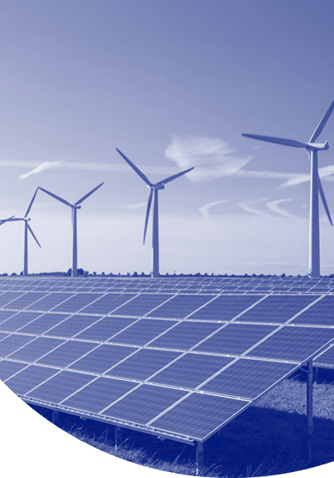
Rowland Solar (Cutlass)-II SPP
Curtailment & Line Outages
May 2025

Slide 2
In the last one-month period, Cutlass-II solar power plant curtailed for around 12 GWh which is 27% of estimated generation
Cutlass-II Solar Power Plant Curtailment History
After maintenance activities started on the transmission network around Cutlass-II, we started to observe heavy curtailment to our generation.
Total curtailment in the last month is more than 12.2 GWh which corresponds to 27.1% of total HSL in that given period.
Estimated loss due to curtailments is around 600 k USD.

Slide 3
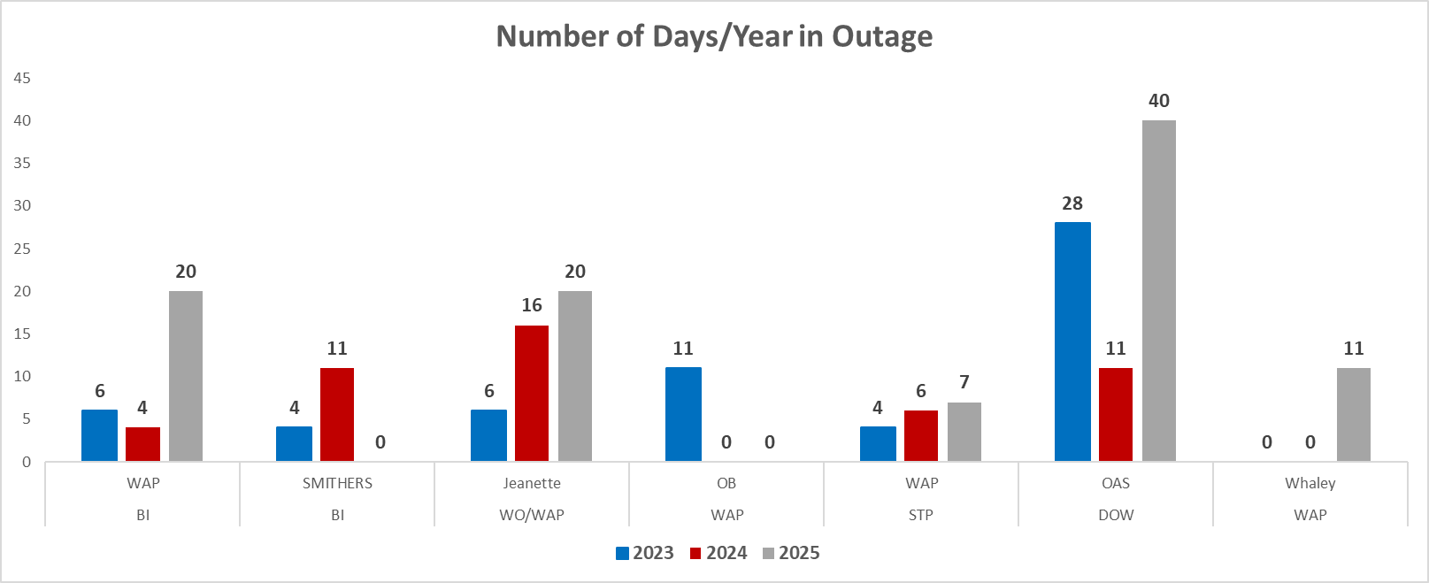
Transmission Line Outages around Rowland Solar II in 2023, 2024 & 2025
Total number of outage days for these transmission lines doubled up in 2025 compared to 2023 and 2024, although we haven’t completed the first 5 months in 2025.
These maintenances created huge imbalances between Southwestern part of Houston and Northern part of Houston, which doesn’t seem proper congestion management.
Economic curtailment is understandable but curtailment that is experienced here is not economic curtailment, instead it is forced curtailment due to outages happening in critical transmission lines around Rowland’s node. In most part of Europe, there is compensation mechanism by the system provider for such type of curtailment if it is led due to transmission outages under the control of transmission companies.
A considerable amount of these outages either approved by ERCOT couple of days before the start date of construction or extended by the TSP couple of days before the planned end date. This puts powerplants in a difficult position because at that time, there is no means/tools to mitigate such non-production risk with some hedging mechanism.
Total Days in Outage

Slide 4
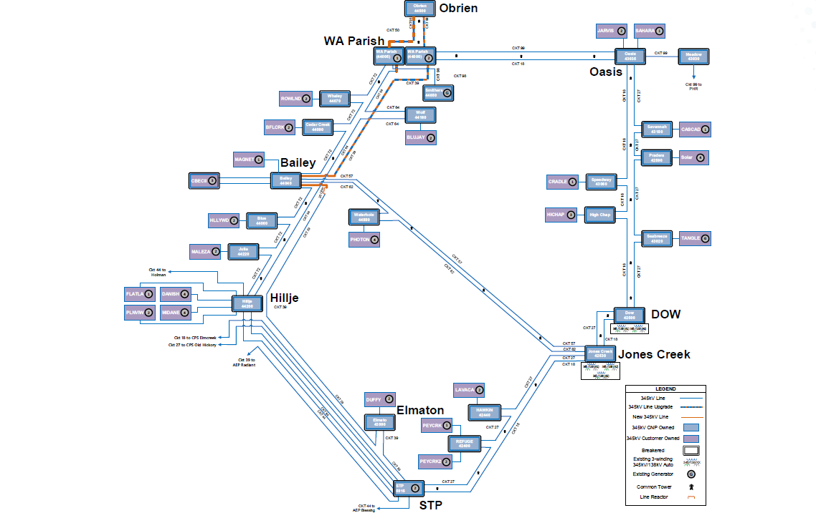
Centerpoint Transmission Line Diagram

