Slide 1
NPRR1230: Monitoring and Analysis
Matthew Schmidt
Market Analysis
Congestion Management Working Group (CMWG)
May 19, 2025

Slide 2
Purpose of NPRR1230 Update
TAC requested periodic updates from ERCOT in terms of monitoring the impacts of NPRR1230

Slide 3
Recap: NPRR1230
Addresses operating conditions observed in Summer 2023 for what are now the South Texas Export Interconnection Reliability Operating Limits (IROLs)
ERCOT was previously dependent on using High Dispatch Limit (HDL) overrides to help mitigate the constraint
NPRR1230 increases the Shadow Price Cap for some IROLs
Establishes a transparent method for determining a new Shadow Price Cap for an individual IROL if needed
Security-Constrained Economic Dispatch (SCED) can further manage the IROLs, allowing for the use of market-based tools
Control Room Operators can focus on near-scarcity conditions
Updated Shadow Price Caps ($19,751/MWh) were implemented for the two South Texas Export IROLs (E_PASP, E_PATA) on 10/01/2024

Slide 4
05/08/2025
Reliability and Pricing Impacts:
Pre-NPRR 1230 Counterfactual Analysis

Slide 5
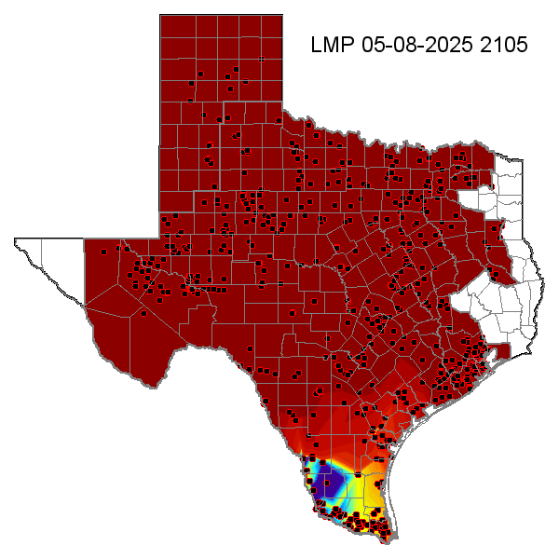
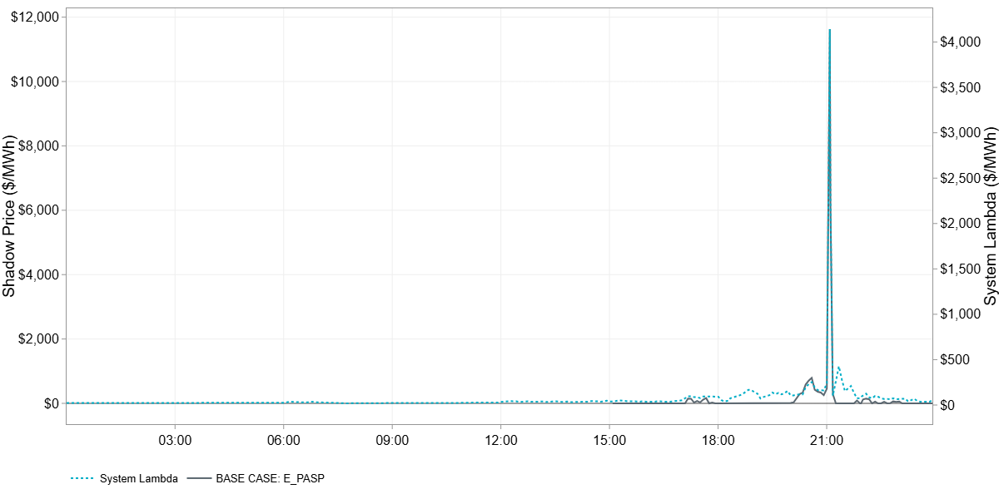
Pricing Event on 05/08 associated with Congestion on South Texas Export IROL
On Operating Day 05/08, the shadow price on the South Texas Export IROL (E_PASP) exceeded the pre-NPRR1230 generic IROL Max Shadow Price of $5,251/MWh for two consecutive SCED intervals between 21:00 and 21:06 to manage the flow across the IROL.
The Shadow Price on the IROL peaked at $11,628/MWh during SCED interval 21:05 with System Lambda reaching a value of $4,142/MWh.
This is the second time since the implementation of NPRR1230 on 10/01/24 that a shadow price above the previous generic Max Shadow Price of $5,251/MWh has been leveraged to manage the South Texas IROLs.
The previous incidence occurred on 11/17/2024 when the Shadow Price on E_PATA reached a value of $12,893.

Slide 6
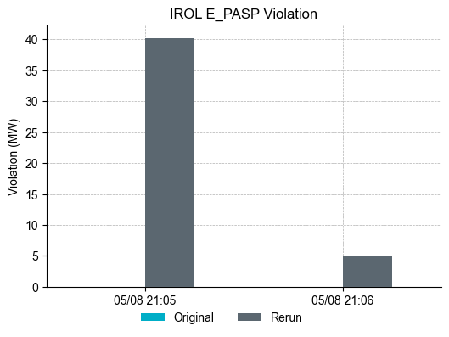
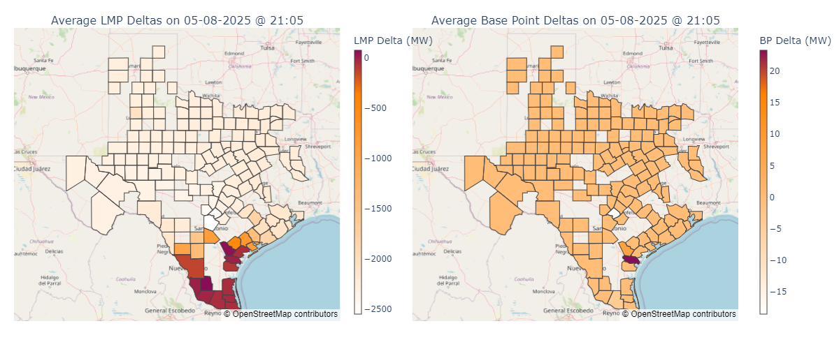
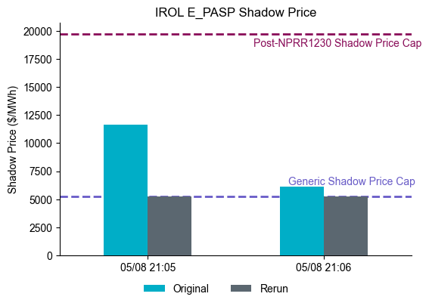
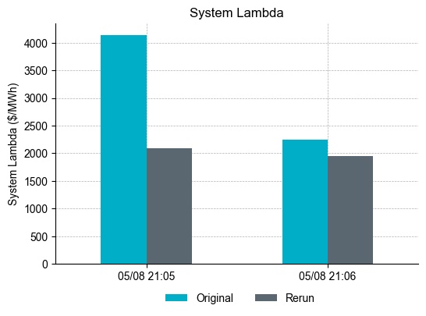
Counterfactual analysis w/ generic SP Cap for South Texas Export IROLs for violated intervals on 05/08/2025
Violation of IROL E_PASP could have exceeded 40 MW based on the limit sent to SCED (if no out-of-market actions were taken) with pre-NPRR 1230 generic IROL Shadow Price Cap of $5,251/MWh.
Note that the limit passed to SCED includes a margin entered by the Operator.
Decrease in System Lambda to ca. $2,000/MWh in counterfactual rerun due to more capacity available to SCED with transmission violation
Due to the magnitude of the shadow price post-NPRR1230, generation on the hurting side of the constraint can be curtailed to mitigate the violation, which increases system-wide scarcity contributing to the spike in System Lambda to over $4,000/MWh in SCED interval 21:05.
Note that based on the analysis, the market result was also affected by depleted or near depleted HASLs for ESRs providing Ancillary Service at the turn of the Operating Hour.

Slide 7
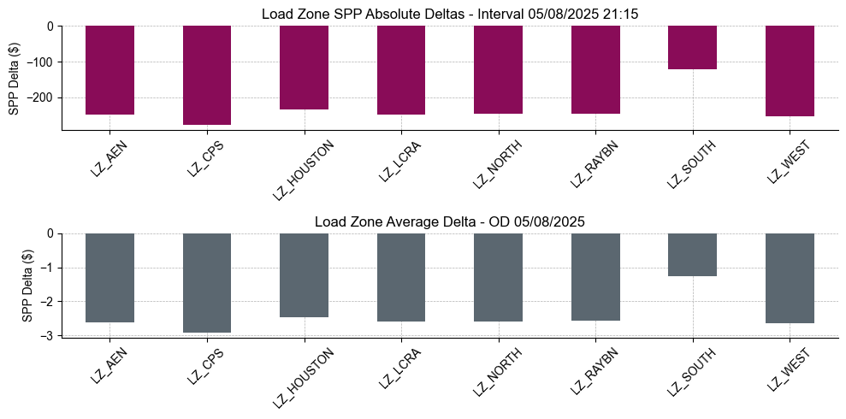
Load Zone SPP Deltas (Interval & OD Avg. Values)
Largest negative Load Zone SPP deltas observed in Load Zone CPS and smallest in Load Zone South
Largest OD average SPP price delta ca. $3/MWh.

