Slide 1
Project Update
May 14, 2025
Troy Anderson
ERCOT Portfolio Management

Slide 2
Project Update Agenda
Recent / Upcoming Project Highlights
2025 Release Targets
Major Projects
Priority/Rank Recommendations for Revision Requests with Impacts
NPRR1214 – Reliability Deployment Price Adder Fix to Provide Locational Price Signals, Reduce Uplift and Risk
NPRR1226 – Estimated Demand Response Data
NPRR1238 – Registration of Loads with Curtailable Load Capabilities
NPRR1267 – Large Load Interconnection Status Report
Technology Working Group (TWG)
Next meeting is 5/29/2025
Aging Projects Related to Revision Requests
Location of Revision Request Project Information: http://www.ercot.com/services/projects

Slide 3
Recent / Upcoming Project Highlights
2025 May Release – R5 – 5/29/2025 In Flight
NPRR1253 – Incorporate ESR Charging Load Information into ICCP
ICCP and Public API implementation
Implementation Update
Background:
Recall that ERCOT was challenged to support this NPRR’s reporting requirements without disrupting RTC development and took an action item to consider alternative ways to develop the API reporting
At TAC, ERCOT stated there was an alternative technical reporting solutions, however, it was recently discovered this will not fully meet the protocol requirements (published every 5 minutes, rather than every SCED run)
ERCOT will proceed as planned with delivery of the new telemetry points and API reporting for ESR charging data
ERCOT will issue a Market Notice in next 1-2 weeks with more details on how to access the ESR charging (as discussed at TWG meeting)
ERCOT’s delivery of NPRR1253 will provide the data requested by the market (real-time telemetry and API values for ESR charging)
The technical delivery for summer 2025 will not strictly meet the protocol language as related to reporting requirements for “each SCED process” so NPRR1253 will remain gray-boxed
Reminder from last month’s report
Note: Projected Go-Live dates are subject to change. Please watch for market notices as the effective dates approach.

Slide 4
2025 Release Targets – Approved NPRRs / SCRs / xGRRs
R1
R3
R5
January 1/30 | February 2/27 | March 3/27 | April 4/24 | May 5/29 | June 6/26
NPRR945 NPRR1219 | NPRR1254 RTC+B Market Trials Sandbox Deployed | NPRR1145 | RTC+B Market Trials begin on 5/5/2025 | NPRR1253
R2
R4
R6
ü
ü
ü
RTC QSE Submission Testing
3/1
ü
RTC QSE Telemetry Check-out
1/1
3/7
ü
E
RTC+B
12/5
July 7/31 | August 8/28 | September 9/25 | October 10/23 |  | December 12/18
 |  |  |  |  | RTC+B Stabilization begins
R7
R8
R9
R10
E
R11
NPRR1007-1013
Open-loop RTC SCED
Closed-loop SCED/LFC
NPRR963(a)
NPRR965
NPRR1000
NPRR1014
NPRR1054
NPRR1058
NPRR1172
NPRR1204
NPRR1216
NPRR1236
NPRR1245
NPRR1246
NOGRR211
NOGRR268
OBDRR020
OBDRR052
PGRR118
QSE Telemetry Tests
Day-Ahead Market
Go-live dates can differ from Protocol effective dates – Please refer to market notices for more details
APPENDIX
Red Text: New additions and target release changes
Strike-Through Text: Previous target release
(a), (b), etc.: Multiple phase release
Project Status Codes
NS = Not Started
I = Initiation
P = Planning
E = Execution
H = On Hold
NPRR963(a) – Portion of NPRR
NPRR1253(a) – ICCP
NPRR1253(b) – Public API
RTC+B Market Trials
RTC+B Stabilization
Release targets are subject to change

Slide 5
Major Projects
Other Project Highlights

Slide 6
Priority / Rank Recommendations for Revision Requests with Impacts
Recommendations for…
Revision Request | Description | Priority | Rank | Comments
NPRR1214 | Reliability Deployment Price Adder Fix to Provide Locational Price Signals, Reduce Uplift and Risk | TBD | TBD | $800k-$1.2M, 12-18 months Impacted Systems: MMS, Settlements, Reporting
NPRR1226 | Estimated Demand Response Data | TBD | TBD | $100k-$150k, 5-7 months Impacted Systems: EMS, Reporting
NPRR1238 | Registration of Loads with Curtailable Load Capabilities | TBD | TBD | $700k-$1M, 10-14 months Impacted Systems: MMS, EMS, NMMS ERCOT continues to discuss the approach to a manual data collection process
NPRR1267 | Large Load Interconnection Status Report | 2026 | 4760 | $100k-$150k, 5-8 months Impacted Systems: RIOO, Public API ERCOT will deliver a monthly manual report until the project to automate it using data sourced from RIOO can be completed
PPL Rank Information
Next 2025 Rank in Business Strategy = 4570 Next 2028 Rank in Business Strategy = 5110
Next 2026 Rank in Business Strategy = 4760 Next 2029 Rank in Business Strategy = 5300
Next 2027 Rank in Business Strategy = 4900 Next Rank in Regulatory = 400

Slide 7
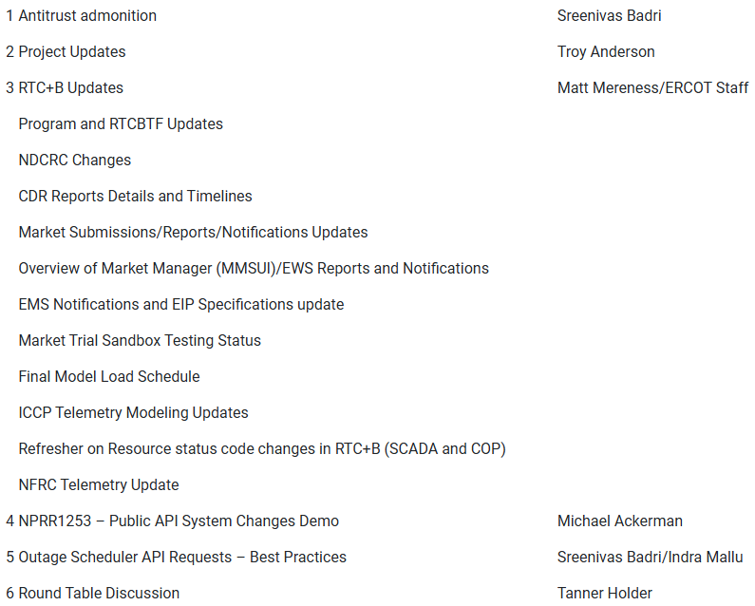
Technology Working Group (TWG)
Agenda for TWG meeting held on 4/24/2025:
Next TWG scheduled for 5/29/2025

Slide 8
Aging Revision Request Project Review
After the RTC+B project goes live, it will be valuable to have a reprioritized list of pending Revision Request projects
The “Aging Projects Relating to Revision Requests” list used in 2024 has been updated for recent activity
Multi-month review at PRS
May: Review the contents of the posted aging list
June: PRS members are asked to be prepared for a priority discussion
July/August: Follow-up discussion after ERCOT assesses resources on the highest priority items
Legislative priorities will be an important consideration

Slide 9
Aging Revision Request Review at PRS – Stats
Category | 2024 Process | May 2025
1 – Proceed as Planned | 19 | 10
3 – No Action | 14 | 10
4 – Candidate for Revision / Removal | 2 | 2
5 – Post-RTC+B | 23 | 26
6 – Market Input Needed | 0 | 13
Total | 58 | 61
“2024 Process” is where PRS concluded in August 2024
“May 2025” includes updates since last year’s review
RR’s started and completed
Newly approved items
New items in the queue for PUCT or Board approval
See posted Excel file for details

