Slide 1
RMTTF
Tomas Fernandez NRG
Debbie McKeever ONCOR
Melinda Earnest AEP Texas

Slide 2
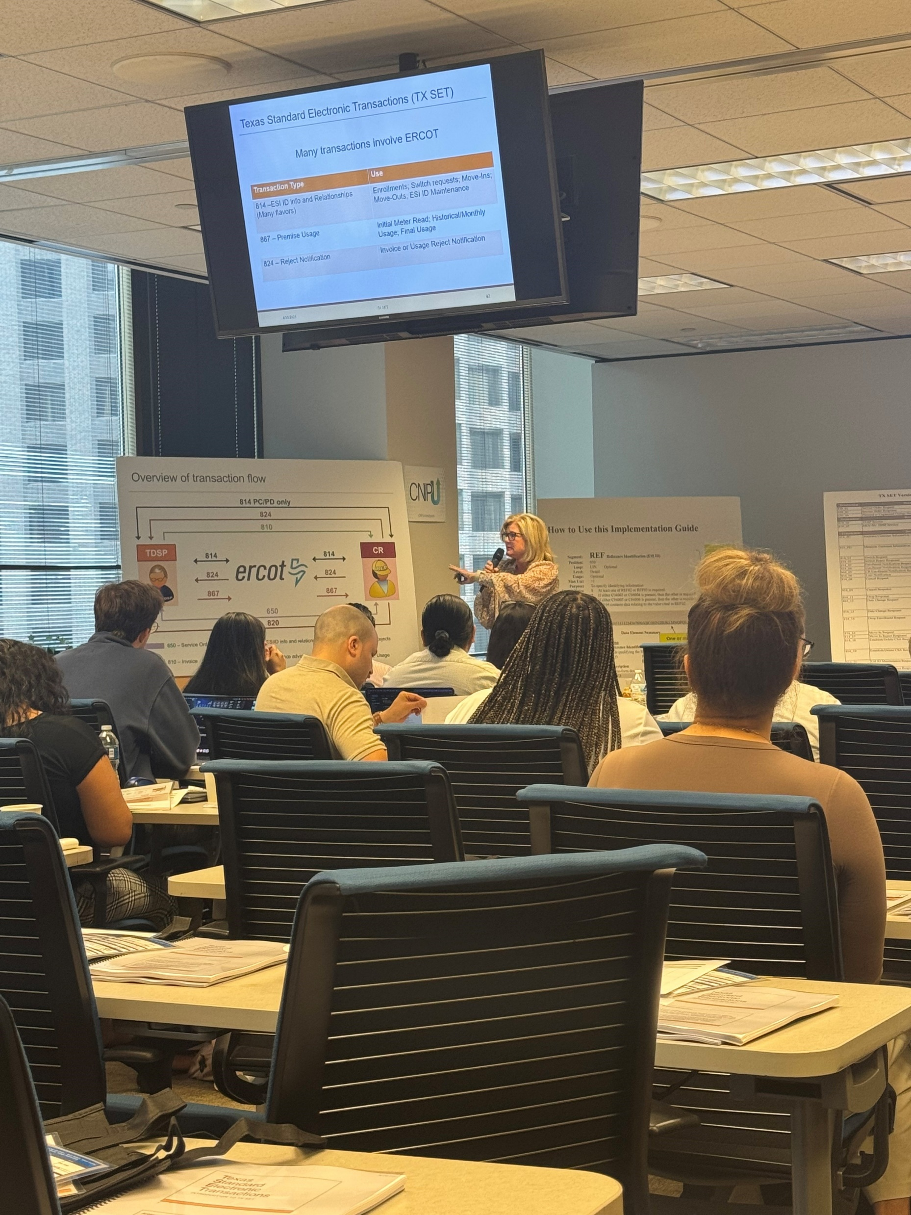
TxSet 5.0 Training in Houston
TxSet 5.0 training was held in Houston on Wednesday, April 30th at CenterPoint Energy Tower
Over 50 participants
Representing various market participants
TDSP’s
Service Providers
REP’s
PUCT
ERCOT
Survey Responses:
The course was very engaging and interactive! I really liked the exercises/practice.
Every trainer was extremely knowledgeable and engaging with the class.
Thank you for a job well done and your continued service to the market.
Amazing!! Very energetic throughout the day and really kept us engaged. Great topics and extensive coverage on the material. All of the speakers were excellent and knowledgeable. Thank you for the food as well! Delicious

Slide 3
Upcoming Retail Training Opportunities
Retail 101
June 18th – WebEx only
TX SET 5.0 Training
June 25th – In Person
Training class in Irving
Hosted by Vistra
Open for registration on ERCOT.com
+ Cornerstone OnDemand +
Maximum of 60 seats for the class.
MarkeTrak Training
WebEx Only (TBD - 4th Quarter 2025)
MarkeTrak Part 1-Overview
MarkeTrak Part 2-Switch Holds and IAG

Slide 4
On-Demand ERCOT Retail Training Modules Available 24/7
MarkeTrak Online Training Modules -
MarkeTraks Overview
Switch Hold Removal
Cancel With/Without Approvals
Inadvertent Gains/Losses & Rescissions
Usage and Billing
Other D2D Subtypes
Bulk Insert
MarkeTrak Admin Functionality
Data Extract Variances (DEV) LSE Subtypes
Data Extract Variances (DEV) Non-LSE Subtypes
Emails and Notifications
Reporting – Background & GUI
Additional Retail Online Training Modules
Retail 101
TXSET
Mass Transition

Slide 5
Upcoming RMTTF Meeting
Thursday, June 26th 9:30 AM
WebEx and In person
Oncor
1616 Woodall Rogers Fwy
Dallas, TX 75202
Room 824
If planning to attend in person, please email Debbie McKeever deborah.mckeever@Oncor.com
If you have questions or suggestions for training, please contact one of the RMTTF co-chairs listed below. Tomas Fernandez, NRG tomas.fernandez@nrg.com Melinda Earnest, AEP mdearnest@aep.com Debbie McKeever, Oncor deborah.mckeever@Oncor.com Thank you!

