Slide 1
ERCOT Frequency Events
April 2025
ERCOT
Operations Planning
PDCWG | May 12, 2025

Slide 2
4/3/2025 21:47:06 (Non-FME)
Notes:
The unit tripped offline while carrying ~477 MW
Starting Frequency: 59.986 Hz
Minimum Frequency: 59.950 Hz
A-C Time : 3 seconds
Recovery Time(back to deadband): 5 minutes 33 seconds
ECRS Released: 0 MW
Trip Reason: Oil leak issue
Reason for no selection: Frequency is outside low deadband and C point is 59.950

Slide 3
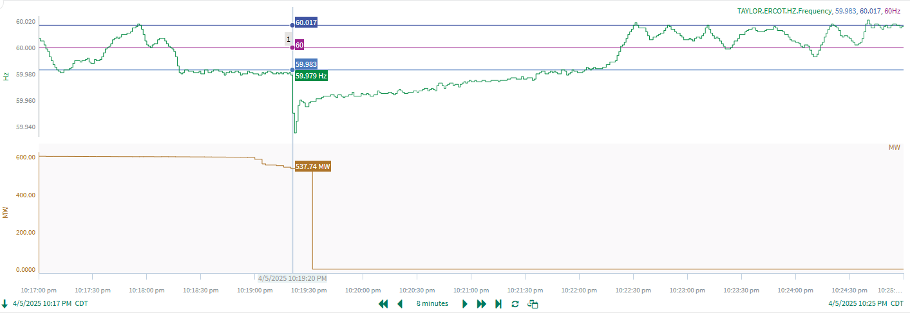
4/5/2025 22:19:20 (Non-FME)
Notes:
The unit tripped offline while carrying ~ 528 MW
Starting Frequency: 59.979 Hz
Minimum Frequency: 59.935 Hz
A-C Time : 2 seconds
Recovery Time(back to deadband): 2 minutes 43 seconds
ECRS Released: 0 MW
Trip Reason: Unknown at this time
Reason for no selection: Frequency is outside low deadband and C point is 59.935
Contextual Information: A total of 134 MW of regulation Up was deployed during the event.

Slide 4
4/15/2025 7:13:27 (Non-FME)
Notes:
A unit tripped for loss of ~629 MW
Starting Frequency: 59.996 Hz
Minimum Frequency: 59.928 Hz
A-C Time : 2 seconds
Recovery Time(back to deadband): 5 minutes 4 seconds
ECRS Released: 0 MW
Trip Reason: A baghouse issue
Reason for no selection: The C point is 59.928

Slide 5
4/23/2025 5:17:32 (Non-FME)
Notes:
A unit tripped for loss of ~560 MW
Starting Frequency: 60.015 Hz
Minimum Frequency: 59.939 Hz
A-C Time : 3 seconds
Recovery Time(back to deadband): 5 minutes 4 seconds
ECRS Released: 0 MW
Trip Reason: Loss of boiler circulation pumps.
Reason for no selection: The C point is 59.939

Slide 6
4/24/2025 1:03:32 (FME)
Notes:
A unit tripped for loss of ~773 MW
Starting Frequency: 60.012 Hz
Minimum Frequency: 59.916 Hz
A-C Time : 3 seconds
Recovery Time(back to deadband): 5 minutes 6 seconds
ECRS Released: 0 MW
Trip Reason: Unknown at this time
Contextual Information: A total of 13 MW of regulation Up was deployed during the event.

Slide 7
Questions?
Thank you!

