Slide 1
Weekly
RTC+B Market Trials Update
ERCOT Staff
May 5, 2025

Slide 2
Outline
Antitrust Admonition
For first meeting:
Orientation to Market Trials and Key Artifacts
Expectations of QSEs for the Week
Review 2 Handbooks
Communicate any known Issues within On-going Trial
Provide Snapshot of Cumulative QSE Scorecards
Support any Technical and/or Business Questions

Slide 3
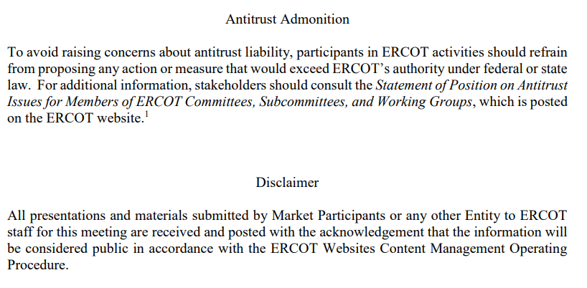
WebEx Meeting reminders (same as other ERCOT forums):
Please keep line muted
If you have a question, please use the chat feature to either:
Type in your question, or
Type in “Question” and wait to be recognized to state question

Slide 4
Sequence and Dates for Market Trials to Go-Live
Market trials are a progression of activities to mitigate the risk for Go-Live on new systems and processes for both the Market Participants & ERCOT.
30-day Market Notice
11/5/25
March/April
2025
Start
5/5/25
Start
7/7/25
Start
9/2/25
Go-Live
12/5/25*
May 2025
June 2025
July 2025
Aug 2025
Sep 2025
Oct 2025
Nov 2025
Dec 2025
QSE Scorecards & Exit Criteria for each Trial Phase
#1 RTC QSE Submission Testing
(Submit COP, RT AS Offers,
DAM Virtual AS, Outages for ESRs)
#3 Open-loop RTC SCED
(QSE offers, SCED non-binding award/dispatch)
#5 Ongoing Open-Loop
& Periodic Closed-loop SCED/LFC
(QSE RTC offers and telemetry to support closed-loop frequency control test 2-3 tests of 2-4 hour durations)
Transition to Go-Live
Upon completion of testing, confirmation of ERCOT and market readiness for Go-Live.
QSE/Vendor Submission Sandbox and Telemetry Points added Prod EMS model.
#2 RTC QSE Telemetry Checkout (QSEs add/verify new telemetry points for UDSP, New ramp rates, ESR telemetry)
#4 QSE Telemetry Tests
(Individual QSE to follow UDSP and support new ramp rate and ESR telemetry)
#6 Day-Ahead Market
(Non-binding DAM using QSE offers for at least 2 tests)
* Go-Live date reflects 12/5/2025 as first Operating Day
where 12/4/2025 is planned software migration.

Slide 5
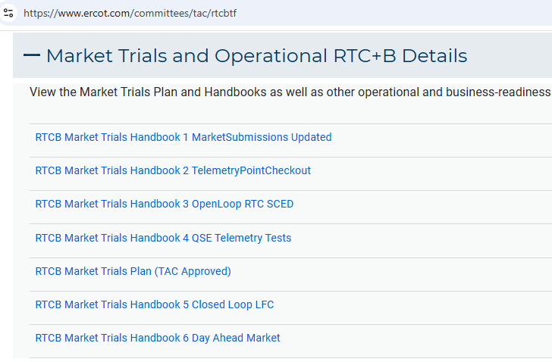
Market Trials
TAC Approved the Market Trials Plan in October 2024
Discussions with RTC+B Task Force have shaped the Handbooks
Handbook #1- QSE Submission Testing
Handbook #2- QSE Telemetry Tests
Handbook #3- Open Loop SCED
Handbook #4- QSE Telemetry Tests
Handbook #5- Close-Loop LFC Tests (draft)
Handbook #6- Day-Ahead Market Tests (draft)
All are posted on the
RTCBTF Homepage
under Market Trials banner

Slide 6
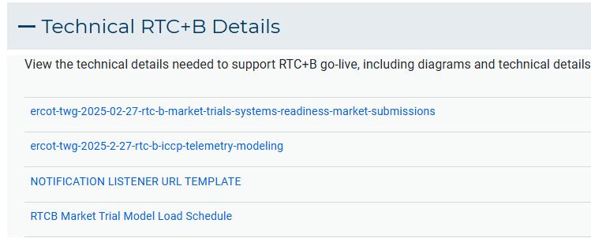
Market Trials
Detailed discussions with TWG have provided technical content details
Digital Certificate details
Connectivity/URL details to User Interfaces and APIs
Reminder of how to submit new ICCP requests
RTC and Production Telemetry connectivity
Network Model Load Schedule
All are posted on the
RTCBTF Homepage
under Technical Details banner

Slide 7
RTCBTF website
We will now open RTCBTF home page and walk through the key materials you will need for next 2 months.
Walkthrough the 2 Handbooks (Nathan and Abhi)
Walkthrough the key technical docs (Sruthi and Tejas)

Slide 8
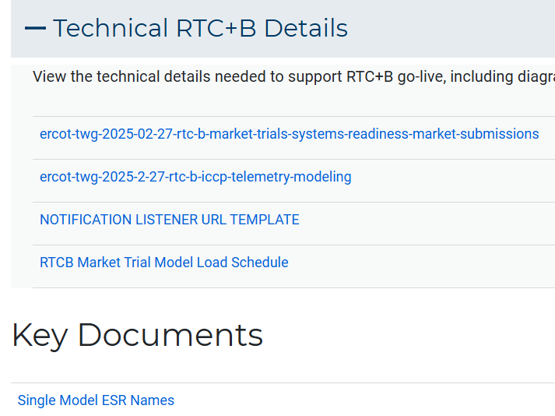
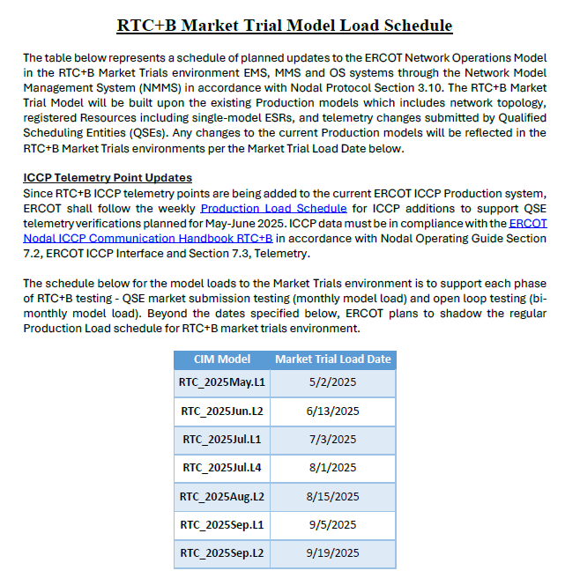
Network Model Schedule and ESRs

Slide 9
Summary of Market Trial activities for this week and following weeks
QSE connectivity and market submissions
Submit to Market Management System and Outage Scheduler
Goal to submit at least one successful transaction for each requested transaction type per QSE once during the 8 week period
QSE set up and population of telemetry points
Submit ICCP requests to ERCOT to add telemetry points
Goal to complete set-up of telemetry
Scoring will not start until Week of May 19

Slide 10
Scorecard example:
Scores for responding to March RTC+B Awareness Readiness Survey for QSE with Resources ~ 107 QSEs
Scoring does not start until week of May 19

Slide 11
Current ERCOT Issues Impacting Trial sequence
No current issues to report

Slide 12
Wrap-Up and Questions
Remainder of meeting time to take questions each week-
First round of questions specifically about this Market Trial period
Second round of questions for more general RTC+B as time allows
Can always email the RTC+B Program mailbox: RTCB@ercot.com
ERCOT is working to develop Market Trials Frequently Asked Question document to evolve during trials.
Thanks for your support!

