Slide 1
Improve Self Commitment within RUC Opt Out Window
Constellation Energy Generation
May 2025

Slide 2
Current Rules Limit Ability to Opt Out of A RUC Instruction
NP 5.5.2 Reliability Unit Commitment (RUC) Process
NP 5.5.2(14): A QSE with a Resource that is not a Reliability Must-Run (RMR) Unit or has not received an Outage Schedule Adjustment (OSA) that has been committed in a DRUC or HRUC process may opt out of the RUC Settlement (or “buy back” the commitment) by setting the COP status of the RUC-committed Resource to ONOPTOUT for the first hour of a contiguous block of RUC-Committed Hours in the Opt Out Snapshot.
Protocol Definition of Opt Out Snapshot
A record of a Resource’s Current Operating Plan (COP) used to determine whether the Resource will opt out of Reliability Unit Commitment (RUC) Settlement for a block of RUC-Committed Hours. The Opt Out Snapshot is taken at the earlier of:
(a) Two hours prior to the end of the Adjustment Period for the first hour of a contiguous block of RUC-Committed Hours; or
(b) Two hours prior to the beginning of the hour that is at least N hours prior to the first hour of the contiguous block of the RUC-Committed hours, where N is the start time contained in the ERCOT computer system at the time of the RUC execution associated with the RUC instruction corresponding to the Resource’s warmth state. If the RUC-Committed Hours are an extension of a Qualified Scheduling Entity (QSE)-Committed Interval either before or after, N will be set to zero. For a Combined Cycle Generation Resource within a Combined Cycle Train, including a RUC to a different configuration with additional capacity, the start time is the start time corresponding to the specific configuration of the RUC-committed Combined Cycle Generation Resource.

Slide 3
Limited Ability to Opt Out A RUC Instruction
In order to opt out successfully, a QSE needs to take action at least (two hours + warm start up hours) ahead. If the warm start up time is three hours, a QSE needs to make a decision five hours ahead.
ERCOT operators have historically waited until the startup deadline to issue the first RUC interval/hour.
The QSE could not Opt Out of either the initial or subsequent RUC instruction.
Suggested solutions:
A generator must be given adequate time to opt-out when it receives RUC instructions, similar to the timeline it would normally have to self-commit.

Slide 4
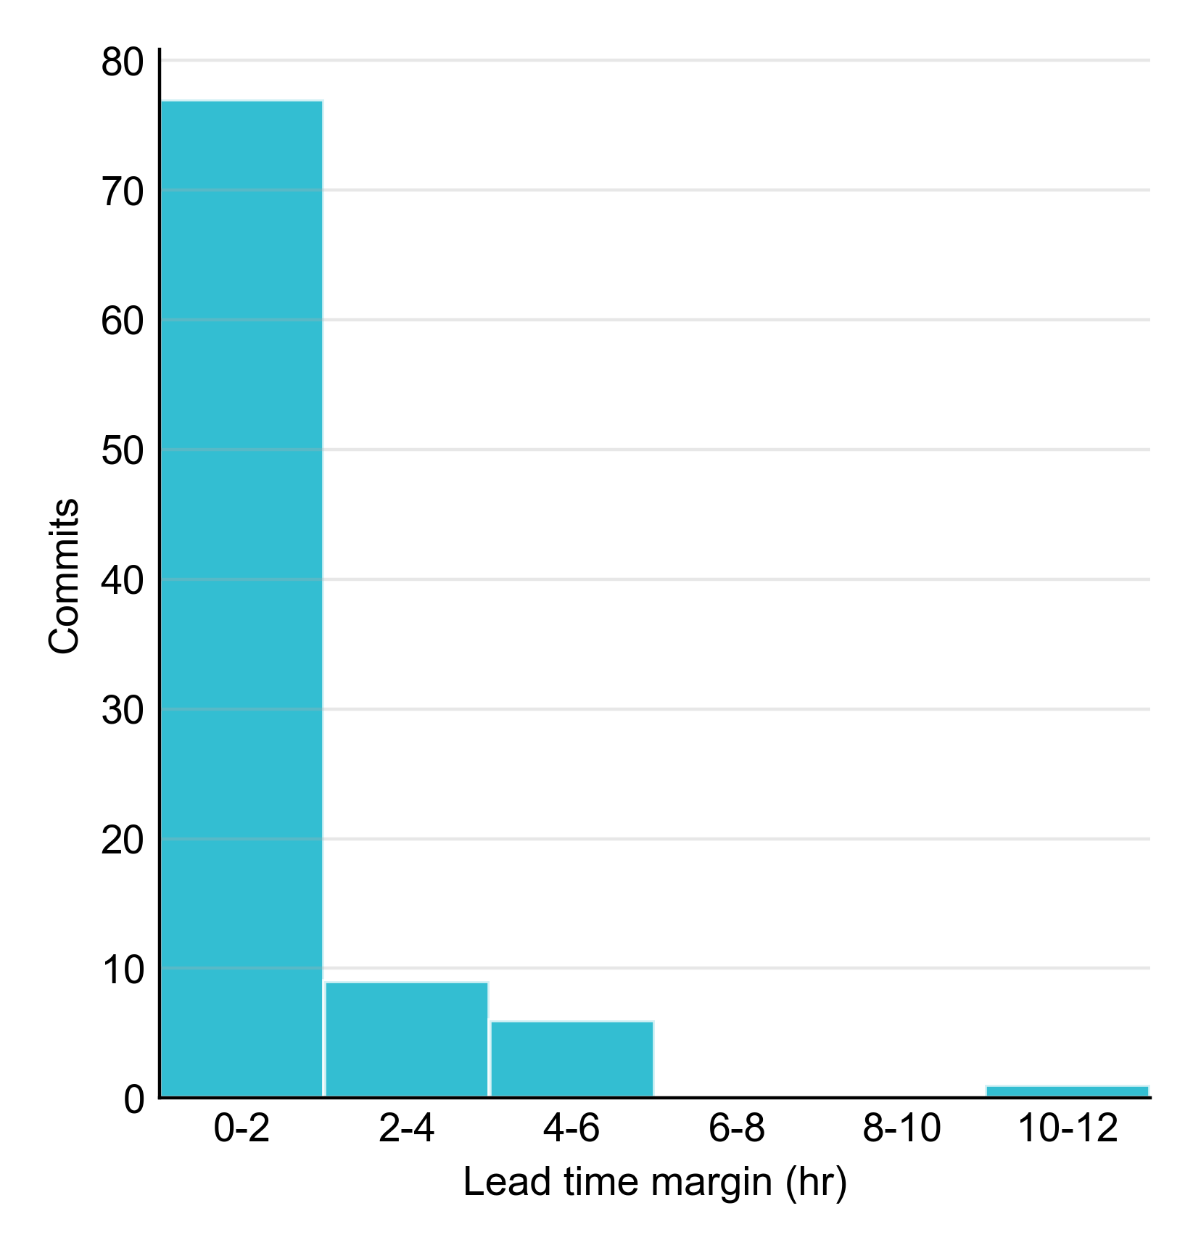
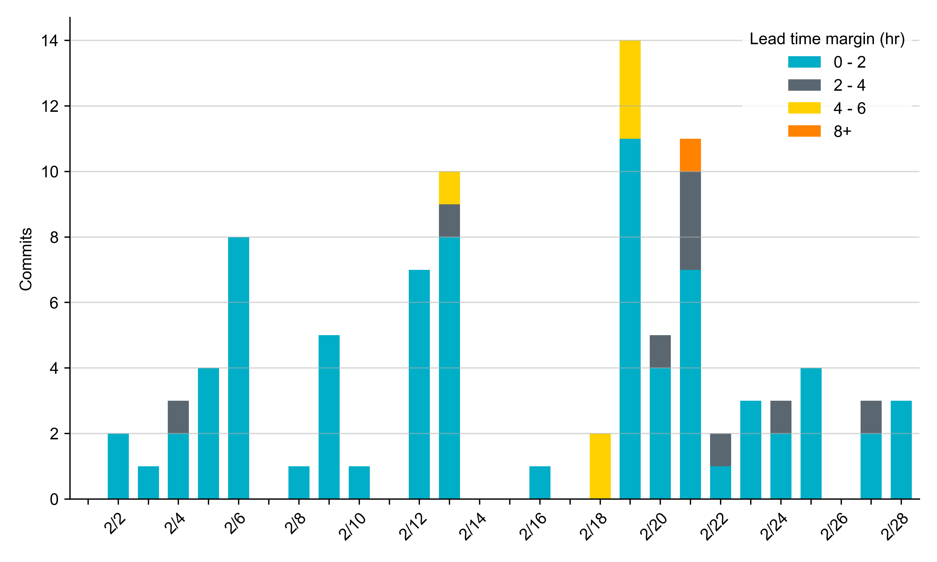
RUC Lead Time Margin: February 2025
Most RUC commitment windows (83%) had a lead time margin of 2 hours or less.
Lead time refers to the length of time between a RUC instruction and the start of the commitment window.
Lead time margin is the difference between lead time and the Resource’s startup time.
In cases where a Resource is committed for multiple back-to-back time blocks, lead time margin is calculated from the first instruction.

Slide 5
RUC Resource-Hours
February 2025 | Total | Capacity |  | Congestion
 |  | Opt-Out | Non-Opt-Out | Opt-Out | Non-Opt-Out
Instructed Resource-Hours
Total Count | 841.4 | 25 | 388.4 | 17 | 411
Effective Resource-Hours*
Total Count | 803.3 | 25 | 376.2 | 17 | 385.1
Average Megawatts (MW) for Effective Resource-Hours
Average LSL | 110.6 | 128.7 | 106.8 | 70.6 | 114.9
Average LDL | 120.3 | 129.5 | 119.1 | 73.3 | 122.9
Average BP | 123.2 | 158.1 | 120.6 | 78.5 | 125.5
Average HSL | 314 | 266.4 | 294.3 | 242.7 | 339.6
* The difference between “Instructed” and “Effective” values is a result of Resources starting up, shutting down, receiving partial hour instructions, or otherwise not being dispatchable by SCED.

Slide 6
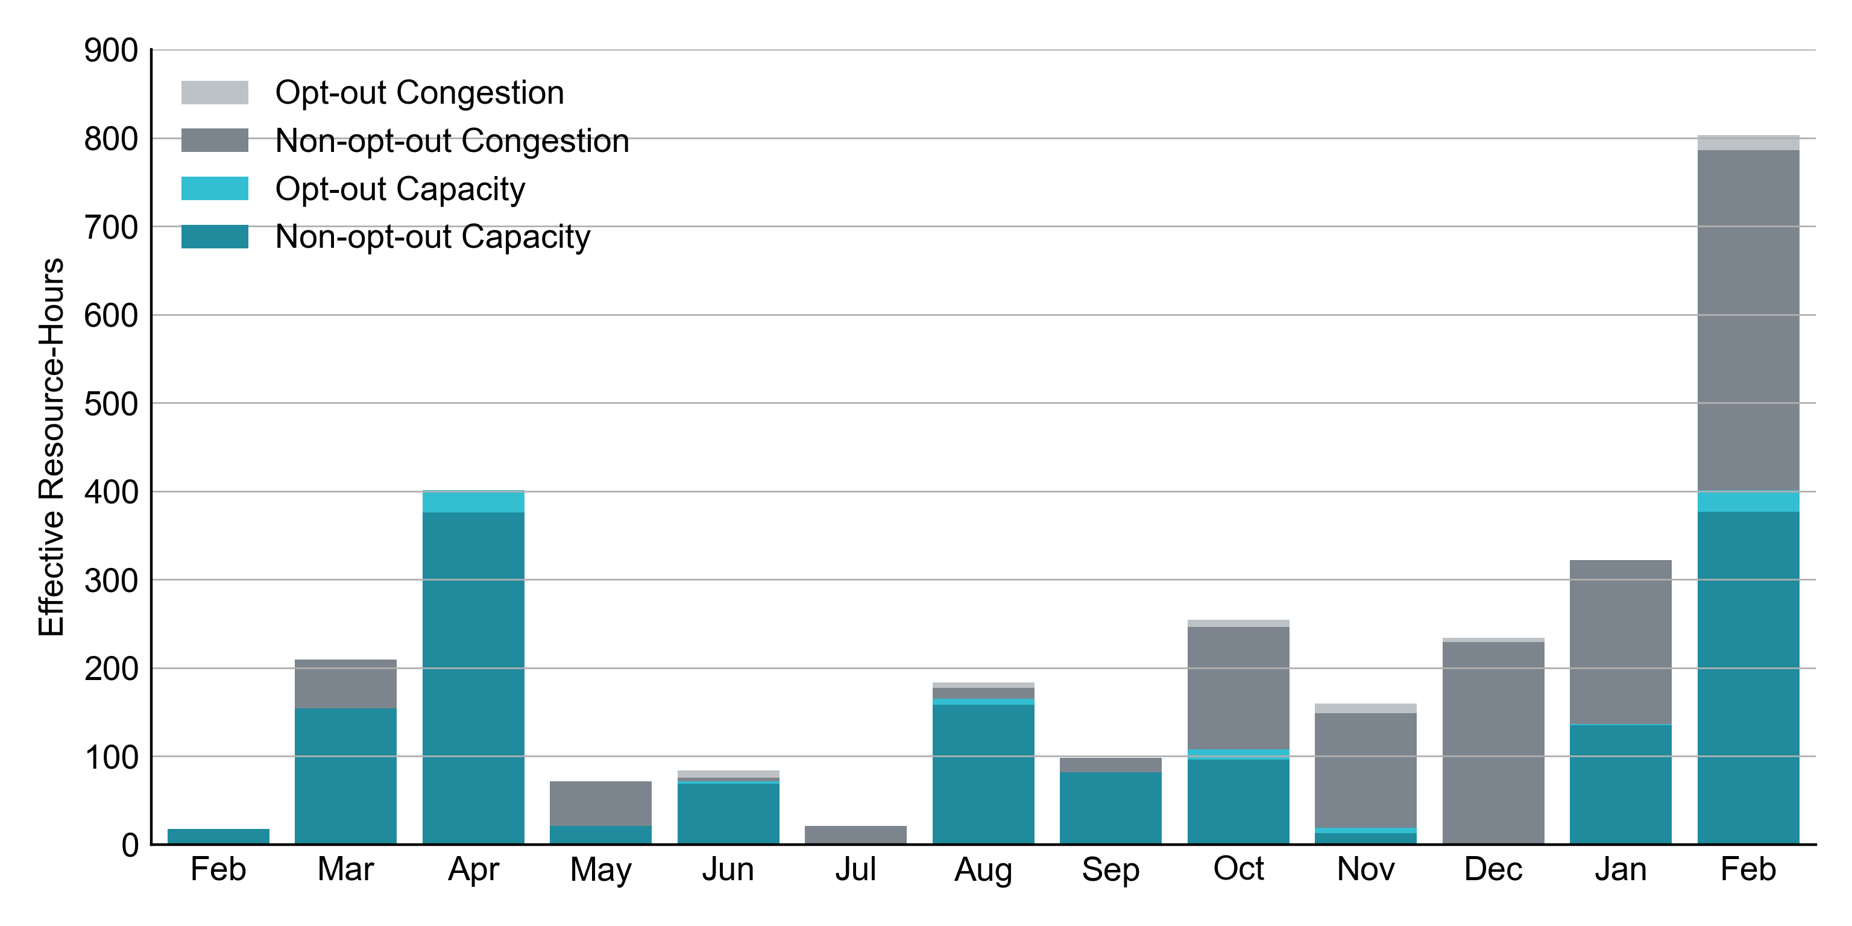
RUC Instruction Reasons: Last 13 Months RUC effective hours in February 2025 were deployed about equally to resolve congestion and ensure sufficient capacity.

Slide 7
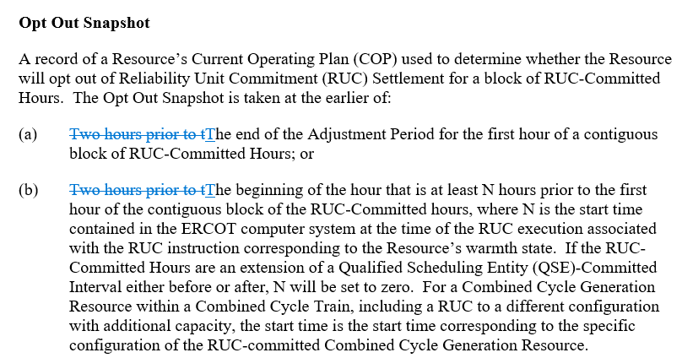
Proposed Protocol Revision Language:

Slide 8
Thank You
Any questions or additional suggestions to improve self commitment?

