Slide 1
DWG Report to ROS
Fahad Qureshi – DWG Chair
May 1st , 2025

Slide 2
DWG Update
DWG Webex meeting held on 4/17/2025
PGRR124 (ESR Maintenance Exception to Modifications)
Tesla shared their approach to manage battery (mega-pack) degradation and implications it has from a generation interconnection perspective
Approach is for customers to manage degradation by augmenting batteries to their site while maintaining overall plant performance by derating via firmware updates
ERCOT/TSP questioned how Tesla can ensure the augmentation does not result in negative impact/performance to the system
Based on what equipment is being augmented and its performance, ERCOT feels like the current processes may already allow for some of the proposed exceptions (e.g. PGRR 109)
Additional discussions to take place with Tesla

Slide 3
DWG Update, continued
PGRR120 (SSO Prevention for Generator Interconnection)
ERCOT reviewed proposed Planning Guide language changes for PGRR120
Lonestar and AEP requested additional time to review comments as they were posted the day before the meeting
Will continue discussion at next ad-hoc DWG Meeting (May 15th)
SSWG response to DWG requests
Request 1 - MPT modeling in SSWG Cases for EXDS units
SSWG currently unable to accommodate request
DWG will model MPT as part of flatstart build (requires PM update)
Request 2 - Transition to PSSE v36
SSWG unable to transition to v36 due to PTI software limitations
DWG will begin collecting data for v36 transition (requires PM update)
DWG will update Procedure Manual and request ROS approval in June/July

Slide 4
DWG Update, continued
Extraordinary Dispatch (EXDS) Generation in Flat Start Cases
Discussed Procedure Manual language changes to accommodate modeling of EXDS generators in flatstart cases
Discussion will continue at next DWG Meeting
DWG will update Procedure Manual and request ROS approval in June/July
Large Load Stability Study Approach/Screening Techniques
ERCOT summarized feedback received: study area, estimated load loss, location of project within GTC; however, approaches from feedback are not consistent
ERCOT is working on a proposal based on feedback received and will reach out to TSP to discuss further
Draft of Stability Study Whitepaper is complete and was emailed for DWG review
Updated SSO Scope for large loads nearing completion, ERCOT is looking for feedback prior to finalizing and posting to DWG Webpage

Slide 5
DWG Update, continued
Flat Start update
Stability Book and Contingency Tool have been posted to MIS
ERCOT shared proposed Procedure Manual update for posting load model data to MIS
Discussed possibility of addition of dynamic models for large loads to flatstart cases
Continue work on NERC case quality metrics
Addition of New Large Loads co-located with generators
AEP shared simulation plots from their testing where including loads co-located with generators resulted in oscillation when performing Voltage Ride Through (VRT) test
ERCOT is in the process of updating the Model Quality Test (MQT) guidelines to address
Large Load Model Survey Form
AEP shared survey form co-developed by DWG members to gather load data prior to performing studies
Data included in survey: facility design & location, basic load information, technical characteristics, equipment data, dynamic model, site backup, protection settings, SSO

Slide 6
DWG Update, continued
Action items agreed to at April DWG meeting
Transitioning from PSS/E version 35 to version 36+, with a tentative date of June 2026.
As part of the transition efforts, ERCOT plans to issue a Market Notice in May informing REs and IEs of the requirement to submit dynamic models compatible with PSS/E version 36.
Procedure Manual [UPDATE 1] edits related to AGS-ESR (e.g., Sections 3.1.5 [p. 10] and 3.1.5.10–15 [pp. 29-38], 3.1.6 [p. 38) (requesting ROS vote today)
Procedure Manual [UPDATE 2] edits related to the removal of the ALDR paragraph and the edits for the dynamic load model sharing practice in Section 3.4.4 (Load Model Data) [p. 46] (requesting ROS vote today)

Slide 7
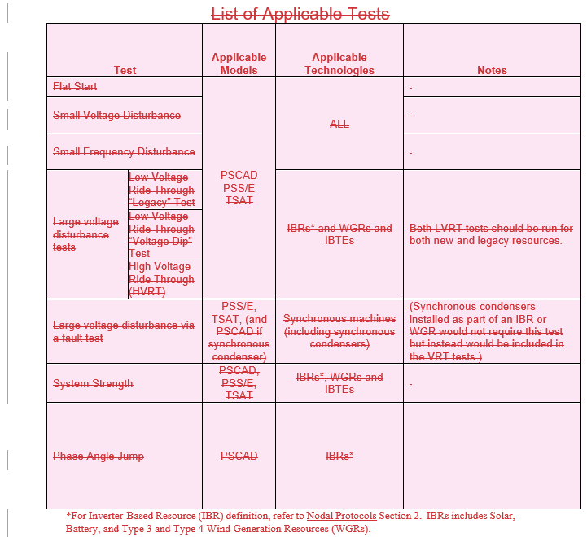
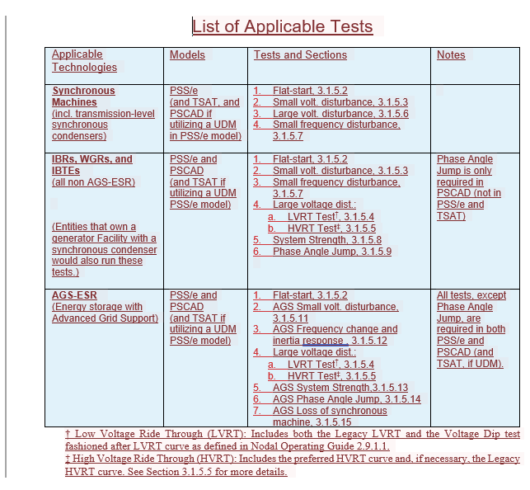
Procedure Manual Update 1
Procedure Manual [UPDATE 1] edits related to AGS-ESR (e.g., Sections 3.1.5 [p. 10] and 3.1.5.10–15 [pp. 29-38], 3.1.6 [p. 38) (requesting ROS vote today)

Slide 8
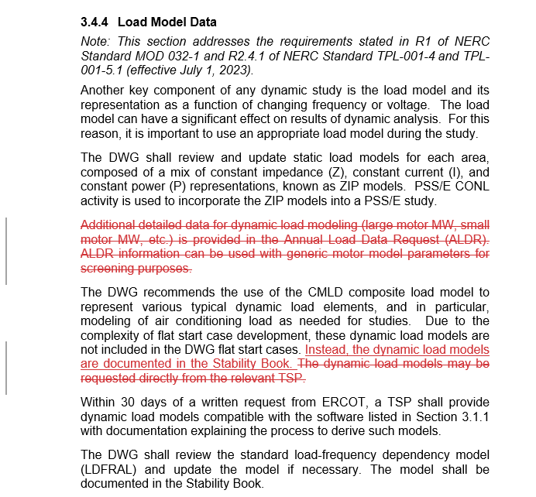
Procedure Manual Update 2
Procedure Manual [UPDATE 2] edits related to the removal of the ALDR paragraph and the edits for the dynamic load model sharing practice in Section 3.4.4 (Load Model Data) [p. 46] (requesting ROS vote today)

Slide 9
Questions or Feedback?

