Slide 1
SSWG Report to ROS
May 1, 2025
Chair: Zach Walker (Zachary.Walker2@oncor.com)
Vice Chair: Chris Ramirez (cramirez@wettllc.com)

Slide 2
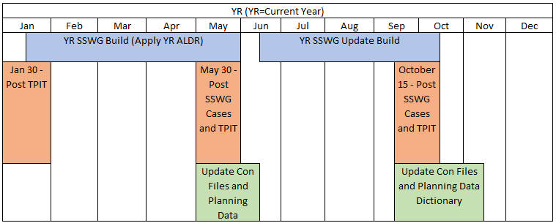
SSWG Updates
Key Dates & Updates
25SSWG Case Build #1
Currently Ongoing
Post-Dispatch Tuning Meetings: 4/28/25 – 4/30/25
Significant difficulty producing solving cases
Several TSPs included Officer Letter Load (OLL) in SSWG Cases
Not enough generation to support additional load levels
Posting could be delayed up to two weeks
Target Posting: 5/23/25 6/6/25
Path Forward
SSWG will turn-off OLL’s to produce solving cases and meet Posting Deadline for 25SSWG
Will additionally provide non-solving case set with OLL online for internal studies
Moving forward, SSWG will draft Procedure Manual Revisions to better outline process & methodology for OLL inclusion
SSWG Report to ROS External

Slide 3
SSWG Updates
Updates
SCR 789
SSWG overall supports
Still working on joint-meeting with other working groups to better outline requirements
SSWG Procedure Manual (PM) Updates
One additional revision added at SSWG Meeting yesterday
Will bring PM for consideration at June ROS
SSWG Report to ROS External

