Slide 1
Description of the Enhanced Emergency Settlement Methodology for Price Correction Events
Magie Shanks
ERCOT
Wholesale Market Working Group (WMWG)
May 05, 2025

Slide 2
Background
While running the analysis on the recent price correction event for Operating Days August 12 through September 11, 2024, ERCOT identified some unwarranted payments to Resources under the Emergency Operations Settlement.
ERCOT refined the current methodology to limit the additional payment for Emergency Operations Settlement to those Resources for whom it was appropriate to be made whole under a price correction event.
This refinement only impacts the determination of which Resource’s qualify for Emergency Operations Settlement during the price correction event. There is no change to the price correction calculations and the corrected prices will be used for all settlement calculations.

Slide 3
Protocol References
Paragraph (6)(c) of Section 6.3 Adjustment Period and Real-Time Operations Timeline:
  (6) If it is determined that any Real-Time Settlement Point Prices, Settlement Point LMPs, Electrical Bus LMPs, Real-Time prices for energy metered, Real-Time On-Line Reliability Deployment Price Adders, Real-Time On-Line Reliability Deployment Prices, Real-Time On-Line Reserve Price Adders, Real-Time Off-Line Reserve Price Adders, Real-Time Reserve Prices for On-Line Reserves, Real-Time Reserve Prices for Off-Line Reserves, and/or constraint Shadow Prices are erroneous, ERCOT shall correct the prices before the prices are considered final in paragraph (7) below. Specifically:
    (c) If the Base Points received by QSEs are inconsistent with the Real-Time Settlement Point Prices reduced by the sum of the Real-Time On-Line Reliability Deployment Prices and the Real-Time Reserve Prices for On-Line Reserves averaged over the 15-minute Settlement Interval, then ERCOT shall consider those Base Points as due to manual override from the ERCOT Operator and settle the relevant Settlement Interval(s) in accordance with Section 6.6.9, Emergency Operations Settlement.
Paragraph (4) of Section 6.6.9, Emergency Operations Settlement:
  (4) QSEs that received Base Points that are inconsistent with Real-Time Settlement Point Prices and QSEs that receive a manual override from the ERCOT Operator shall be considered for additional compensation using the formula in Section 6.6.9.1. If the Resource Settlement Point Price at the Resource Node is lower than the Energy Offer Curve price, capped per the MOC pursuant to Section 4.4.9.4.1, at the held Base Point during the 15-minute Settlement Interval, ERCOT shall pay the QSE additional compensation for the amount of energy from a zero Base Point to the held Base Point….

Slide 4
Previous Methodology
For Settlement Intervals impacted by the price correction, ERCOT would run all Generation Resources through the Emergency Operations Settlement, regardless of if the issue that led to the price correction had an impact on that Resource’s dispatch.
ERCOT would calculate the difference between the Real-Time Settlement Point Price and the price on the Resource’s Energy Offer Curve, capped by the MOC.
If the Resource was financially harmed by the price correction, ignoring the ability of the Resource to be dispatched differently, the Emergency Operations Settlement would calculate a make-whole payment using the delta price and the minimum of the aggregated base point or Real-Time Metered Generation (RTMG) for each Settlement Interval.

Slide 5
Enhanced Methodology
An additional step was added to determine the eligibility of each Settlement Interval for each Generation Resource.
Resources whose Base Points did not change between the actual SCED optimization and the re-calculated optimization using the appropriate telemetry MW are no longer eligible for Emergency Operations Settlement since it is understood that their dispatched quantities were indifferent to the price and they were effectively price-takers.
  I.e., if the two Base Points are the same, then the Base Points should not be deemed to be inconsistent with the prices.
Reasons why some Resources did not have a change in Base Point:
  Had a Resource status of ONTEST or ONHOLD
  HDL = LDL; SCED is unable to dispatch these Resources
  Their original dispatch was correct

Slide 6
Example
 | Q1 | P1 | Q2 | P2
EOC | 0 | $4999.99 | 100 | $5000
MOC | 0 | $5000 | 100 | $5000
After further review of the data, this Resource had a status of ‘ONTEST’ during the price correction event and was therefore a price taker and did not need to receive the additional make-whole payment through Emergency Settlements.
 | Int1 | Int2
RTSPP | $35 | $35
AEBP | 20MWh | 25MWh
RTMG | 19MWh | 27MWh
EMRE | 19MWh | 25MWh
EBPWAPR | $4999.99 | $4999.99
EMREPR | $4964.99 | $4964.99
EMREAMT | -$94,334.81 | -$124,124.80
AEBP = Aggregated Emergency Base Point
EMRE = Emergency Energy = Min (AEBP, RTMG)
EBPWAPR = Weighted Average Price on the Resource’s EOC, capped by the MOC
EMREPR =Emergency Energy Delta price = Max(0, EBPWAPR – RTSPP)
EMREAMT = Emergency Settlement Payment = (-1* EMRE * EMREPR)

Slide 7
Update on the Price Correction Event
On April 7, 2025, the ERCOT Board reviewed and approved the price correction for 27 days between OD 8/12/24 – 9/11/24.
While preparing the data for resettlements, ERCOT identified an error in the input data to the calculation of the Emergency Operations Settlement. ERCOT adjusted the calculated price data to account for the Resources that are no longer eligible for payment, however, for intervals with negative RTSPPs, the Emergency Settlement inadvertently calculated a payment.
After correcting the data for this error, it was determined that 2 ODs that originally qualified for resettlement, September 4 and 11, no longer qualified. These 2 ODs will not be resettled.
Market Notice was sent on April 24, 2025: M-A091124-03

Slide 8
Appendix

Slide 9
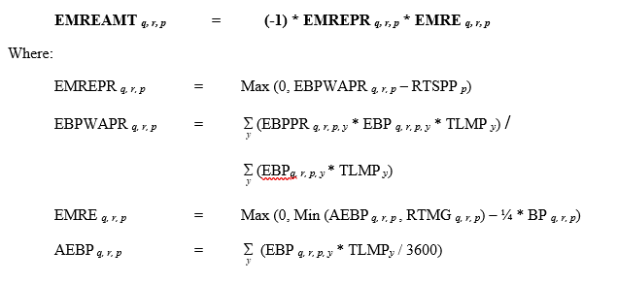
Section 6.6.9.1

