Slide 1
Unregistered Distributed Generation Report:
2024 Annual Report
2025 Q1 Update
Resource Adequacy
5/7/2025

Slide 2
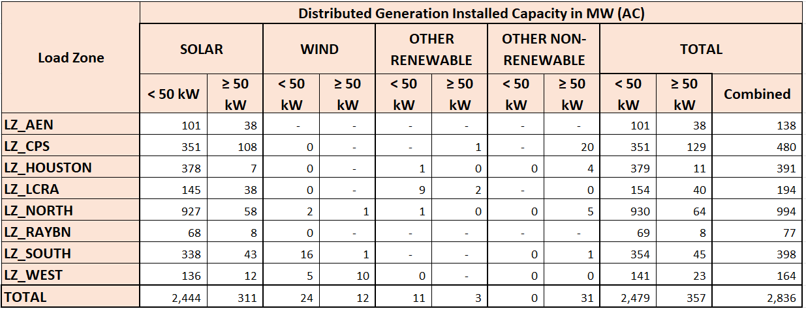
2024 Annual Unregistered Distributed Generation Report
DG Battery Energy Storage not included in the table above
(40.51 MW Competitive, 12.35 MW NOIEs, 52.86 MW Total)
Totals may not match the sum of their columns/rows due to rounding
Notes:
Competitive and NOIE breakdown:
Competitive: 1,596 MW
NOIE: 1,240 MW
* For annual DG report, all NOIE and Competitive capacity is listed.
* Other Renewable category includes: biomass (wood/wood wastes), landfill gas, other biomass gases, and water
* Other Non-Renewable category includes: bituminous coal, subbituminous coal, lignite coal, petroleum coke, distillate fuel oil, natural gas, other gases, and waste heat not directly attributed to a fuel source

Slide 3
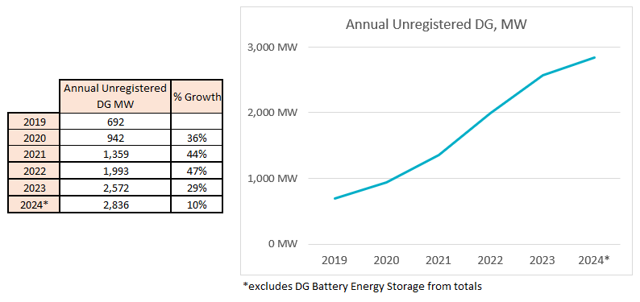
Annual Unregistered DG Growth Comparison
Competitive TDSP data: Same as 2024 Q4 quarterly report
NOIE data: All NOIEs required to report all capacity in annual report
Notes:
Competitive and NOIE breakdown:
Competitive: 1,596 MW
NOIE: 1,240 MW

Slide 4
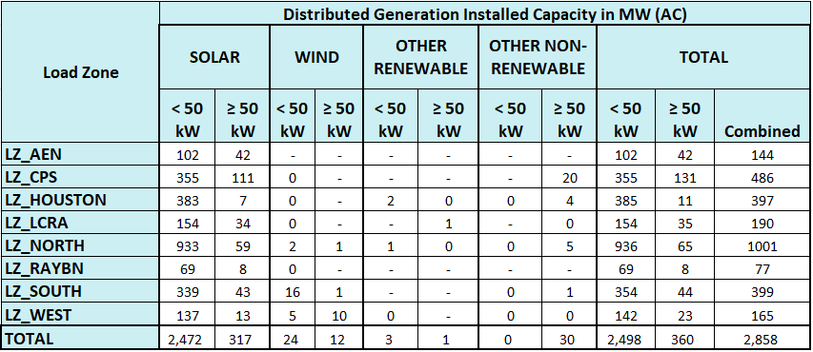
2025 Q1 Unregistered Distributed Generation Report
DG Battery Energy Storage not included in the table above
(52.46 MW Competitive, 17.23 MW NOIEs, 69.69 MW Total)
Totals may not match the sum of their columns/rows due to rounding
Notes:
Competitive and NOIE breakdown:
Competitive: 1,625 MW
NOIE: 1,233 MW
For the quarterly report, NOIE capacity below 50 kW only includes information from NOIEs that have more than two MW of aggregate capacity from those sites.

Slide 5
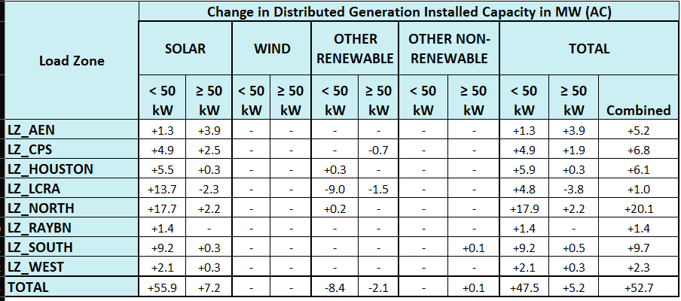
2024 Q4 → 2025 Q1 Change
Decreases from NOIE data due to the following reasons: unit retirements
data corrections (DC/AC conversion), DG battery energy storage removal
Totals may not match the sum of their columns/rows due to rounding

Slide 6
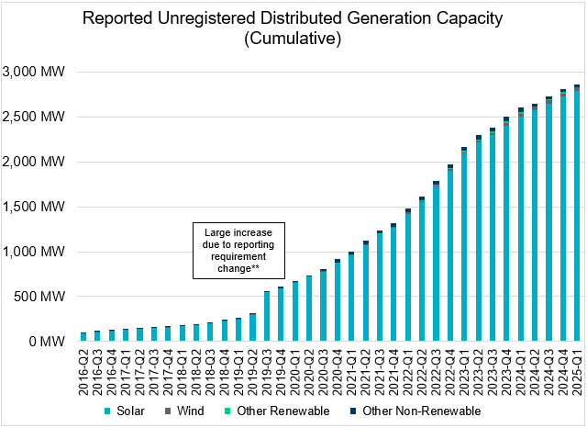
Unregistered DG Growth: 2016-Q2* to 2025-Q1
* 2016-Q2 was the first report published after implementation of report changes per NPRR794/COPMGR044
** 2019-Q3 was the first report published after implementation of report changes per NPRR891

