Slide 1
PDCWG Report to ROS
Chair: Chad Mulholland, NRG
Vice Chair: N/A
ROS
May 1st, 2025

Slide 2
Report Overview & Notes
Report Overview
Meeting Minutes
Annual Inertia Presentation
NPRR1278 - Establishing Advanced Grid Support Service as an Ancillary Service
RTCB Telemetry for Resources with Power Augmentation Capacity
NPRR1257/NOGRR271 - RRS Limits Update
Status on BAL-001-TRE, SAR-13
BAL-001-TRE-2 FMEs and IMFR
1 FME in the month of March
Frequency Control Report

Slide 3
Frequency Measurable Events Performance

Slide 4
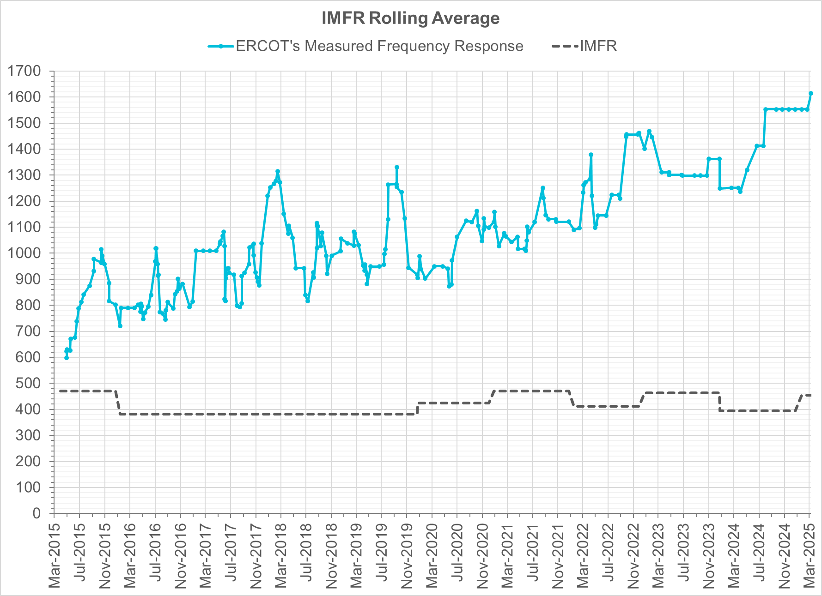
Interconnection Minimum Frequency Response (IMFR) Performance
IMFR Performance currently
1613.67 MW/0.1HZ
Frequency Response Obligation (FRO): 455 MW/0.1 Hz

Slide 5
Questions?

Slide 6
Frequency Control Report
March 2025

Slide 7
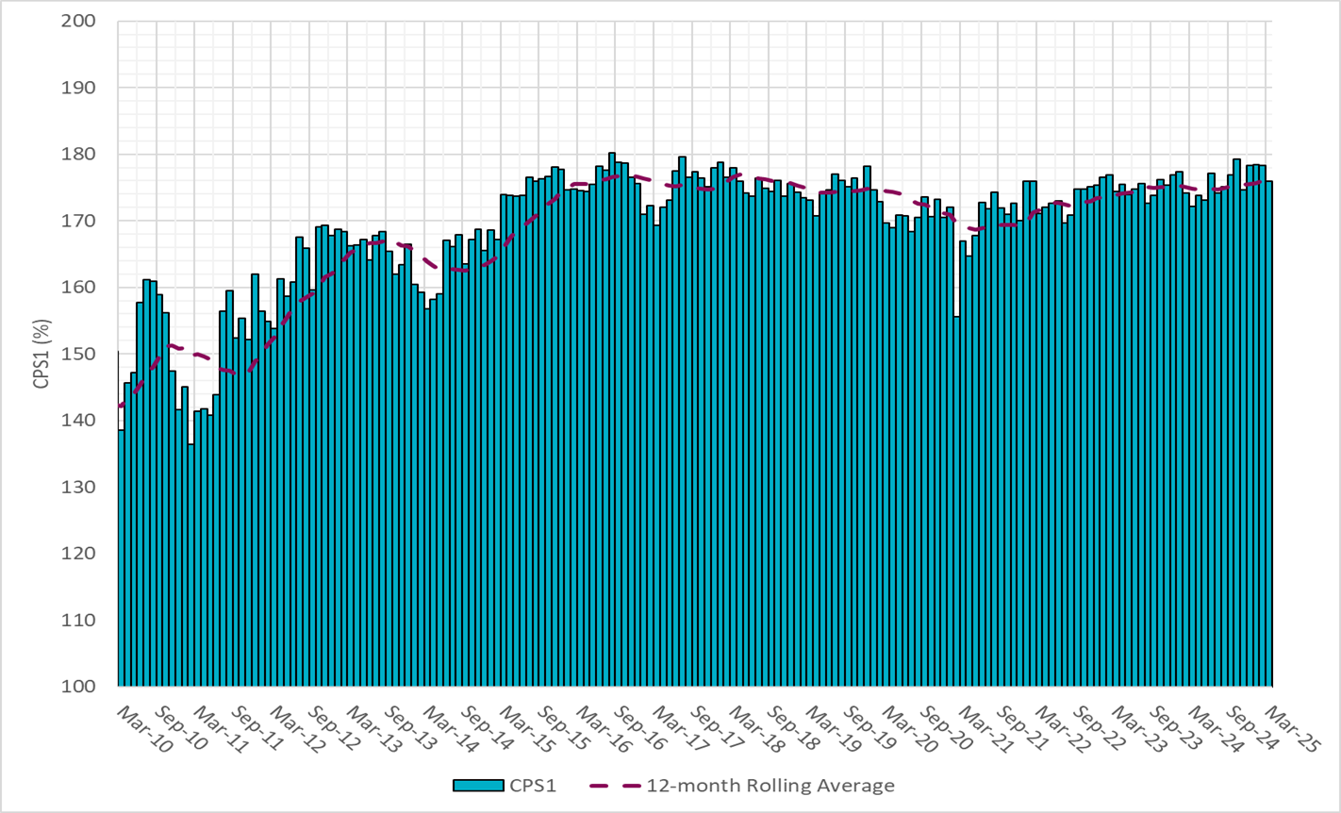
CPS1 Performance

Slide 8
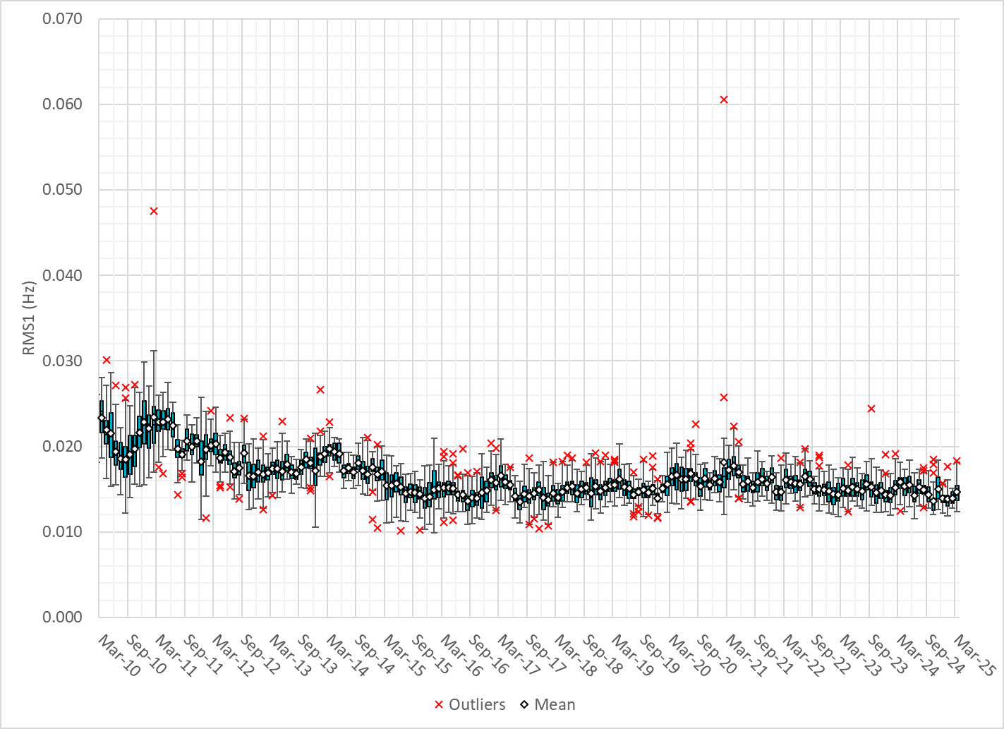
RMS1 Performance of ERCOT Frequency
Notes:
14.18 mHz on avg for March 2025

Slide 9
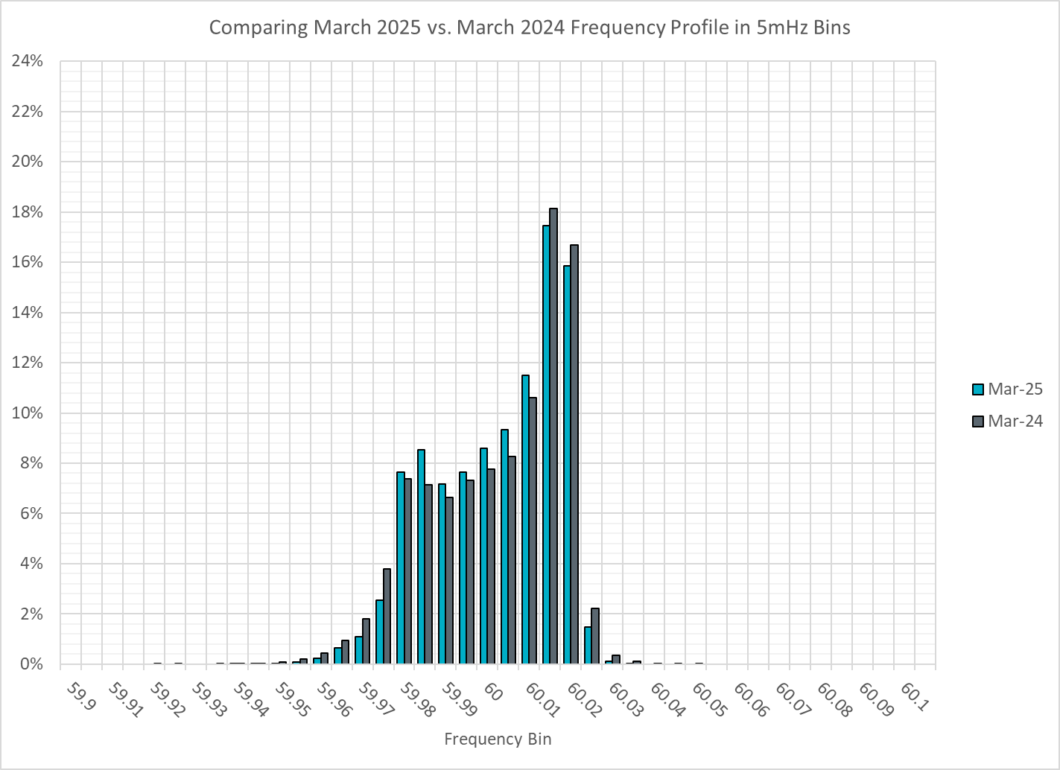
Frequency Profile Analysis

Slide 10
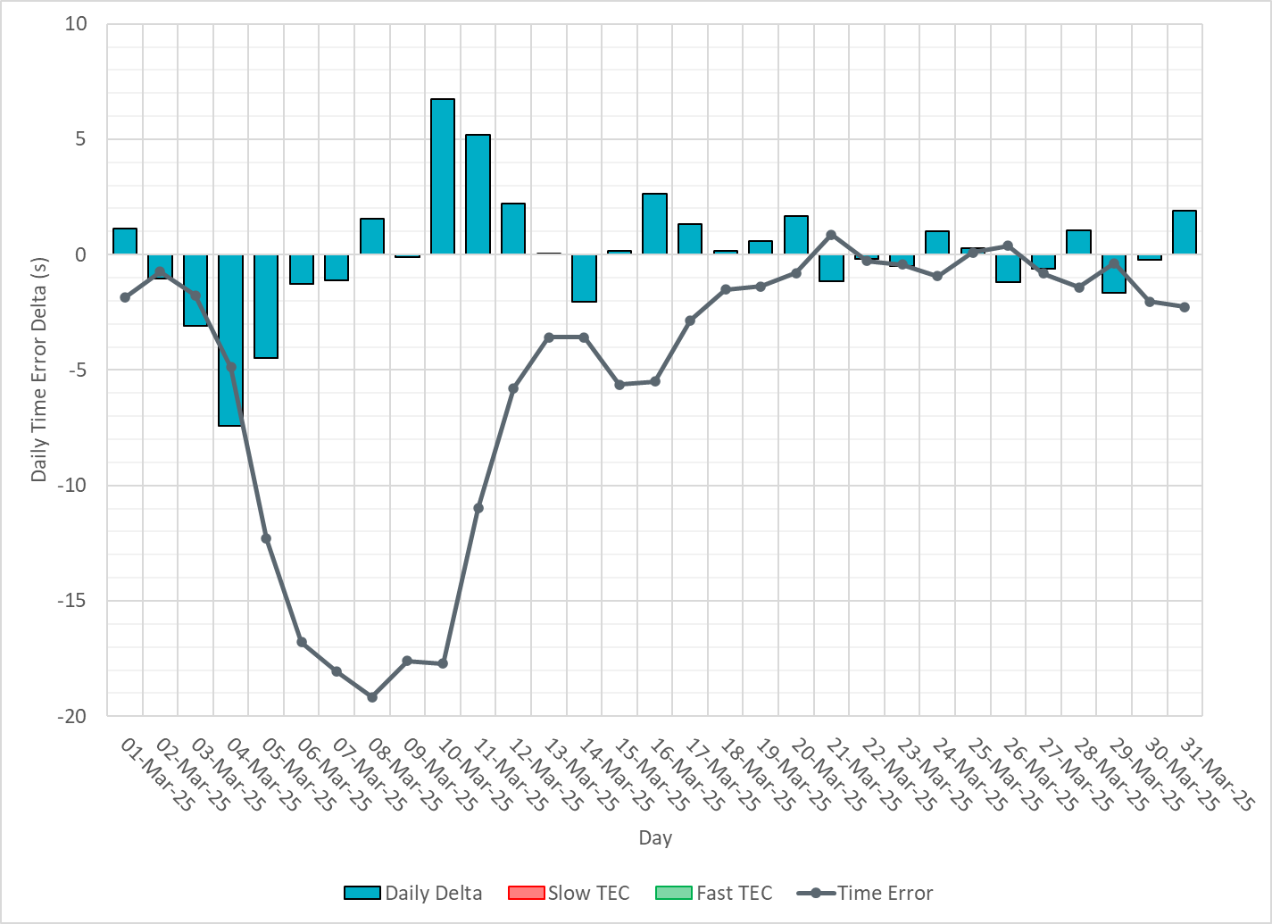
Time Error Corrections
Notes:
Time error is negative throughout March. We saw significant accumulation in the first two weeks. ERCOT observed real-time telemetry and operational issues from wind and solar units which effected the ERCOT frequency control. ERCOT has been working with the Market Participants to address the operational issues. ERCOT tuned the GTBD ACE integral feedback to recover the time error.

Slide 11
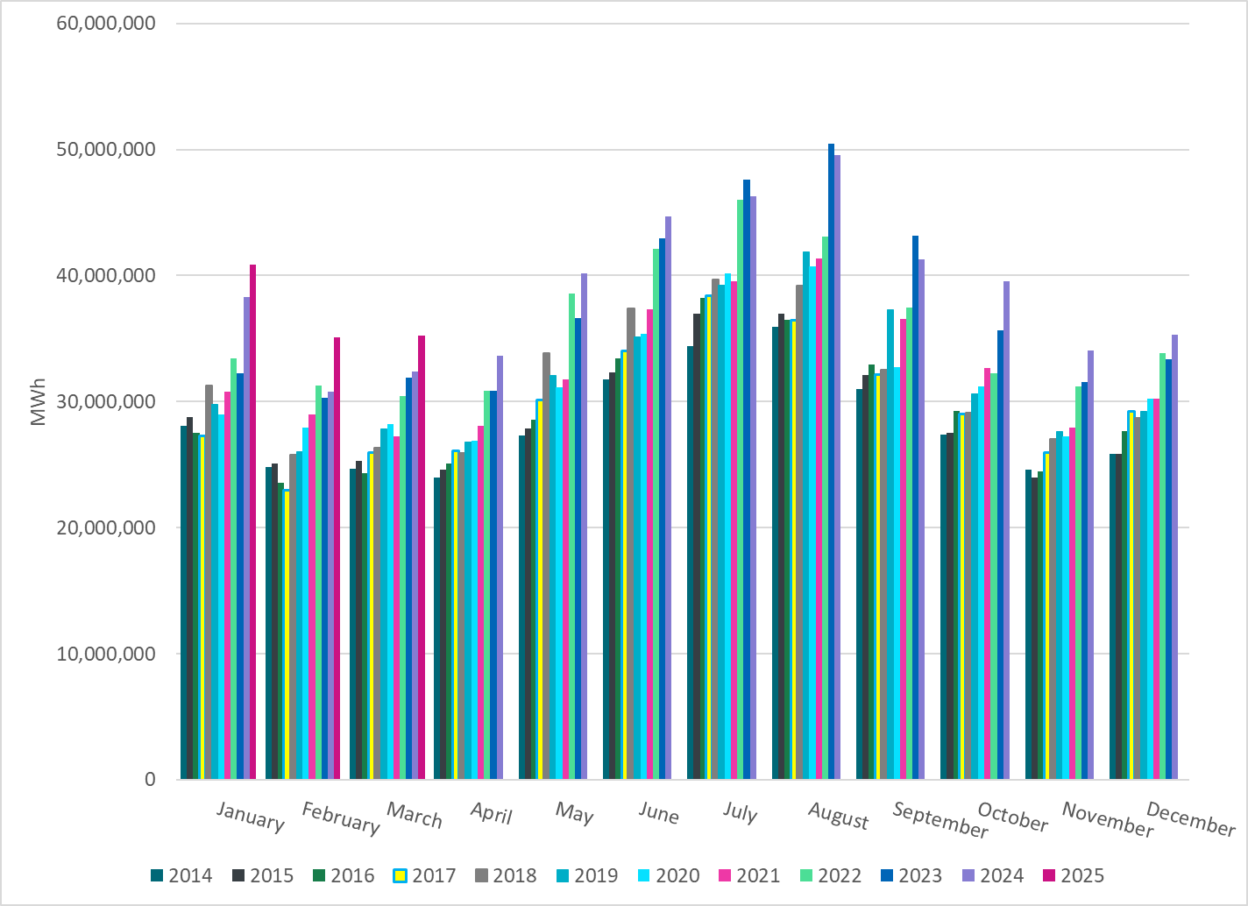
ERCOT Total Energy
Notes:
35,208,781 MWh

Slide 12
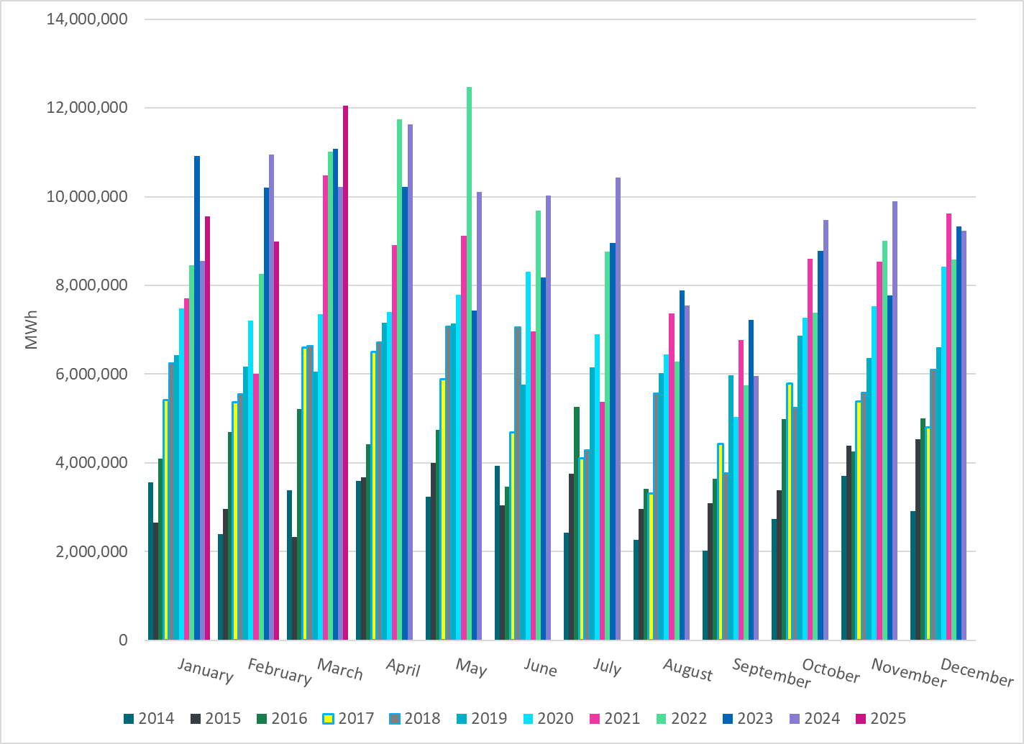
ERCOT Total Energy from Wind Generation
Notes:
12,055,131 MWH

Slide 13
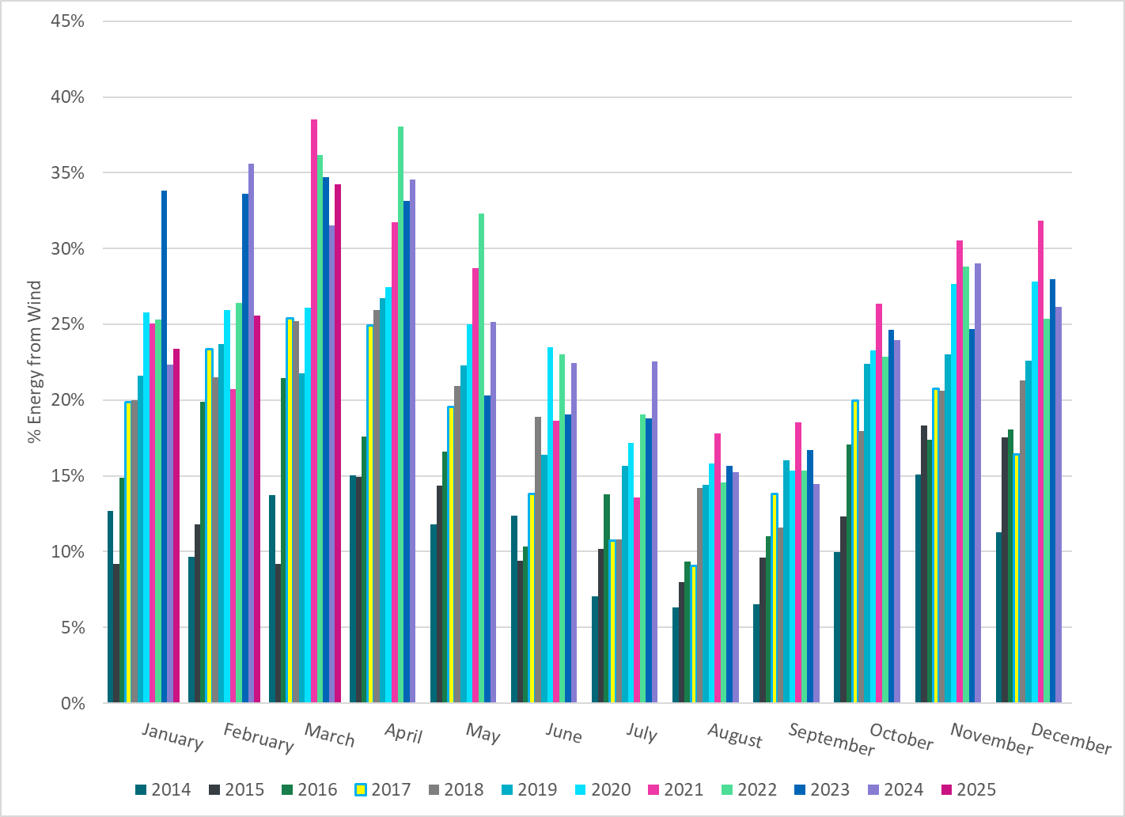
ERCOT % Energy from Wind Generation
Notes:
34.24% of total energy was provided by wind generation

Slide 14
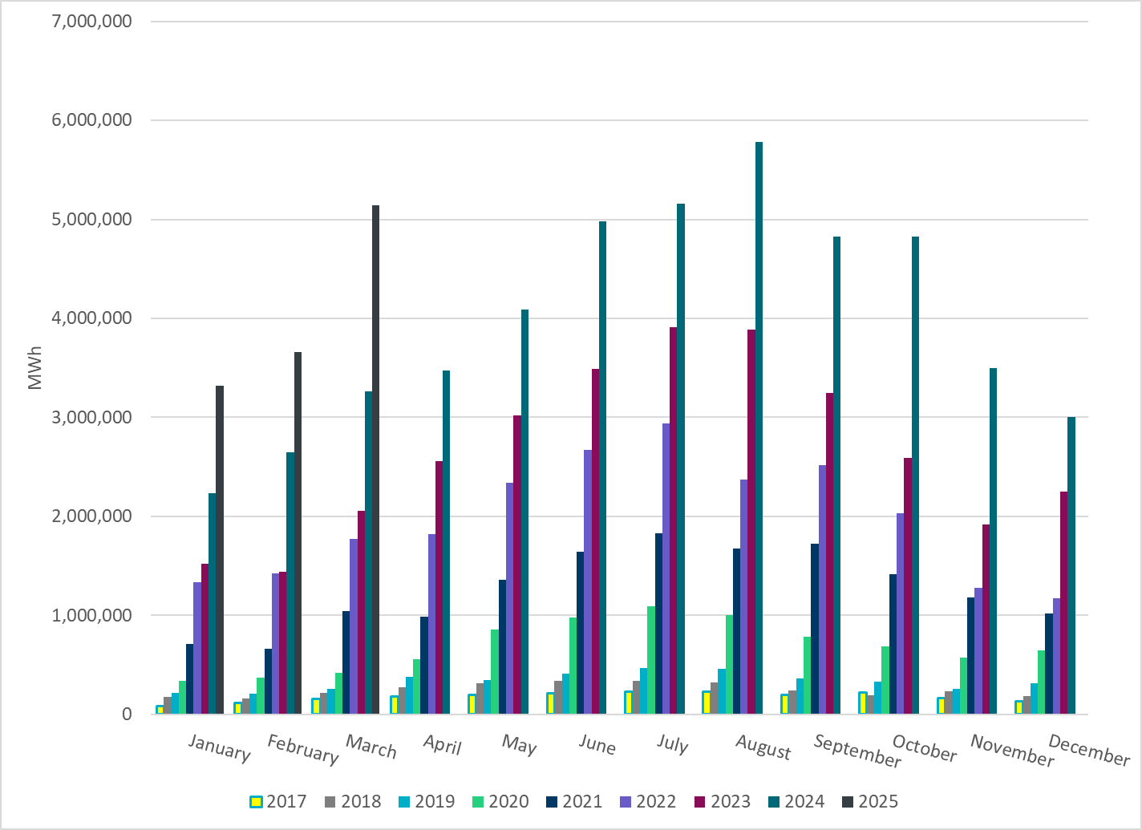
ERCOT Total Energy from Solar Generation
Notes:
5,143,399 MWh

Slide 15
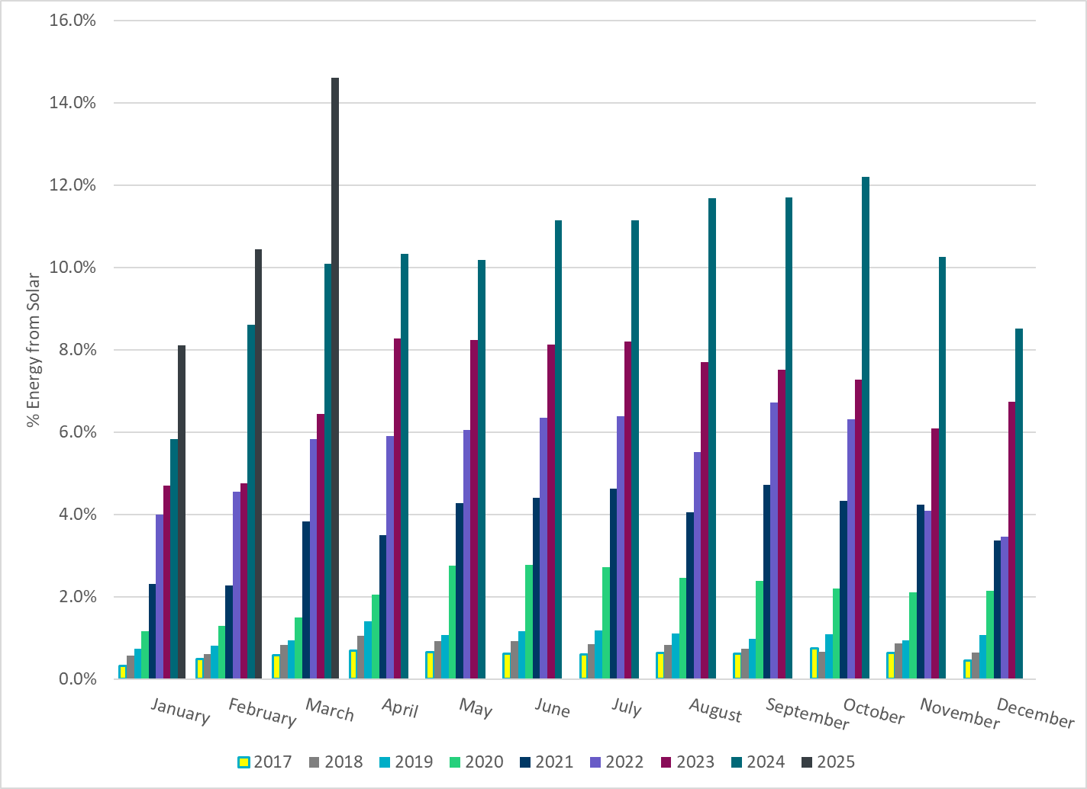
ERCOT % Energy from Solar Generation
Notes:
14.61% of total energy was provided by solar generation

Slide 16
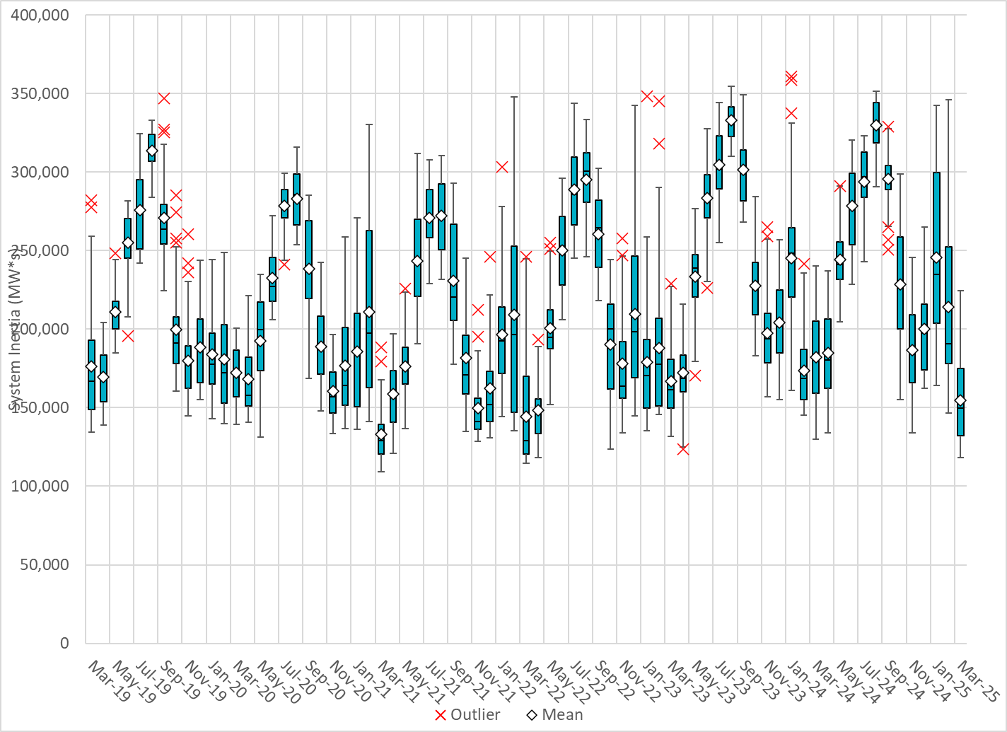
ERCOT Daily Minimum System Inertia
Notes:
Minimum Inertia in March 2025 = 118,032 MW*s on March 18th
Historical Overall Minimum was 109,029 MW*s on 3/22/2021
March Data:
Mean: 154,700 MW*s
Max: 224,372 MW*s on March 24th
Min: 118, 032 MW*s on March 18th

Slide 17
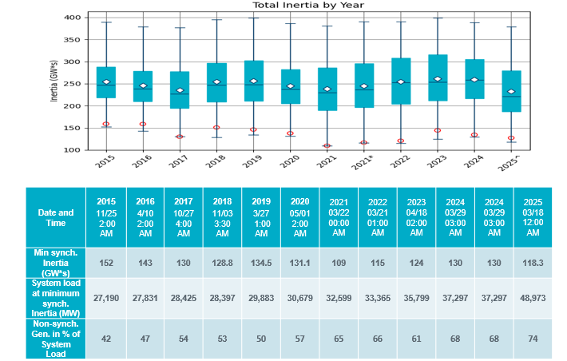
ERCOT Inertia Trend
Notes:
Summary of ERCOT inertia for the previous 10 years. Lowest inertia this year was on March 18th.
For each box, the central mark (red line) is the median, the edges of the box (in blue) are the 25th and 75th percentiles, the whiskers correspond to +/- 2.7 sigma (i.e., represent 99.3% coverage, assuming the data are normally distributed. The corresponding lowest inertia in each year is given in the table.
The circle on each boxplot is showing inertia during time when highest portion of load was served by wind/solar generation in that year.

