Slide 1
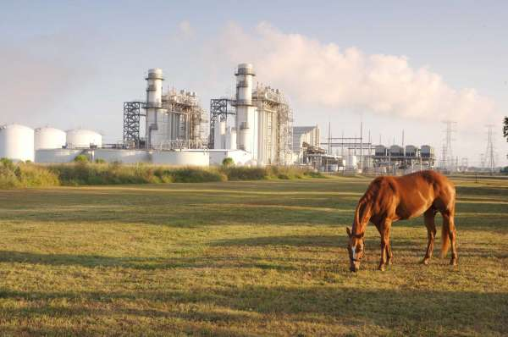
TCPA RECOMMENDATIONS ON OUTAGE CAPACITY Limits

Slide 2












TCPA: Who We Are
Texas Competitive Power Advocates (TCPA) is a trade association that represents independent power generators and wholesale power marketers with investments in Texas and ERCOT’s wholesale electric market. Our assets represent approximately 56,000 MW in ERCOT with more than 75% in thermal dispatchable resources.

Slide 3
SB3 (87th Legislature)
Sec.35.0021. WEATHER EMERGENCY PREPAREDNESS.
(a) This section applies only to a municipally owned utility, electric cooperative, power generation company, or exempt wholesale generator that sells electric energy at wholesale in the ERCOT power region.
(f) The independent organization certified under Section 39.151 for the ERCOT power region shall review, coordinate, and approve or deny requests by providers of electric generation service described by Subsection (a) for a planned power outage during any season and for any period of time.

Slide 4
GOALS FOR RECOMMENDATIONS
Ensure generation owners are able to schedule & complete needed planned outages
Reduce use of forced outages to complete OEM-required or major maintenance outages
Ensure ERCOT has the generation resources it needs to properly operate the grid
Allow for the competitive wholesale market to reconfigure planned outages based on price signals

Slide 5
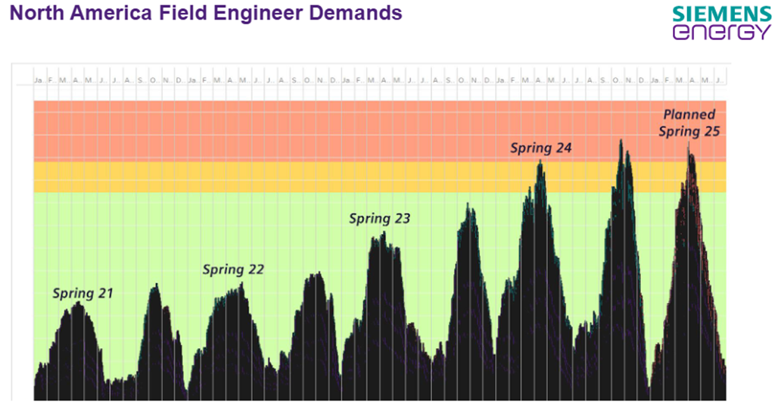
Problem Statement
Generators compete for resources to schedule and complete outages across North America
Green – Resources available
Yellow – Resources near capacity limits
Red – Shortage of resources and skilled labor

Slide 6
Recommended Changes
Modify MDRPOC to be informational only. Provide advance notice to the market when MDRPOC is exceeded by scheduled outages and allow the competitive wholesale market to reconfigure them. Utilize AAN process if needed.
Automatically approve planned outages submitted 6 months in advance.
Prioritize outages for major turbine inspections and servicing.
Include Energy Storage Resource capacity in the calculation of the MDRPOC. Already in consideration.
Allow for QSEs to transfer planned outage capacity among their Generation Resources.
Establish a minimum amount of planned outage capacity available throughout the year.
Gradually increase & decrease the MDRPOC entering & exiting outage seasons.
ERCOT to evaluate outage requests based on an average MDRPOC headroom over the requested period (i.e., if it’s just 1 or 2 days over a 2-week outage, don’t deny the whole outage request).
Broader authority for ERCOT to grant exceptions (i.e., not limited to environmental issues).

Slide 7
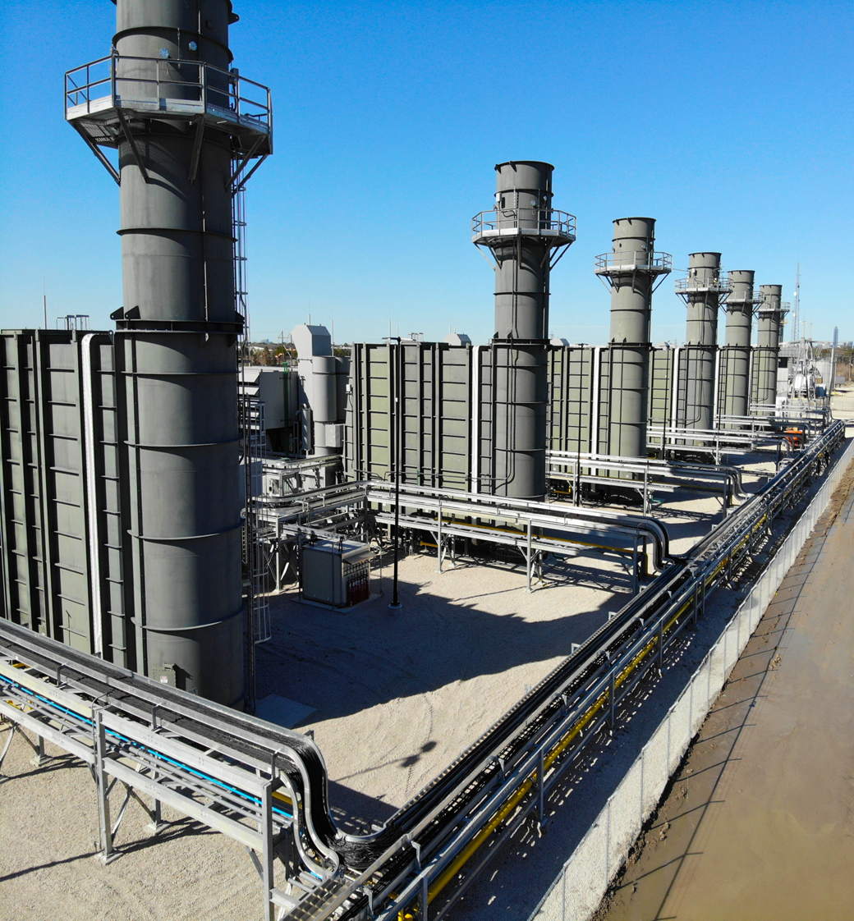
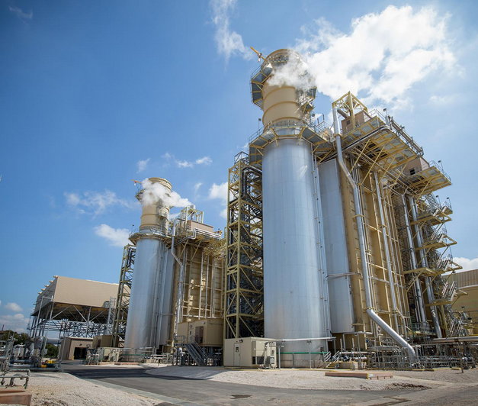
THANK YOU!

