Slide 1
Project Update
April 9, 2025
Troy Anderson
ERCOT Portfolio Management

Slide 2
Project Update Agenda
Recent / Upcoming Project Highlights
2025 Release Targets
Major Projects
Revision Request Additional FTEs
Aging Projects Related to Revision Requests
Priority/Rank Recommendations for Revision Requests with Impacts
NPRR1229 – Real-Time Constraint Management Plan Cost Recovery Payment
SCR830 – Expose Limited API Endpoints Using Machine-to-Machine Authentication
Additional time needed to complete IAs
NPRR1214 – Reliability Deployment Price Adder Fix to Provide Locational Price Signals, Reduce Uplift and Risk
NPRR1226 – Estimated Demand Response Data
NPRR1238 – Registration of Loads with Curtailable Load Capabilities
Technology Working Group (TWG)
Next meeting is 4/24/2025
Location of Revision Request Project Information: http://www.ercot.com/services/projects

Slide 3
Recent / Upcoming Project Highlights
2025 March Release – R3 – 3/28/2025 Complete
NPRR1145 – Use of State Estimator-Calculated ERCOT-Wide TLFs in Lieu of Seasonal Base Case ERCOT-Wide TLFs for Settlement
2025 May Release – R5 – 5/29/2025 In Flight
NPRR1253 – Incorporate ESR Charging Load Information into ICCP
ICCP and Public API implementation
Implementation Update
Background:
Recall that ERCOT was challenged to support this NPRR’s reporting requirements without disrupting RTC development and took an action item to consider alternative ways to develop the API reporting
At TAC, ERCOT stated there was an alternative technical reporting solutions, however, it was recently discovered this will not fully meet the protocol requirements (published every 5 minutes, rather than every SCED run)
ERCOT will proceed as planned with delivery of the new telemetry points and API reporting for ESR charging data
ERCOT will issue a Market Notice in next 1-2 weeks with more details on how to access the ESR charging (as discussed at TWG meeting)
ERCOT’s delivery of NPRR1253 will provide the data requested by the market (real-time telemetry and API values for ESR charging)
The technical delivery for summer 2025 will not strictly meet the protocol language as related to reporting requirements for “each SCED process” so NPRR1253 will remain gray-boxed
Note: Projected Go-Live dates are subject to change. Please watch for market notices as the effective dates approach.

Slide 4
2025 Release Targets – Approved NPRRs / SCRs / xGRRs
R1
R3
R5
January 1/30 | February 2/27 | March 3/27 | April 4/24 | May 5/29 | June 6/26
NPRR945 NPRR1219 | NPRR1254 RTC+B Market Trials Sandbox Deployed | NPRR1145 | RTC+B Market Trials begin on 5/5/2025 | NPRR1253
R2
R4
R6
ü
ü
ü
RTC QSE Submission Testing
3/1
ü
RTC QSE Telemetry Check-out
1/1
3/7
ü
E
RTC+B
12/5
July 7/31 | August 8/28 | September 9/25 | October 10/23 |  | December 12/18
 |  |  |  |  | RTC+B Stabilization begins
R7
R8
R9
R10
E
R11
NPRR1007-1013
Open-loop RTC SCED
Closed-loop SCED/LFC
NPRR963(a)
NPRR965
NPRR1000
NPRR1014
NPRR1054
NPRR1058
NPRR1172
NPRR1204
NPRR1216
NPRR1236
NPRR1245
NPRR1246
NOGRR211
NOGRR268
OBDRR020
OBDRR052
PGRR118
QSE Telemetry Tests
Day-Ahead Market
Go-live dates can differ from Protocol effective dates – Please refer to market notices for more details
APPENDIX
Red Text: New additions and target release changes
Strike-Through Text: Previous target release
(a), (b), etc.: Multiple phase release
Project Status Codes
NS = Not Started
I = Initiation
P = Planning
E = Execution
H = On Hold
NPRR963(a) – Portion of NPRR
NPRR1253(a) – ICCP
NPRR1253(b) – Public API
RTC+B Market Trials
RTC+B Stabilization
Release targets are subject to change

Slide 5
Major Projects
Other Project Highlights

Slide 6
Revision Request Additional FTEs page 1 of 2
RR | RR Title | Approval | Dept | FTEs | Status
PGRR082 | Revise Section 5 and Establish Small Generation Interconnection Process | 12/8/2020 | Resource Integration | 3 | Added in 2023
NPRR1007 | RTC – NP 3: Management Activities for the ERCOT System | 12/8/2020 | EMMS Production Support | 2 | IA noted ERCOT “may” need 2 FTEs – staffing increase in GMS has been driven by other factors
NPRR1073 | Market Participant Application Changes | 8/19/2021 | General Counsel | 1 | 2024/2025 budget
NPRR1108 | ERCOT Shall Approve or Deny All Resource Outage Requests | 5/12/2022 | Outage Coordination | 2 | Added in 2022
PGRR098 | Consideration of Load Shed in Transmission Planning Criteria | 5/12/2022 | Transmission Planning | 1 | 2024/2025 budget
NOGRR215 | Limit Use of Remedial Action Schemes | 10/12/2023 | Operations Stability Analysis | 1 | Candidate for 2028/2029 budget
NPRR1198 | Congestion Mitigation Using Topology Reconfigurations | 7/25/2024 | Grid Analysis | 1 | 2026/2027 budget request
NOGRR245 | Inverter-Based Resource (IBR) Ride-Through Requirements | 9/26/2024 | Dynamic Studies | 3 | 2 FTEs included in 2026/2027 budget request
 |  |  | Resource Integration | 1 | 2026/2027 budget request
 |  |  | Event Analysis | 1-2 | 1 FTE for new team
 |  |  | Operations IBR Performance Evaluation | 2-4 | 3 FTEs in 2026/2027 budget request

Slide 7
Revision Request Additional FTEs page 2 of 2
RR | RR Title | Approval | Dept | FTEs | Status
NPRR1180 | Inclusion of Forecasted Load in Planning Analyses | 1/16/2025 | Dynamic Studies | 2 | 2026/2027 budget request
 |  |  | Regional Planning | 4 | 2026/2027 budget request
 |  |  | Regional Transmission Planning | 4 | 2026/2027 budget request
 |  |  | Load Forecasting & Analysis | 1 | 2026/2027 budget request
NPRR1247 | Incorporation of Congestion Cost Savings Test in Economic Evaluation of Transmission Projects | 1/16/2025 | Economic Analysis & Long-Term Studies | 2 | Added in 2024/2025
PGRR117 | Addition of Resiliency Assessment and Criteria to Reflect PUCT Rule Changes | 3/13/2025 | Regional Transmission Planning | 2 | Added in 2024/2025
NPRR1234 | Interconnection Requirements for Large Loads and Modeling Standards for Loads 25 MW or Greater | Pending | Resource Integration | 1 | Pending PUCT approval
PGRR122 | Reliability Performance Criteria for Loss of Load | Pending | Dynamic Studies | 2 | Currently at ROS
 |  |  | Regional Planning | 2
 |  |  | Regional Transmission Planning | 1

Slide 8
Aging Projects Related to Revision Requests
ERCOT-led review of Aging Projects Related to Revision Requests
May 2025 – July 2025
Key Factors to a Successful Delivery Approach
Resources (Staffing)
ERCOT’s 2026/2027 budget request includes additional staffing in many resource-constrained areas, including 5 in the GMS area (critical for Revision Request work)
Priorities
NPRR1235 (DRRS) is expected to be a high priority
Other Revision Requests to be addressed without delaying DRRS
Funding
$10.6M in 2026/2027 funding for Revision Requests, including DRRS
Awareness
TAC and the ERCOT Board have been briefed on these projects
ERCOT leadership is supportive of efforts to deliver them
Capacity
2nd iTest Environment expected to go-live in mid-2026
This will add an additional pathway for project delivery

Slide 9
Priority / Rank Recommendations for Revision Requests with Impacts
Recommendations for…
Revision Request | Description | Priority | RankSahwi | Comments
NPRR1214 | Reliability Deployment Price Adder Fix to Provide Locational Price Signals, Reduce Uplift and Risk | TBD | TBD | Additional time needed to complete IA
NPRR1226 | Estimated Demand Response Data | TBD | TBD | Additional time needed to complete IA
NPRR1229 | Real-Time Constraint Management Plan Cost Recovery Payment | 2026 2028 | 4740 5100 | $100k-$200k, 8-10 months Impacted Systems: Settlements
NPRR1238 | Registration of Loads with Curtailable Load Capabilities | TBD | TBD | Additional time needed to complete IA
SCR830 | Expose Limited API Endpoints Using Machine-to-Machine Authentication | 2026 | 4750 | $100k-$200k, 7-10 months Impacted Systems: RIOO
PPL Rank Information
Next available 2025 Rank in Business Strategy = 4570
Next available 2026 Rank in Business Strategy = 4740
Next available Rank in Regulatory = 400

Slide 10
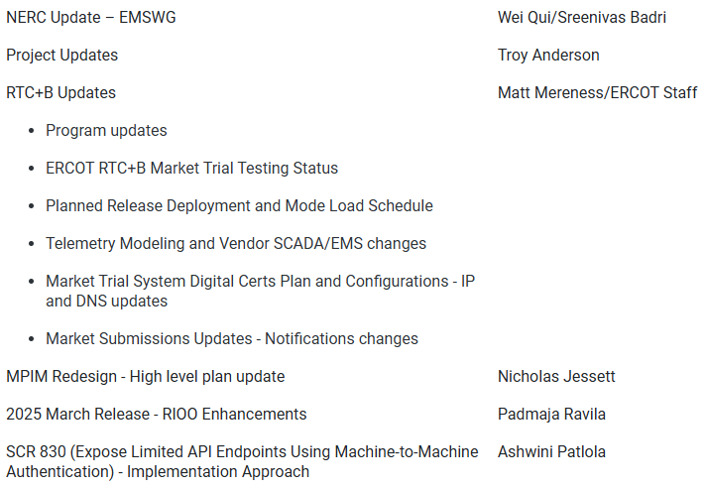
Technology Working Group (TWG)
Agenda for TWG meeting held on 3/26/2025:
Next TWG scheduled for 4/24/2025

