Slide 1
ERCOT Technology Working Group (TWG)
April 24, 2025

Slide 2
ERCOT TWG
WELCOME

Slide 3
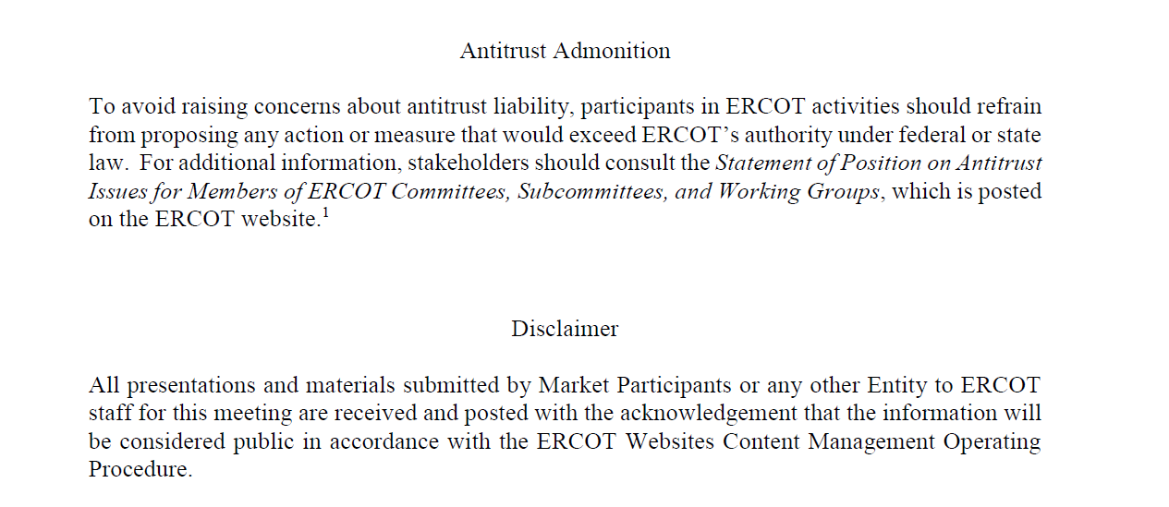
ERCOT TWG

Slide 4
ERCOT TWG Agenda
Item # | Item Description | Presenter | Start Time
1 | Antitrust admonition | Sreenivas Badri | 2:00 PM
2 | Project Updates | Troy Anderson | 2:02 PM
3 | RTC+B Updates Program and RTCBTF Updates NDCRC Changes CDR Reports Details and Timelines Market Submissions/Reports/Notifications Updates Overview of Market Manager (MMSUI)/EWS Reports and Notifications EMS Notifications and EIP Specifications update Market Trial Sandbox Testing Status Final Model Load Schedule ICCP Telemetry Modeling Updates Refresher on Resource status code changes in RTC+B (SCADA and COP) NFRC Telemetry Update | Matt Mereness/ERCOT Staff | 2:15 PM
4 | NPRR1253 – Public API System Changes Demo | Michael Ackerman | 3:25 PM
5 | Outage Scheduler API Requests – Best Practices | Sreenivas Badri/Indra Mallu | 3:40 PM
6 | Round Table Discussion | Tanner Holder | 3:50 PM
7 | Adjourn | Tanner Holder | 4:00 PM

Slide 5
Project Updates
Project Updates – Troy Anderson

Slide 6
RTC+B Updates
RTC+B Updates – Matt Mereness/ERCOT Staff

Slide 7
NPRR1253 – Public API Systems Changes Demo
NPRR1253 – Public API System Changes Demo–Michael Ackerman

Slide 8
Outage Scheduler API Requests – Best Practices
Outage Scheduler API Requests – Best Practices – Sreenivas Badri/Indra Mallu

Slide 9
ERCOT TWG – Round Table Discussion
ERCOT TWG – Round Table Discussion
  Future Topics of Interest
  Topics and presentations from TWG members

Slide 10
ERCOT TWG
Thank You
You can reach Sreenivas at
Sreenivas.Badri@ercot.com and Tanner at tholder@tnsk.com

