Slide 1
NDCRC – RTC+B Changes
Nick Barbas
April 24, 2025

Slide 2
NDCRC – RTC+B
Timeline Update
NDCRC RTC+B release planned for production in December 2025 to incorporate changes supporting the submission of test data for single model ESRs
Project is in execution phase with a release candidate currently deployed to test environment at ERCOT

Slide 3
NDCRC – RTC+B
Reactive Test Changes
Launching a new ESR specific version of the reactive test that’s similar to existing MVAR/IRR versions of the form with the following notable changes
Only allows selection of single model ESR units
Displays two separate sets of CURL points for discharging and charging rather than a single set like existing reactive tests
“CURL Points (Charge)” section expects negative “Megawatt” values
The 3 separate tests to gather metrics on are now classified as “Test 1a (15 min)”, “Test 1b (15 min)”, and “Lagging Test 2 (1 hr)”
VSS Validation section of form adds “Max Net Discharge Power” and “Max Net Charge Power” fields

Slide 4
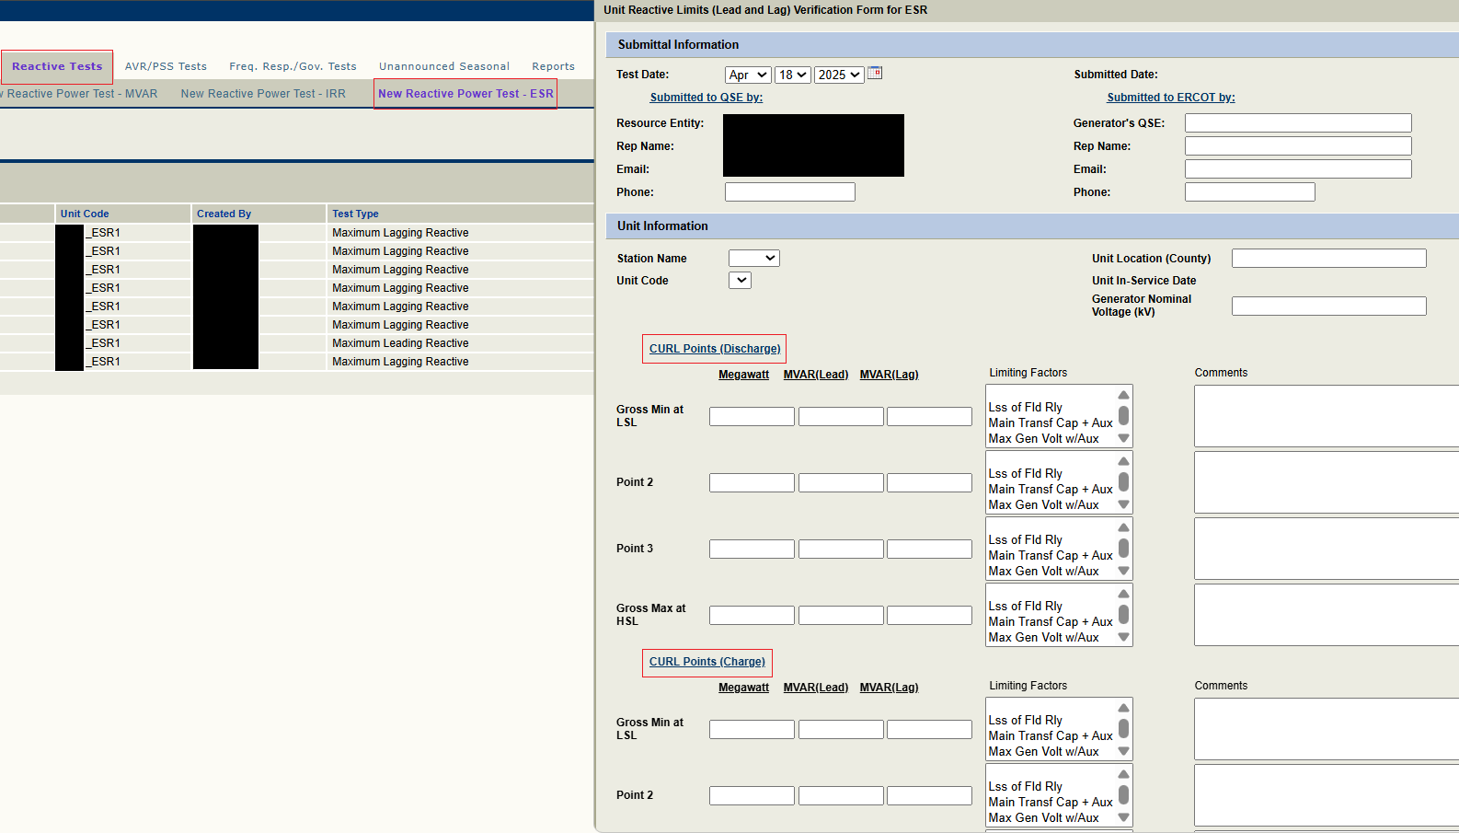
NDCRC – RTC+B

Slide 5
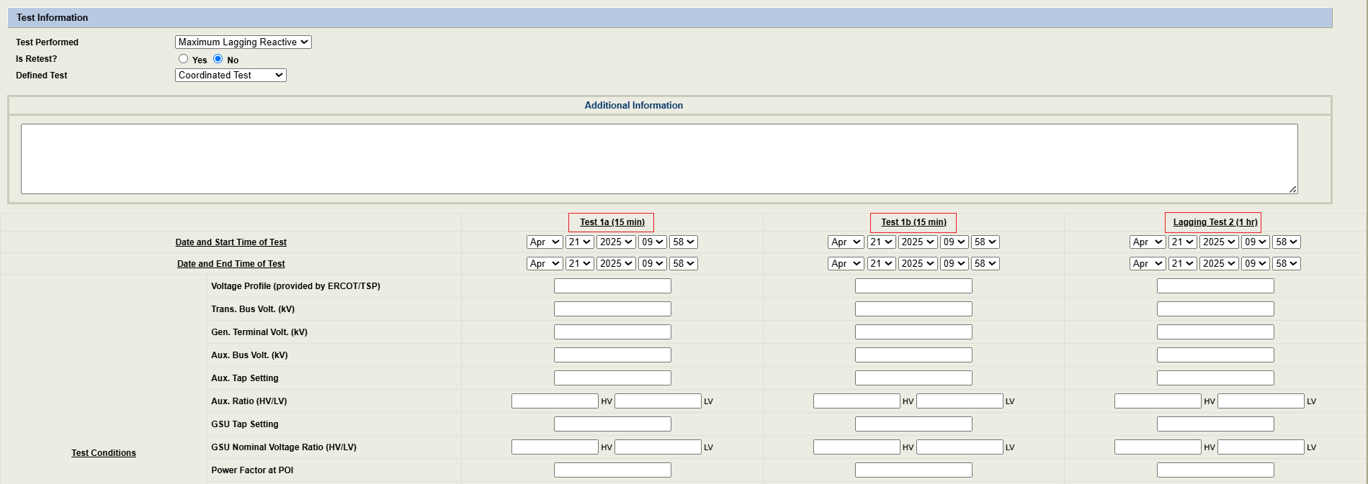
NDCRC – RTC+B

Slide 6
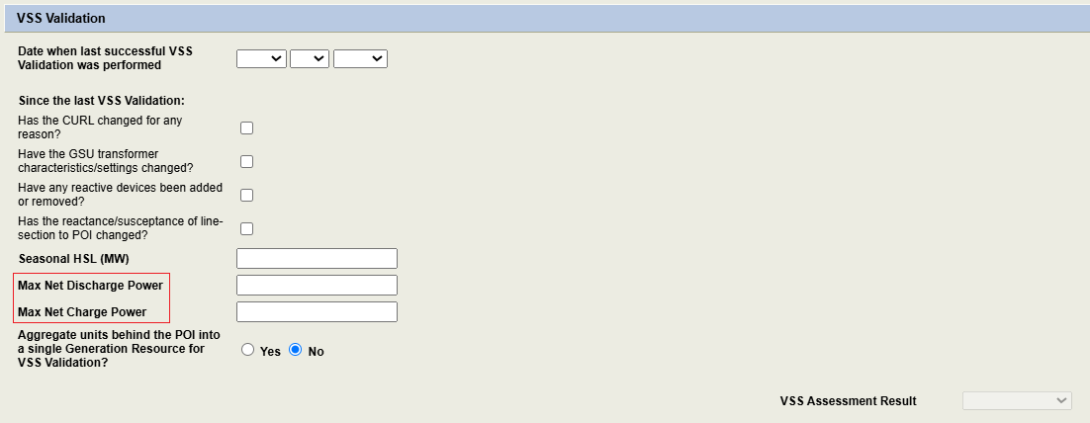
NDCRC – RTC+B

Slide 7
NDCRC – RTC+B
AVR Test Changes
Users are expected to use the existing version of the form to submit single model AVR tests, unlike the reactive test
New field added to form called “AVR Test Category” with values “ESR Charging”, “ESR Discharging”, and “Normal”

Slide 8
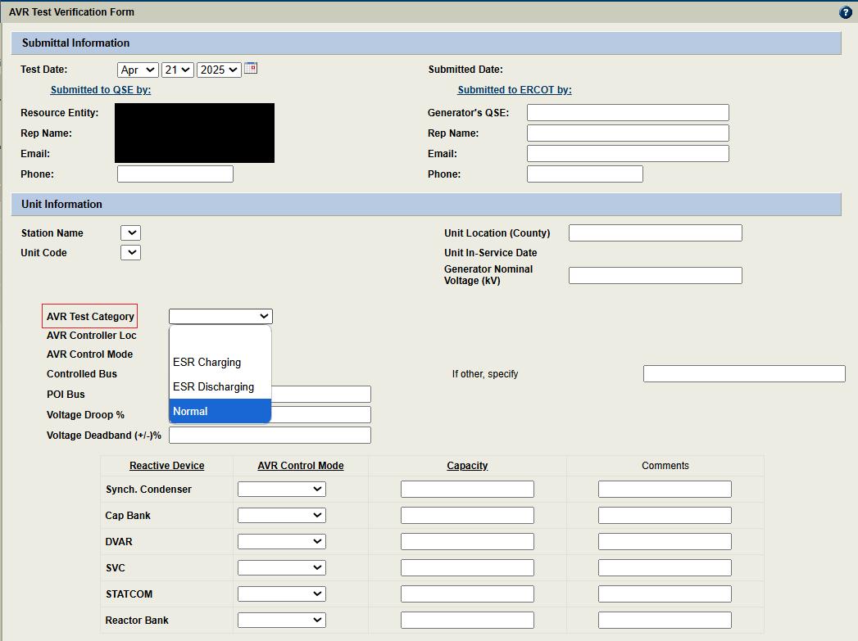
NDCRC – RTC+B

Slide 9
NDCRC – RTC+B
Unit Changes - Database
Units with the designation “PWRSTR” (power storage) representing the generation side of a combo model ESR will be removed
Units with the designation “CLR” (controllable load resource) representing the load side of a combo model ESR will be removed, but other CLRs outside of combo model ESRs will remain in the database
New units with the designation “ESR” (energy storage resource) will be added to the database to replace the removed “PWRSTR”/”CLR” combo model units
Naming convention for “ESR” units are “STATION_ESR1”, “STATION_ESR2”…

Slide 10
NDCRC – RTC+B
Unit Changes – Existing NDCRC Forms
CT Freq. Resp. – exclude single model ESRs from unit list
ESR Freq. Resp. – only show single model ESRs in unit list
CLR Freq. Resp. – only show CLRs that aren’t part of a combo model ESR
Turbine Mech-Hydr. – exclude single model ESRs from unit list
Turbine Electro-Hydr. – exclude single model ESRs from unit list
Historical Freq. Resp. – exclude single model ESRs from unit list
ESR Historical Freq. Resp. – only show single model ESRs in unit list
Unannounced Seasonal HSL – exclude single model ESRs from unit list

