Slide 1
Contingency Review
Leah Murff

Slide 2
Pseudo Switches
Purpose
To maintain the previous configuration of a substation before new equipment is energized.
When to model
When addition of new equipment creates alternate paths for power flow, impacting existing lines and transformers.
How to model
Generally modeled in pairs with the pseudo switch connecting to the previous configuration as normally closed and the pseudo switch connecting to the new equipment as normally open.

Slide 3
Manual Contingencies
Purpose
To provide accurate contingency definitions for new equipment or topology change.
When to use
When addition of new equipment or a topology change creates alternate paths for power to flow, impacting contingencies for existing lines and transformers.
How to model
TSP provides a contingency definition in a CAMR that represents the new alternate path
CAMR modeled by ERCOT and reviewed by TSP before submission

Slide 4
When are Manuals not needed?
New equipment does not include fault isolating devices
New equipment does not impact existing contingencies
New station is radial
Only one path for power flow, connects to only one substation

Slide 5
Double Circuit Contingencies
Contingencies containing more than one power flow
Used when lines share a tower
Seed elements added manually, contingency maintainer adds other elements
When impacted by new equipment, manual contingency represents double and adds all devices

Slide 6
Contingency Maintainer
Creates and updates single circuit contingencies
Power flow path of a single contingency will conclude when
Path reaches a fault isolating device
Path reaches an open switch
When a switch status changes (opens or closes) the power flow path can change causing an update to the contingencies
Updates every model load
Manuals needed due to asynchronous nature of equipment energization and switch status changes
Double circuit contingency regular elements updated by the maintainer
Double Circuit Annual Review needed to update seed elements

Slide 7
Contingency Maintainer Logic
Contingencies are dependent on:
Initially Open and Normal Open flags.
Contingency Component Flag (CC)
Circuit Breaker:
Disconnect
FID = Fault Interrupting Device.
Ignored = The Contingency Maintainer stops the trace and ignores to include the device of the contingency definition.
Skip = The Contingency Maintainer skips over the device and continues tracing.
Breaker
 | CC = True | CC = False
N.O. | Ignored | Ignored
N.C. | FID | Skip
Disconnector
 | CC = True | CC = False
N.O. | Ignored | Ignored
N.C. | Skip | FID

Slide 8
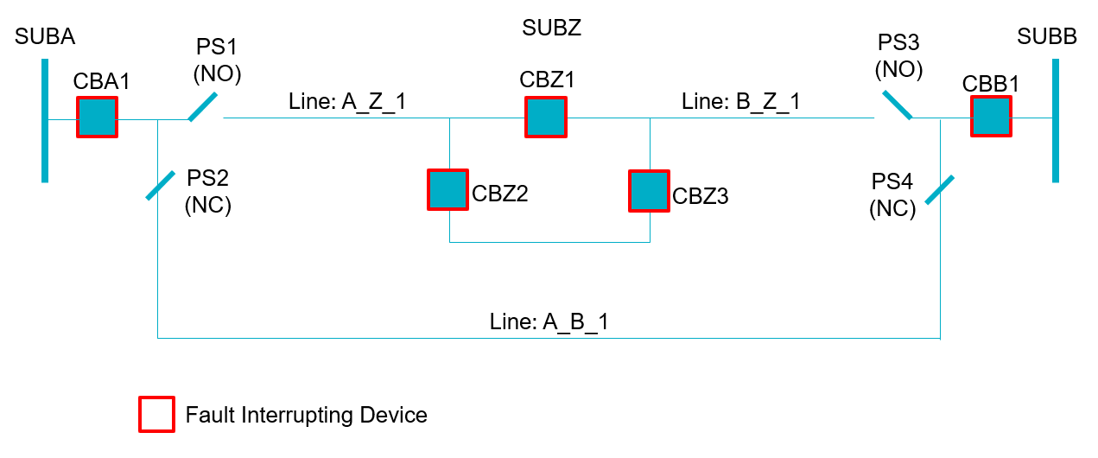
Cut in Substation – Manuals needed

Slide 9
Cut in Substation – Manuals needed

Slide 10
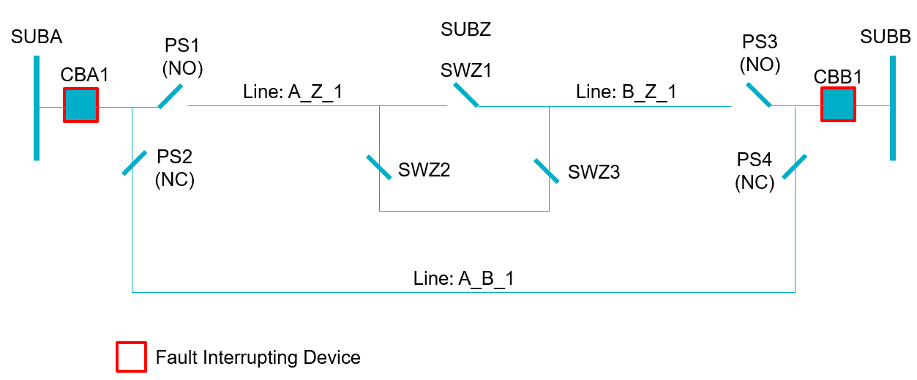
Cut in Substation – Manuals not needed

Slide 11
New Breaker – One line impacted
SUBZ
CBZ1
SUBA
PS2 (NC)
CBA1
Line: A_Z_1
CBZ2 (OLD)
PS1 (NO)
CBZ3 (NEW)

Slide 12
New Breaker – Two lines impacted
SUBZ
CBZ1
SUBA
PS2 (NC)
CBA1
Line: A_Z_1
CBZ2 (OLD)
PS1 (NO)
CBZ3 (NEW)
SUBB
PS3 (NO)
PS4 (NC)
CBB1
Line: B_Z_1
CBZ4 (OLD)

Slide 13
Change in Flow with change in Switch Status
Path with SW1 ‘NO’
Path with SW1 now closed
CBZ1
SUBZ
SUBA
CBA1
Line: A_Z_1
CBZ2
SW1 (NO)
CBZ3
CBZ1
SUBZ
SUBA
CBA1
Line: A_Z_1
CBZ2
SW1 (NC)
CBZ3

Slide 14
Cleanup NOMCR and CAMR
A Cleanup NOMCR removes old equipment and pseudo switches after new equipment is energized
If new equipment energization needed manuals a Cleanup CAMR should be submitted for the same model load as the NOMCR
A Cleanup CAMR deletes manuals and enables singles
Singles of deleted lines should be enabled so the contingency maintainer can make the necessary updates

Slide 15
Questions?

