Slide 1
RTC+B Task Force
Update
Matt Mereness
RTCBTF
April 22, 2025

Slide 2
Outline
Discussion today:
Update on RTCBTF Issues List
Update on NPRR1268, 1269, 1270
Market Readiness response scorecard
Market Notice on Market Trials Start 5/5/25
Network Model Schedule
Rest of Today’s Agenda

Slide 3
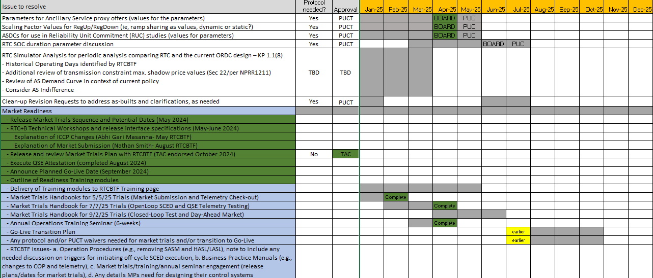
RTCBTF Issues List
Red boxes are NPRR1268, 1269, 1270 (April Board)
Blue Box is evaluation of State of Charge and AS Duration (target June Board)
Market Trials
Market Trials

Slide 4
Summary and Timeline of NPRRs
NPRRs set for PUCT May 15 Open Meeting
NPRR1268 for ASDC Modifications (IMM sponsor)
NPRR1269 for 3 Parameter/Policy Changes (ERCOT sponsor)
NPRR1270 for AS Qualification details (ERCOT sponsor)
State of Charge – Began discussion March 25 and targeting June Board
Final Clarifying NPRR – Begin discussion June 18 and target Sep Board
Settlement changes (corrections)
Retain current NFRC telemetry point (do not retire)
Offer/Bid structure clean-up (inconsistent protocols)
Remaining Stakeholder path to Board Meetings before Go-Live:
PRS May 14 > TAC May 28 > Board June 24
PRS Aug 13 > TAC Aug 28 > Board Sep 23

Slide 5
Sequence and Dates for Market Trials to Go-Live
30-day Market Notice
11/5/25
March/April
2025
Start
5/5/25
Start
7/7/25
Start
9/2/25
Go-Live
12/5/25*
May 2025
June 2025
July 2025
Aug 2025
Sep 2025
Oct 2025
Nov 2025
Dec 2025
QSE Scorecards & Exit Criteria for each Trial Phase
RTC QSE Submission Testing
(Submit COP, RT AS Offers,
DAM Virtual AS, Outages for ESRs)
Open-loop RTC SCED
(QSE offers, SCED non-binding award/dispatch)
Ongoing Open-Loop
& Periodic Closed-loop SCED/LFC
(QSE RTC offers and telemetry to support closed-loop frequency control test 2-3 tests of 2-4 hour durations)
Transition to Go-Live
Upon completion of testing, confirmation of ERCOT and market readiness for Go-Live.
QSE/Vendor Submission Sandbox and Telemetry Points added Prod EMS model.
RTC QSE Telemetry Check-out (QSEs add/verify new telemetry points for UDSP, New ramp rates, ESR telemetry)
QSE Telemetry Tests
(Individual QSE to follow UDSP and support new ramp rate and ESR telemetry)
Day-Ahead Market
(Non-binding DAM using QSE offers for at least 2 tests)
* Go-Live date reflects 12/5/2025 as first Operating Day
where 12/4/2025 is planned software migration.

Slide 6
Other Updates
Readiness engagement update:
Developed new folders on RTCBTF home page (done and continue to add content)
Market Trials folder: Handbooks and supporting materials
Technical Support folder: Key TWG technical materials
RTCB@ercot.com mailbox for support of stakeholder implementation questions (done)
Target to add more training videos in next 60 days (in process)
Operations
Load Resources
Day-Ahead Market
Battery
RTC Worksheet Solver Walkthrough
Following guidance from RTCBTF to engage DSWG separately (done 4/17/25)
Outreach to Operator Training Seminar and Spring GCPA (complete next Wednesday)
Next TWG meeting is April 24
ERCOT will continue to support detailed technical conversations such as adding telemetry points to network model, digital certificates, accessing ERCOT systems in March/April timeframe
Closed-Loop LFC planning (April initial review)- later today
Formal Market Trials begin in 2 weeks (May 5, 2025)
Weekly WebEx every Monday 10am-10:30am (starting May 5 – December 8, 2025)

Slide 7
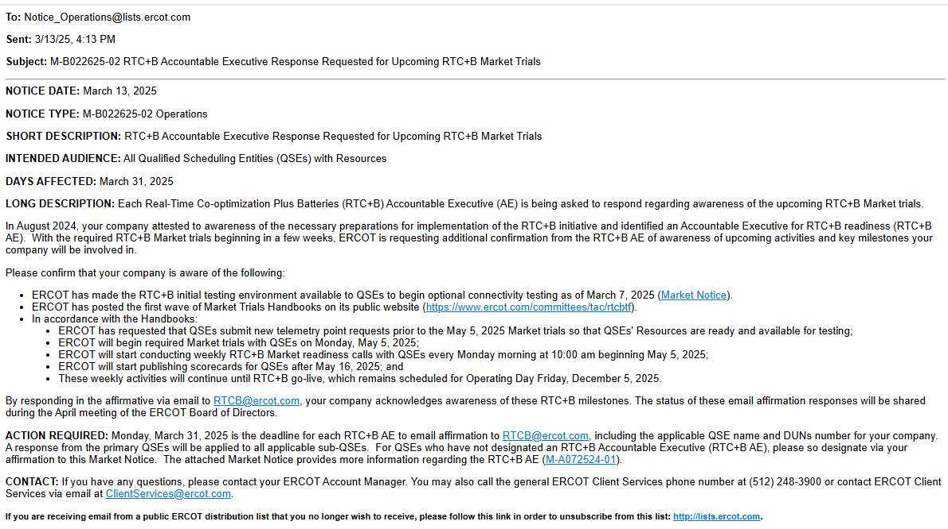
Market Notice on QSE Readiness (response due by March 31)
Market Notice for QSE Awareness with Monday March 31 due date:

Slide 8
QSE Scores
Scores for responding to March RTC+B Awareness Readiness Survey: 100%

Slide 9
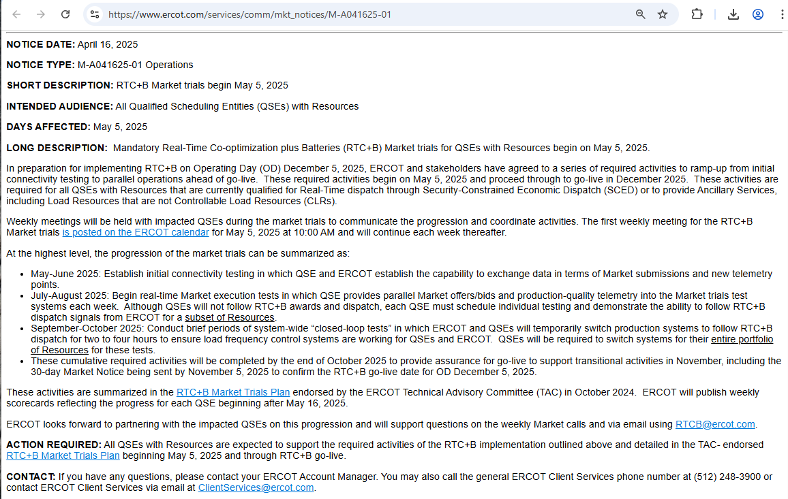
Market Notice on RTC+B Market Trials
Market Notice sent April 16 to announce start date/time and explain market trials:

Slide 10
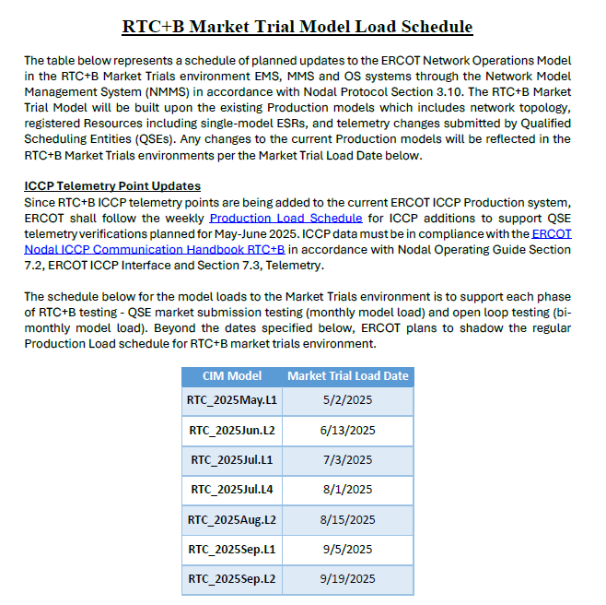
Network Model Schedule (to be posted RTCBTF Tech Folder)

Slide 11
Focus for remainder of RTCBTF today:
State of Charge / AS Duration Discussion (Nitika Mago)
Presentation and Draft NPRR and NOGRR
Market Readiness
Review Handbook #3- Open Loop SCED (Round 3-final) - Nathan Smith
Review Handbook #4- QSE Telemetry Tests (Round 3-final) - Abhi Masanna Gari
Review Handbook #5- Close-Loop LFC Tests (Round 1-initial) - Matt Mereness
Review Handbook #6- Day-Ahead Market Tests (Round 1-initial) - Alfredo Moreno
Review 3 New training modules
Day-Ahead Market Training- Alfredo Moreno
Battery Training- Kenneth Ragsdale
RTC Spreadsheet tool and examples- Ryan King
TWG Updates/Questions
Reports update- (Matt for Jamie Lavas)
Other Business
Next steps on HEN proposal related to underlying AORDC calculations (Shams)

