Slide 1
RTCB Task Force
Battery Overview/Training
Kenneth Ragsdale
ERCOT Principal, Market Design & Development
RTCBTF
April 22, 2025

Slide 2
What is the “plus Batteries” part of the project?

Slide 3
Agenda
ESR background information
Where are we? How did we get here? What does the future look like?
Overview of the scope of the “+B” changes and the transition steps
High-level review of the “Final State” with the “+B” changes (along with RTC)
Specific topics/details
Registration, qualification, and modeling
Day Ahead Market
Real-Time Market
EB/OCs, COP information, and telemetry
Set point deviation (SPD)
Reliability Unit Commitment (RUC) and exposure to being short

Slide 4
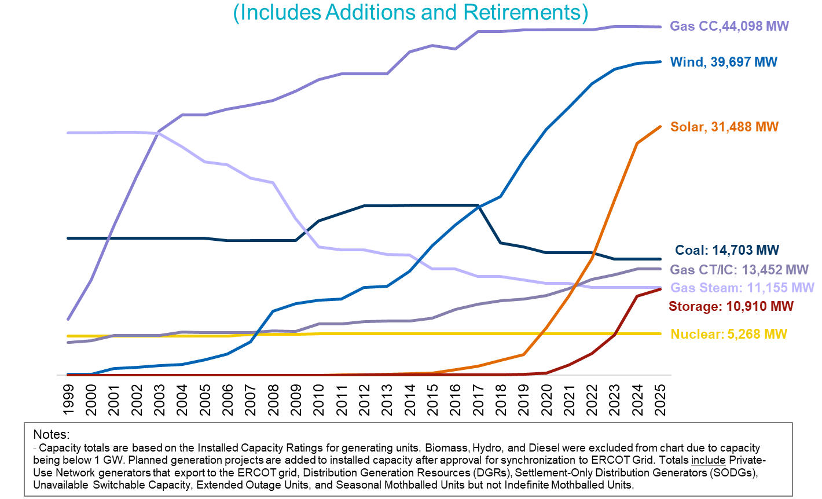
ERCOT Installed Net Generation Capacity (as of April 1, 2025)
End of 2028 (MW)
[Based on GIS Info]
WIND: ~ 46,000
PV: ~ 72,000
ESR: ~ 38,000

Slide 5
Summary of Generation Interconnection Requests (run date 4/1/25)
Fuel Type/ Technology Type | SS and FIS Completed IA (MW) | Grand Total In Progress (MW)
Combined Cycle | 88 | 10,559
Combustion Turbine | 2,138 | 20,468
Steam Turbine | 14 | 694
ICE (Internal Combustion Engine) | 218 | 1,857
Wind | 6,556 | 39,795
Solar | 30,771 | 156,685
Compressed Air Storage | 0 | 0
Battery | 16,898 | 172,192
Other (Includes Pumped Hydro 1,232 MW) | 0 | 2,913
Total | 56,683 | 405,163
Report Run Date Battery Qty
The battery total of 172,192 MW includes requests of 407 MW of distribution connected.
It does not include requests of batteries planned at a “Self-Limiting Facility.”
SS = Security Screening Study
FIS = Full Interconnection Study
IA = Interconnection Agreement
Dec 1, 2024: 156,730 MW
Dec 1, 2023: 124,941 MW
Dec 1, 2022: 78,746 MW
Dec 1, 2021: 46,946 MW
Dec 1, 2020: 21,404 MW
Dec 1, 2019: 7,214 MW
Dec 1, 2018: 2,048 MW

Slide 6
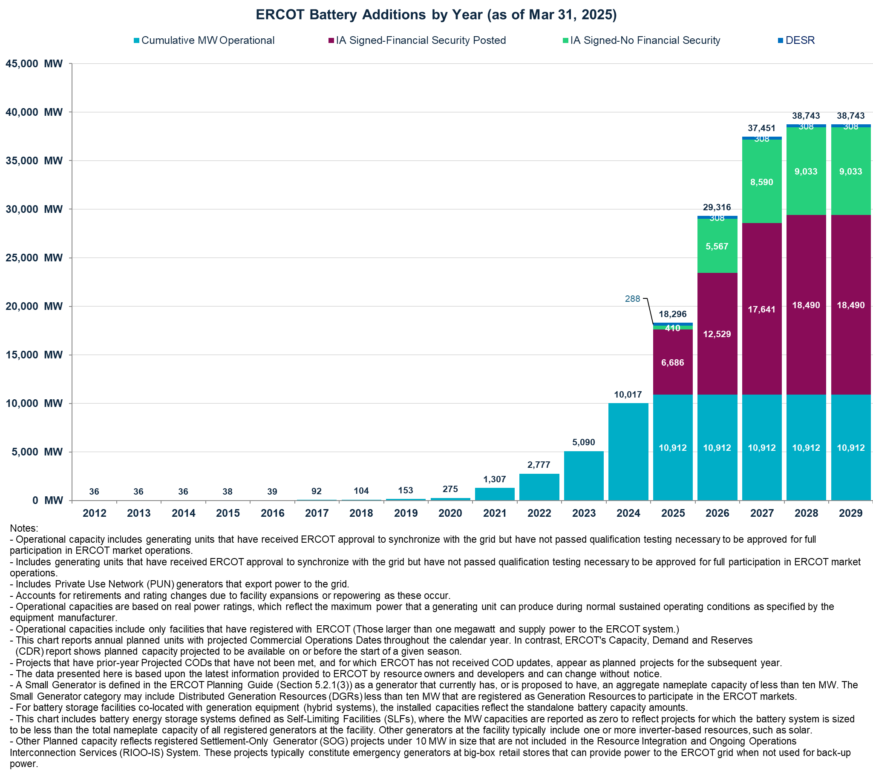
Battery Additions by Year (as of March 31, 2025)
1) WSL –NPRR461: Approved 12/2012; Effective 2/2013
2) FRRS Pilot: 2/2013-2/2014
3) FRRS – NPRR 581: Effective 3/2024
4) SoC Telemetry Requirement: 10/2018
5) FFR – NPRR863: Approved 2/2019
6) BESTF: 10/2019 – 3/2021
7) FRR Phase 1 Implementation: Effective 3/2020
8) NPRR986 “Bid to Buy” Functionality: Effective 4/2021
9) NPRR 1096 Require Sustained Capability (ECRS and NS); Effective 12/2022
10) ECRS Go-Live 6/2023
NPRR 1026 Self Limiting Facilities: Effective 3/2024
NPRR 1186: Approved by PUCT 4/2024
11,196 MW as of April 2025
Dec 2024 CDR: 63 DESRs Total = 628 MW. September 2019 DGR moratorium lifted Jan. 4, 2022

Slide 7
Duration Information (Based on Feb 2025 GIS Report – posted 3/6/25)

Slide 8
Energy Storage Resource (ESR) Percent of Total System-Wide Ancillary Service Procurement in Day-Ahead Market (DAM)

Slide 9
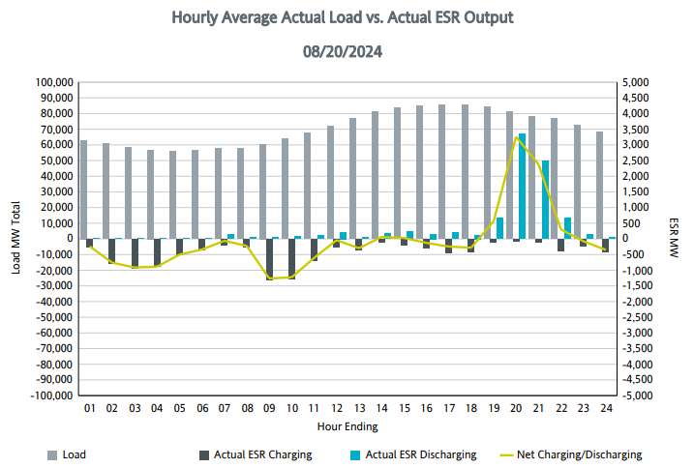
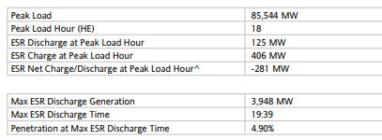
ERCOT-wide Load and Energy Storage Resource (ESR) Injection and Withdrawal

Slide 10
High Level Scope of “+B”
NPRR 1014: BESTF-4 Energy Storage Resource Single Model (Approved December 2020)
NPRR 1204: Considerations of State of Charge with Real-Time Co-Optimization Implementation (Approved February 2024)
NPRR 1236: RTC+B Modifications to RUC Capacity Short Calculations (Approved November 2024)
NPRR 1246: Energy Storage Resource Terminology Alignment for the Single-Model Era (Approved March 2025) [NOGRR 268, OBDRR 052, PGRR 118]
Not part of RTC+B Project. (On the back burner. “Way back” burner.) NPRR 1029: BESTF-6 DC-Coupled Resources (Approved December 2020)
10

Slide 11
NPRR 1014: Energy Storage Resource (ESR) Single Model
Registration, Qualification and Modeling (An ESR is represented (as it is) — as one physical Resource)
Single set of telemetry
Single “energy bid/offer curve” submittal (covering both the charging and discharging MW range) and Single “COP” submittal
Single Performance Monitoring (Note: Tolerance for Set Point Deviation is smaller.)
Single Settlements
Single entry into Outage Scheduler

Slide 12
ERCOT Evolution for Battery Energy Storage Resources
Phase
Registration
(RARF or RIOO)
Siebel, NMMS, EMS, MMS, Settlements
GR
Mark the GR and CLR so that it can be seen they are a pair
GR
A
BATCAVE_BES1
ESR
ESR
CLR
CLR
Combo Model
ESR
ESR
BATCAVE_LD1
BATCAVE_ESR1
BATCAVE_ESR1
D
Single
Resource
Single
Resource
RTC+B Go-Live
Link to Single Model Names for existing ESRs:
https://www.ercot.com/files/docs/2025/02/14/single-model-esr-names.xlsx

Slide 13
Typical One-Line (Battery and Other Generation Resources)
Current Approach = Combo Model
138 kV
34.5 kV
M2
M1
Resource
Node
BATCAVE_BES1
SS_AUX
WGR 2
WGR 1
BATCAVE_LD1

Slide 14
Typical One-Line (Battery and Other Generation Resources)
with Single Model (After RTC+B Go-live)
No changes to meter locations and Resource Node locations
34.5 kV
M2
138 kV
Resource
Node
M1
BATCAVE_ESR1
WGR 2
WGR 1
SS_AUX

Slide 15
Registration/Qualification
ERCOT initiated Request for Information (RFIs) from August 6 through September 26, 2024, to support Resource Integration and Ongoing Operations (RIOOs) transition to a single model representation of ESR. Data collection through DocuSign was sent to the Authorized Representative as stated in the Market Notice https://www.ercot.com/services/comm/mkt_notices/M-A071024-02. ERCOT may need to reach out to the REs to provide additional or missing information. For projects in the interconnection process, we are currently collecting the necessary data for single model ESR via RIOO.
Relevant References: https://www.ercot.com/files/docs/2024/08/21/RIWG_ERCOT_ESR_RFI_Updates_Aug24.pptx
If there are any Protocol changes that impact qualification or qualified MW based on duration, ERCOT will plan to interact with the appropriate entities prior to transitioning to RTC.

Slide 16
Energy Bid/Offer Curves (EB/OC), Current Operating Plan (COP), and Telemetry
EB/OC, COP information, and telemetry are provided for the ESR as a single device to cover the entire range from Low Sustained Limit (LSL) to High Sustained Limit (HSL); the maximum charging MW a negative number to maximum discharging MW positive number.
Continue to provide Hour Beginning State of Charge information for future hours in the COP for the ESR.
Telemetry is for the ESR as a single device.
All ERCOT systems including the Outage Scheduler, DAM, RT Market, RUC, and Settlements will “handle” the ESR as a single device.
The implementation of the Single Model will eliminate extra coordination currently required with the Combo Model and reduce administration for ERCOT and QSEs.

Slide 17
Single Model ESR: Energy Bid/Offer Curve (EB/OC)
Single EB/OC curve shall be monotonically non-decreasing from maximum charging MW (negative) to maximum discharging MW.
The maximum price on the charging curve is less than the minimum price on the discharging curve
10 Pairs of $/MWh and MW level.
ESR Combo Model
$/MWh
$100/MWh
ESR-GR EOC
ESR (Single Model) [+/- 100 MW]
Discharging MW (+ve)
$/MWh
$/MWh
$100/MWh
$4/MWh
ESR-CLR RTM Bid
LSL = -100 MW
HSL = 100MW
$4/MWh
Charging MW (-ve)
Discharging MW (+ve)
Charging MW (+ve)

Slide 18
Telemetry with the Implementation of the RTC+B Project (1 of 2)
Continue 5 State of Charge telemetry items for each ESR:
ESR telemetry includes:
ESR Telemetry
Resource Status (ON,ONOS,ONTEST, ONEMR, ONHOLD, OUT)
Gross (MW) (positive for discharge, negative for charge)
Gross (MVAr)
Net MW (positive for discharge, negative for charge)
Net MVar
HSL
LSL (can be negative)
ESR State Of Charge (SOC) Telemetry
SOC (MWh)
Max SOC (MWh)
Min SOC (MWh)
Max Operating Discharge Power Limit (MW)
Max Operating Charge Power Limit (MW)

Slide 19
Telemetry with the Implementation of the RTC+B Project (2 of 2)
Net MW telemetry of the ESR, when it is charging or when it receives a Base Point of zero, should NOT include internal losses in the Battery (electro-chemical) and inverter.
Net MW (charging or discharging) represents the ESR response to UDSP (plus any frequency response) at the Point Of Interconnection. Thus, the Net MW telemetry when the ESR is discharging includes the internal losses in the battery (electro-chemical) and inverter.
The Gross MW telemetry is the actual charging or discharging MW as measured at the modeled terminals of the ESR and includes all internal losses in the battery (electro-chemical) and inverter.
Including the losses, when there is no expected injection from the ESR, could lead to SPD charges — that may not be appropriate.
With the implementation of NPRR 1014, the Base Point Deviation (DPD) calculation from the past is replaced with the Set Point Deviation (SPD) calculation and the tolerances for ESRs are smaller (3% or 3 MW).

Slide 20
Draft Proposal for AS Duration Requirements under RTCB (Slide 6 from 3-25-25 RTCTF presentation) Introduction – ERCOT’s Analysis and Conclusion
​
To inform appropriate duration needs for every Ancillary Service type under Real Time Co-optimization (RTC) paradigm, ERCOT has conducted analysis of the (1) duration of historic risks that drive the need for these reserves and (2) length of historic deployment events, some of these deployments occurred in response to the sustained risks.
The subsequent slides provide summary of the analysis that was conducted.
Below is a summary of the minimum duration for various Ancillary Service types that ERCOT is recommending based on this analysis. Red text identify values that are different from or not stated in the current RTC Protocols.
Table below shows the impact of these recommendations in red text.
Ancillary Service Type | Real-Time |  | Qualification |  | RUC
 | Duration | Protocol Reference | Duration | Protocol Reference | Duration Award and Deployment
Regulation Service* | 30 minutes | 8.1.1.3.1 (2) | 30 minutes | 8.1.1.2.1.1 (5) | 1 hour
Responsive Reserve Service (excluding FFR) | 30 minutes | 8.1.1.3.2 (4) | 30 minutes | 8.1.1.2.1.2 (9) | 1 hour
ERCOT Contingency Reserve Service | 1 hour | 8.1.1.3.4 (2) | 1 hour | 8.1.1.2.1.7 (3) | 1 hour
Non-Spinning Reserve Service | 4 hours | 8.1.1.3.3 (2) | 4 hours | 8.1.1.2.1.3 (8) | 1 hour
*Note FRRS is being eliminated with RTC.

Slide 21
ESR Participation in the DAM with the RTC+B Project
EB/OCs for the ESR is input to DAM. Resource-specific DAM energy sales and purchases that are cleared are cleared at the Resource Node of the ESR.
State of Charge (SOC) is not considered in the clearing for Energy and Ancillary Services in the DAM. (If not careful, a QSE representing ESRs could “oversell” its capability in DAM. Financial Exposure is based on imbalance between DAM and Real-Time. [DAM Ancillary Service awards, Real-Time Ancillary Service awards, self-arrangement of Ancillary Services, and trades].)
The ESR will be awarded DAM Resource-specific energy sales and purchases and Resource-specific Ancillary Service sales.
Fast Responding Regulation Service (FRRS) is no longer a subset of Regulation.
For details on how the DAM will “convert” various EB/OCs; See 2-7-25 RTCBTF “DAM ESR Offers” presentation: https://www.ercot.com/files/docs/2025/02/07/7b.%20ESRs%20in%20DAM.pptx

Slide 22
Real-Time Market With the Implementation of the RTC+B Project (1 of 2)
EB/OCs for the ESR and the Ancillary Service offers are input data to SCED process. EB/OC can be updated anytime. SCED uses the most recent EB/OC that is available in the database and the telemetered physical capability of the resource in determining awards (along with other information).
SCED incorporates SOC accounting within the optimization. This is to ensure that awards to ESRs are feasible and that there is sufficient energy to sustain the MW awards for energy (Base Points) and Ancillary Services for their respective SCED duration requirements. SCED will not violate the telemetered minimum and maximum SOC values for ESRs.
The awards for each Resource are limited based on the Resource’s qualification, telemetered physical capabilities, SoC information, ramp rates, and duration requirements for each Ancillary Service type. This is different from today where it is the QSE’s responsibility to ensure sufficient SoC is reserved to cover their Ancillary Service Responsibility and duration requirements. Multiple Ancillary Service types and energy can be awarded to an ESR in a SCED execution.
QSE management of Ancillary Service responsibility across their portfolio no longer exists.

Slide 23
Real-Time Market With the Implementation of the RTC+B Project (2 of 2)
6.6.5.5 ESR Set Point Deviation Charge for Over Performance
The tolerance is the greater of 3% of the AASP for the ESR in the Settlement Interval, or three MW above the AASP for the ESR in the Settlement Interval.
6.6.5.5.1 ESR Set Point Deviation Charge for Under Performance
The tolerance is the lesser of 3% of the AASP for the ESR in the Settlement Interval, or three MW below the AASP for the ESR in the Settlement Interval.
Key Takeaway: The Set Point Deviation calculation implemented with the RTC+B Project is less tolerant than the current Base Point Deviation calculation.

Slide 24
RUC with Implementation of RTC+B Project
DRUC and HRUC will be the tools to assess if enough capacity is available (and in the right locations) to ensure RTC SCED will have enough capacity to solve for energy and Ancillary Services.
Similar to today, ESRs will NOT be seen as OFF and available to be RUCed, and therefore, the RUC software will NOT RUC an ESR to come online. (ESRs should have a status of “ON”, “ONOS” “ONTEST”, “ONEMR”, “ONHOLD” or “OUT.” “OUT” should be used only if the resource is “broken.”)
In evaluating the capability of the online Resources (and those shown off-line), the full capability of the Resources (including ESRs) planned to be available will be “fair game” for the RUC software. In other words, with the RTC+B implementation the RUC software will not assume Ancillary Services are carried by any particular Resource and will consider all possibilities of where to carry Ancillary Services for future hours.

Slide 25
RUC with Implementation of RTC+B Project: Continued
The RUC software will use the Hour Beginning SoC (HB SoC) provided by the QSEs in their COPS for each ESR to appropriately limit the possible use/capability of each ESR.
RUC self-schedules ESRs to their HB SoC. The process of self-scheduling evaluates the change in the COP submitted HB SoC (change in stored energy SoC) across two consecutive hours and determines the best use of that change in energy – combination of charging or discharging the ESR as Base Points and/or procuring Ancillary Services considering Deployment Factors for that hour. Deployment Factors are used to simulate deployment of Ancillary Services for an hour.
The RUC Capacity Short calculations use optimization techniques to minimize a QSE’s potential energy and/or Ancillary Service shortfall. This optimization process, will also consider the change in the COP submitted HB SOC across consecutive hours for an ESR to determine the best use of that change in energy to cover the QSE’s energy and Ancillary Services position for each hour in the RUC study period.

Slide 26
Thank You!

