Slide 1
ERCOT IBRWG: Industry Updates
Julia Matevosyan
Associate Director and Chief Engineer
ESIG
04/18/2025

Slide 2
2025 ESIG Spring Technical Workshop
Select Topics (of interest to IBRWG)
Oscillations and Stability
Grid Forming Inverters
FERC Order 901, NERC Milestone 3
Large Load Integration
Presentation and recording are posted here

Slide 3
GFM Capability Requirements in IESO, Ontario, Canada
IESO has included the following GFM capability requirement for all BESS in the connection assessment applications.
The connection applicant shall ensure that the inverters are capable to operate in GFM Control mode.
As the power system evolves, the IESO may require the inverters to be operated in that mode.
Grid Forming Control mode shall not be enabled without IESO approval.
NERC functional specifications for GFM control specify that its primary objective is maintaining an internal voltage phasor that is constant or nearly constant in the sub-transient to transient time frame. The voltage phasor must be controlled to maintain synchronism with other devices in the grid and must also regulate active and reactive power appropriately to support the grid.
The requirement is currently enforceable, and IESO has already required several developers to procure equipment to meet GFM BESS requirement (see, e.g., Tilbury BESS SIA here)
IESO is working on detailed performance specifications document
Presentation by M. ElNozahy (IESO) is available here

Slide 4
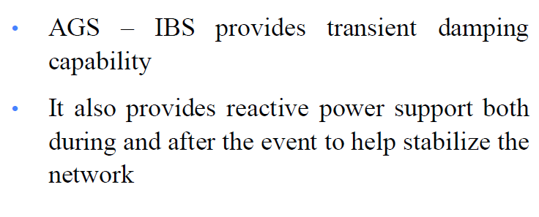
Benefits of Advanced Grid Support in Stability Constrained Areas
Presentation by D. Ramasubramanian (EPRI) is available here
Also brought up, importance of location for better effectiveness
Off-the-shelf solution may not work, may need application-specific tuning

Slide 5
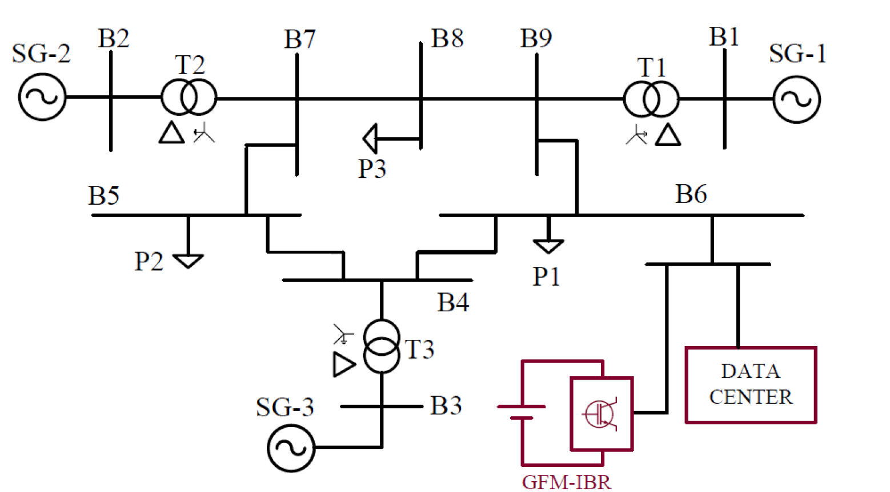
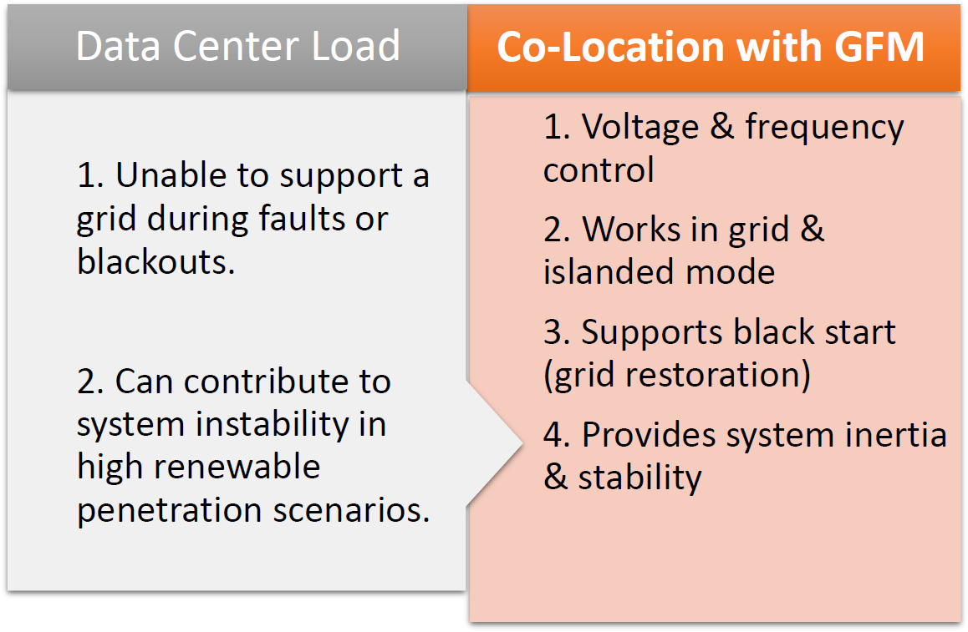
Grid-Forming Inverter Applications for Improved Reliability and Power Quality in AI Data Centers
The presentation is available here

Slide 6
Integration of GFM IBRs in Chelian Grid
The test systems demonstrated the performance of EMT models.
The results for the Chilian grid proved GFM IBRs can positively impact the dynamic behavior and stability of grids composed mostly of VRE resources.
System parameters and conditions, such as the penetration of GFL IBRs and their associated control strategies, the presence of SynCons, as well as the availability of dynamic compensation devices, play a pivotal role in the minimum amount of GFM required in large grids.
Additional research needed to test additional capabilities and attributes for this technology in large grids, such as short-term over current contribution, protection coordination, and black start capabilities
The presentation is available here

Slide 7
DOE Forum for the Implementation of Reliability Standards for Transmission (i2X FIRST)
i2X FIRST workshop March 17, 2025 (half-day hybrid event)
Covered IBR plant conformity assessment process with applicable interconnection requirements after IBR plant commissioning, learning from the draft IEEE P2800.2 (SG5).
Topics:
IEEE P2800.2 Update
Post Commissioning IBR Plant Model Validation
Selection of Disturbance Event Triggers
Post Commissioning Monitoring
Event-Based IBR Plant Model Validation
Periodic Testing
Comparison of IEEE2800 and NERC PRC-028 and PRC-029
Presentation and recording are posted here

Slide 8
DOE Forum for the Implementation of Reliability Standards for Transmission (i2X FIRST)
ESIG reposted the recordings, presentations and synopsis for the prior meetings to ESIG i2x FIRST page https://www.esig.energy/i2x-first-forum/
If you have participated in i2x FIRST meetings before, please provide your feedback filling in a short survey here https://t.e2ma.net/click/ckst2i/wrf4ivw/0mezvbb
Last meeting of season 1:Tuesday, April 29 from 11 a.m. – 1 p.m. ET, will focus on reactive power and voltage control requirements, specifically “Vars at night,” Reactive at sunrise as well as a developer’s perspective on Reactive Power-Voltage Control Requirements. REGISTER FOR THE MEETING
Nighttime Reactive Power Support from Solar Inverters: Aminul Huque, EPRI
Communication of Capability and Status of Online IBRs at 0 MW Output: Alex Lee, ERCOT
Reactive Power – Voltage Control Requirements, Developer’s Perspective: Divya Kurthakoti Chandrashekhara, Orsted
i2x FIRST SEASON 2 will start in May focusing on implementation of IEEE2800, NERC Milestone 3 Standards and Grid Forming Specs. More info will be available @ https://www.esig.energy/i2x-first-forum/

Slide 9
GFM Landscape Page
https://www.esig.energy/working-users-groups/reliability/grid-forming/gfm-landscape/

Slide 10
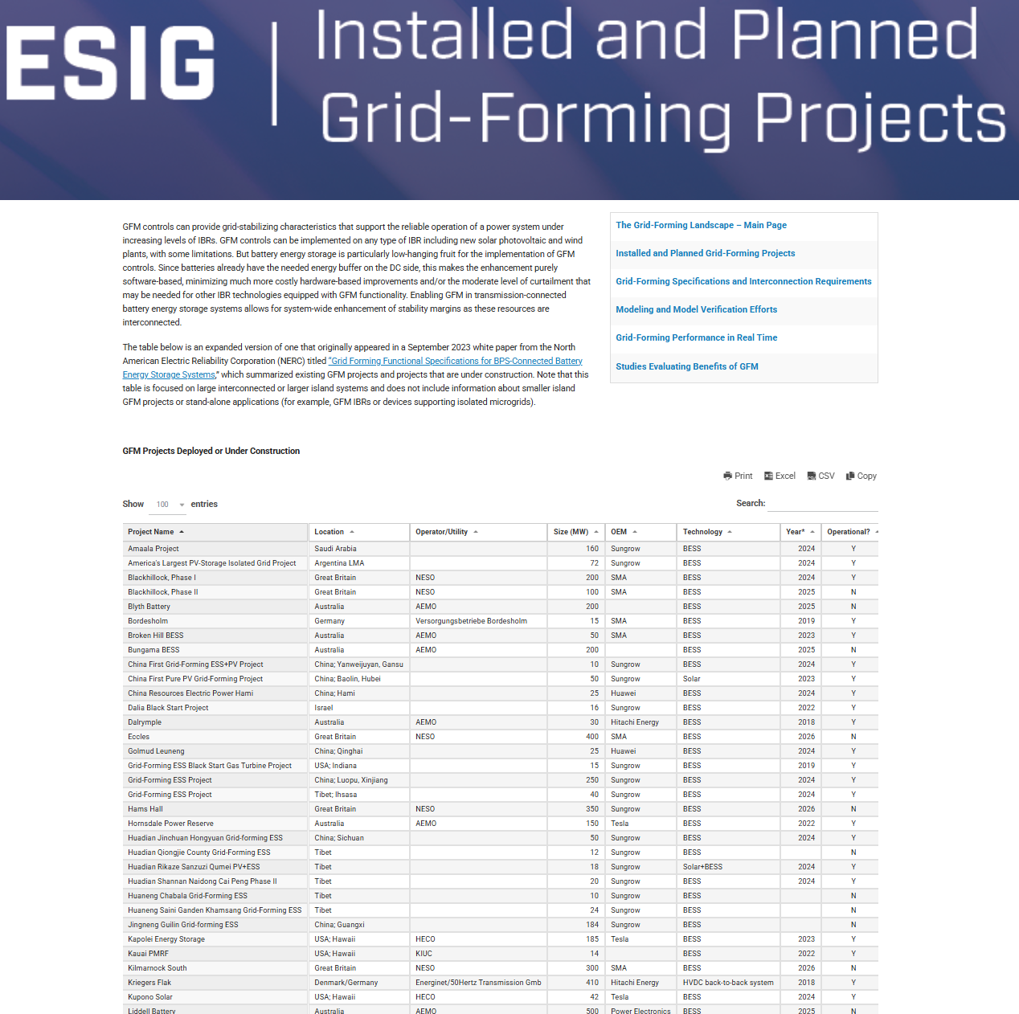
https://www.esig.energy/working-users-groups/reliability/grid-forming/gfm-landscape/

Slide 11
Julia Matevosyan
julia@esig.energy

