Slide 1
Technical Advisory Committee
Market Design Framework - Workshop
Keith Collins
ERCOT Vice President, Commercial Operations
April 23, 2025

Slide 2
Workshop Goals

Slide 3
Workshop agenda
Discuss purpose of ERCOT’s proposed market design framework
Update framework based on feedback
Highlight examples of framework use
Address outstanding questions and gather feedback
Outline next steps
Discuss measurement

Slide 4
Framework Purpose

Slide 5
Framework can achieve multiple purposes
Primary Purpose
Provide decision-makers, including the ERCOT Board, regulators, and legislators, a framework for understanding, assessing, and prioritizing market design initiatives, by better appreciating how different initiatives contribute to the overall market design
Secondary Purposes
Aid stakeholder discussion, communication, and prioritization
Provide common framework for stakeholders to discuss and consider initiatives
What the framework is not
A comprehensive list of all factors and attributes that influence market design
In other words, to better understand how each market design tool fits within the market design toolshed to make better use of tools to meet goals
Setting a reliability standard or superseding legislative or regulatory priorities

Slide 6
Framework use in stakeholder process
Assess initiatives relative to framework attributes
Prioritize initiatives ERCOT staff will focus on

Slide 7
Updated Framework

Slide 8
Initial attributes
Flexibility
Value resources that can ramp up and down, quickly
Dependability
Value resources that can achieve instructed dispatch levels for required durations
Availability
Provide incentives for resource availability when needed, meeting current and future demands
Resiliency
Provide the grid with tools to manage both local and system-wide reliability events
Quality
Value operational attributes that are important to the ERCOT market, such as being carbon-free and contributing to inertia
Efficiency
Design markets to achieve efficient and affordable results to benefit consumers and market participants
Enhance value of locating resources closer to where they are most needed
Location

Slide 9
Updated new attributes
Affordability
Minimizing costs to consumers while maintaining and promoting reliability
Competition
Maximizing the use of competitive and inclusive market mechanisms, where appropriate

Slide 10
Measurement

Slide 11
How to we measure success of the framework?
Vistra/Luminant suggested to measure success with the reliability standard
A good place to start evaluation of framework particularly with respect to availability, flexibility, and dependability, as the reliability standard can help measure some of the framework attributes
Additional measures/studies will need to be developed over time to assess some attributes
Study of flexibility needs could be included as part of the evaluation of DRRS requirements
Some attributes, such as efficiency have been evaluated and assessed by the IMM in their annual reports
For instance, a flexibility study could assess ability to meet current and future ramping needs
Is not a comprehensive enough measure for some attributes including efficiency or quality

Slide 12
Examples of framework attributes and market initiatives

Slide 13
Market design initiatives and framework
An initiative generally addresses a small number of attributes
It is the collective actions of a set of initiatives that can meet overall design needs

Slide 14
Real-time Co-optimization plus Batteries
Efficiency
Location
Efficiently optimizes energy, congestion, and ancillary services in real-time
Re-optimizes resources when congestion patterns shift from day-ahead
Flexibility
Increases by shifting to lower cost resources to rapidly adjust to changing conditions
Competition
Inclusive of new technologies (i.e., batteries) to help drive down costs

Slide 15
Dispatchable Reliability Reserve Service
Flexibility
Sends price signals to value dispatchable capacity
Resiliency
Works to ensure system secure during ramping events
Dependability
Values resources that can achieve ramping and dispatch levels for required durations

Slide 16
Performance Credit Mechanism (shelved)
Availability
Affordability
Sends signals to promote dispatchable capacity and rewards availability
Balances performance payments with energy payments to achieve reliability
Dependability
Provides incentives to improve resource performance

Slide 17
Operating Reserve Demand Curve
Availability
Flexibility
Intention of scarcity prices to promote availability of resources
Values reserves that are quicker
Competition
Scarcity pricing promotes competition to capture price rents

Slide 18
ERCOT Contingency Reserve Service
Resiliency
Ensures that there are sufficient resources to manage system events
Quality
Values duration
Flexibility
Ensures that there are sufficient ramp available to address system needs

Slide 19
HB 1500 “Firming” Requirement
Dependability
Provides incentives for dependable output levels for new resources
Availability
Provides value for resources that can perform beyond expected output levels

Slide 20
Attribute and initiative comparison
These rankings are largely intended to be illustrative. Under the proposed framework, it’s expected that each of the attributes will have more specific metrics associated with them.

Slide 21
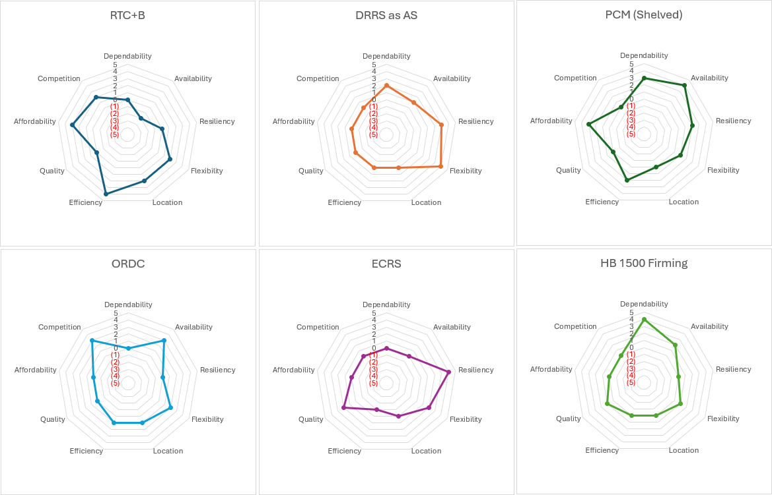
Attribute and initiative comparison – Alternative view
Note: These rankings are largely intended to be illustrative. Under the proposed framework, it’s expected that each of the attributes will have more specific metrics associated with them.

Slide 22
Other questions and feedback

Slide 23
Additional questions
Are there any other insights that stakeholders would like to share?

Slide 24
Next steps

Slide 25
Next steps
Discuss progress with Board
Discuss framework with PUC staff and commissioners
Follow-up with stakeholders as needed
Continue consideration of measurement approaches
Use framework

Slide 26
Appendix

Slide 27
ERCOT Mission
We serve the public by ensuring a reliable grid, efficient electricity markets, open access, and retail choice.

Slide 28
ERCOT Vision
Lead with independent insight on the future of electricity reliability, markets, and technology in Texas in order to facilitate grid and market change for the benefit of all stakeholders.

Slide 29
ERCOT Strategic Pillars
Be an industry leader for grid reliability and resilience
Enhance the ERCOT region’s economic competitiveness with respect to trends in wholesale power rates and retail electricity prices to consumers
Advance ERCOT, Inc. as an independent leading industry expert and an employer of choice by fostering innovation, investing in our people, and emphasizing the importance of our mission

