Slide 1
RIOO Updates
Padmaja Ravila
April 16, 2025

Slide 2
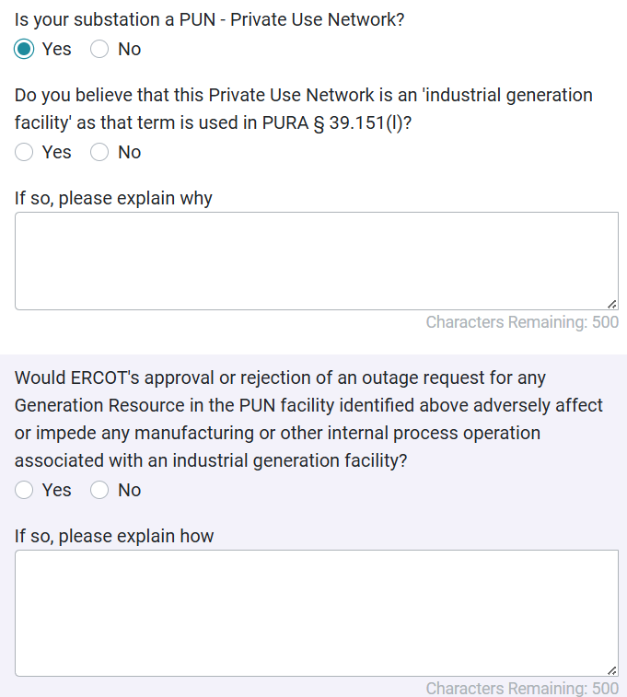
RIOO
RIOO Updates (Production deployment was on 3/27/2025)
Private Use Network (PUN) - Industrial Generation Facility Designation questions/ input fields have been added in the UI on Substation Details form for PUN stations. These fields will be populated with default values as False in ROO-RS

Slide 3
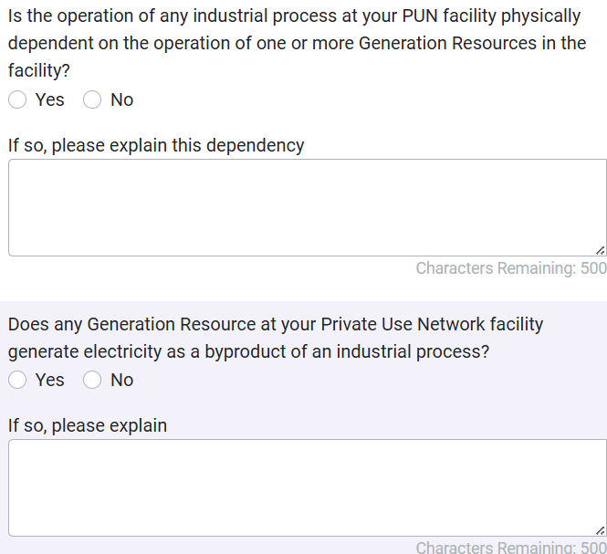
RIOO
More Industrial Generation Facility Designation PUN questions:

Slide 4
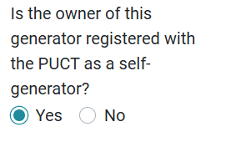
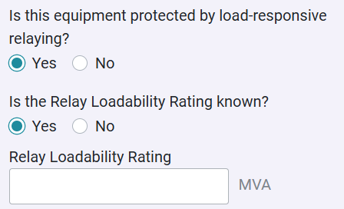
RIOO
PUCT Self Gen: A new field has been added in RIOO on Unit Details panel to capture self gen PUCT registration status.
Relay Loadability Rating Known: A new radio button filed has been added to Line, Series Device, MLSE and MPT details panels to capture Relay Loadability data as per current ERCOT data collection process needs.

Slide 5
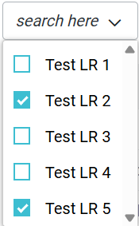
RIOO
"Base kV for Transformer in kV" label is renamed to "Base MVA for Transformer in MVA" on Unit Solar Inverter panel.
SSR Required flag has been added to the INR TSP View, under ‘TSP Key Milestones’ tab
Load Resource UI improvement: Stopped LRs will be hidden by default on the View pages and User should be able to manually select and view them. On the form page, stopped LRs will no longer be visible.

