Slide 1
Regulation Bias Analysis Post SCR-773
March 2025
ERCOT
Operations Planning
PDCWG | April 16, 2025

Slide 2
Discussion Points
Current GTBD Parameters & References
Metric to measure Regulation bias and performance
Regulation Deployed comparison for last three months.
Total Regulation (net) Deployed Comparison
Regulation Deployed 15-minute interval comparison by each hour for 2023, 2024, and 2025 months
Regulation Exhaustion Rate
Regulation bias for consecutive 5-min SCED intervals
Time Error & Contributing Factors
Summary

Slide 3
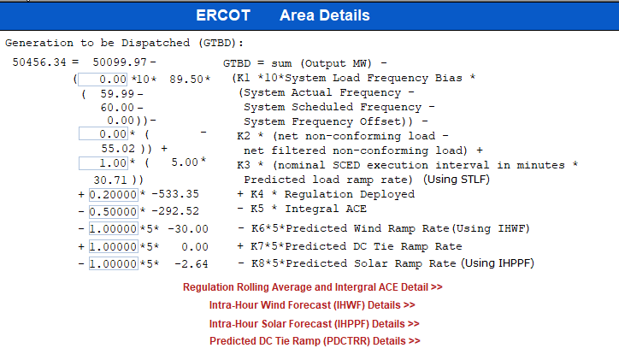
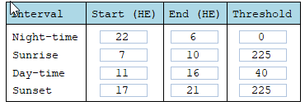
Current GTBD Parameters
Notes:
3/12/18 – Integral ACE Time Constant Changed from 60 min to 45 min
5/17/18 – K4 Changed from 0.3 to 0.2 and K5 Changed from 0.4 to 0.5
12/4/18 – 10:05 AM – K6 Changed from 0 to 0.5
2/12/19 – 2:15 PM – K6 changed from 0.5 to 1.0
3/12/19 – 2:10 PM – PWRR Threshold from 10 to 15 MW/min
3/19/19 – 2:15 PM – PWRR Threshold from 15 to 20 MW/min
4/01/19 – 10:00 AM – K5 changed from 0.5 to 0.4 and Max. Integral ACE Feedback changed from 250 to 150
4/24/19 – 1:15 PM – Max. Integral ACE Feedback changed from 150 to 160. PWRR Threshold changed from 20 to 25.
5/22/19 – 1:10 PM – K5 changed from 0.4 to 0.5, Max Integral ACE feedback changed from 160 to 200, PWRR Threshold changed from 25 to 30
6/17/20 – 10 AM - PWRR Calculation method changed from Direct to Interpolated
9/1/20 – 11 AM - Max Integral ACE Feedback changed from 200 to 250
9/3/20 – 3 PM - Max Integral ACE Feedback changed from 250 to 300
9/4/20 – 3 PM - Max Integral ACE Feedback changed from 300 to 250
6/1/21 – 10:00 AM – K8 Changed from 0 to 0.5, PSRR Threshold changed to 10
6/2/21 – 10:00 AM – PSRR Threshold changed from 10 to 20
6/3/21 – 10:00 AM – K8 Changed from 0.5 to 0.75
6/4/21 – 10:00 AM – K8 Changed from 0.75 to 1
9/2/21 – 10:00 AM – PSRR Threshold changed to 30
6/7/22 – 10:30 AM – K7 Changed from 0 to 0.5, PDCTRR Min/Max Threshold changed to 10 MW/min
6/8/22 – 10:30 AM – PDCTRR Min/Max Threshold changed from 10 to 20 MW/min
6/9/22 – 10:30 AM – K7 Changed from 0.5 to 0.75
6/10/22 – 10:30 AM – K7 Changed from 0.07 to 1.0
7/21/22 – 10:00 AM–Max Integral ACE Feedback changed from 250 to 350
7/21/22 – 05:10 PM – K5 Changed from 0.5 to 1
7/22/22 – 09:40 PM – K5 Changed from 1 to 0.5
7/27/22 – 08:40 AM – PSRR Threshold changed to 40 MW/min
6/12/23 - PSRR dynamic threshold enabled. The Max PSSR started at 80 MW/min for sunrise and sunset hours
6/15/23 – The Max PSRR threshold increased to 100 MW/min for sunrise and sunset hours
10/26/23 – Max Integral ACE Feedback changed from 350 to 250
3/7/24 – PSRR threshold increased from 100 MW/Min to 120 MW/Min
05/30/24 – Max Integral ACE Feedback changed from 250 MW to 350 MW
8/28/24 – PSS Dynamic Threshold changed from 120 MW/Min – 180 MW/Min
10/31/24– K5 changed to 0.5 to 1 to correct the time error
11/1/24 - K5 changed from 1 to 0.75
11/5/24 – K5 changed from 0.75 to 0.5
11/18/24 – K5 changed from 0.5 to 0.75
11/22/24 – K5 changed from 0.75 to 0.5
3/5/25 – K5 changed from 0.5 to 0.75
3/6/25 – K5 changed from 0.75 to 1
3/7/25 – Max Ace Integral Feedback changed from 350 MW to 400 MW
3/7/25 – PSRR Dynamic Threshold for sunrise and sunset changed from 180 MW/Min to 225 MW/Min
3/11/25 – Max Ace Integral Feedback changed from 400 MW to 350 MW
3/12/25 – K5 changed from 1 to 0.5

Slide 4
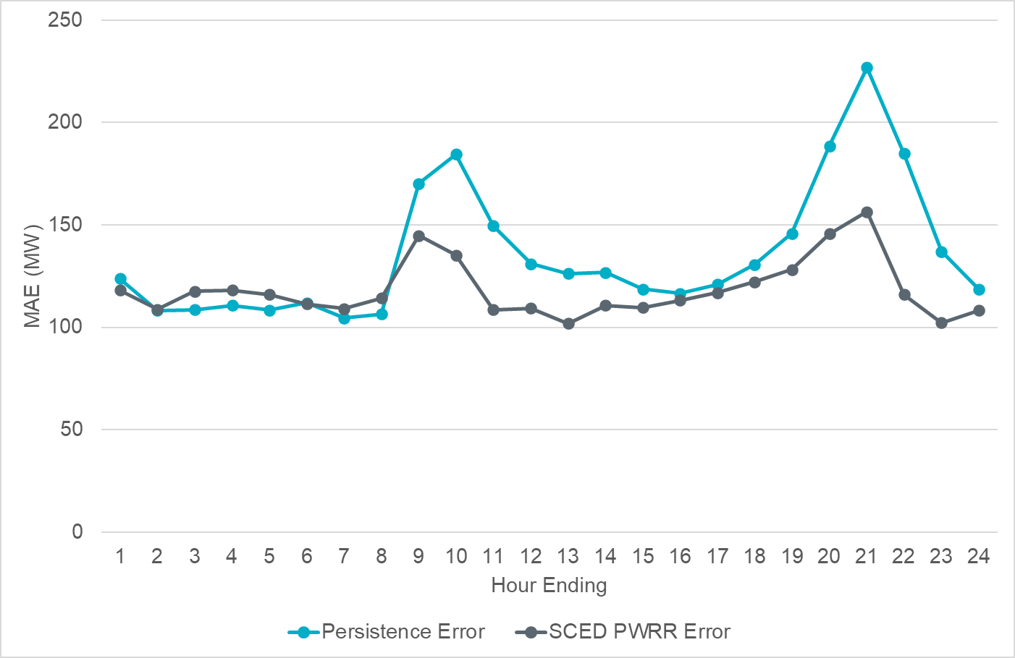
Projected Wind Ramp Rate MAE
Notes:
For intra-hour wind ramp forecast, SCED PWRR MAE is consistent and smaller than the Persistence forecast across the board. More errors occur during ramping hours.

Slide 5
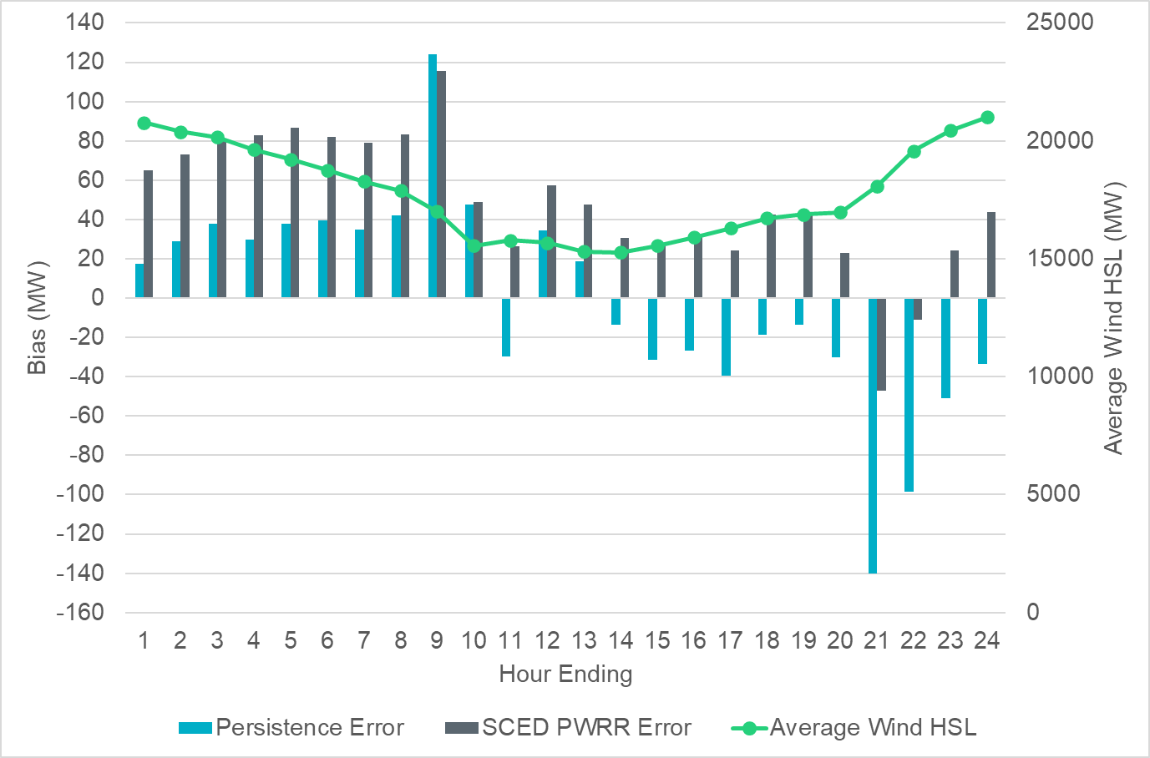
Projected Wind Ramp Rate Error
Notes:
More errors during ramping hours

Slide 6
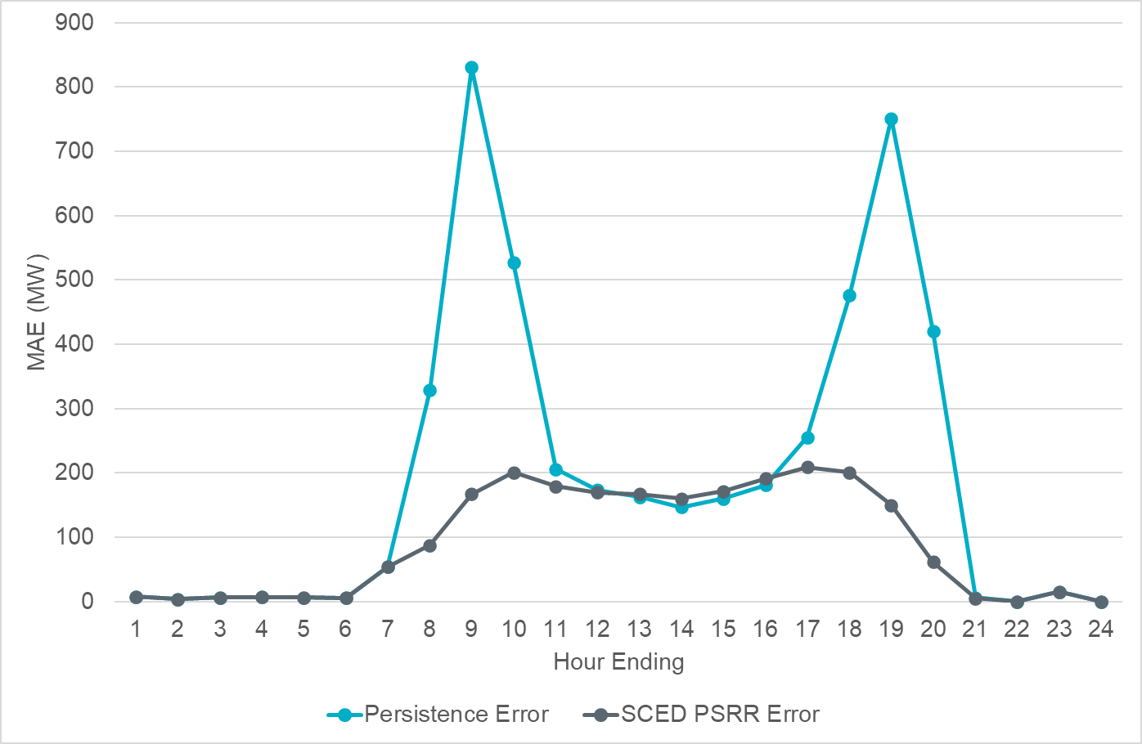
Projected Solar Ramp Rate MAE
Notes:
For intra-hour solar ramp forecast, SCED PSRR is generally performing better when compared to the persistence forecast, particularly during the most significant solar ramp hours.

Slide 7
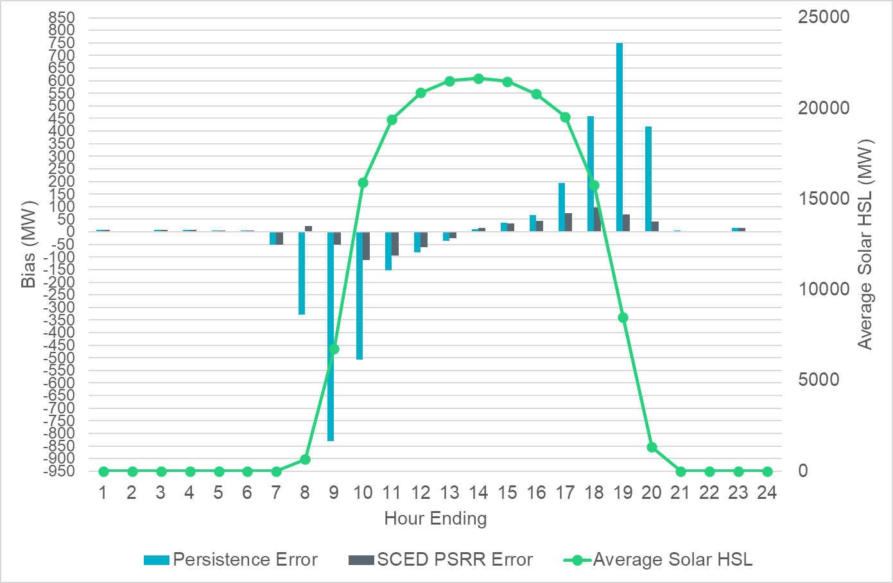
Projected Solar Ramp Rate Error
Notes:
Similar to wind, generally we see greater forecast errors during ramping periods.

Slide 8
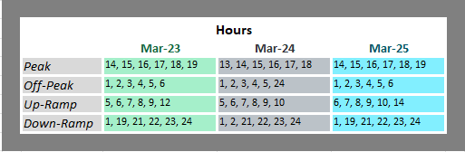
References

Slide 9
Metrics to Measure SCR-773 Performance
Trend and monitor the regulation deployed by hour.
Set target of 50 MW for total regulation deployed by hour for peak hours.
Set target of 85% for the number of intervals where regulation deployment was both up and down for peak hours.
Track the Regulation exhaustion rate for all hours (not to exceed 5%).
Using a 50MW filter, target 15 occurrences or less per month for regulation bias of six or more consecutive 5 minute intervals for peak hours.

Slide 10
Total Regulation Deployed Comparison
Total regulation deployed for the last three months.

Slide 11
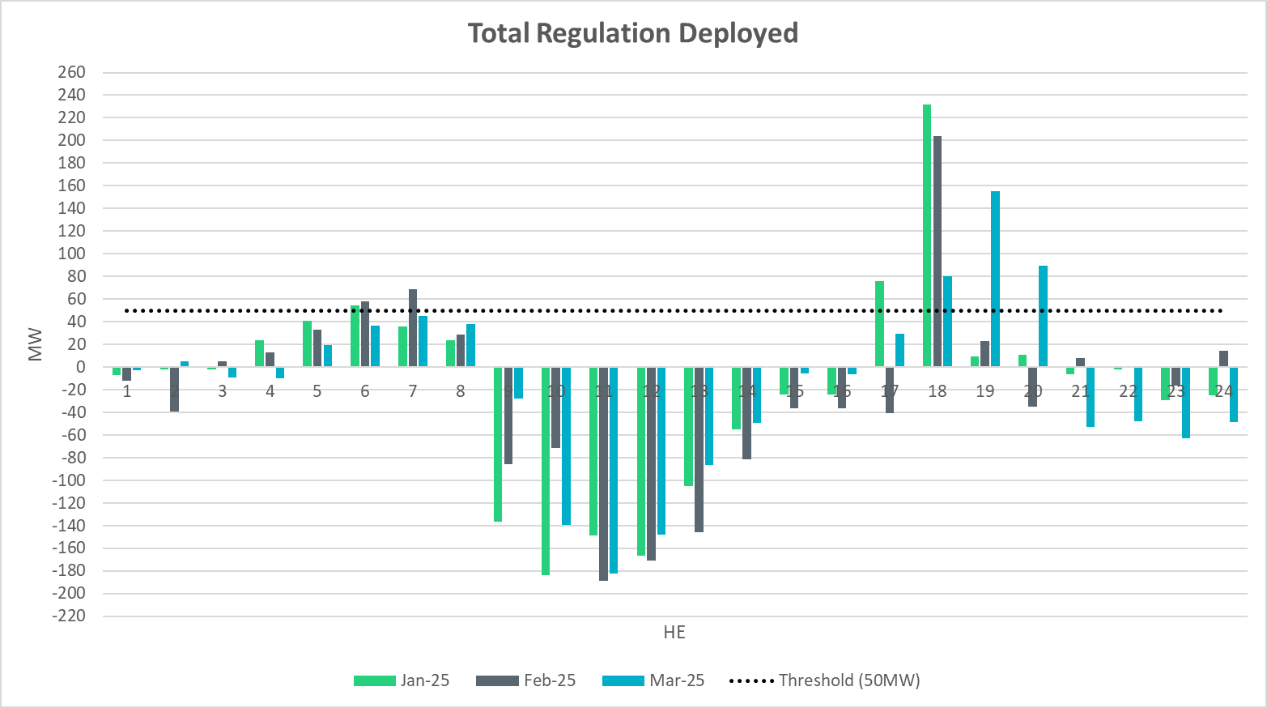
Total Regulation Deployed Comparison - Monthly
Notes:
Total regulation deployed comparison in the last 3 months: Overall regulation deployment trends follow the previous two months with more bias towards Regulation Down deployment, but we could see more Regulation Up deployed during HE19 – HE20

Slide 12
Metric 1: Regulation Deployed Comparisons
Trend and monitor the regulation deployed by hour.

Slide 13
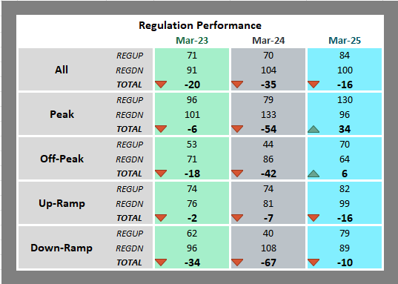
Regulation Deployed Comparison
Notes:
Overall, the trend is bias towards Reg down for all hours.

Slide 14
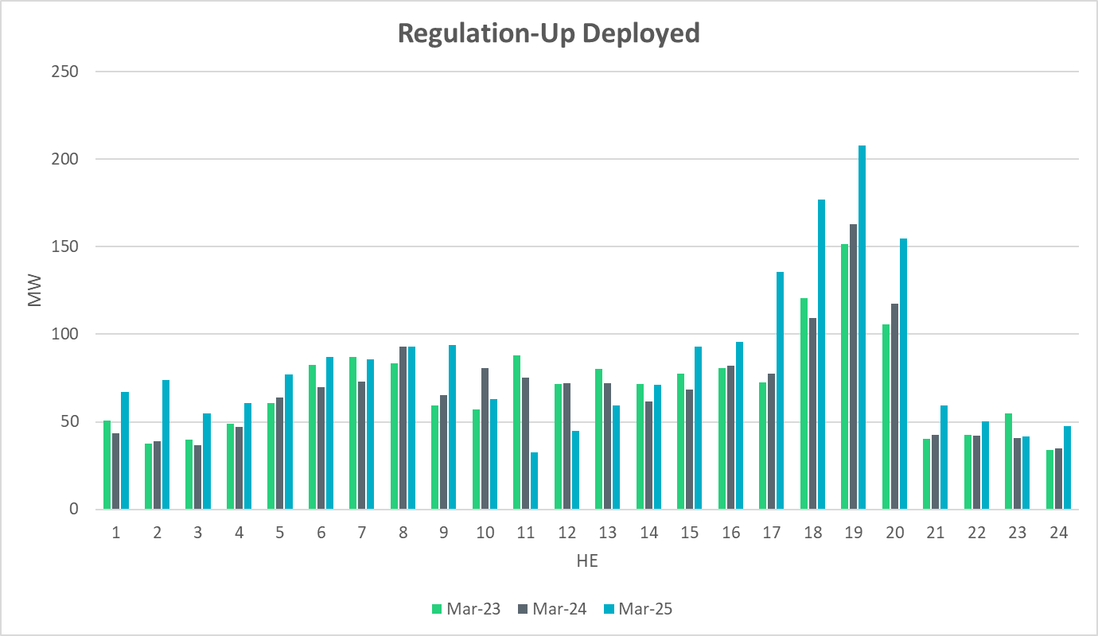
Regulation Deployed Comparison
Notes:
Similar levels of reg up deployment overall compared to previous years with only few instances where more reg up is deployed during sunset hours.

Slide 15
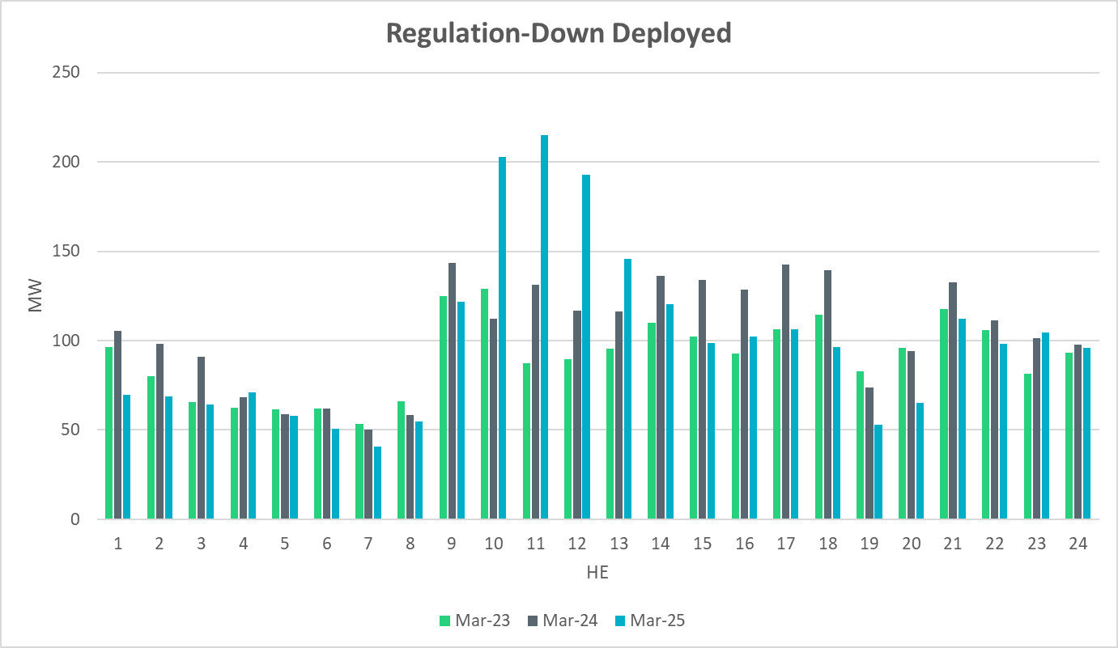
Regulation Deployed Comparison
Notes:
Overall Regulation down deployment in March 2025 is consistent with that of the previous two years. There was an increase in regulation down deployment during sunrise hours.

Slide 16
Metric 2: Total Regulation Deployed Comparisons
Set target of 50MW for total regulation deployed by hour for peak hours.

Slide 17
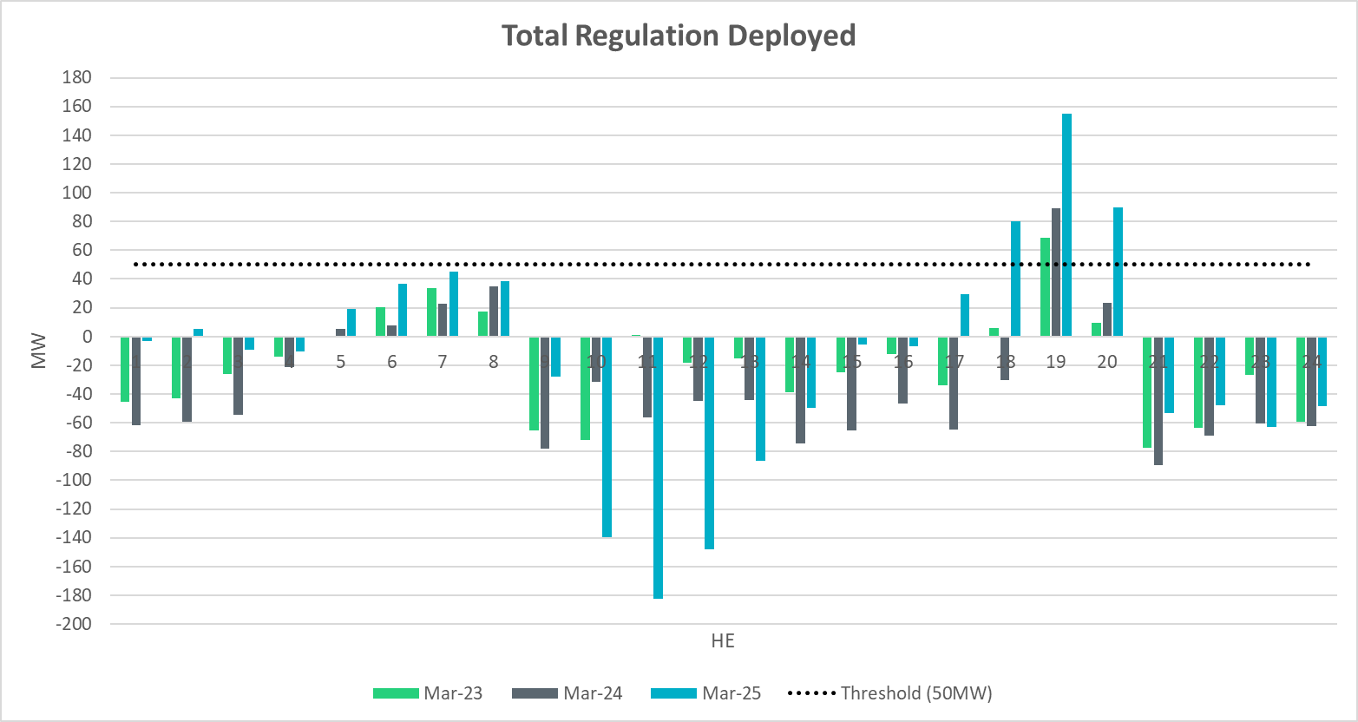
Total Regulation Deployed Comparison
Notes:
Total regulation deployed compared with the previous two years. More reg down during sunrise hours and more reg up deployment during sunset hours.

Slide 18
Metric 3: 15-min Intervals Where Both REGUP/REGDN Were Deployed
Set target of 85% for the number of intervals where regulation deployment was both up and down.

Slide 19
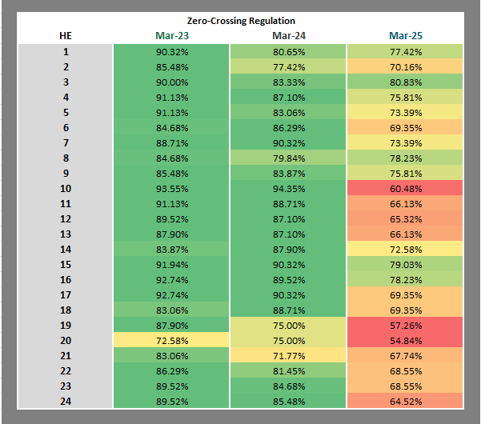
“Zero” Crossing Regulation
Notes:
Zero crossing regulation is generally lower to the last two years. The lower zero crossing percentages are seen during ramp hours.

Slide 20
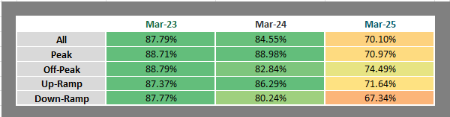
“Zero” Crossing Regulation
Notes:
Overall, we see that it is above 70% for all hours and lower compared to previous years.

Slide 21
Metric 4: Regulation Exhaustion Rate
Track the regulation exhaustion rate for all hours (not to exceed 5%.)

Slide 22
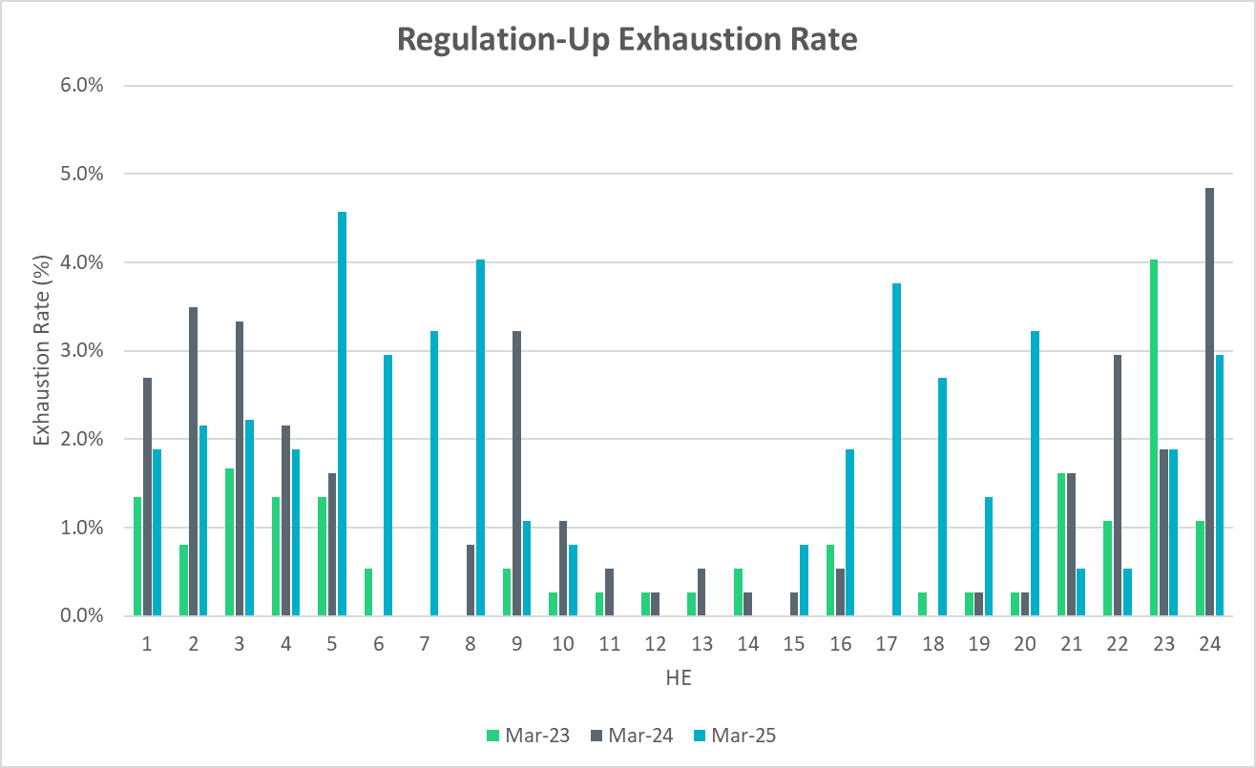
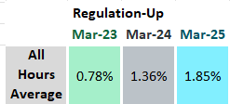
Regulation Exhaustion Rate
Notes:
Average regulation up exhaustion rate for all hours is 1.85% which is more than last March. FFRS originally wasn’t accounted for in the regulation calculations but is now included.

Slide 23
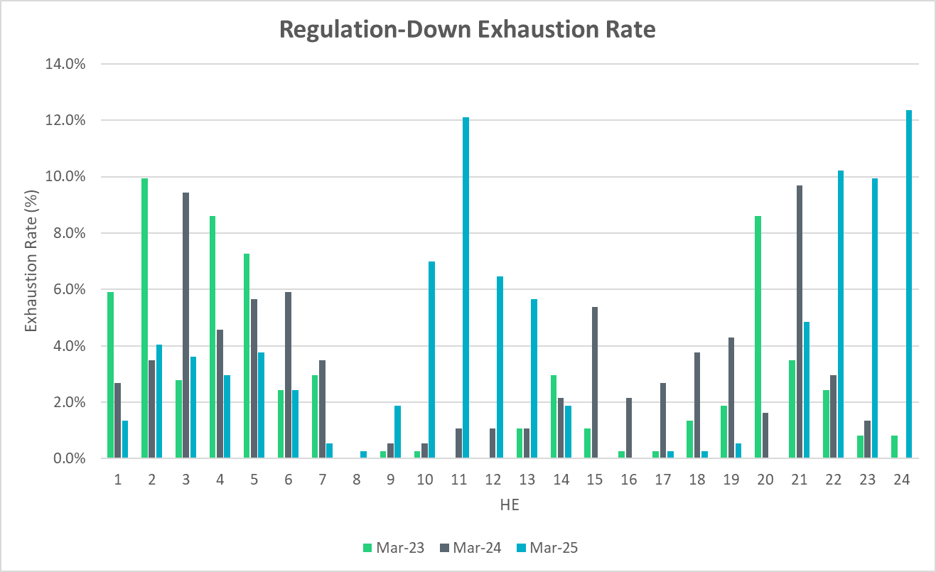
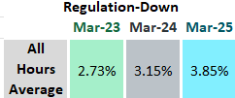
Regulation Exhaustion Rate
Notes:
Average regulation down exhaustion rate for all hours is 3.85%, which is higher than last year.

Slide 24
Metric 5: Stats on REGUP Bias for Consecutive 5-min Intervals
Using a 50MW filter, target 15 occurrences or less per month for regulation bias of six or more consecutive 5-minute intervals for peak hours.

Slide 25
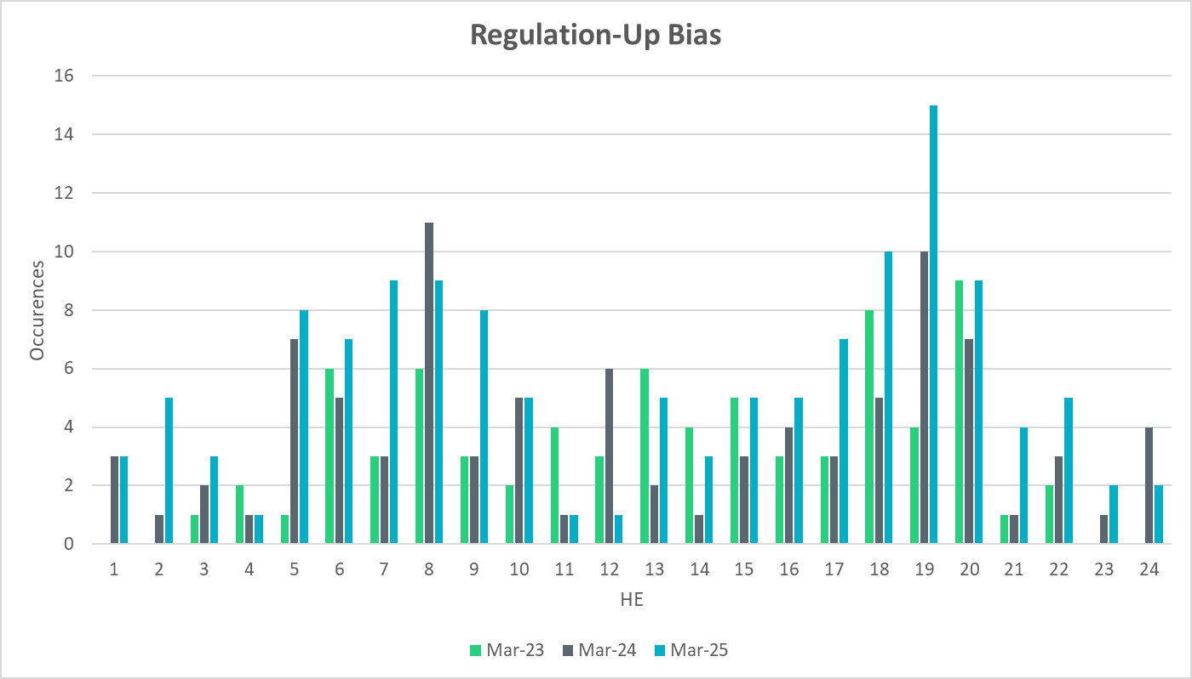

Regulation Bias for Consecutive SCED Intervals
Notes:
Regulation up bias occurrence for consecutive SCED intervals for all hours is 132 and peak hours is 45.

Slide 26
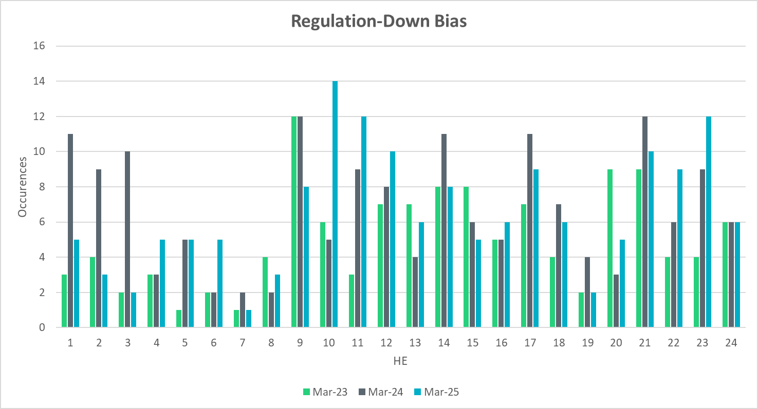

Regulation Bias for Consecutive SCED Intervals
Notes:
Regulation down bias occurrence for consecutive SCED intervals for all hours is 157 and peak hours is 36.

Slide 27
Time Error and Contributing Factors
Accumulated Time Error, Load and Wind Ramp, PWRR Error, Start-Up/Shut-Down Hours, STLF Error, and Expected Generation Deviation.

Slide 28
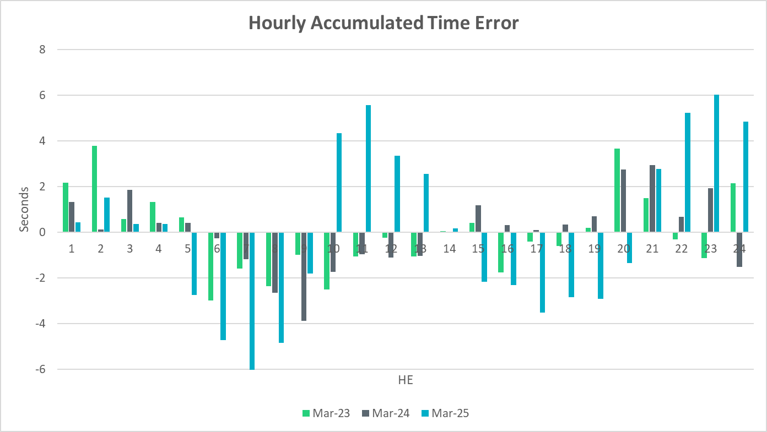
Time Error Accumulation
Notes:
Accumulated time error is higher compared to last two years due to real time telemetry and operational issues ERCOT observed from wind and solar units which affected the ERCOT frequency control. ERCOT has been working with the Market Participants to address the operational issues. ERCOT tuned the GTBD ACE integral feedback to recover the time error.

Slide 29
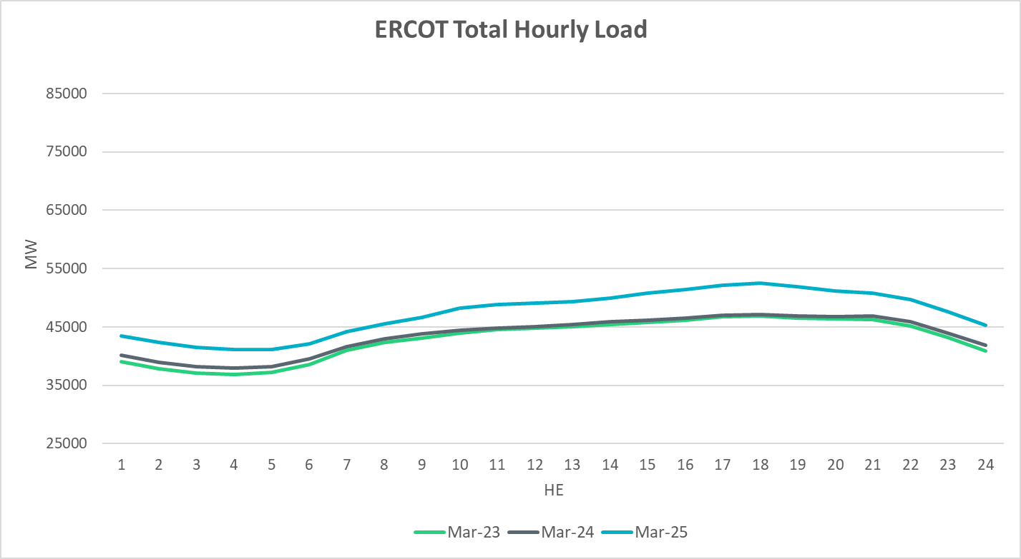
Load Profile
Notes:
The load is generally more than the last year.

Slide 30
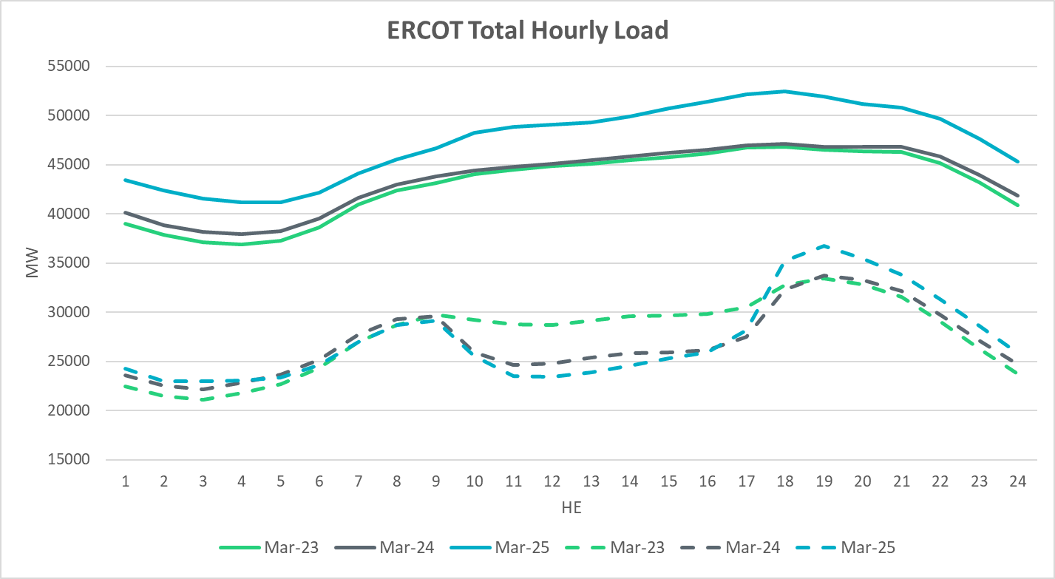
Net Load Profile
Notes:
The total load is more than the last year during
Less Net Load during Up ramp and peak hours.
Net Load: dashed line.

Slide 31
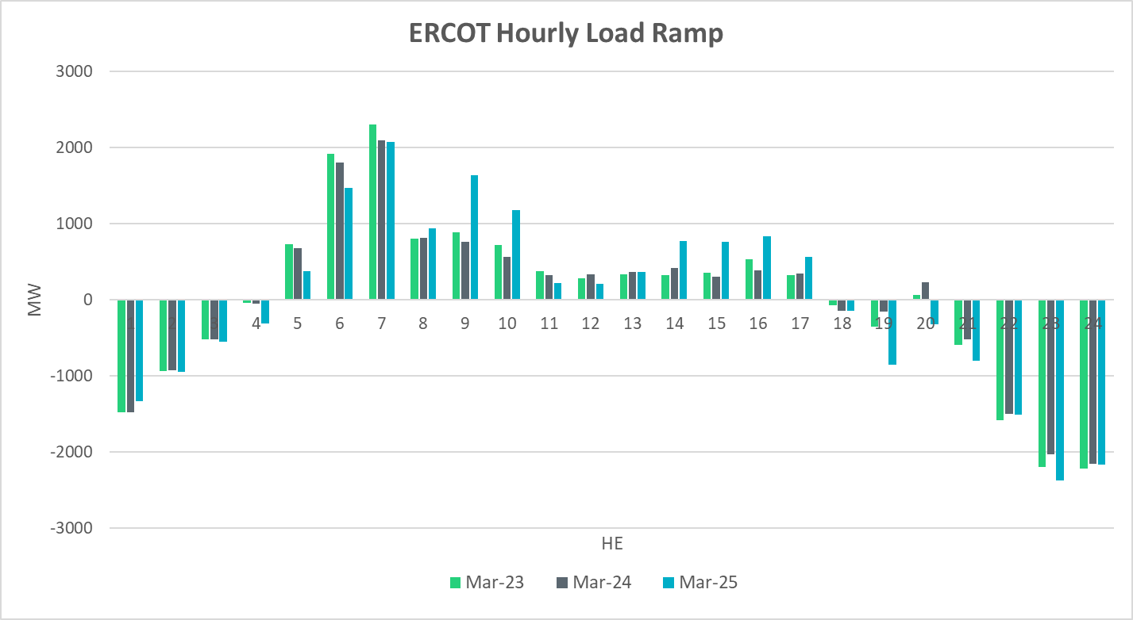
Load Ramp
Notes:
Overall hourly load ramp trend remained similar compared to the last couple of years.

Slide 32
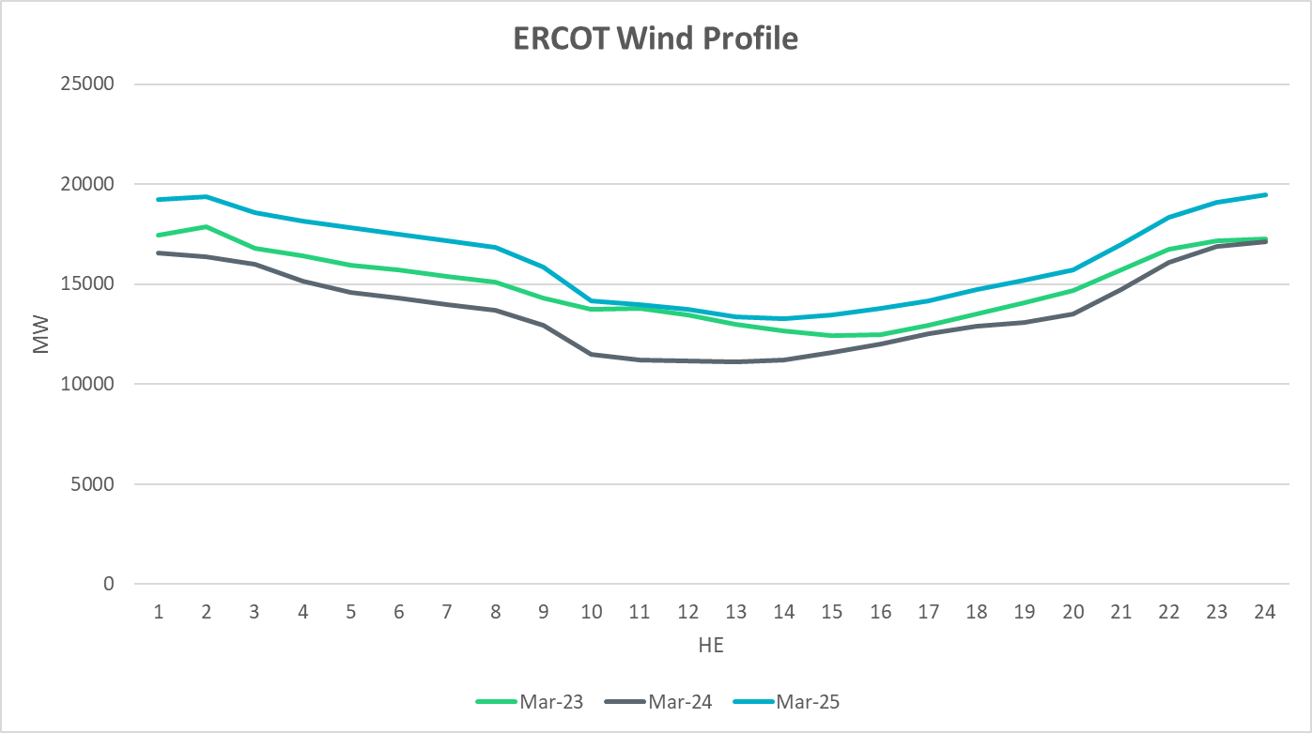
Wind Profile
Notes:
Wind generation is higher than last year

Slide 33
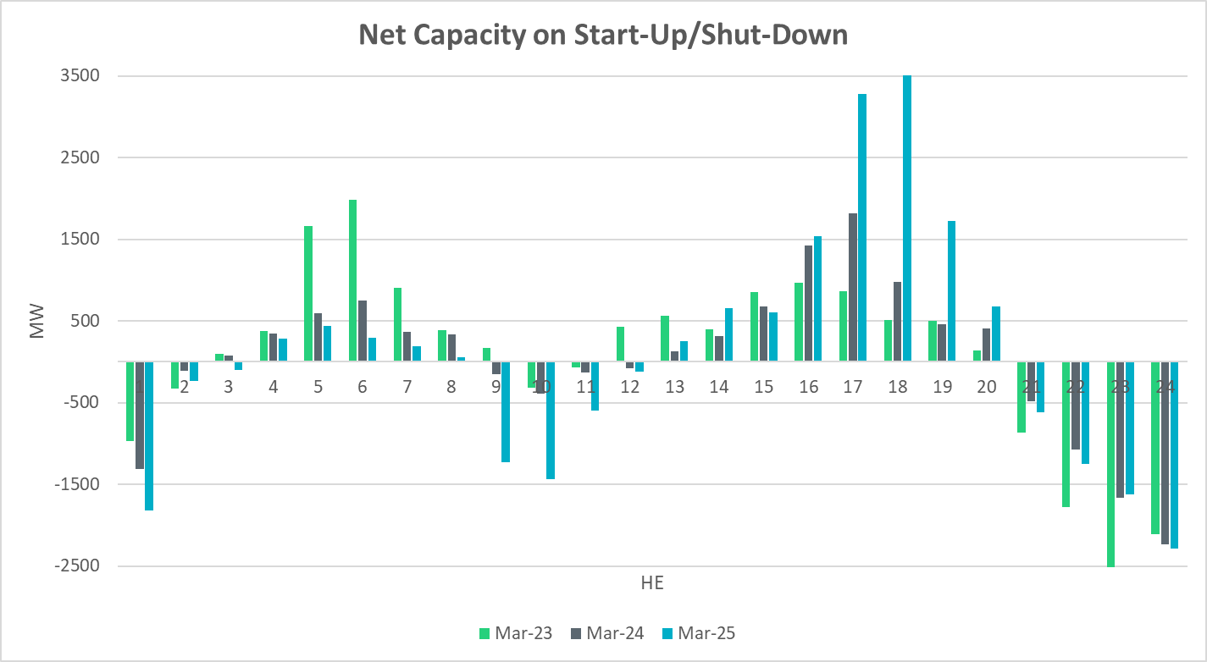
Start-Up & Shut-Down Hours
Notes:
Net Capacity on Start-Up/ShutDown are generally following the trends of the last two years. More capacity during sunset hours

Slide 34
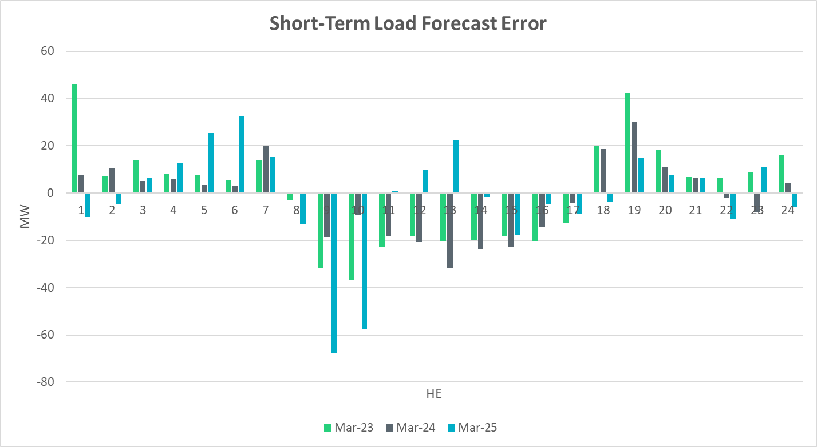
Short-Term Load Forecast Error
Notes:
Forecast – Actual
+ve Error => Over forecasted load
-ve Error +> Under forecasted load
During peak load hours we see an under forecasted load, and an over forecasted load during off peak and ramp down hours

Slide 35
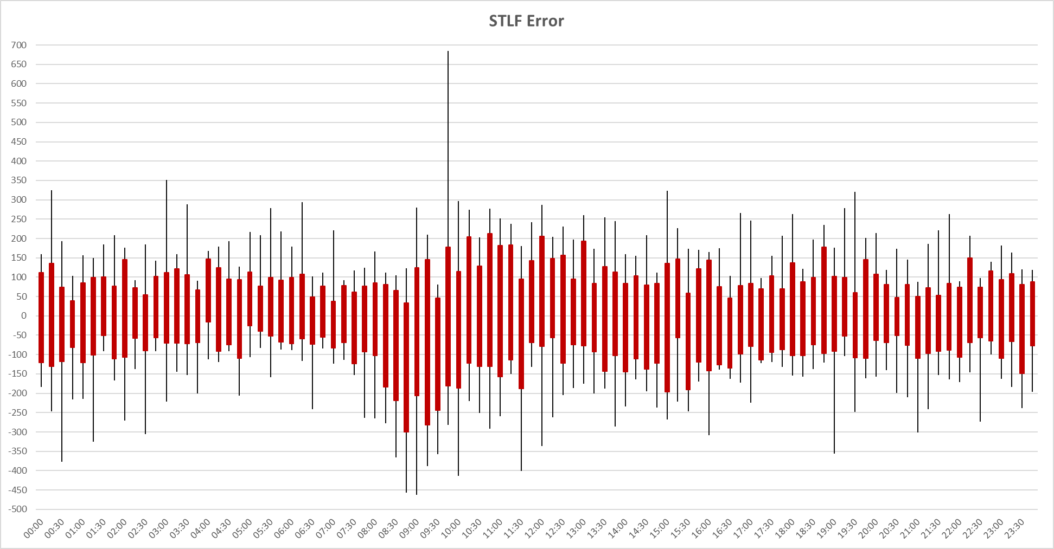
STLF Error Chart
Notes:
Error = Forecast – Actual
Min, Max, 10th, 90th percentile
15-minute intervals
Max Positive Forecast Error:
3/6/2025 HE9 -> 685 MW
Max Negative Forecast Error:
3/25/2025 HE9 -> -462 MW

Slide 36
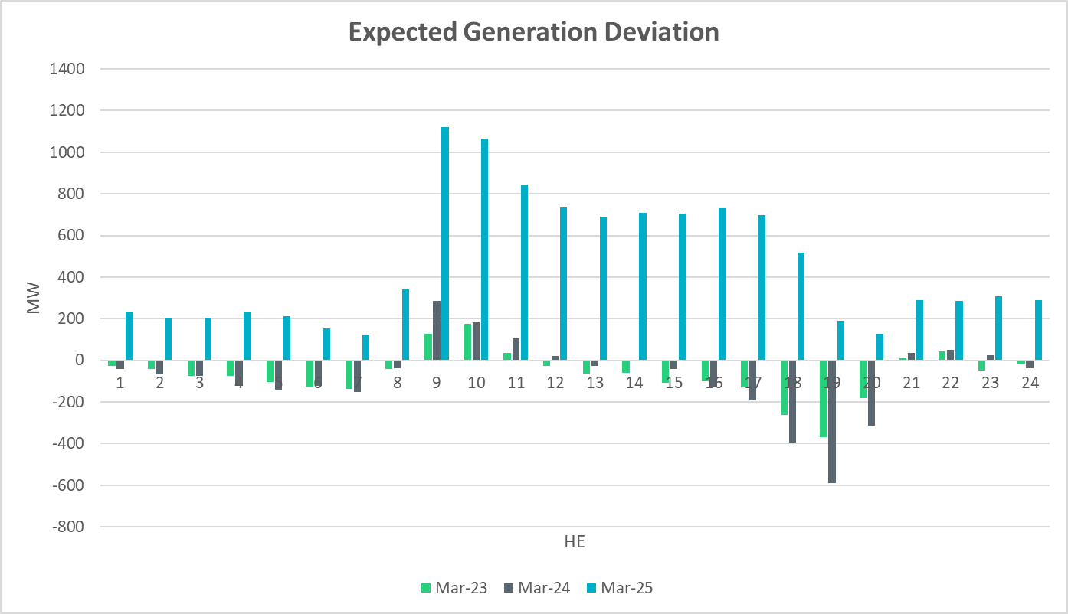
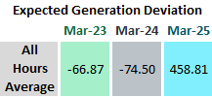
Expected Generation Deviation
Notes:
Largest expected generation deviation occurs during solar ramps. We see a positive average expected generation deviation in March

Slide 37
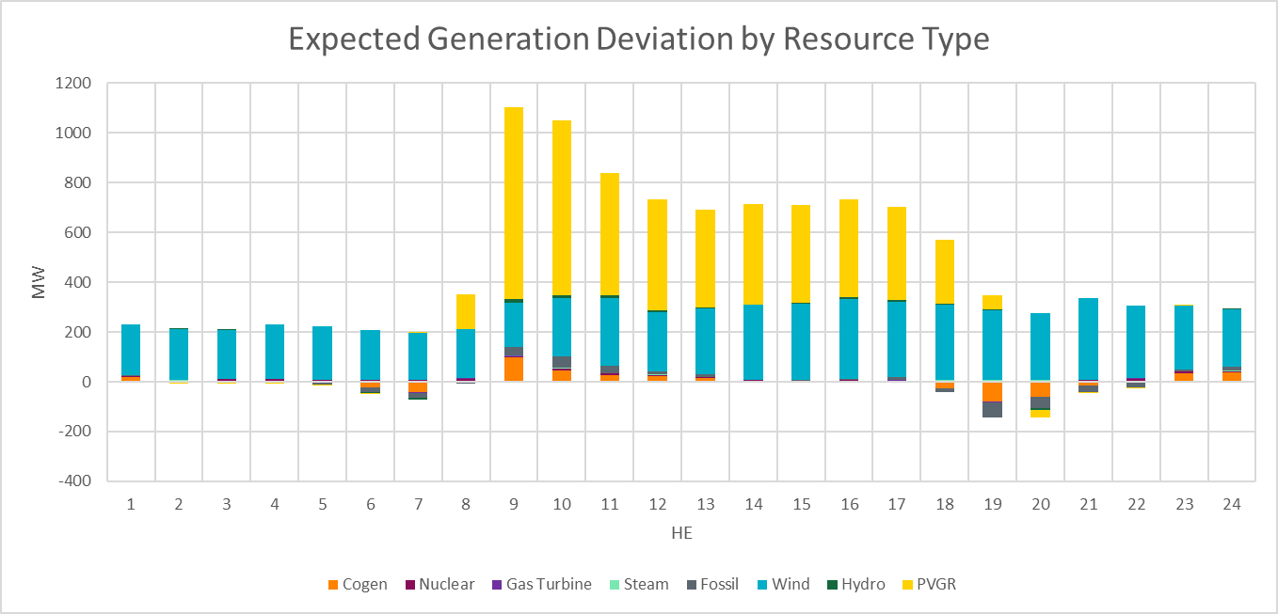
Expected Generation Deviation
Notes:
Expected Generation Deviation Breakdown by resource type and we see significant contribution from wind and solar during the ramping hours

Slide 38
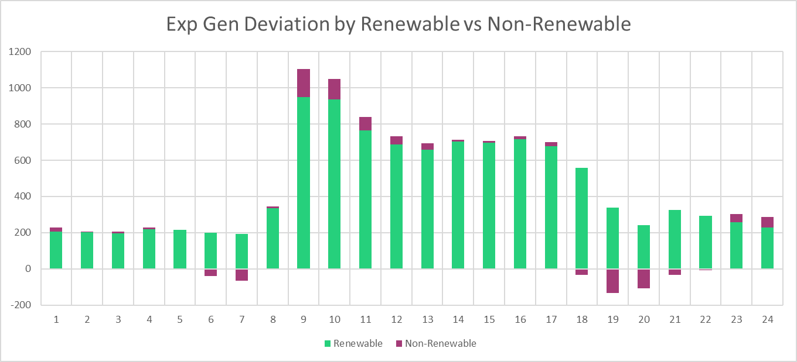
Expected Generation Deviation
Notes:
Comparing renewables vs non-renewables. IRR resources are the main contributor for most part of the day.

Slide 39
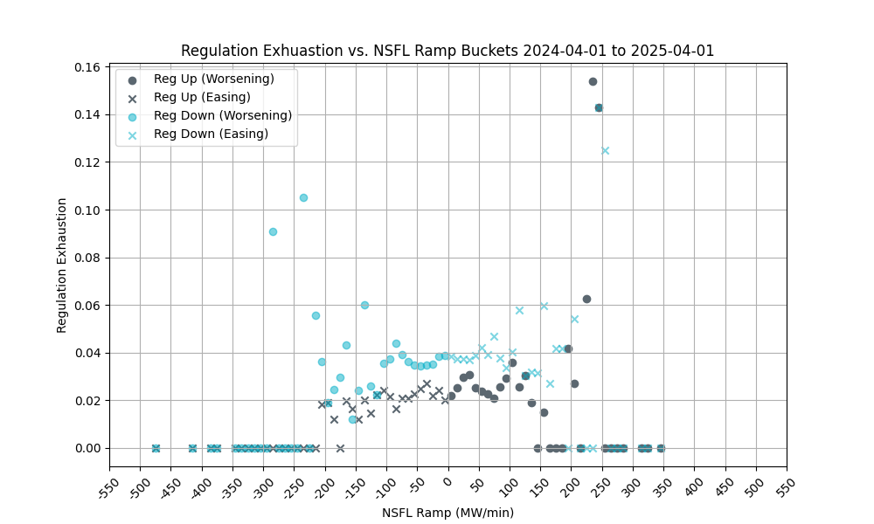
Non-SCED Qualified Flexible Load (NSFL) Ramping
Notes:
1-min NSFL ramp values were examined in bins of 10 MWs (as tracked on x-axis) and the average rate of intervals during which regulation was exhausted (i.e. remaining regulation was less than 5 MW) was computed (as tracked on y-axis).
NSFL includes Large Loads and Steel Mills that are not following SCED dispatch.
Trend is the same: we see low correlation between regulation exhaustion and NSFL ramp

Slide 40
Questions?
Thank you!

