Slide 1
ERCOT Frequency Events
March 2025
ERCOT
Operations Planning
PDCWG | Apr 16, 2025

Slide 2
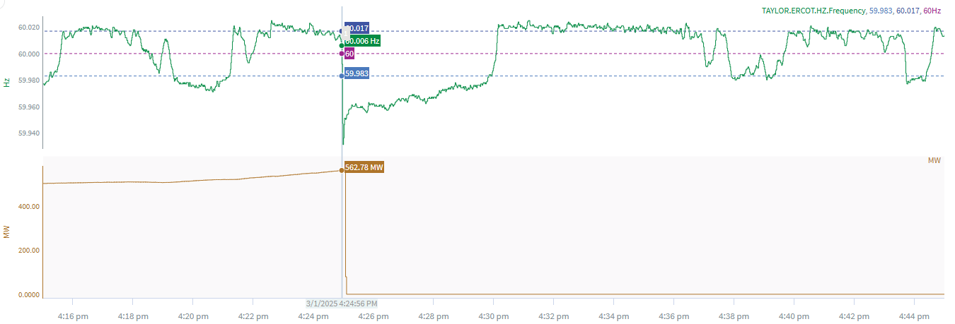
3/1/2025 16:24:56 (Non-FME)
Notes:
The unit tripped offline while carrying ~563 MW
Starting Frequency: 60.006 Hz
Minimum Frequency: 59.931 Hz
A-C Time : 3 seconds
Recovery Time(back to deadband): 4 minutes 54 seconds
ECRS Released: 0 MW
Trip Reason: Generator voltage issue
Contextual Information: A total of 313 MW of regulation Up was deployed during the event.
Reason for no selection: C point is 59.931

Slide 3
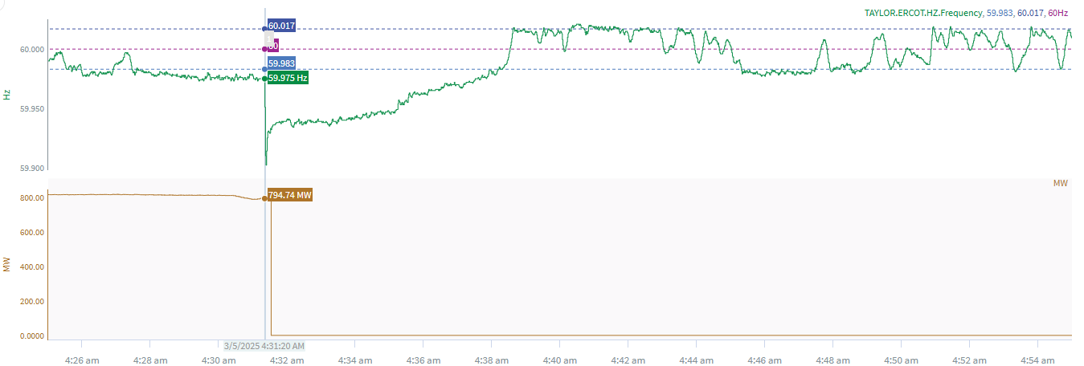
3/5/2025 4:31:20 (Non-FME)
Notes:
The unit tripped offline while carrying ~ 793 MW
Starting Frequency: 59.975 Hz
Minimum Frequency: 59.902 Hz
A-C Time : 3 seconds
Recovery Time(back to deadband): 6 minutes 52 seconds
ECRS Released: 0 MW
Trip Reason: Air pre heater
No Selection Reason: Frequency is outside low deadband
Contextual Information: A total of 247MW of regulation Up was deployed during the event.

Slide 4
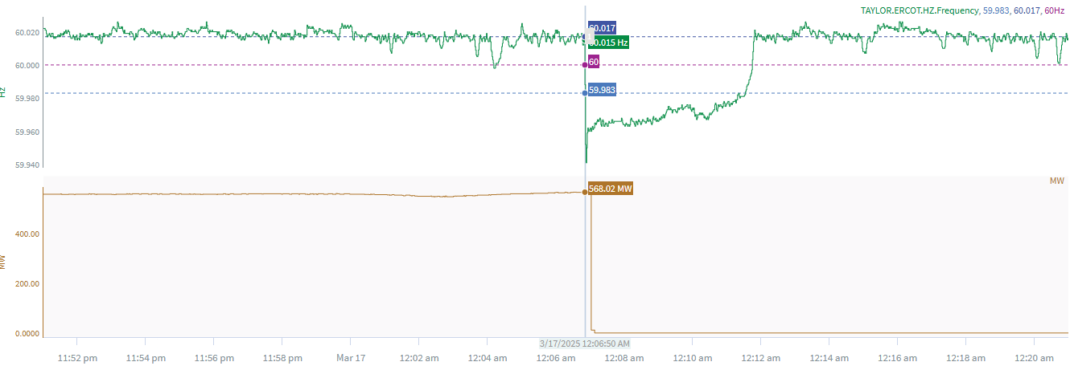
3/17/2025 00:06:50 (Non-FME)
Notes:
A unit tripped for loss of ~567 MW
Starting Frequency: 60.015 Hz
Minimum Frequency: 59.941 Hz
A-C Time : 3 seconds
Recovery Time(back to deadband): 4 minutes 43 seconds
ECRS Released: 0 MW
Trip Reason: An electric hydraulic control leak
Reason for no selection: The C point is 59.941

Slide 5
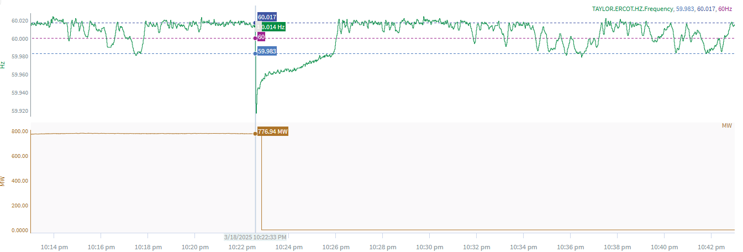
3/18/2025 22:22:33 (FME)
Notes:
A unit tripped for loss of ~777 MW
Starting Frequency: 60.014 Hz
Minimum Frequency: 59.917 Hz
A-C Time : 3 seconds
Recovery Time(back to deadband): 3 minutes 17 seconds
ECRS Released: 0 MW
Trip Reason: Unknown at this time

Slide 6
Questions?
Thank you!

