Slide 1
Day-Ahead Market PTP and PTPLO Submission Activity
April 14, 2025
Curry Holden
Day-Ahead Market Supervisor

Slide 2
Background
Point-to-Point (PTP) Obligation Bids and Point-to-Point with Links to an Option (PTPLO) interval records have been identified as a particularly strenuous product for the DAM optimization engine to solve for.
In 2021, ERCOT communicated to WMWG regarding DAM delays.
During analysis, it was determined that high volumes of PTP interval records were causing increased optimization engine execution times. Therefore, we’ve decided to bring our observations to CMWG and provide an update.

Slide 3
Background: Continued
ERCOT performed studies to determine the impact of PTPs on the performance. As analysis continued, we discovered that unawarded PTPs may have an outsized impact on performance.
A PTP submission fee for unawarded PTPs was proposed. The IMM has also recommended a PTP fee since the 2020 State of the Market report.
This issue was deprioritized shortly thereafter due to
  Winter Storm Uri impacts
  DAM operations’ process changes that improved execution times
  DAM engine hardware updates that improved execution times
  SCR 814 allows ERCOT to limit PTP submission activity per counterparty.
Note: In this discussion, PTPs and PTPLOs (aka CRRs) are lumped together because the DAM optimization engine models them identically. ERCOT is not implying that any changes should be made to current PTPLO practices. Historically, about 20-30 PTP interval records are submitted for each PTPLO interval record.

Slide 4
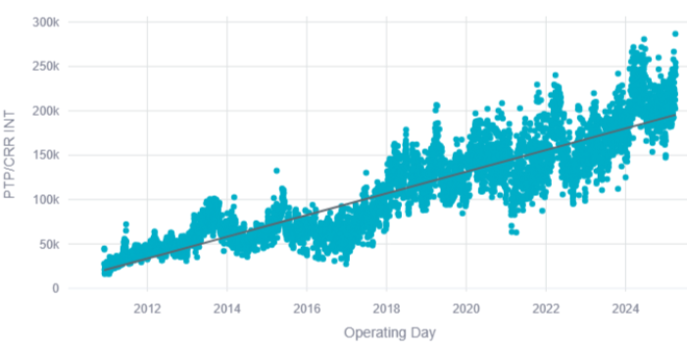
Historical PTP Counts
DAM PTP/CRR interval (hourly) record submission counts continue to break records.
OD vs PTP/CRR interval count 2010-2025

Slide 5
Looking Forward
Further process and hardware improvements offer diminishing returns, as the underlying issue remains unresolved.
Without additional measures to manage PTP submission volume, we may be forced to lower the number of PTP interval submissions allowed per counterparty (currently set to 10,000).
This is a hard cutoff and doesn’t necessarily assign appropriate value to PTP submissions.

Slide 6
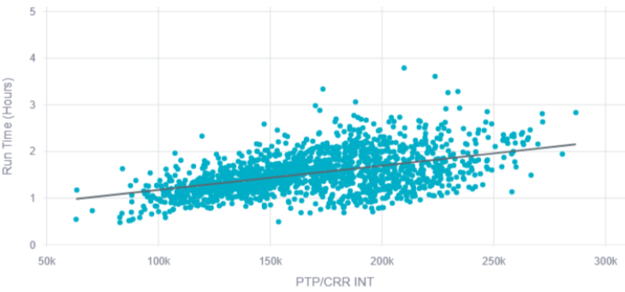
Historical PTP Counts
Performance concerns are beginning to reemerge, making late solutions postings and DAM aborts more likely.
Execution time vs PTP/CRR interval count 2021-2025

Slide 7
Next Steps
ERCOT will:
  Re-evaluate correlation of unawarded PTPs vs execution time.
  Analyze submission activity to make informed suggestions regarding fee structure.
Any questions or concerns?
Notes:
Note: when AS insufficiency occurs in DAM, two notices are sent. One is automated and one is manual.

