Slide 1
Credit Exposure Update
Market Credit Work Group
ERCOT Public
April 17, 2025

Slide 2
Monthly Highlights: February 2024 – March 2025
Market-wide average Total Potential Exposure (TPE) remained flat at $1.84 billion in March
Both real-time prices and forward adjustment factors were slightly lower in March
Discretionary Collateral is defined as Secured Collateral in excess of TPE,CRR Locked ACL and DAM Exposure
Average Discretionary Collateral decreased from $4.53 billion in February to $4.10 billion in March
No unusual collateral call activity

Slide 3
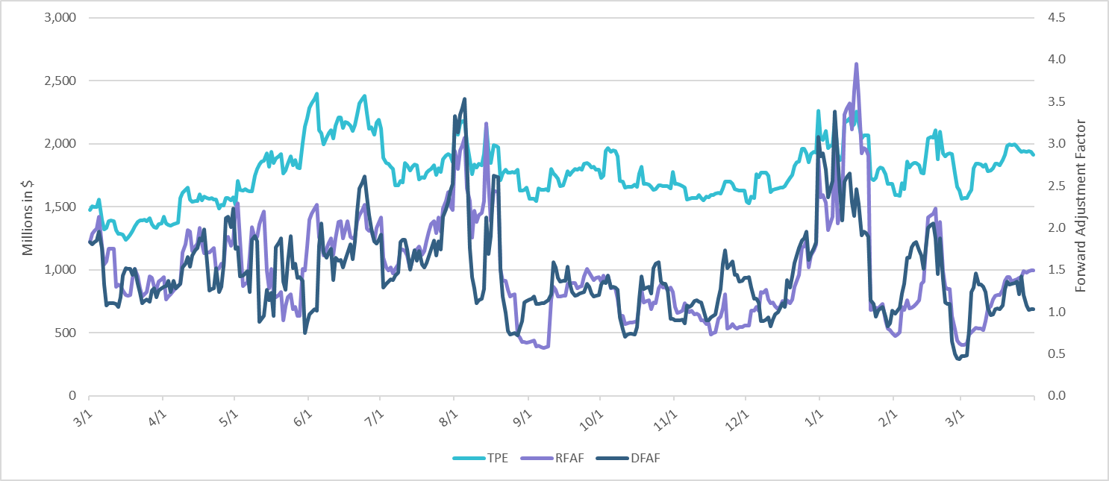
TPE and Forward Adjustment Factors: March 2024 – March 2025

Slide 4
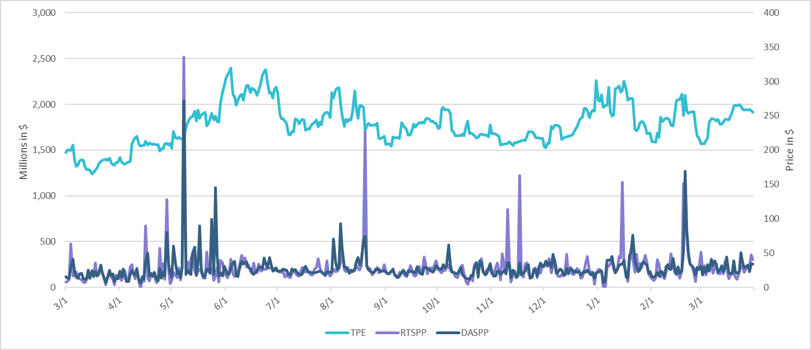
TPE/Real-Time & Day-Ahead Daily Average Settlement Point Prices for HB_NORT:H March 2024 – March 2025

Slide 5
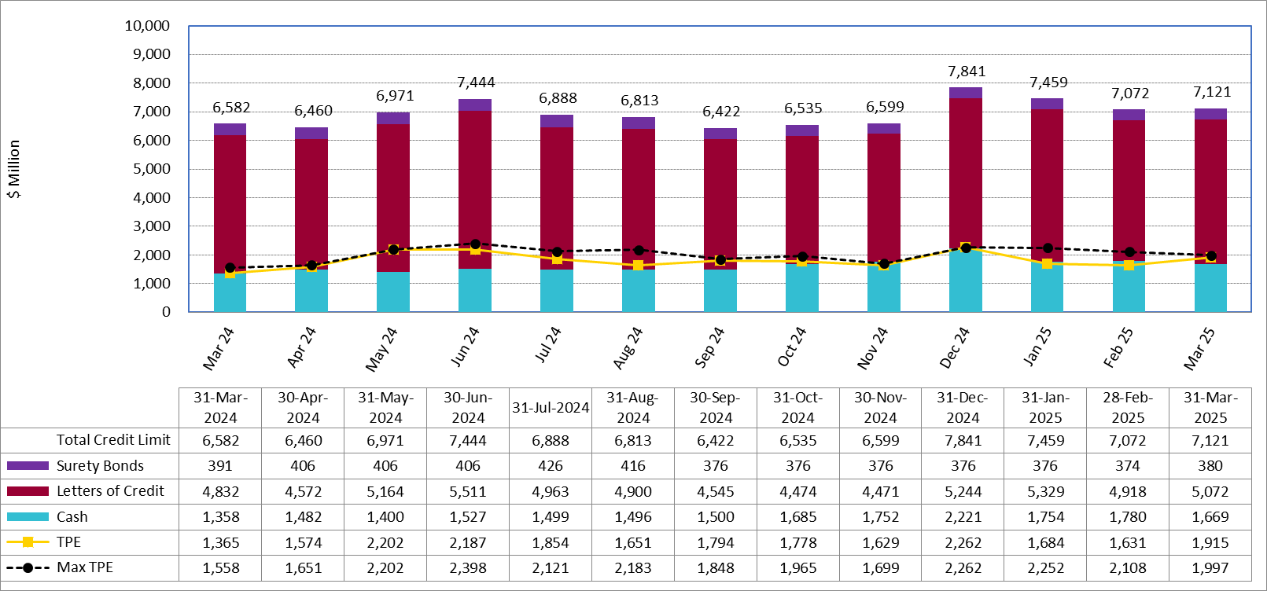
Available Credit by Type Compared to Total Potential Exposure (TPE): March 2024 – March 2025
Numbers are as of month-end except for Max TPE
Max TPE is the highest TPE for the corresponding month

Slide 6
Issuer Credit Limits vs Total LC Amounts Per Issuer: End-March 2025
As of March 31, 2025
There are a total of 36 banks that have issued LCs.

Slide 7
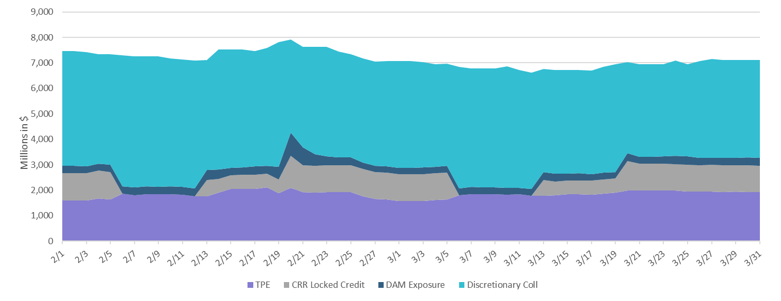
Discretionary Collateral February 2025 – March 2025

Slide 8
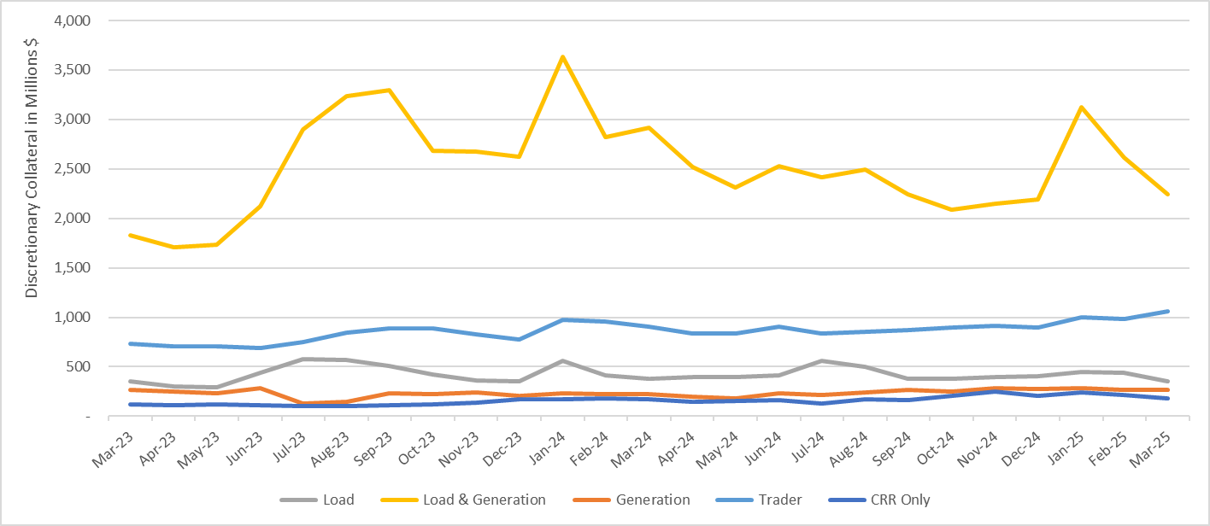
Discretionary Collateral by Market Segment March 2023 - March 2025
* Discretionary Collateral adjusted to exclude short pay amounts eliminating data skew

Slide 9
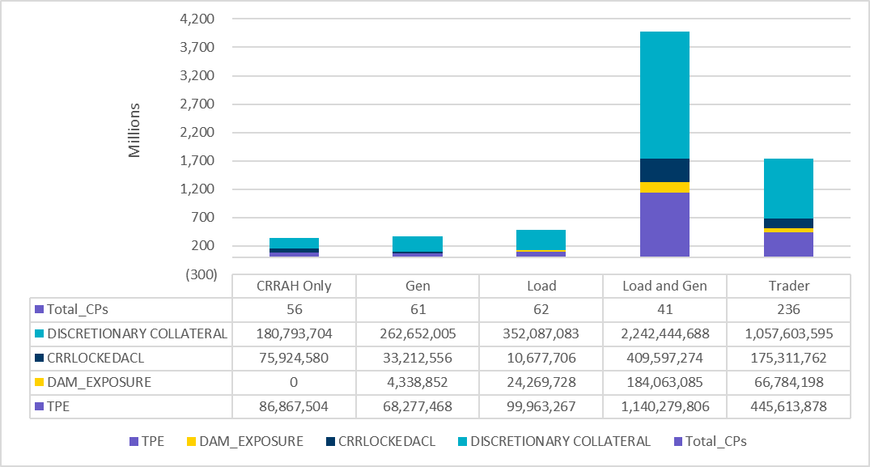
TPE and Discretionary Collateral by Market Segment - March 2025
Load and Generation entities accounted for the largest portion of discretionary collateral

Slide 10
TPEA Coverage of Settlements February 2024 - February 2025
Invoice Exposure | Historical | Future
Existing Invoice Exposure | RTLCNS + UDAA | M1 Days (including current day) Forward Charge Invoice Amounts
New Invoice Exposure | 7 Days Back Net Invoice Amounts (Charges & Credits) | M1 Days (including current day) Forward Net Invoice Amounts (Charges & Credits); Excluding: 1) Securitization Invoices; 2) CRR Auction Invoices; and 3) Subchapter N Funds Distribution Invoice
TPEA closely approximates actual/invoice exposure

Slide 11
TPEA Coverage of Settlements February 2024 - February 2025
Invoice Exposure | Historical | Future
Existing Invoice Exposure | RTLCNS + UDAA | M1 Days (including current day) Forward Charge Invoice Amounts
New Invoice Exposure | 7 Days Back Net Invoice Amounts (Charges & Credits) | M1 Days (including current day) Forward Net Invoice Amounts (Charges & Credits); Excluding: 1) Securitization Invoices; 2) CRR Auction Invoices; 3) Subchapter N Funds Distribution Invoice
*TPEA exceeds invoice exposure

Slide 12
TPEA Coverage of Settlements February 2024 - February 2025
Invoice Exposure | Historical | Future
Existing Invoice Exposure | RTLCNS + UDAA | M1 Days (including current day) Forward Charge Invoice Amounts
New Invoice Exposure | 7 Days Back Net Invoice Amounts (Charges & Credits) | M1 Days (including current day) Forward Net Invoice Amounts (Charges & Credits); Excluding: 1) Securitization Invoices; 2) CRR Auction Invoices; 3) Subchapter N Funds Distribution Invoice
Invoice exposure generally exceeds TPEA

Slide 13
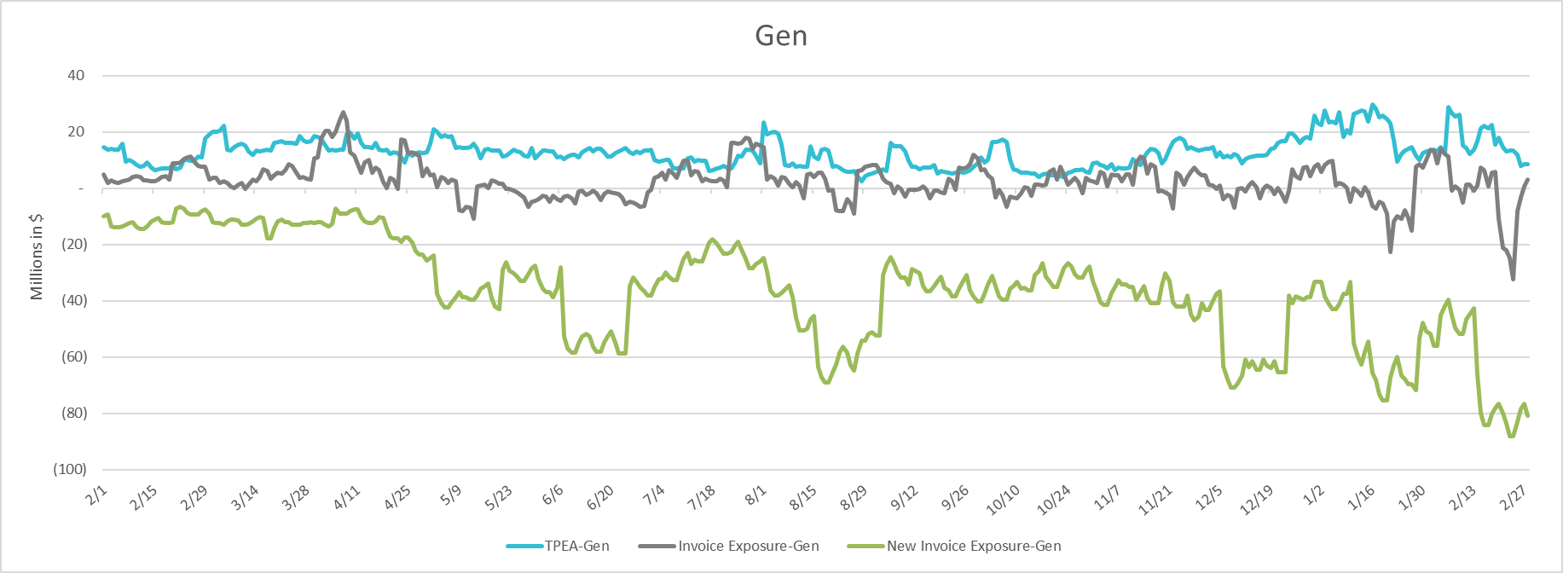
TPEA Coverage of Settlements February 2024 - February 2025
Invoice Exposure | Historical | Future
Existing Invoice Exposure | RTLCNS + UDAA | M1 Days (including current day) Forward Charge Invoice Amounts
New Invoice Exposure | 7 Days Back Net Invoice Amounts (Charges & Credits) | M1 Days (including current day) Forward Net Invoice Amounts (Charges & Credits); Excluding: 1) Securitization Invoices; 2) CRR Auction Invoices; 3) Subchapter N Funds Distribution Invoice
* TPEA generally exceeds Invoice exposure

Slide 14
TPEA Coverage of Settlements February 2024 - February 2025
Invoice Exposure | Historical | Future
Existing Invoice Exposure | RTLCNS + UDAA | M1 Days (including current day) Forward Charge Invoice Amounts
New Invoice Exposure | 7 Days Back Net Invoice Amounts (Charges & Credits) | M1 Days (including current day) Forward Net Invoice Amounts (Charges & Credits); Excluding: 1) Securitization Invoices; 2) CRR Auction Invoices; 3) Subchapter N Funds Distribution Invoice
*TPEA generally exceeds invoice exposure

Slide 15
TPEA Coverage of Settlements February 2024 - February 2025
Invoice Exposure | Historical | Future
Existing Invoice Exposure | RTLCNS + UDAA | M1 Days (including current day) Forward Charge Invoice Amounts
New Invoice Exposure | 7 Days Back Net Invoice Amounts (Charges & Credits) | M1 Days (including current day) Forward Net Invoice Amounts (Charges & Credits); Excluding: 1) Securitization Invoices; 2) CRR Auction Invoices; 3) Subchapter N Funds Distribution Invoice
*TPES exceeds actual/invoice exposure

Slide 16
Questions

