Slide 1
SSWG Report to ROS
April 3, 2025
Chair: Zach Walker (Zachary.Walker2@oncor.com)
Vice Chair: Chris Ramirez (cramirez@wettllc.com)

Slide 2
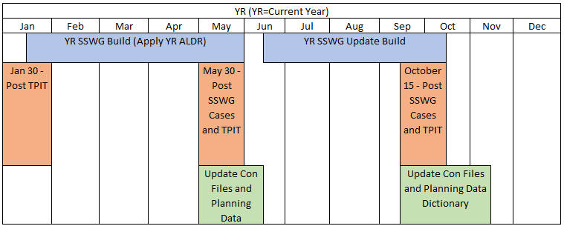
SSWG Updates
Key Dates & Updates
25SSWG Case Build #1
Currently Ongoing
Load & Topology Deadline: 3/28/25
Pre-Dispatch Tuning Meetings: 3/31/25 – 4/2/25
Post-Dispatch Tuning Meetings: 4/28/25 – 4/30/25
Target Posting: 5/23/25
SCR 789
Initial discussion at March SSWG meeting
Discussion to continue at April SSWG Meeting
Working with TSPs to outline SSWG requirements for SCR
Will work with NDSWG and SPWG to schedule joint meetings
SSWG Procedure Manual (PM) Updates
Working to finalize updates and reach consensus
Expect to have updated PM for approval at May ROS meeting
SSWG Report to ROS External

