Slide 1
Operations Working Group
Chair- Rickey Floyd
Vice-Chair- Tyler Springer
03/20/2025

Slide 2
NPRR 1070 - Planning Criteria for GTC Exit Solutions
Working on a rewrite on existing NPRR. Nothing for group yet.
Remains tabled.

Slide 3
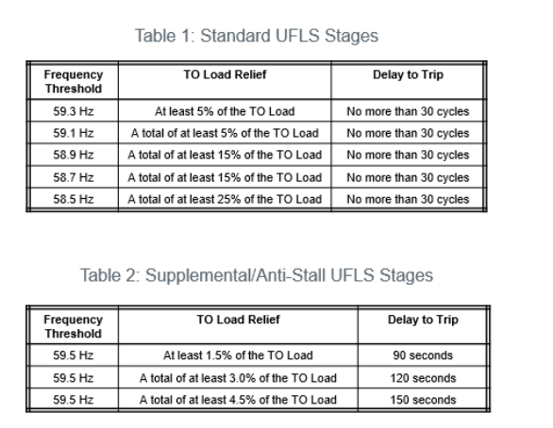
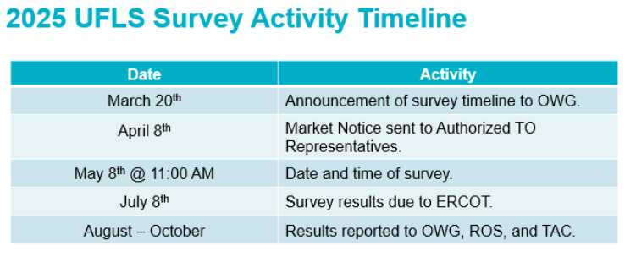
2025 UFLS Survey Announcement
Number of load shed stages is increased from 3 to 5.
25% of ERCOT system load shall be equipped with UFLS.
ERCOT presentation can be found on OWG 3/20 meeting page.

Slide 4
Other Business
None.

