Slide 1
NERC EMSWG Update
Wei Qiu, NERC EA
ERCOT TWG Conference Call
March 27, 2025

Slide 2
A New EMS Lesson Learned
Loss of SCADA/EMS monitoring and control
Manual intervention stemming from the replacement of a failed Global Positioning System (GPS) clock led to a loss of supervisory control and data acquisition (SCADA) and energy management system (EMS) monitoring and control due to an incorrect configuration of the network time protocol (NTP)

Slide 3
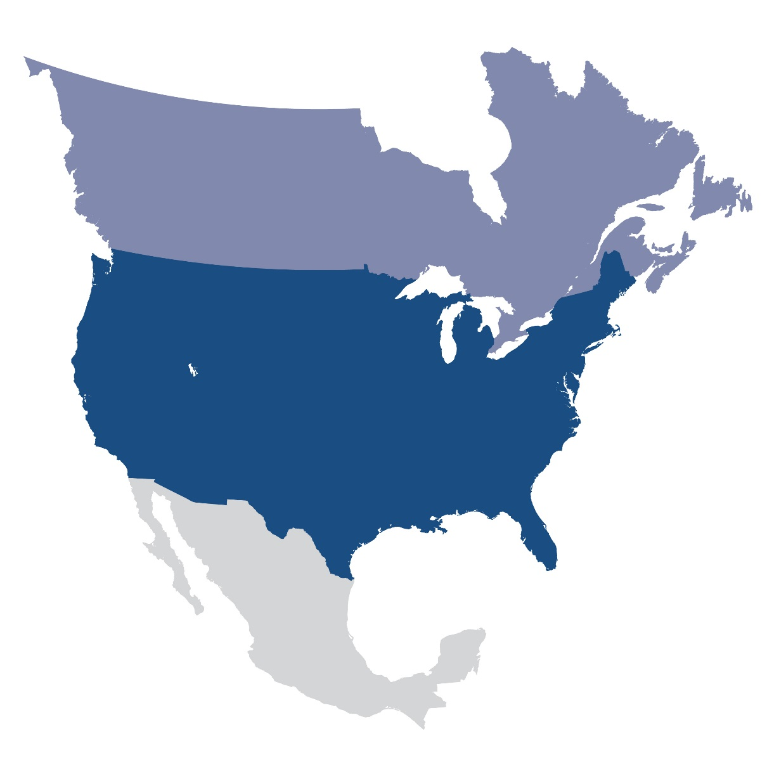
Questions and Answers
Contact Information:
wei.qiu@nerc.net

