Slide 1
Technical Working Group
ICCP Telemetry Points Modeling
&
EMS SCADA/AGC Changes
Kevin McGarrahan
Tejaswi Potluri
03/26/2025

Slide 2
RTC+B ICCP Telemetry Modeling – Key Documents
Resource specific ICCP Telemetry Modeling Template (ICCP_Change_Request_example_RTCB_V1.3.xlsx) is posted in two locations
ercot.com site under User Guides: https://www.ercot.com/services/mdt/userguides
RTCBTF site under Key Documents: https://www.ercot.com/committees/tac/rtcbtf
Request all market participants to follow the template for the object name format.
Latest version of RTC+B ICCP Handbook is available at
New single model ESR names for existing combo-model ESRs have been published to the RTCBTF page: https://www.ercot.com/committees/tac/rtcbtf
*Link to RTC+B ERCOT Nodal ICCP Communications Handbook

Slide 3
RTC+B ICCP Telemetry Points Modeling Expectations
QSEs to Submit new ICCP telemetry point requests
QSEs/ERCOT to maintain the new ICCP telemetry points for both current system and RTC+B system through weekly model loads.
When submitting ICCP requests for existing resources, please provide RTC specific object names only for modeling. These are the objects in RED text in the template.
Similarly for single model ESR devices, all objects in RED text on the ESR tab are required to be submitted.
In RTC+B, single model ESR device names are changed to ESR1, ESR2,..,ESR# under a given site.

Slide 4
RTC+B ICCP Telemetry Points Modeling Expectations
Within the RTC+B construct,
AS capabilities for IRRs no longer required to be modeled (Updated the ICCP Telemetry Template and Handbook).
CLRs are not expected to participate in FFR service.
The AVR and PSS points are not required to be modelled on CLRs in RTC.
Station specific ICCP telemetry like line flows, auxiliary load are NOT required to be modeled again.
Non-ESR Generation Resources as well as Controllable and Non-Controllable Load Resources are required to model the new RTC+B telemetry points under the existing non-ESR device.

Slide 5
Updates to ICCP handbook
Add System level statuses for ONSC and FFR
Cleaned up duplicates for System level AS MCPCs and added object Names
Removed System level ORDC points – ONHT and ONLT
Removed FFRC from CLR
*Link to RTC+B ERCOT Nodal ICCP Communications Handbook

Slide 6
Updates to ICCP telemetry template
Removed AVR and PSS for CLR

Slide 7
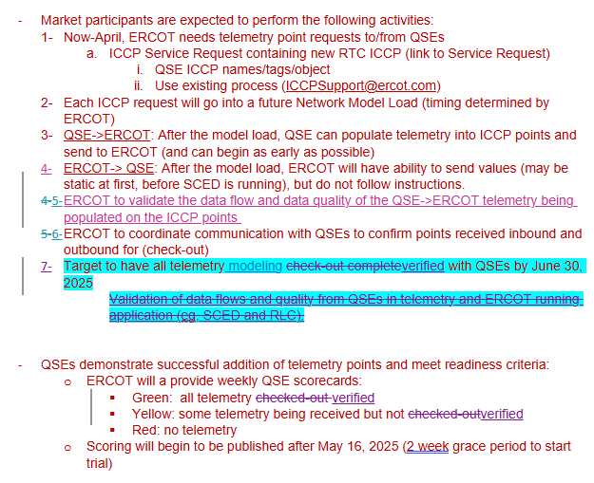
Market Trial Handbooks
QSE Telemetry point Check-Out (Handbook #2)

Slide 8
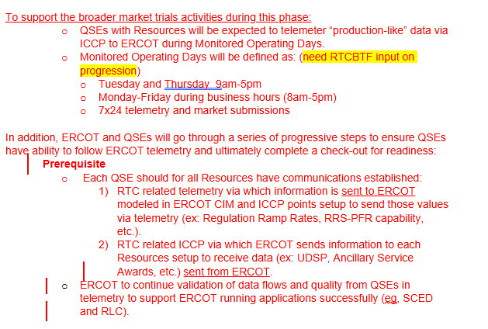
Market Trial Handbooks
QSE Telemetry Tests (Handbook #4)
Review draft Handbook #4 for QSE Telemetry Tests

Slide 9
RTC+B ICCP Model Load and Testing
ERCOT will model the RTC+B ICCP points in the network model and perform ICCP model load in lower environment for ERCOT internal verification.
This verified model with the RTC+B ICCP points will be loaded into current Production ICCP system.
ERCOT will publish a schedule to indicate when the new RTC+B specific telemetry points will be available in Production.
ERCOT will provide support to QSEs to setup the RTC+B telemetry points in their Production ICCP system and perform communication testing.
ERCOT and QSE to start testing the RTC+B telemetry points in current Production ICCP system (telemetry points check out) from market trials starting from 05/05.
ERCOT expects continuous good quality telemetry from July 1st week for points that are needed to support RTC+B EMS/SCED open loop testing.

Slide 10
RTC+B Refresher on ICCP configuration
RTC+B ICCP telemetry will be modeled in the current Production ICCP system under existing ICCP links.
No new sandbox will be available for RTC+B specific ICCP testing.
All point-to-point telemetry checkouts will be performed in the current Production ICCP system from market trials starting from 05/05.

Slide 11
RTC+B QSE EMS SCADA/AGC changes
Reminder for QSEs to work with their EMS vendors (and/or in-house development teams) to update their EMS Tools/SCADA/AGC control system functionality to send RTC+B specific telemetry to ERCOT and receive telemetry (like UDSP) from ERCOT and follow control signal.
QSE EMS Tools/SCADA/AGC system changes are expected to be in place to support Market Trials from June time frame.
Examples of RTC+B specific telemetry changes:
UDSP (ERCOT to QSE)
Current Capability ( QSE to ERCOT)
New RTC Resource Status Code (QSE to ERCOT)

Slide 12
QUESTIONS?
Send any additional questions, feedback and comments to RTCB@ercot.com.

