Slide 1
ERCOT Technology Working Group (TWG)
March 26, 2025

Slide 2
ERCOT TWG
WELCOME

Slide 3
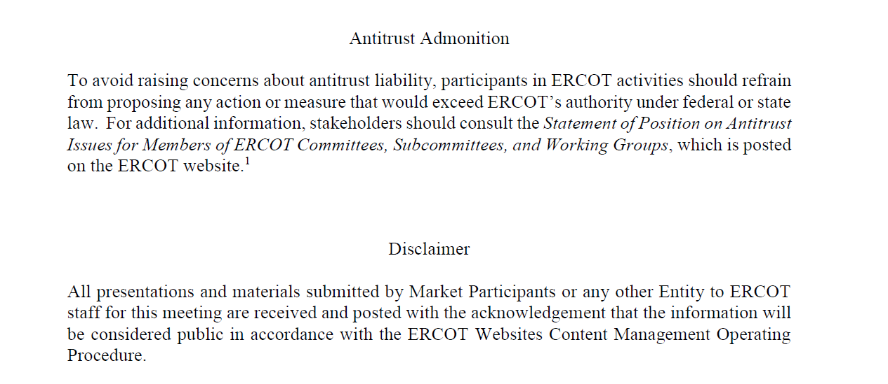
ERCOT TWG

Slide 4
ERCOT TWG Agenda
Item # | Item Description | Presenter | Start Time
1 | Antitrust admonition | Sreenivas Badri | 2:00 PM
2 | Vice-Chair Selection | Sreenivas Badri | 2:02 PM
3 | NERC Update – EMSWG | Wei Qui/Sreenivas Badri | 2:10 PM
4 | Project Updates | Troy Anderson | 2:15 PM
5 | RTC+B Updates Program updates ERCOT RTC+B Market Trial Testing Status Planned Release Deployment and Model Load Schedule Telemetry Modeling and Vendor SCADA/EMS changes Market Trial System Digital Certs Plan and Configurations - IP and DNS updates Market Submissions Updates - Notifications changes | Matt Mereness/ERCOT Staff | 2:25 PM
6 | MPIM Redesign - High level plan update | Drew Bonser/Nicholas Jessett | 3:20 PM
7 | 2025 March Release - RIOO Enhancements | Padmaja Ravila | 3:35 PM
8 | SCR 830 (Expose Limited API Endpoints Using Machine-to-Machine Authentication) - Implementation Approach | Ashwini Patlola | 3:45 PM
9 | Round Table Discussion | Sreenivas Badri | 4:00 PM
10 | Adjourn | Sreenivas Badri | 4:10 PM

Slide 5
TWG
Vice-Chair Selection

Slide 6
NERC Update - EMSWG
NERC Updates - EMSWG – Wei Qui/Sreenivas Badri

Slide 7
Project Updates
Project Updates – Troy Anderson

Slide 8
RTC+B Updates
RTC+B Updates – Matt Mereness/Sruthi Hariharan/Tejaswi Potluri/Kevin McGarrahan

Slide 9
MPIM Redesign - High level plan update
MPIM Redesign - High level plan update – Drew Bonser/Nicholas Jessett

Slide 10
2025 March Release - RIOO Enhancements
2025 March Release - RIOO Enhancements – Padmaja Ravila

Slide 11
RIOO SCR830 – Implementation Approach
SCR 830 (Expose Limited API Endpoints Using Machine-to-Machine Authentication) - Implementation Approach – Ashwini Krishna

Slide 12
ERCOT TWG – Round Table Discussion
ERCOT TWG – Round Table Discussion
  Future Topics of Interest
  Topics and presentations from TWG members

Slide 13
ERCOT TWG
Thank You
You can reach Sreenivas at
Sreenivas.Badri@ercot.com

