Slide 1
Data center operations task force
Large flexible load task force
March 28, 2025

Slide 2
Purpose of the focused task force
Four items on our plate:
  Low voltage ride through (PGRR122)
  Rapid load ramping
  Harmonics and other distortions
  Commissioning standard for large loads
To be discussed today

Slide 3
Low voltage ride through issues
Definition: Failure to maintain consistent load level on grid
  Load that is on, but served off-grid is a problem for the grid
Three potential failure points with Low Voltage Ride Through
  Massive failover to backup generation
    “3 Strikes” Control
  UPS system switching configurations
    Inverter programming
  Variable Frequency Drive motors failing to ride through
    Mostly cooling load

Slide 4
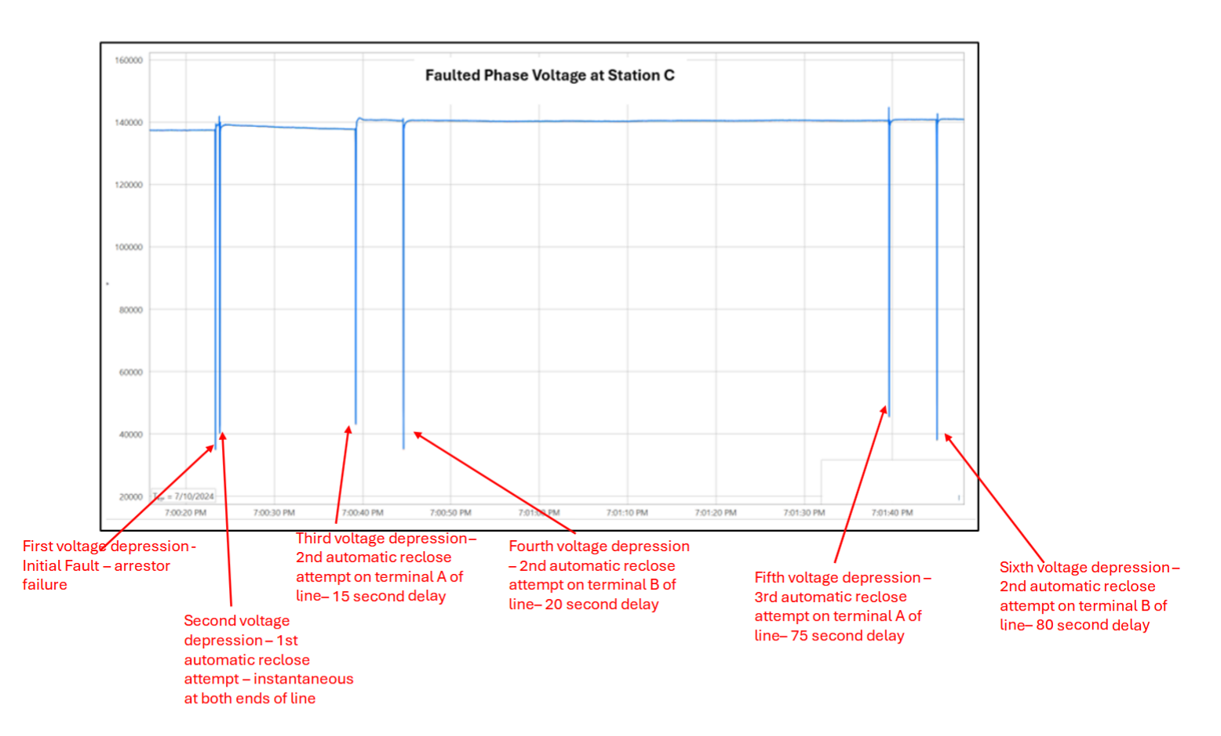
Backup generation failover
“When a good thing becomes a bad thing.”
Problem: failover to backup generation removes data center load from the grid instantaneously, when done in masse, can lead to:
  High frequency
  High voltage
  Cannot be allowed to happen at the scale of current development
Backup Failover Control – “3 Strikes” control
  Many failover schemes utilize a 3 - voltage dip pattern along with a time delay
  3 voltage dip pattern appears aligned with distribution system operation
    Voltage dip and recovery in transmission means you are not on the impacted line
Potential Solutions
  Eliminate “3 Strikes” control
    Is it actually needed for anything?
  Ensure transmission in ERCOT does not excessively reclose
    Very difficult to manage – impacts change as the grid changes
    Need to evaluate close-in 138kV faults to a 345kV interconnection point
  Homogeneity in controls is a problem

Slide 5
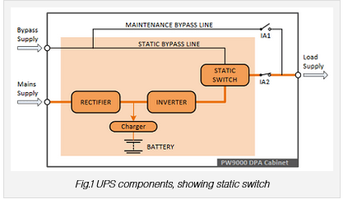
UPS inverter operation
Problem: UPS inverter operation during low voltage events can cause similar results to backup generation use
  Inverters act as programmable one-way devices that convert AC power to DC power for battery charging and power conditioning
  During events, the inverter in effect opens like a switch and remains open until conditions “stabilize” based on a programmatic delay (usually 5-30 seconds)
    Ensure stable power/limit repeated switching
  Long delays can cause same problems mentioned previously
Solutions:
  Can delays be eliminated?
  If not, need to study what is allowable.

Slide 6
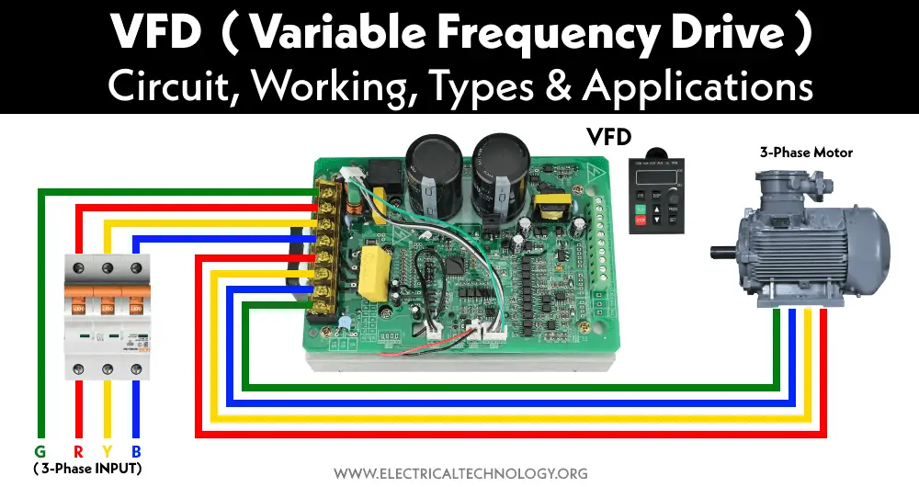
Variable Frequency drive load
Critical cooling systems utilize VFD motor loads
  Cooling chillers, fans, pumps, etc.
  For air cooled data centers can represent 15-35% of total load
  Size of future data centers indicates this is an ever increasing vulnerability
VFD loads are often not protected by the UPS due to cost
Susceptible to tripping during low voltage events
  Generally when voltage is below .5-.35 PU
  Duration matters
  Protection of power electronics
  Currently designed to meet SEMI F47
    .5PU – 12 cycles
    .7PU – 30 cycles
    .8PU – 50 cycles

Slide 7
ERCOT Large Load Voltage Ride-Through Standard Proposal
Large Loads that interconnect to the ERCOT Transmission Grid must ride through and shall not cease its power consumption for the following operating conditions in Tables A as measured at the Large Load’s Point of Interconnection:
From ITIC Curve
Based on IEEE 1668 Single-Phase and Phase-Phase Curve
Comparison
Voltage PU | ERCOT Proposal | SEMI F47
V > 1.20 | May trip | No data
1.10 < V ≤ 1.20 | 0.5 | No data
0.90 ≤ V ≤ 1.10 | Continuous | No data
0.80 ≤ V < 0.90 | 2.00 | 0.83
0.70 ≤ V < 0.80 | 0.50 | 0.50
0.50 ≤ V < 0.70 | 0.20 | 0.20
V < 0.50 | 0.15 | No data
Based on ITIC Curve, but extended to ride-through fault duration

Slide 8
Variable frequency drive recommendations
Study differences and determine need
  How should the study be framed?
  Who should perform?
  What are the measures of success?
  Note potential of equipment damage should it be required to operate beyond design
Note that this is a very broad need
  VFDs are in most industrial processes now
  Study impact will reach across to other loads

Slide 9
Large load Commissioning standard
Standard should be developed to commission loads in a similar manner to generation facilities
  Must meet standard to energize
  Loads the size of cities can impact grid reliability
  No need to establish specific design parameters, just need to meet the standard
  May need to set a minimum above 75MWs
  Ensure system reliability when load is energized
Sample of things that could be included
  “As Built” dynamic model submission or refresh
  Testing to determine throw over schemes are not triggered for normal operating events
  Testing to determine delays on UPS return
  Whatever practice is determined for VFDs
  May need occasional audit of control coding to ensure no common mode failures being created
Do whatever you want as long as it meets commissioning standards

Slide 10

Questions?

