Slide 1
RTCB Operations Training
ERCOT Staff
RTCBTF
3/25/25
ERCOT Public

Slide 2
Agenda Outline
AS Procurement Today
AS Procurement in RTC+B (and other impacts)
Detailed AS Changes
Wrap-up

Slide 3
Acronyms
Ancillary Services (AS)
Ancillary Service Demand Curve (ASDC)
Controllable Load Resource (CLR)
Current Operating Plan (COP)
Day-Ahead Market (DAM)
ERCOT Contingency Reserve Service (ECRS)
High Sustained Limit (HSL)
Load Frequency Control (LFC)
Load Resource (LR)
Load Serving Entity (LSE)
Locational Marginal Price (LMP)
Low Power Consumption (LPC) = (LSL in EMS)
Low Sustained Limit (LSL)
Max Power Consumption (MPC) = (HSL in EMS)
Market Clearing Price for Capacity (MCPC)
Net Power Consumption (NPC)
Nodal Protocol Revision Request (NPRR)
Non-Spinning Reserve Service (Non-Spin)
Operating Reserve Demand Curve (ORDC)
Qualified Scheduling Entity (QSE)
Real-Time Co-optimization (RTC)
Real-Time Market (RTM)
Regulation Down (Reg-Down)
Regulation Up (Reg-Up)
Resource Limit Calculator (RLC)
Responsive Reserve Service (RRS)
Security-Constrained Economic Dispatch (SCED)
Supplemental Ancillary Service Market (SASM)
Under-Frequency Relay (UFR)

Slide 4
Ancillary Services Procurement Today

Slide 5
AS Procurement Today (Reminder)
The Day-Ahead Market (DAM) is voluntary… except for the Ancillary Services that are procured in DAM.
After DAM publishes, QSEs update their Current Operating Plans (COPs) to reflect online resources and specify AS responsibilities on resources prior to DRUC.
Awarded QSEs can manage/move AS responsibilities across their fleet (reserve AS capability on Resources)
HSL = High Sustained Limit (eg 100MW unit)
HASL = HSL – AS (if carrying 10MW AS, then HASL = 90)
If QSE fails to provide AS, ERCOT Supplemental AS Market (SASM) can be run
ERCOT Operator initiates Supplemental AS Market (SASM) to replace missing AS
Takes up to two hours to announce and execute SASM
Not efficient replacement market (slow and usually expensive)
HSL
HASL

Slide 6
AS Procurement in Real-Time Co-optimization

Slide 7
AS Procurement in RTC
In RTC:
DAM still clears Energy and AS
However….. DAM awards are only financially binding, and based on the DAM results the QSE chooses how to update their Resource COPs to be online or not be online.
QSE management of AS responsibility across their portfolio no longer exists.
DRUC/HRUC become the tools to assess if enough capacity is available to ensure RTC SCED will have enough capacity to solve for energy and AS capacity.
In real-time SCED co-optimizes and clears Energy and AS
Co-optimization is clearing multiple products at same time for optimal solution

Slide 8
What components of the market are changing with RTC+B project?

Slide 9
Today’s Real-Time Market is designed to reflect scarcity through a process that is outside of the optimization
Currently
Energy Offers
Security- Constrained Economic Dispatch (SCED)
(Amount of Energy limited by QSE HASL)
Base Points
Telemetry
Locational Marginal Prices (LMPs)
Constraints
Combined to form Settlement Point Prices
Operating Reserve Demand Curve (ORDC)
Reserve Pricing
Price Adders

Slide 10
RTC is also designed to reflect scarcity, but now it occurs within the optimization
Under RTC
Energy & Ancillary Service Offers
SCED
(Amount of Energy & AS up to QSE HSL)
Base Points
Form Settlement Point Prices
Telemetry
LMPs
Constraints
Ancillary Service Awards
Ancillary Service Demand Curves (ASDCs)
Ancillary Service Prices

Slide 11
While the primary focus is the Real-Time Market, changes to other parts of the wholesale market are also part of RTC
DAM
RUC
RUC
SASM
Hour-Ahead
Operating Hour
Reporting
Performance Monitoring
Settlement
Day-Ahead Operations
Adjustment Period
Operating Period
Post Real-Time

Slide 12
Reliability Unit Commitment (RUC), like Real-Time, currently takes Ancillary Service assignment to individual Resources as a known input
Ancillary
Service Capacity
Ancillary Service capacity is assigned to Resources by Market Participants to fulfill Ancillary Service Supply Responsibilities
Available for Energy Dispatch
RUC attempts to meet forecasted demand and solve transmission congestion with remaining capacity, not reserved for AS
System Capacity
Currently

Slide 13
To better reflect and plan for Real-Time grid conditions with RTC, RUC will also be modified to co-optimize energy and Ancillary Services
Available for Energy Dispatch
or
Ancillary
Services
RUC attempts to meet forecasted demand, solve transmission congestion, and meet system Ancillary Service needs using the full capability of Resources planned to be available
System Capacity
Under RTC

Slide 14
The current Day-Ahead Market (DAM) fundamentally stays the same with the implementation of RTC
Energy Offers & Bids
DAM
Energy Awards
Point-to-Point (PTP) Obligation Bids
PTP Obligation Awards
Ancillary Service Offers*
Ancillary Service Awards
ASDCs
*With RTC, “virtual” Ancillary Service Offers will be allowed.
Ancillary Service Awards are financially binding, but not physically binding as RTC-SCED procures AS in Real-Time

Slide 15
The current Supplemental Ancillary Services Market (SASM) process will be eliminated with the implementation of RTC
SASM allows ERCOT to fill Ancillary Service gaps that appear after completion of the DAM
Failure to provide
Infeasible Ancillary Service capacity
More Ancillary Service capacity needed
Insufficient Ancillary Service offers in the DAM
SASM
Ancillary Service
Awards
Under RTC, a co-optimized RUC and the Real-Time Market fulfill this role.

Slide 16
Detailed AS Changes

Slide 17
With RTC, there will be several changes in the communications of data between ERCOT QSEs
Currently
Under RTC
QSE Manages AS
Resource Responsibilities
QSE AS Resource Capabilities
are inputs to ERCOT SCED
Awards for AS to Resources
Ancillary Service-Specific Resource Statuses
General Resource Statuses for ERCOT to award AS
Regulation Participation Factors/QSE-Level Deployments
Regulation Resource-Specific Deployments
Updated Desired Base Points
UDBP
Updated Desired Set Points
UDSP

Slide 18
RTC A/S Dispatch Summary
SCED Dispatch
RTC SCED dispatches online AS with SCED solution (eg, ECRSS and Online Non-Spin).
QSEs are expected to follow UDSP signal.
Telemetry Dispatch
UDSP Telemetry includes energy dispatch, AS dispatch, and Regulation instructions.
AS Manager Dispatch
ERCOT Operations continues to use AS Manager (XML message) for operational dispatch (eg, manual dispatch of ECRS and RRS during scarcity).
Frequency Response
A/S Services with frequency requirement are still required to respond to frequency levels (e.g. RRS).
Added note, if AS is being carried by Resources behind active transmission constraints the ERCOT operator can limit awards to those Resources.

Slide 19
RTC Dispatch of Ancillary Services by Resource Type
Current AS Qualification for Resources will carry over into RTC
All AS Dispatch will be Resource Specific
Resource abbreviations:
Gen = Generation
CombCycle = Combined Cycle
Sync Cond = Synchronous Condenser
ESR = Energy Storage Resource (Battery)
CLR = Controllable Load Resource
NCLR = Non-Controllable Load Resource

Slide 20
Operating Hour: Energy and AS Awards
Today
Only energy is optimized
Output is base points for energy and energy prices (LMPs)
SCED solves power balance and congestion with capacity not reserved for AS
Resource AS assignment taken as a given (base points limited by HASL/LASL)
Base points are subject to ramp rates via dispatch limits
Under RTC
Energy and AS are co-optimized
Output is base points for energy, AS awards for each product, energy prices (LMPs) and AS prices (MCPCs) for each product
SCED solves power balance, congestion and AS needs simultaneously
Base points no longer limited by an assumed HASL/LASL
Base points and AS awards take into consideration ramp rates, AS qualifications, other limitations

Slide 21
Real-Time Market Timeline – Today
SCED Inputs@11:00:05
Telemetry Snapshot
Offers
GTBD
SCED Base Points, LMP Binding till next SCED Run
SCED Run
SCED Run
LFC Inputs@11:00:20
Telemetry Snapshot
Frequency
Base Points
LFC
4s
11:00:20
11:00:24
11:00:05
11:05:05
Time

Slide 22
Real-Time Market Timeline – No Change Under RTC
Takeaway: Retain benefits of current timeline. RTC does not change the timeline (i.e., LMP, Base Point, AS Awards, MCPCs are binding immediately after RTC is finished).
RTC Inputs@11:00:05
Telemetry Snapshot
Offers
GTBD
RTC Base Points, LMP, AS Awards, AS MCPCs
Binding till next RTC Run
RTC Run
RTC Run
LFC Inputs@11:00:20
Telemetry Snapshot
Frequency
Base Points
LFC
4s
11:00:20
11:00:24
11:00:05
11:05:05
Time

Slide 23
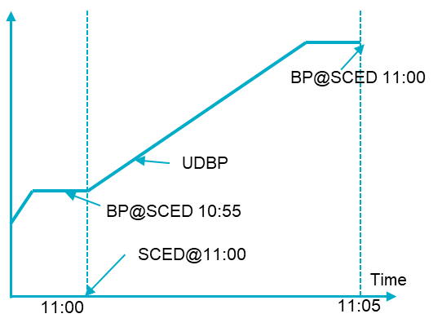
LFC Changes : UDBP to UDSP
Today
UDBP is Resource-specific tracking signal for Resources to ramp to new Base Points
Every LFC cycle(4s), ERCOT sends QSEs the Resource-specific UDBP and QSE portfolio Regulation Instruction
Under RTC
Every LFC cycle(4s), ERCOT will send Updated Desired Set Point (UDSP)
UDSP(t) = Base Ramp(t) + Resource Specific Regulation Instruction(t)
Base Ramp is like 4-minute UDBP Ramp, starting MW of Base Ramp sum of Previous RTC Base Point and Last LFC Regulation Up/Down Instruction
Ending MW for Base Ramp is the next RTC Base Point
RegUp Instruction
HSL
UDSP
BP@ 11:00
RegUp
Award
BP@ 10:55
11:05
11:00
Time

Slide 24
Regulation
Today
LFC sends a QSE portfolio level Regulation Instruction.
QSE system distributes its QSE portfolio level Regulation Instruction among its Resources Providing Regulation based on participation factors.
The Resources carrying Regulation Up will telemeter RURS and RUPF
The Resources carrying Regulation Down will telemeter RDRS and RDPF
Under RTC
LFC sends Resource-specific Regulation Instruction, embedded in UDSP.
RURS,RUPF, RDRS and RDPF telemetry from Resources are no longer needed.
The Resources capable of providing Regulation will telemeter
RegUp Ramp Rate(MW/Min), when multiplied by 5 gives current capability in MW to provide RegUp
RegDn Ramp Rate(MW/Min), when multiplied by 5 gives current capability in MW to provide RegDown.
Fast Responsive Regulation Service (FRRS) will be discontinued in RTC

Slide 25
Reg-Up Award Change and its Deployment Under RTC
Scenario 1: Reg-Up Responsibility Change to Zero
In other words, how to transition to not carrying AS Award
TODAY
RTC
RegUp Instruction
HSL, HASL
RegUp Instruction
UDSP
HSL
HSL
BP@SCED 11:00
MW output (tracking UDSP)
BP@RTC 11:00
RegUp
Resp.
MW output (tracking UDBP + Reg Instruction)
RegUp
Award
UDBP
BP@SCED 10:55
BP@RTC 10:55
HASL
Base Ramp
SCED@11:00
RTC@11:00
Time
Time
11:00
11:05
11:00
11:05

Slide 26
Reg-Up Award Change and its Deployment Under RTC
Scenario 2: RegUp Responsibility Change > Zero
In other words, how to transition to carrying AS Award
TODAY
RTC
RegUp Instruction
MW output
(tracking UDSP)
MW output (tracking UDBP + Reg Instruction)
UDSP
HSL,HASL
HSL
HSL
UDBP
RegUp
Resp.
Base Ramp
RegUp Instruction
RegUp
Award.
BP@SCED 10:55
BP@RTC 10:55
HASL
BP@RTC 11:00
HASL
SCED@11:00
BP@SCED 11:00
RTC@11:00
11:00
11:00
11:05
11:05
Time
Time

Slide 27
ECRS
Today
ECRS from SCED dispatchable Resources is automatically released when Frequency declines below 59.91 Hz.
ECRS from SCED dispatchable Resources is manually released to respond to issues related to net load ramps or when additional capacity is needed.
All Resources providing ECRS will telemeter ECRS and ECSC.
ECRS from Synchronous Condenser fast response mode resources is automatically deployed when frequency declines below 59.8 Hz. ERCOT may manually deploy if needed.
ECRS from NCLRs with HSUF relay armed will be automatically deployed when frequency declines below trigger frequency. ERCOT may manually deploy via Ancillary Service Manager (ASM)
Under RTC
No longer needed:
Automatic and Manual ECRS deployment functionality for SCED dispatchable Resources is no longer needed in RTC.
ECRS and ECSC telemetry from Resources.
When frequency declined below 59.91 Hz, LFC to trigger automatic off cycle RTC-SCED run with GTBD offset if needed.
All Resources capable of providing ECRS will telemeter ECRS Ramp Rate(MW/Min), when multiplied by 10 gives current capability in MW to provide ECRS
No functional changes to:
ECRS deployment from Synchronous Condenser fast response mode. The ERCOT deployment signal will be at Resource level.
ECRS deployment from NCLRs.
NCLRs with HSUF relay armed will telemeter Self-Provided ECRS MW.

Slide 28
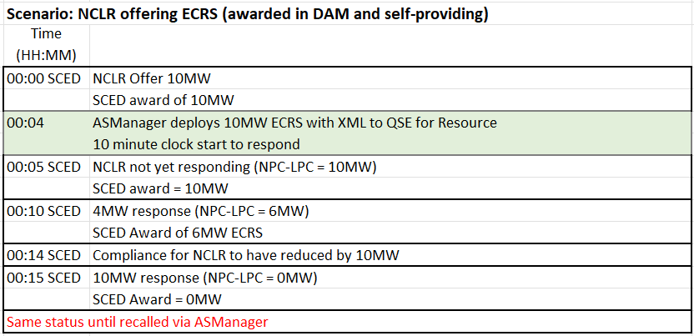
ECRS Example of Dispatch
XML = Electronic instruction from ERCOT AS Manager
NPC = Net Power Consumption for Load Resource
LPC = Low Power Consumption for Load Resource

Slide 29
RRS
Today
RRS-PFR from SCED dispatchable resources is manually released when additional capacity is needed during scarcity conditions.
The Resources providing RRS will telemeter RRRS and RRSC.
RRS-FFR from SCED dispatchable resources that are capable of providing FFR is automatically deployed when frequency declines below 59.85 Hz. ERCOT may manually deploy RRS-FFR if needed.
Resources providing RRS-FFR will telemeter FFRS and FFSC.
RRS from synchronous condenser fast response mode resources is automatically deployed when frequency declines below 59.80 Hz. ERCOT may manually deploy if needed.
RRS-FFR from NCLRs with relay armed will be automictically deployed when frequency declines below 59.85 Hz. ERCOT may manually deploy via ASM.
RRS-UFR from NCLRs with HSUF relay armed will be automatically when frequency declined below 59.7 Hz. ERCOT may manually deploy via ASM.
Under RTC
No longer needed:
Manual deployment of RRS-PFR from SCED dispatchable resources
RRRS and RRSC telemetry from Resources
FFRS and FFSC telemetry from Resources
Resources capable of providing RRS will telemeter current capability to provide RRS-PFR, RRS-FFR and RRS-UFR in MWs
No functional changes:
RRS-FFR deployment from SCED dispatchable resources. The ERCOT deployment signal will be at resource level.
Deployment of RRS from synchronous condenser fast response mode resources. The ERCOT deployment signal will be at resource level.
No functional changes to RRS-FFR and RRS-UFR from NCLRs
NCLRs with relay armed will telemeter self-provided RRS-FFR and RRS-UFR MWs

Slide 30
Non-Spin
No operational changes to the Offline Non-Spin and Online Non-Spin deployment from generation resources.
Offline Non-Spin is deployed via AS Manager
Online Non-Spin is deployed via SCED (energy offer floor goes away)
No changes to the Non-Spin deployment from load resources
Deployed via AS manager
NSRS and NSSC telemetry from resources is no longer needed.
Resources capable of providing Non-Spin will telemeter Non-Spin Ramp Rate (MW/Min), when multiplied by 30 gives current capability in MW to provide Non-Spin.
For Combined Cycle generation resources with Inactive Power Augmentation Capacity, RTC-SCED post-processing will calculate the portion of the Non-Spin award that will be provided by the Inactive Power Augmentation Capacity
Offline Non-Spin from online generation resources will be deployed via AS manager.
Resources with Power Augmentation Capacity will telemeter Power Augmentation Capacity, High limit of the frequency responsive MW capacity, Low limit if the frequency responsive MW capacity and Frequency Responsive Factor.

Slide 31
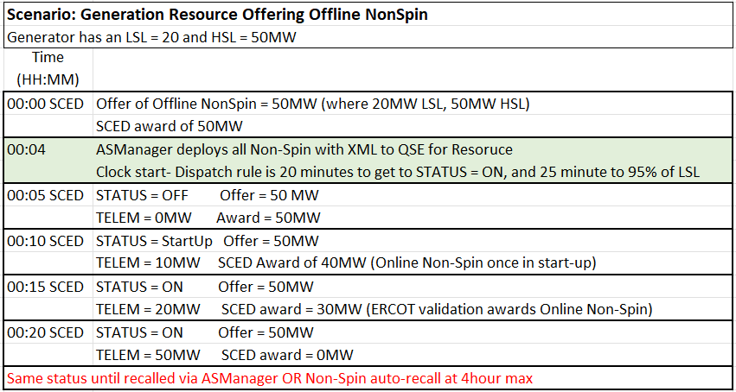
Example of Non-Spin Dispatch

Slide 32
High-level overview of Telemetry From/To QSE in RTC (Updated 2/19/2024)
Resource Specific From QSE
Resource Related |  |  | A/S Related
High/Low Sustained Limits (HSL, LSL) | AVR Status (AVR) |  | FRRS Up/Down Participation Factor (FUPF, FDPF)
High/Low Emergency Limit (HEL, LEL) | Dynamically Scheduled Resource Schedule (DSRS)[Gen] |  | FRRS Up/Down Responsibility (FURS, FDRS)
Energy (Normal) Up/Down Ramp Rate (NURR, NDRR) | Lower/Raise Block Status (LBST, RBST) [Gen] |  | Regulation Up/Down Participation Factor (RUPF, RDPF)
Emergency Up/Down Ramp Rates (EURR, EDRR) | PSS Status (PSS) |  | Regulation Up/Down Responsibility (RURS, RDRS)
Net MW/MVAR (MW (aka NPF for CCP), MVAR) | POI kV Measurement/Target (KVM, KVT) |  | Responsive Reserve Responsibility/Schedule (RRRS, RRSC)
Gross MW/MVAR (GMW, GMV) | Scheduled Power Consumption (SPC, SPC2) [CLR] |  | High Set Under Frequency Relay (HSUF) [NCLR]
Resource Status (RST) | Storage Resource Charge/Discharge Data (MXCP, MXDP, MXOD, SOC) |  | Non-Spin Responsibility/Schedule (NSRS, NSSC)
CCP Config No (CCC) | IRR MET Data (DEG, IRAD, MPH, PRES, PTMP, TEMP) |  | Regulation Up/Down Ramp Rate (based on 5-min blended)
Non Frequency Responsive Capacity (NFRC) | IRR Turbine/Panel Availability (NTOF, NTON, NTUN) |  | RRS PFR/FFR/UFR Capability
Load Resource Breaker Status (LRCB) [NCLR] | CCP Frequency Responsive Capacity High/Low Limit, Frequency Responsive Factor |  | Non-Spin Ramp Rate (based on 30-min blended)
Max/Low Power Consumption (MPC, LPC) [CLR, NCLR] | Inactive Power Augmentation Capacity |  | ECRS Ramp Rate (based on 10-min blended)
Resource Breaker Status (Gen’s and ESRs) | SoC, Max Soc, Min SoC, MXDP, MNDP(ESRs) |  | RRS-UFR/RRS-FFR/ECRS Self Provision (based on DAM Award and AS trades) [NCLR]
 | RRS-FFR deployment |  | ECRS Responsibility, Schedule
 | ONSC RRS/ECRS deployment
Resource Specific To QSE
Unit Related |  | A/S Related
Base Point (BP) |  | Non-Spin Deployed (NDPL)
Locational Marginal Price (LMP) |  | RRS Deployed (RDPL) [NCLR]
Curtailment (SBBH) |  | Regulation Up Award, Regulation Down Award
SCCT Status (SCCT) |  | Responsive Reserve PFR/FFR/UFR Award
Updated Desired BP (UDBP) |  | ECRS Award, Non-Spin Award
 |  | Regulation Up Deployment, Regulation Down Deployment (Not to be used)
 |  | Updated Desired SP (UDSP:Includes Base Ramp and Regulation Instruction)
 |  | System wide MCPCs for all Ancillary Services
QSE Specific To QSE
A/S Related
Regulation Up/Down MW (REGU, REDG)
FRRS Up/Down MW (FURQ, FDRQ)
Responsive Reserve PFR/ONRR/FFR
ECRS Deployment (Gen, ONECRS)
*Base telemetry list in this table has been created using ERCOT Nodal ICCP Communications Handbook
**RTC related changes that are identified in this list (reflected in red color) are based on KP1.3, 1.4, 1.5.

Slide 33
RTC: Generation Resource Statuses Not Used
Resource Status | Generation Resource Status Not Used under RTC
ONREG | Status no longer needed
FRRSUP | Status no longer needed
ONOSREG | Status no longer needed
ONDSRREG | Status no longer needed
ONRR | Status no longer needed
ONECRS | Status no longer needed
ONFFRRRS | Status no longer needed
OFFNS | Status no longer needed

Slide 34
RTC: Generation Resource Statuses
Resource Status | COP | Telemetry | Use of Generation Resource Status under RTC
ON | Y | Y | Available for energy and AS awards
ONOPTOUT | Y | Y | Considered to be same as ON
ONRUC | Y | Y | Considered to be same as ON (specific rules for EOC and AS Offer)
ONOS | Y | Y | Applying current rules for output schedules, available for energy and AS awards
OFFQS | Y | Y | Considered to be same as ON for energy, ECRS and NSPIN. Cannot be awarded Regulation or Responsive Reserve
OFF | Y | Y | Not available to for energy, RegUp, RegDn, RRS, or ECRS awards Available for NSPIN if qualified
ONTEST | Y | Y | Energy participation same as today(BP = Telem MW). Not eligible for AS award
ONEMR | Y | Y | Considered to be same as ON, Not eligible for AS award QSE may appropriately set LSL and HSL to reflect operating limits
STARTUP |  | Y | Energy participation same as today. Cannot be awarded AS (BP=telMW+5*RRup) Exception is when OFF Resource deployed for Non-Spin and OFFQS awarded BP>0
SHUTDOWN |  | Y | Energy participation same as today. Cannot be awarded AS (BP=telMW-5*RRdn)
ONSC | Y | Y | (New Resource Status to replace ONRR, ONECRS) Hydro in Synchronous Condenser mode. BP=TelMW. Available for RRS and ECRS AS deployed by frequency trigger or ERCOT Manual deployment
ONHOLD |  | Y | Indicates unavailability to be moved up or down. BP=telMW Not eligible for AS award Example usage scenario: Combined Cycle Configuration transition, Boiler feed pump start, etc.
OUT | Y | Y | Not available for energy or AS awards
EMR | Y | Y | Not available for energy or AS awards
EMRSWGR | Y | Y | Not available for energy or AS awards

Slide 35
RTC: Load Resource Statuses
Resource Status | COP | Telemetry | Use of Load Resource Status under RTC
ONL | Y | Y | (New Resource Status to replace ONRGL, ONCLR, ONRL,ONECL,ONFRRSL,FRRSDN,FRRSUP)
OUTL | Y | Y | Not available for energy or AS awards
Resource Status | Load Resource Status Not Used under RTC
ONRGL | Status no longer needed
FRRSUP | Status no longer needed
FRRSDN | Status no longer needed
ONCLR | Status no longer needed
ONRL | Status no longer needed
ONECL | Status no longer needed
ONFFRRRSL | Status no longer needed

Slide 36
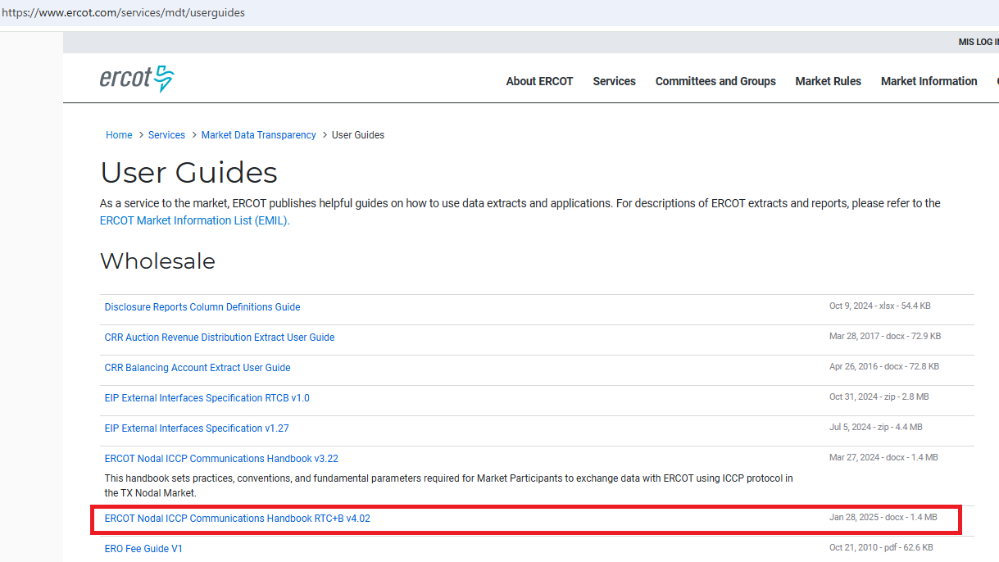
RTC+B ICCP Handbook Updates
ICCP Handbook draft version with RTC+B ICCP Telemetry points modeling was published to ERCOT website in 2024, updated 1/28/2025 (https://www.ercot.com/services/mdt/userguides)

Slide 37
RTC AS Summary of Changes
QSE will no longer reserve AS on each Resource, rather the QSE COP provides the Resource Status (ON, OFF, OUT) and the AS Capabilities for what “up to amount” it is qualified to provide.
Current Operating Plan
SCED
SCED will use QSE economic offer and current telemetry (current MW and AS ramp capabilities) to determine amount of Energy and AS Awards to each Resource.
QSE simply follows UDSP as single signal for energy and AS deployment (instructions are Resources specific and QSE no longer needs to track AS Schedule and AS Responsibility). Note- Frequency responsive services still respond to frequency trigger levels.
AS Dispatch in Telemetry
AS Manager Dispatch
In RTC+B, ERCOT will continue to use AS Manager with XML message for operational dispatch, such as manual dispatch of NCLR for RRS during scarcity.

Slide 38
RTC+B Training videos

Slide 39
Wrap-Up
Thank you for your time and support!
Any questions?
Future questions: email RTCB@ercot.com

