Slide 1
RTC + B
Day-Ahead Market (DAM)
Alfredo Moreno
Forward Market Operations
February 19, 2025

Slide 2
Agenda
DAM Timeline
Ancillary Service Obligations
Ancillary Service Demand Curves (ASDCs)
Ancillary Service (AS) Insufficiency
AS Submissions:
  AS-only Offers
  Resource-Specific AS Offers
  Self-Arranged AS
Energy Storage Resource (ESR)

Slide 3
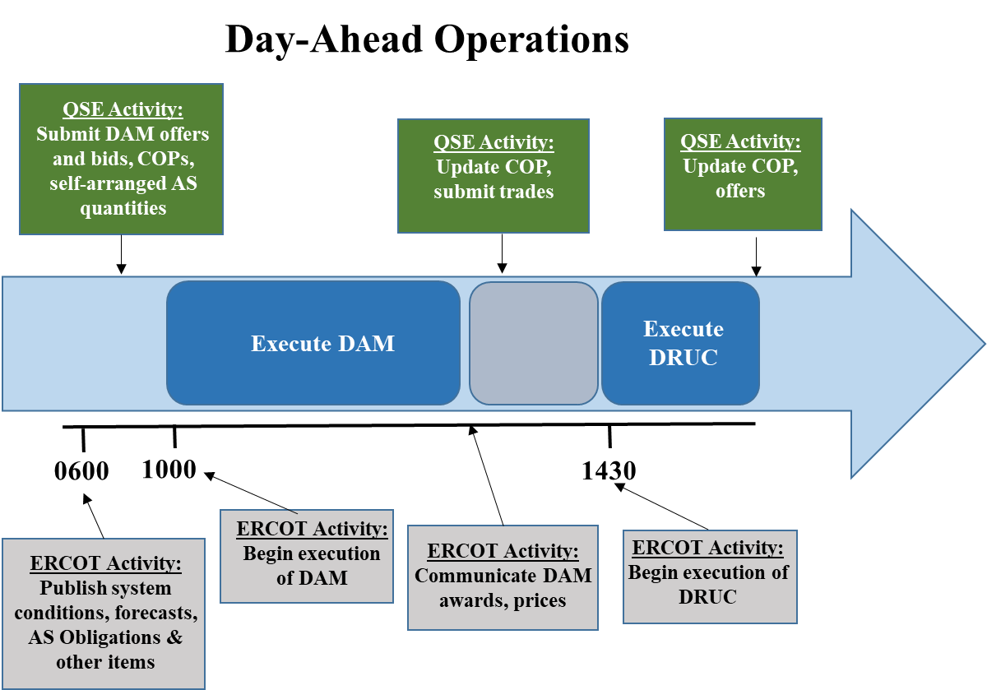
DAM Timeline

Slide 4
Ancillary Service (AS) Obligations
Current Structure
  AS Obligations are calculated, using the AS plan and Load-Serving Entities (LSE) Load-Ratio Share (LRS), and posted by 0600 in the day-ahead
  The minimum obligation is 1MW
RTC+B Structure
  Advisory AS Obligations are calculated, using the AS plan and Load-Serving Entities (LSE) Load-Ratio Share (LRS), and posted by 0600 in the day-ahead
  No minimum obligation
  Final AS Obligations are calculated, using DAM Awards + Self-Arrangement, and sent to Settlements
  Self-Arrangement over Final AS Obligation will be paid-out to QSE

Slide 5
Ancillary Service Demand Curves (ASDCs)
Current Structure
  AS requirement derived from AS Plan minus Self-Arranged AS
  AS penalty costs calculated using the System-Wide Offer Cap (SWCAP)
RTC+B Structure
  Initial DAM ASDCs will be the same as Real-Time (RT) ASDCs
  ASDCs will shift requirements based on self-arranged AS
    Negative self-arranged AS will shift curve to the right
  AS penalty costs will no longer be used in the optimization

Slide 6
Ancillary Service (AS) Insufficiency
Current Structure
  AS insufficiency is analyzed for each AS type per hour
  If AS insufficiency is identified
    Run AS insufficiency procedure and then reopen the market for minimum 30 minutes to receive additional AS offers
  Re-close DAM and re-run
    If AS insufficiency still exists, complete the run and then run the pricing run
      SASM and RUC will attempt to procure the insufficient quantities
RTC+B Structure
  AS insufficiency will no longer be needed as RT will procure the AS

Slide 7
AS Submissions: AS-only Offers
Current Structure
  AS-Only Offers don’t currently exist
RTC+B Structure
  AS-only Offers will be a new submission type that will not require a Resource link. AS qualifications will not be required for either Resource or Qualified Scheduling Entity (QSE)
  AS-only Offers will be procured against their respective ASDCs
  Multi-hour and fixed blocks will not be permitted
  5 offer blocks will be allowed for single part AS-Only Offers
    REGUP
    REGDN
    RRSPFR
    Online NSPIN
    Online ECRS
  Quantity minimum of 0.1MW; Pricing between $0/MW and DAM SWCAP
  New Credit Exposure calculation

Slide 8
AS Submissions: Resource-Specific AS Offers
Current Structure
  Procurement against AS requirement while considering AS penalty costs
  Resource linked AS Offers require Resource and QSE AS qualifications
  AS Offers may be inclusive or exclusive of each other or Energy Offer Curve (EOC); 5 blocks available
  Quantity minimum of 0.1MW; Pricing between $0/MW and SWCAP
  FRRS qualified Resources have a system-wide limit for Up and Down
RTC+B Structure
  Procurement against DAM ASCDs
  Pricing between $0/MW and DAM SWCAP
  FRRS will not longer be a valid option

Slide 9
AS Submissions: Self-Arranged AS
Current Structure
  Self-Arranged AS subtracted from AS plan to determine AS requirement
  Submissions exceeding the AS Obligation is allowed (up to)
    Regulation: 25MW
    RRS and ECRS: 100 MW
    NSPIN: 50 MW
RTC+B Structure
  Self-arrangement AS exceeding their advisory AS Obligation will no longer be allowed
  Negative Self-Arranged AS will be considered price takers on each respective ASDC
  Self-Arranged AS beyond the final AS Obligation will be paid at it’s corresponding AS MCPC
  AS trades submitted above their Self-Arrangement will be charged if not corrected by the end of the Adjustment Period

Slide 10
Energy Storage Resource (ESR)
Current Structure
  ESR/DESR modeled as a combo model: Generator and Controllable Load Resource (CLR) and offered independently
RTC+B Structure
  Single model Resource will incorporate both charging and discharging characteristics
  COP and EOCs will allow for negative values to represent charging
  Energy Bid/Offer Curves will be new submissions in the DAM
    Energy Curves shall be considered inclusive of Resource-Specific AS Offers
    Considered Self-Committed
    No Make-Whole payments
  Resource-Specific AS Offers may be inclusive or exclusive of each other
    Offline reserves, RRSUFR, or ECRSMD will not be allowed
  New Credit Exposure calculations
    Bid portion (charging) like Energy Bid credit exposure
    Offer portion (discharging) like TPO credit exposure

Slide 11
Questions?

